Slide 1
PLANNING AND MANAGING MAJOR BUILDING PROJECTS Holy Trinity, Leeds 21st November 2019

Slide 2
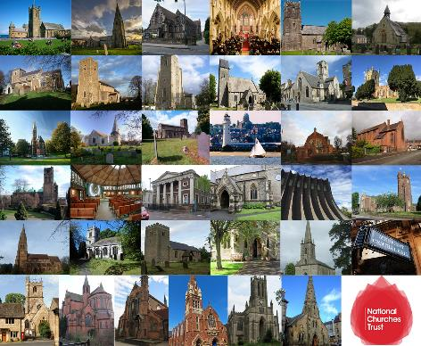
^{Grants 2015 – 2019}
2000+ applications – year on year rise
750+ grants awarded
Over £6 million distributed
24% average success rate for Repair and Community type grants – i.e. 1 in 4
Average Repair grants: £17,000
Average Community grants: £10,200

Slide 3
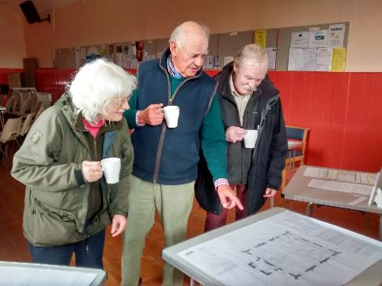
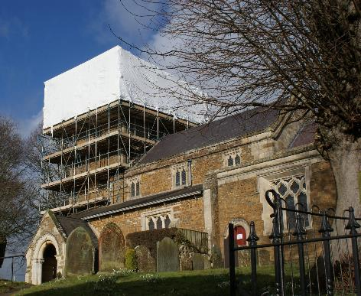
TOP TIP #1
Are you eligible?
Must be a Christian Place of Worship
Must be open
Open to Listed and Unlisted buildings
Must have raised 50% costs
Work must be to the church building
Work must not have started
Must have quotes in place
Must have permissions in place

Slide 4
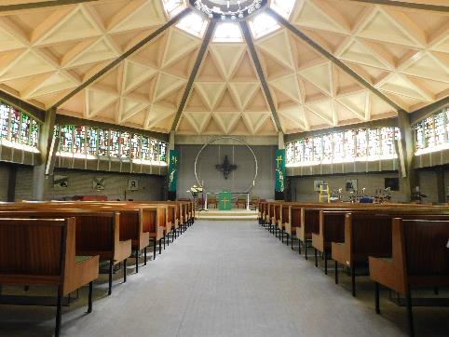
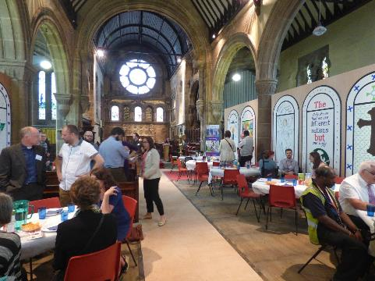
TOP TIP #2
Do we fund what you want to do?
Foundation Grants
Gateway Grants
Cornerstone Grants

Slide 5
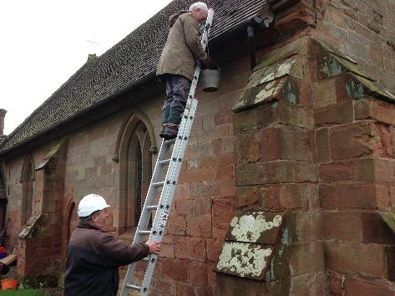
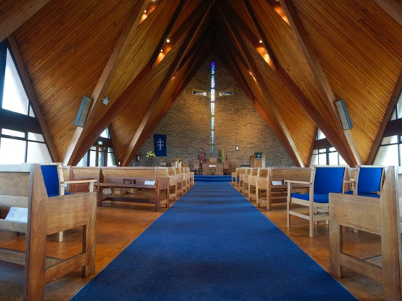
TOP TIP #3
Read the Guidance
How to fill in the form
What to include and why
Examples of what looking for
Scoring Criteria

Slide 6
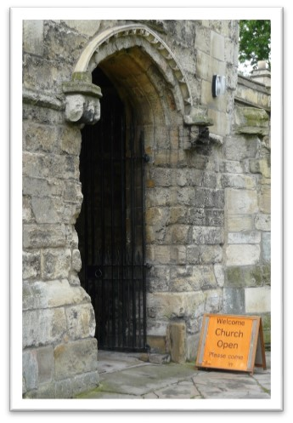
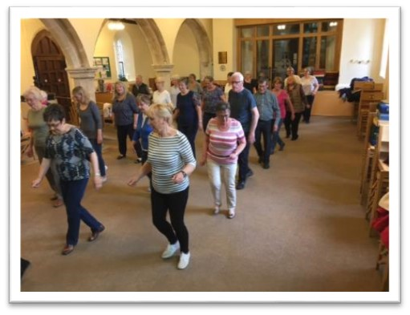
TOP TIP #4
Make a brilliant bid!
One size does not fit all
You are the experts
Three essential ingredients
It is a learning process

Slide 7
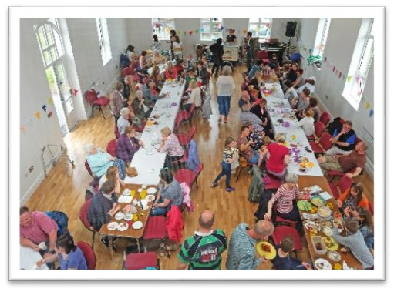
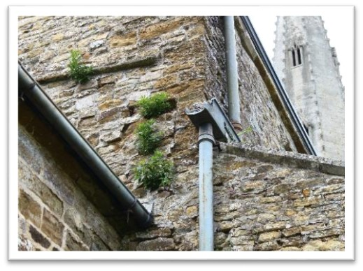
TOP TIP #5
Make a funding plan
Need more than one bid
Reassurance
Timing is crucial

Slide 8
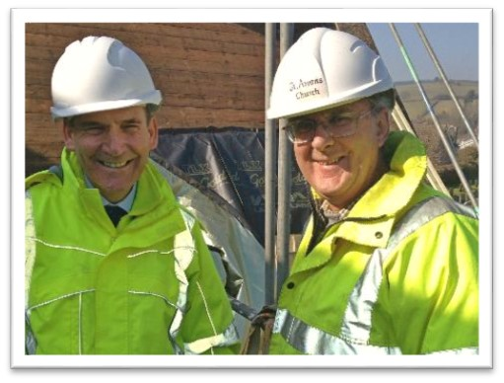
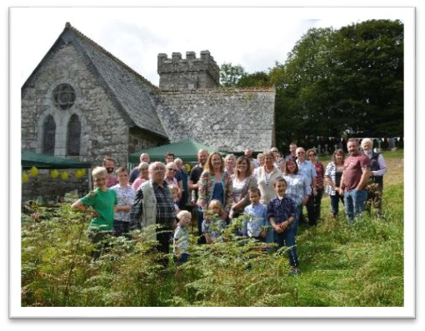
TOP TIP #6
It isn’t just about the money!
MaintenanceBooker
ExploreChurches

Slide 10
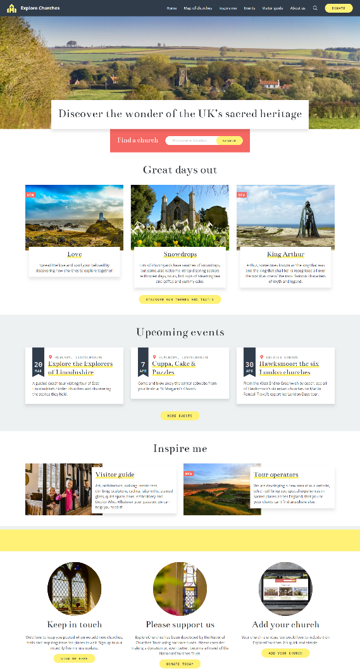
ExploreChurches
A new and exciting place to promote churches.
ExploreChurches is part of the Trust’s church tourism work, which also includes:
regularly changing homepage with features, campaigns, events and themed lists and trails
NEW experiences
NEW events
themed lists and trails, new every fortnight
searchable map
3000+ detailed church pages
visitor guide, including spotters guide and county pages

Slide 11
^{Any questions?}
Nigel Mills, Grants Officer (Scotland / Northern England / Northern Ireland)
nigel.mills@nationalchurchestrust.org
07702812406
The National Churches Trust
7 Tufton Street
London
SW1P 3QB
www.nationalchurchestrust.org
grants@nationalchurchestrust.org

