Slide 1
BEFORE YOU BEGIN
Lisa McIntyre (DAC Secretary)

Slide 2
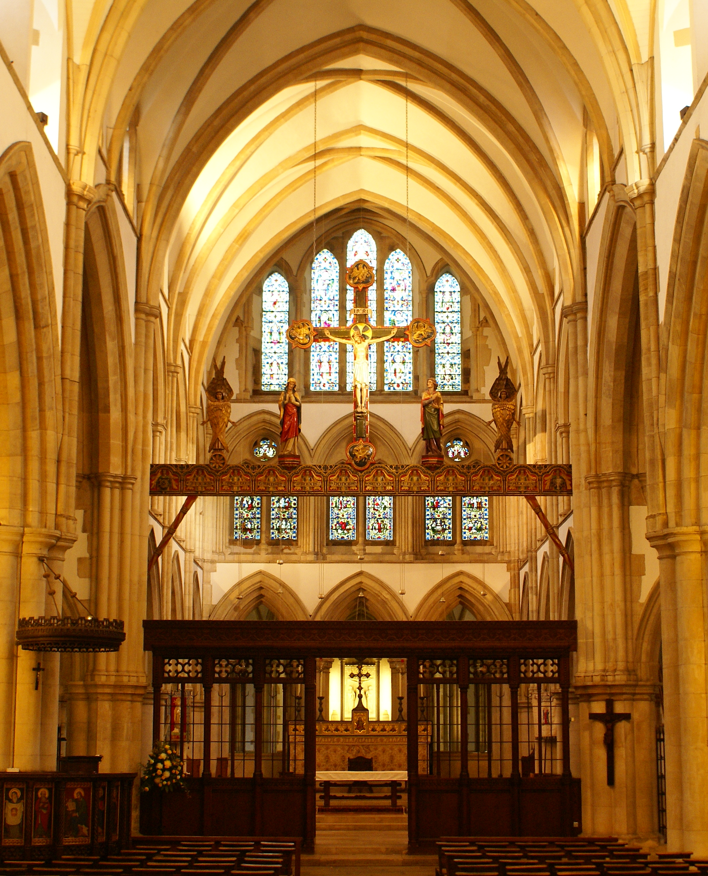
Understand your building
Also known as… Statement of Significance
Set out history of the site
Identify what makes it special
Think about what you want to enhance and what you don’t want to lose

Slide 3
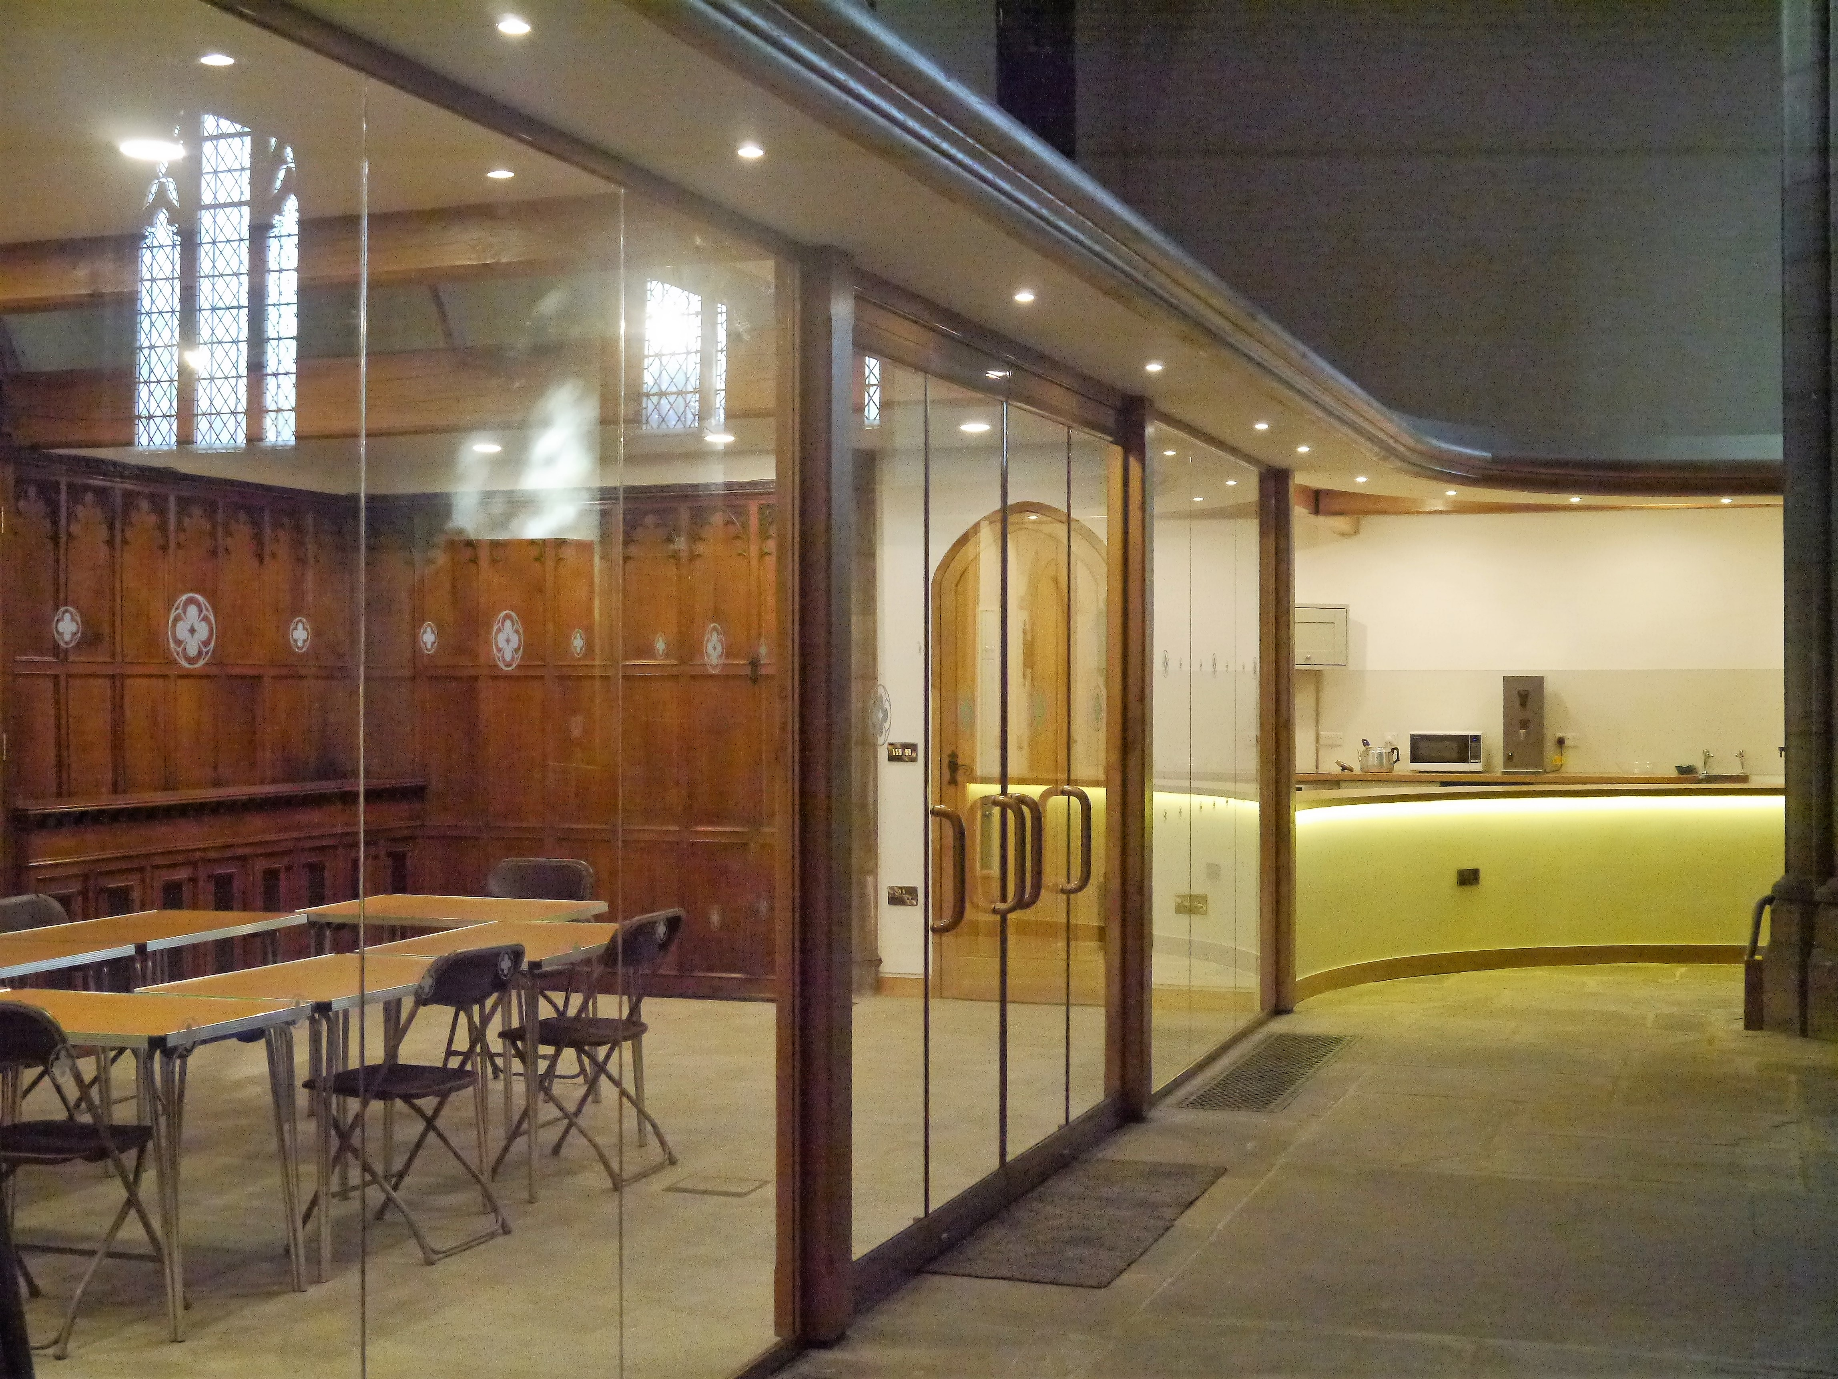
Articulate your needs
Also known as… Statement of Needs
For worship and non-worship
For the church community
For the local community

Slide 4
Be aware of the legal requirements
Also known as…
Faculty Jurisdiction (will apply)
Planning Permission (may apply)

Slide 5
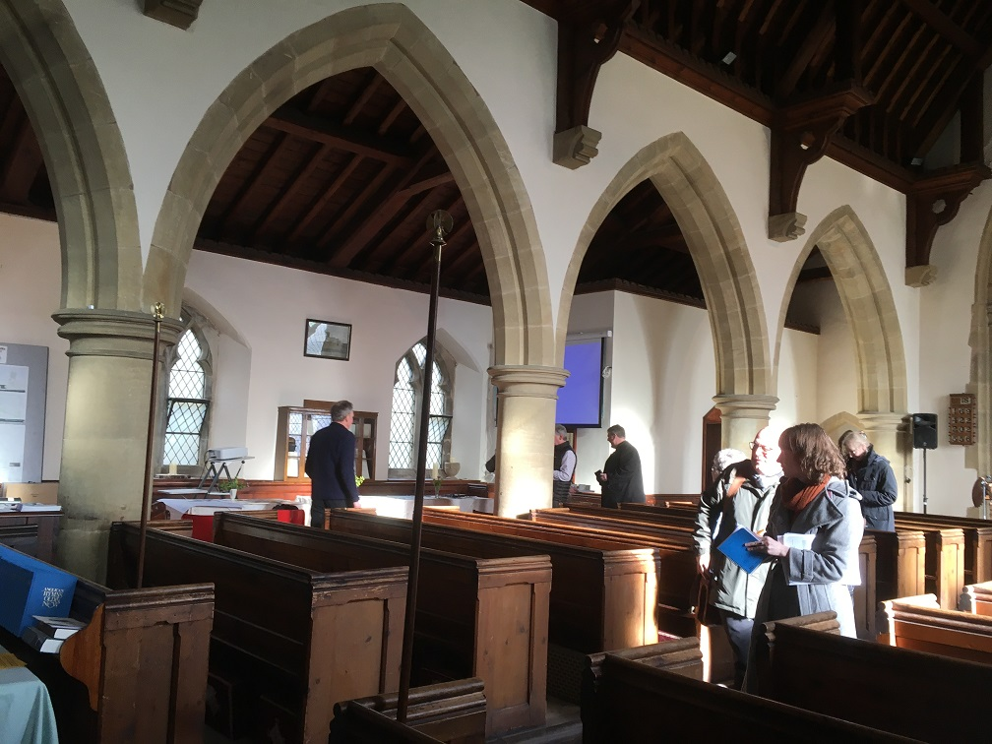
Seek expert advice
Also known as…
DAC
Architects
External statutory consultees

