Slide 1
Churches and Community Energy: a case study from St. Anne's Church, Highgate
30 November 2016

Slide 2
Reduce carbon emissions
Combat climate change
PUNL: Theory of Change
Clean energy generation
Reduce bills
Support local jobs
Encourage green behaviours
Partner with local organisations (roof owners, suppliers)
Our local community, and other communities across the UK, have ownership of their own clean energy network, delivering social, financial and environmental value
Community benefit from funded projects eg. reduced fuel poverty
Environment benefits from funded projects
Community cohesion
Community Energy Fund
Community ownership of local social and environmental issues
Financial, social and environmental returns
Increased energy security
Community cohesion & pride
Community share offers
Inspiring community energy locally and nationally
Inspiring community enterprise in our community
Inspiring others

Slide 3
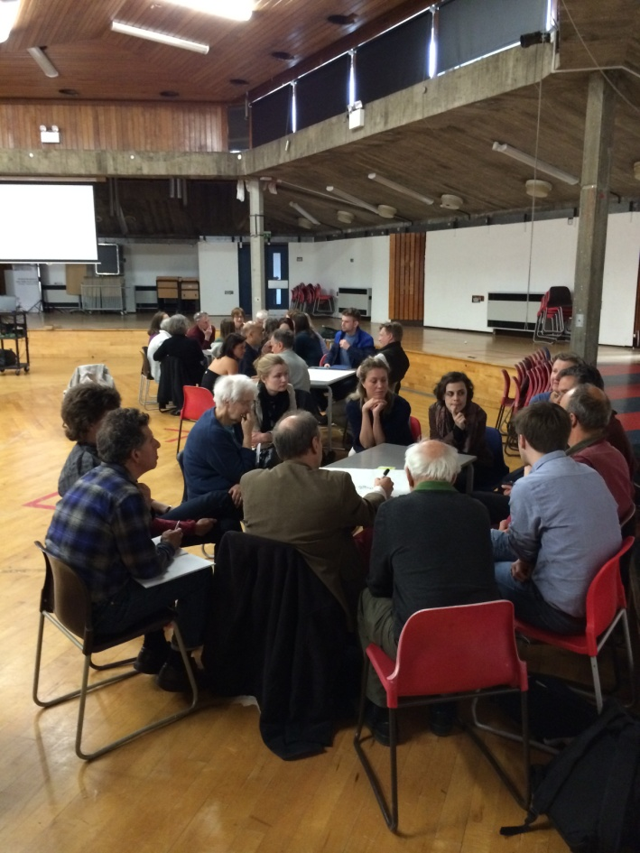
Power Up North London - the story so far
2014
April Public meeting led by 3 Transition Town groups in Camden
May Core group (around 10 volunteers) begin to meet once a month
2015
January Begin speaking to St. Anne’s Church Highgate
July Incorporated as Community Benefit Society
September FiT pre- accreditation for St. Anne’s Church, Highgate
November Awarded UCEF grant for feasibility work for two projects

Slide 4
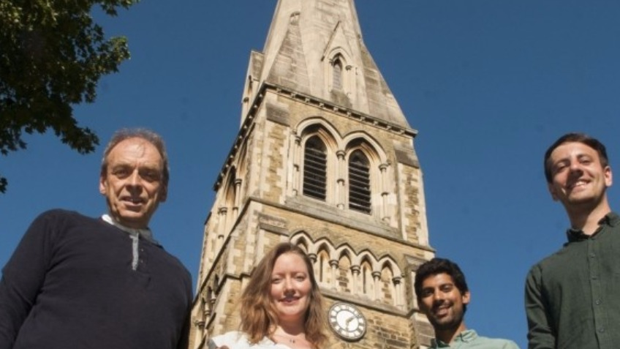
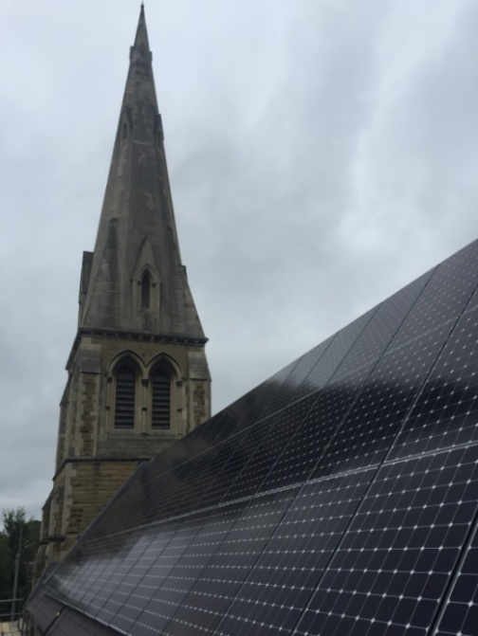
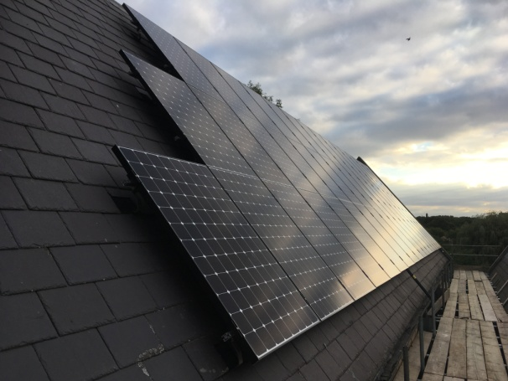
Power Up North London - the story so far
2016
February Begin work on architect’s drawings and planning application for St. Anne’s Church project
March Planning application submitted for St. Anne’s Church project
July Planning application recommended for approval
August £30,100 raised through community share offer
September Installation of panels at St. Anne’s Church

Slide 5
Changes to Government policy have made it harder for community energy....
Closure of Urban Community Energy Fund
End of pre-accreditation for community energy projects
Lower Feed- in-Tariff rate means harder to make financial model work
New projects most feasible on buildings with high energy use
BUT
With the right combination of community shares and grant funding projects may still be feasible. Integrating storage and/or LED lighting would improve model significantly

Slide 6
Local support is key!

Slide 7
powerupnorthlondon.org powerupnorthlondon@gmail.com
@PowerUpNLdn

