Slide 1
Give and Receive
With the Mobile Generation
-
Visitor information and donations
at unmanned buildings
HRBA Big Update November 2016
Neil Rathbone, Info-Point

Slide 2
The Problem
Notes:
Historic Religious Buildings and many other types of heritage site share a common problem...

Slide 3
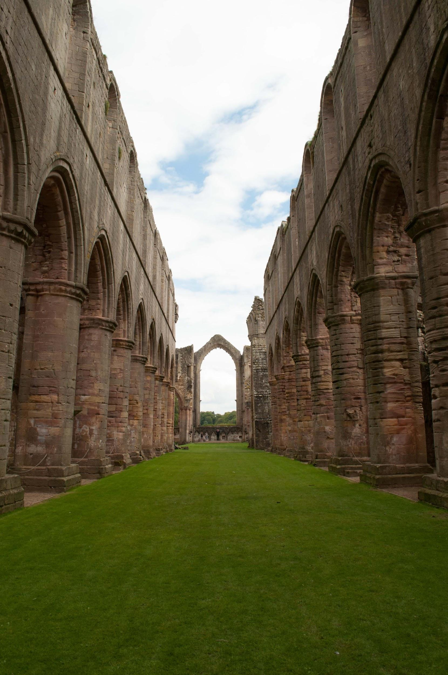
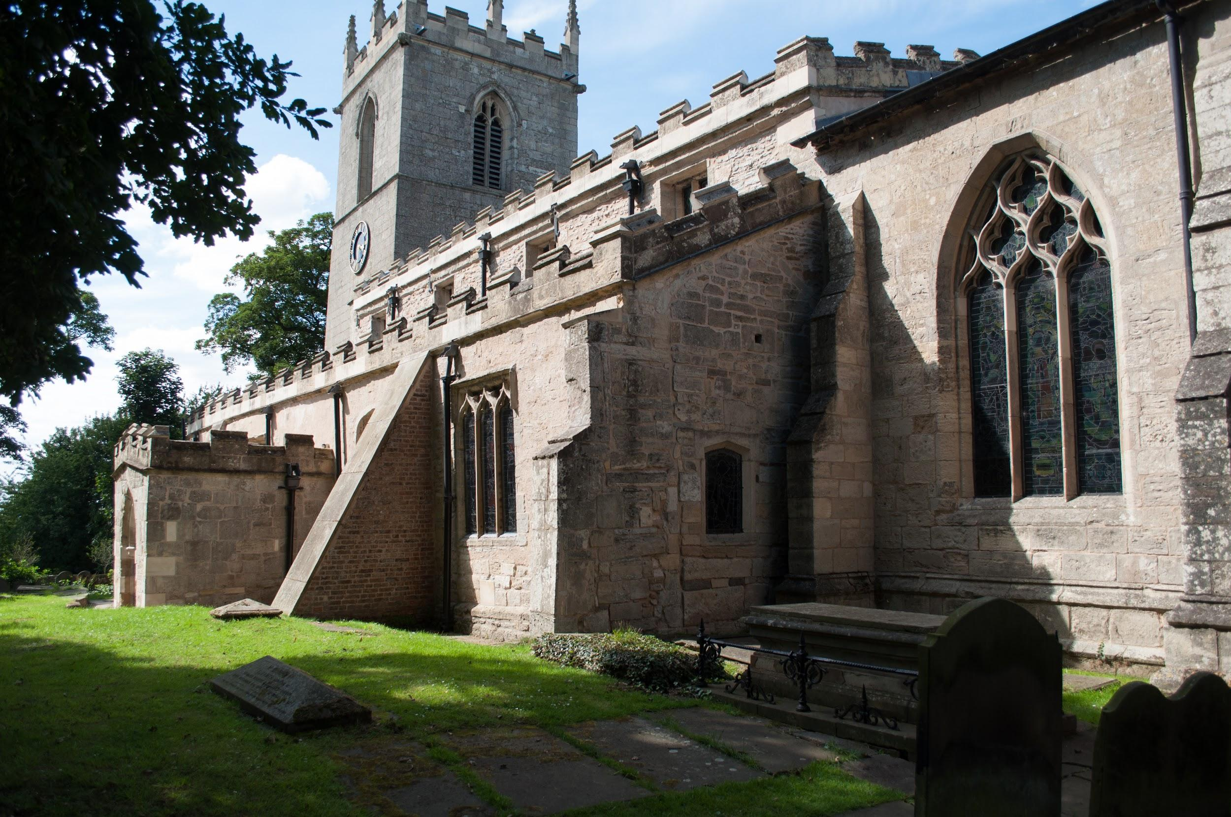
No staffing
No infrastructure
Open access
Notes:
Problems that you are all familiar with.
They make you vulnerable, and reduce your ability to interact with the public.

Slide 4
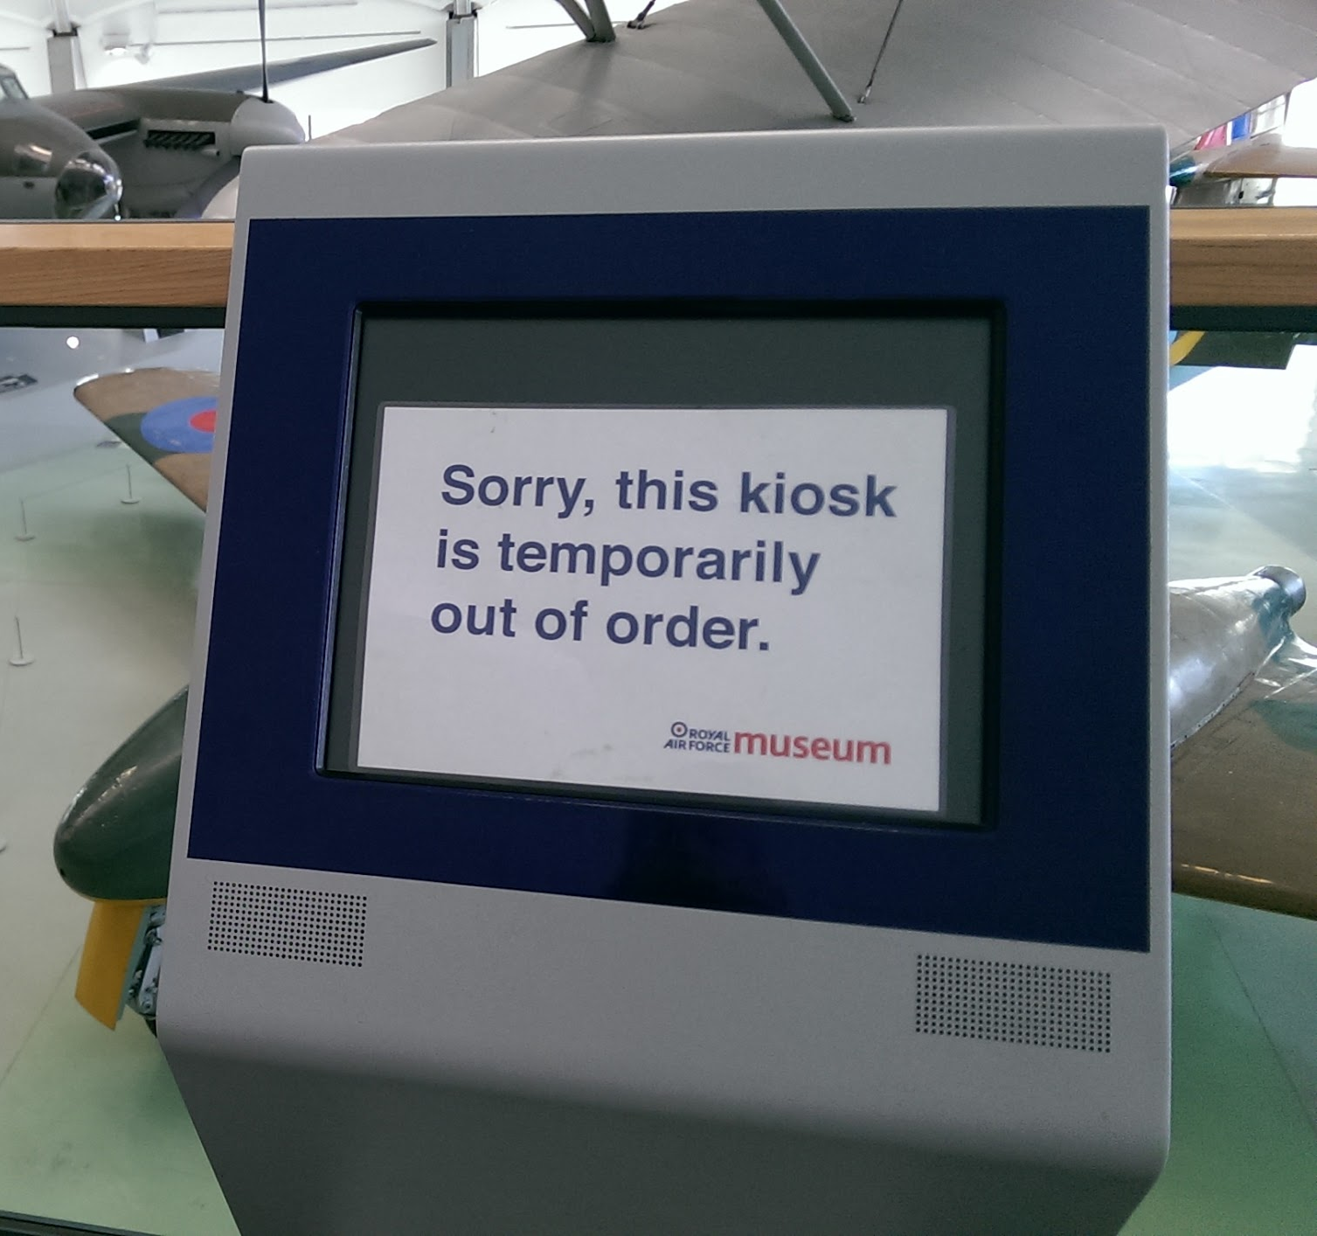
Buy some
Technology?
Capital cost
Maintenance cost
Vendor lock-in
Technical failure
Environmental damage
Theft
Vandalism
Obsolescence
Notes:
On the face of it, technology does not appear to be an appropriate solution.

Slide 5
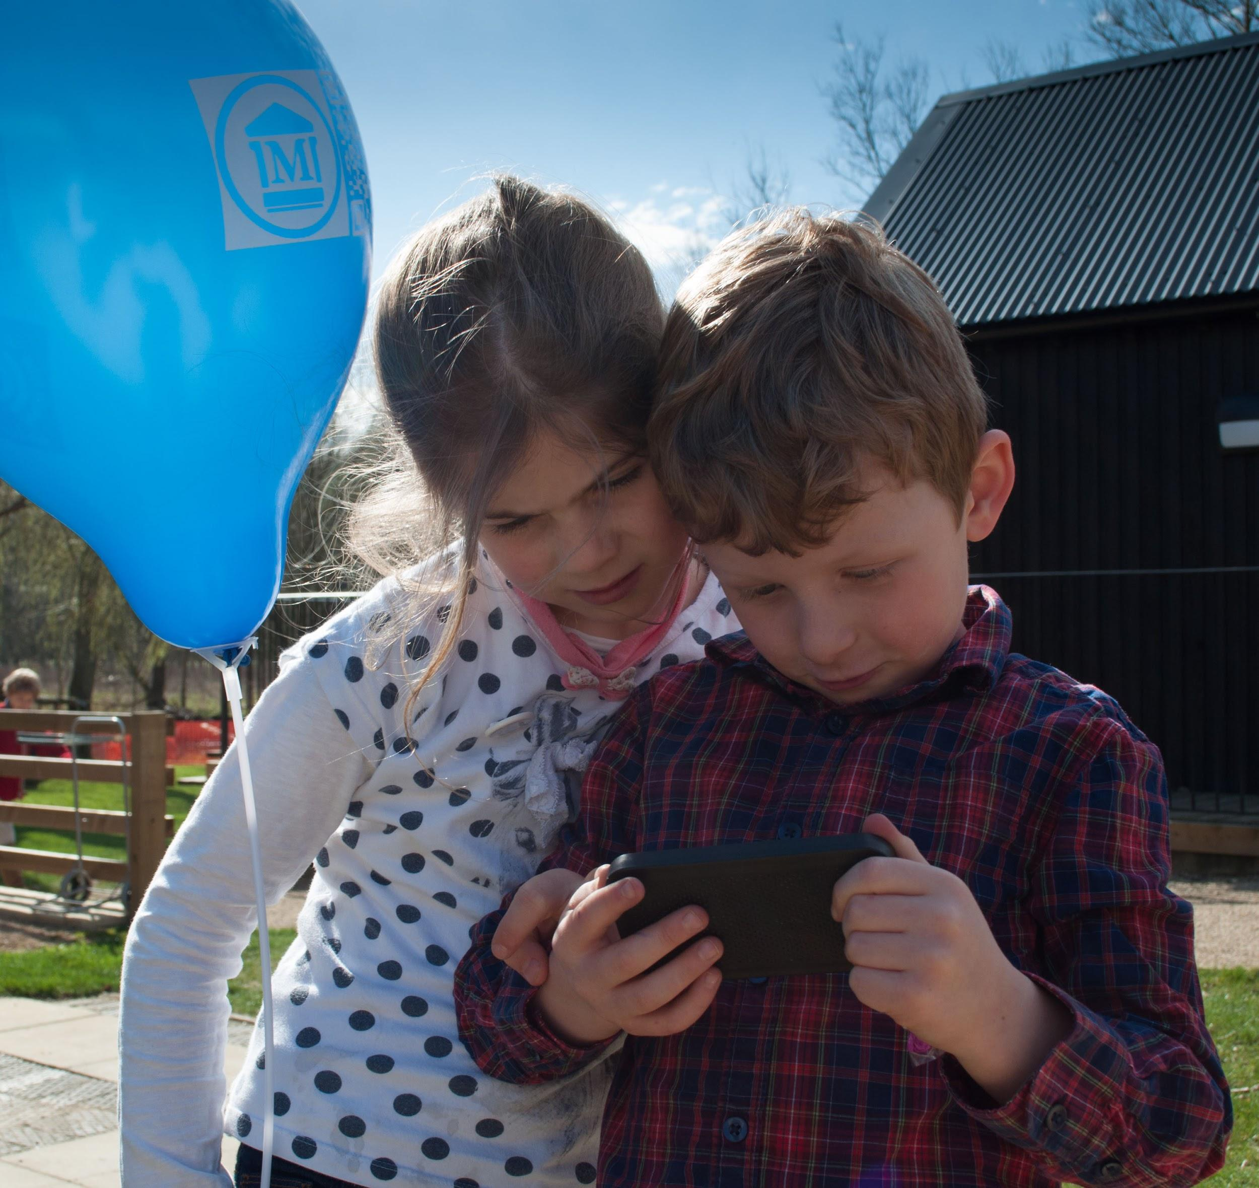
Bring Your Own Device (BYOD)
75% of adults
100% of young people
Notes:
The solution is in your visitor’s pocket (straw poll?)
Deloitte 2016
4 in 5 of UK adults use a smartphone (80%)
Ofcom 2016 (August)
Proportion of adults with a smartphone 71%
V&A 2012
60% of visitors use their mobile device to enhance their visit
They can browse your information on the web or via an app. BUT….

Slide 6
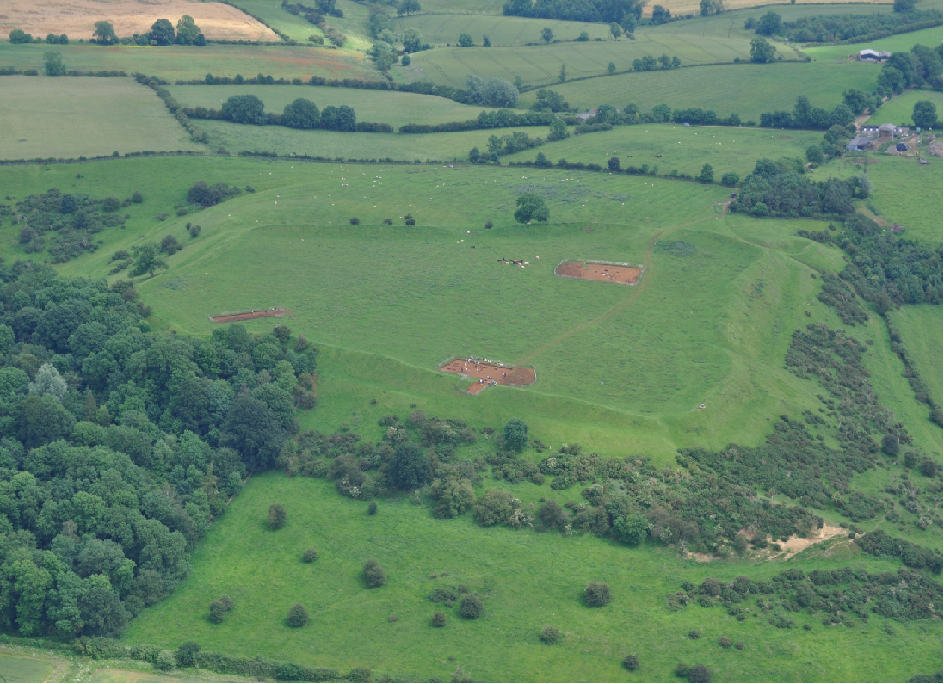
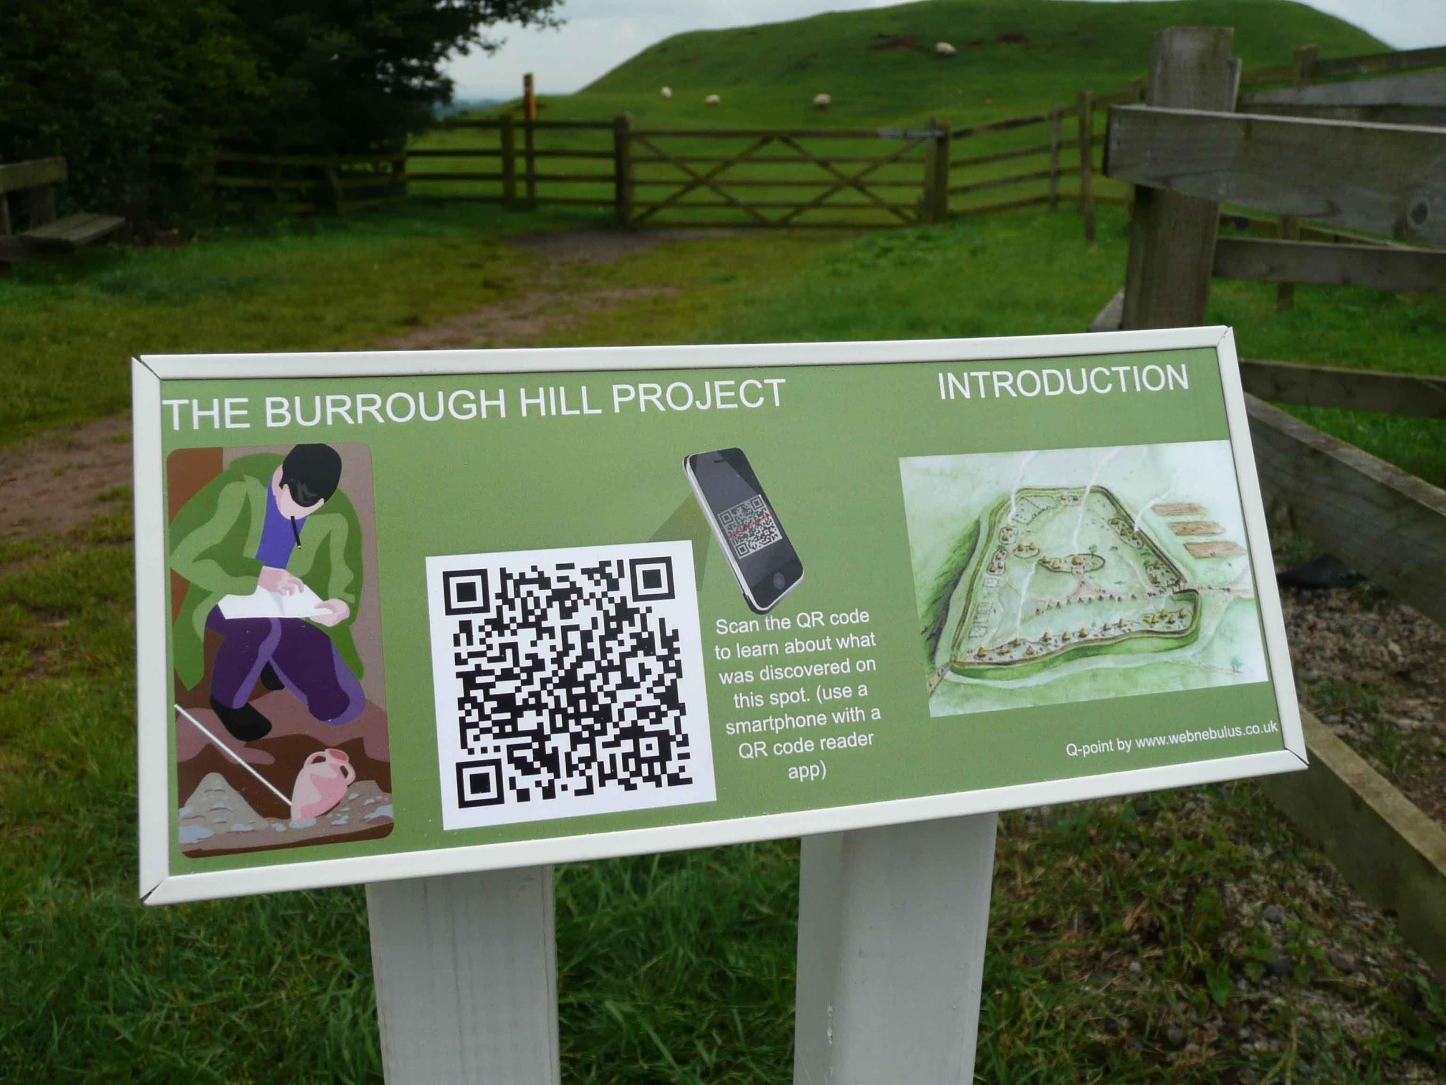
Wi-Fi?
Broadband?
Electricity?
Phone signal?
Customers?
Notes:
BUT it is not as easy as it seems, as we found out.
Neil and Paul background in internet technology and web platforms
Five years ago experiment with digital interpretation as part of an archaeological project
There is no infrastructure at all, and the phone signal is not good enough for audio/video etc.
The problem is economic - no customers live or work here

Slide 7
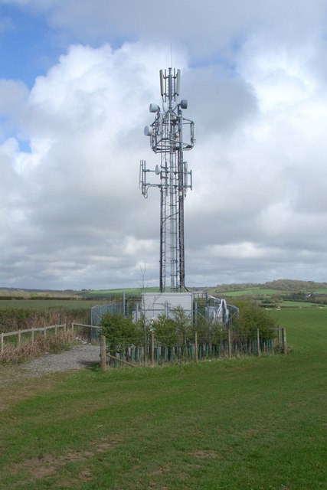
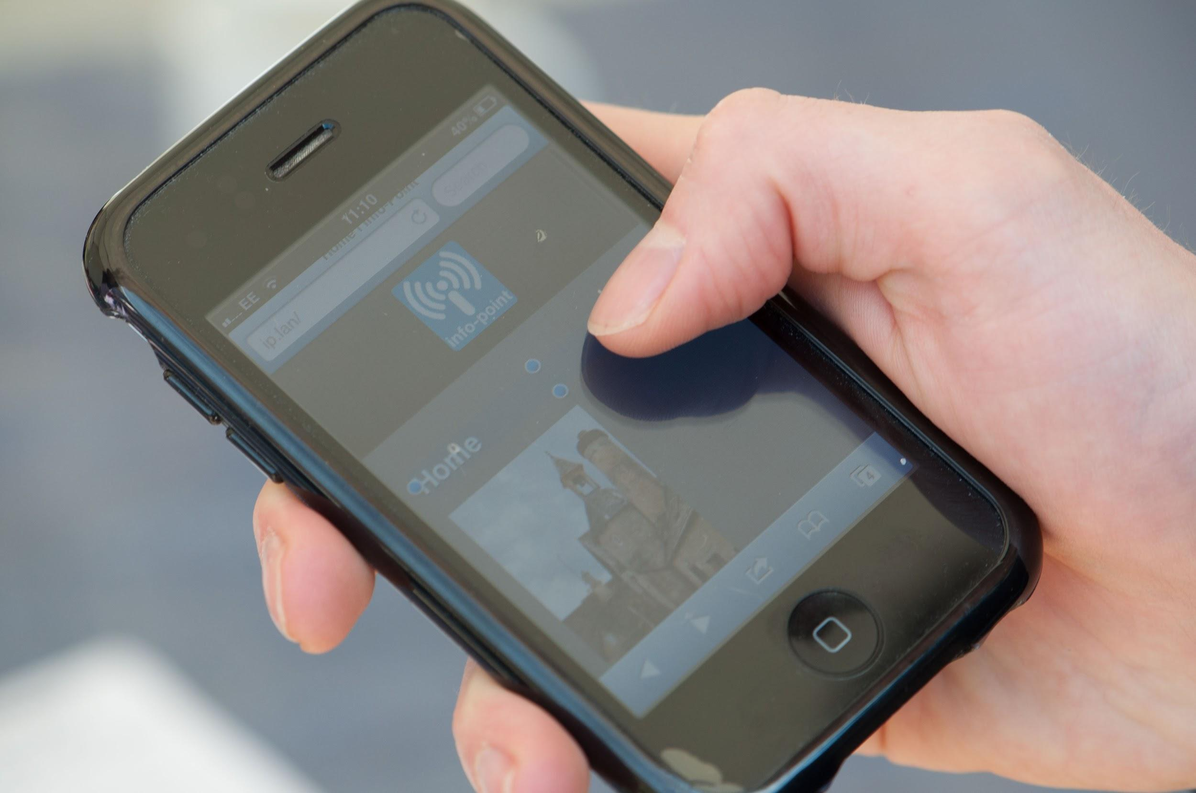
Data Connectivity -
Two possibilities
Phone signal
(my provider)
Public
Internet
Wi-Fi + broadband
Notes:
There are two ways to connect a device to the Internet
BOTH require customers to justify cost of provision
Each has some drawbacks:
Phone - requires all networks present, speed issues for data, data/roaming charges
Broadband - security, hogging, distraction

Slide 8
The Solution
Notes:
Enough problems - let’s look at solutions

Slide 9
Bring Your Own Internet! (BYOI?)
Private
Internet
Wi-Fi
Notes:
Info-Point generates a Wi-Fi with your own private internet behind it.
It looks and works exactly the same as the public internet.
This makes it compatible with all devices that can web-browse via Wi-Fi…
...now and in the future.

Slide 10
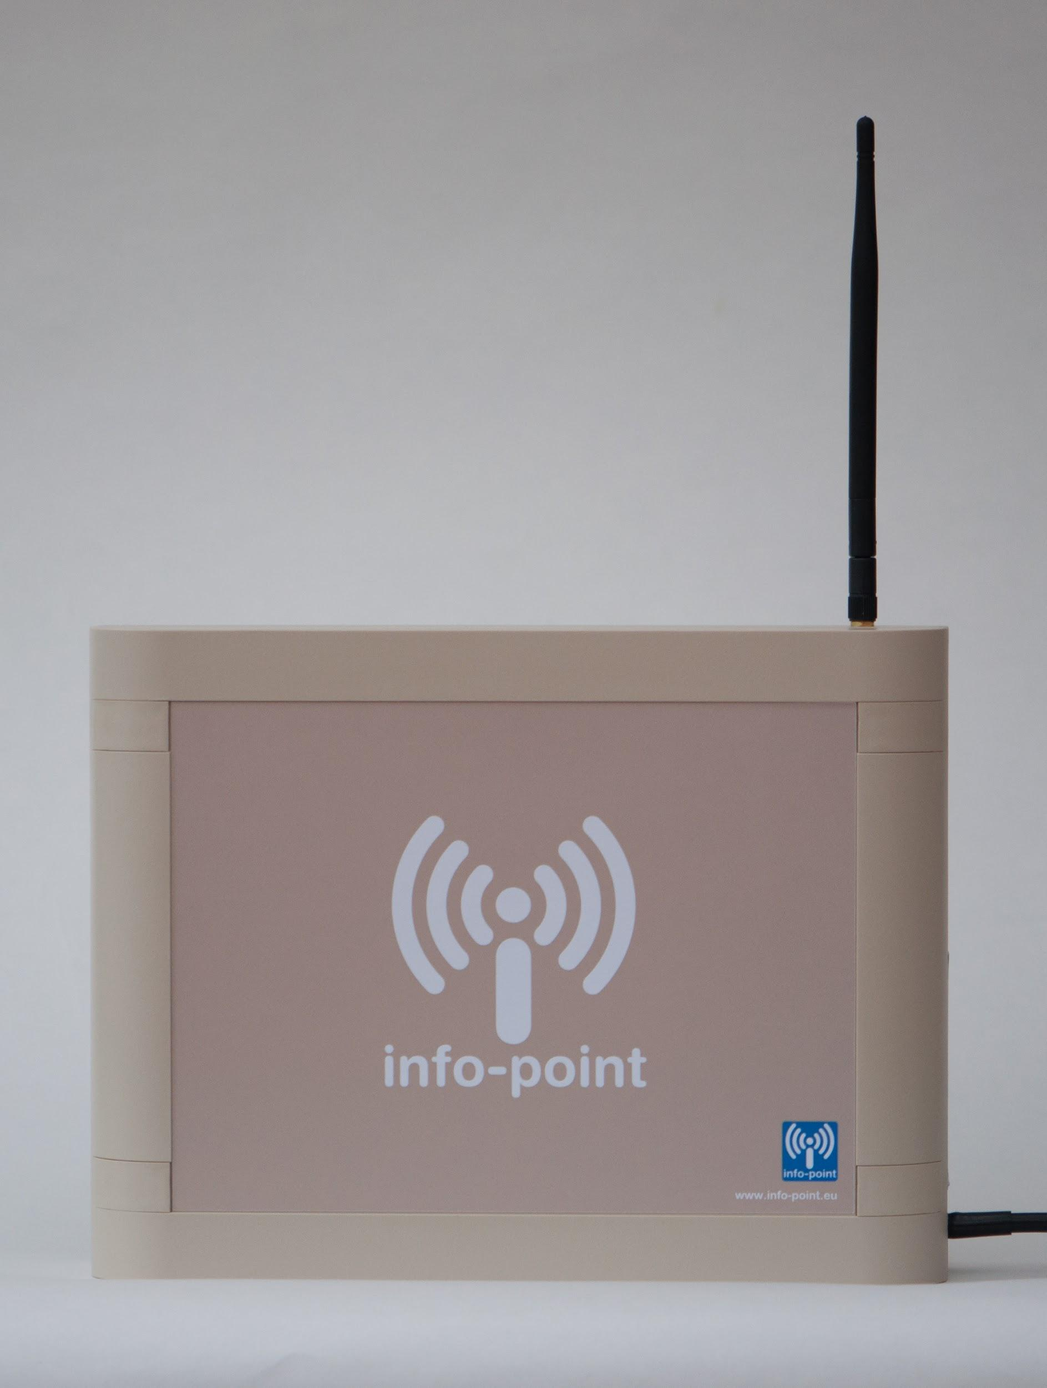
Info-Point
Needs no other infrastructure
Access restricted to visitors
Compatible with all devices
Future-proofed
Secure
Unobtrusive
BYOD, or rent/loan, or kiosk
Capital cost only
Notes:
Whole thing comes in a box - can be mains or solar-powered

Slide 11
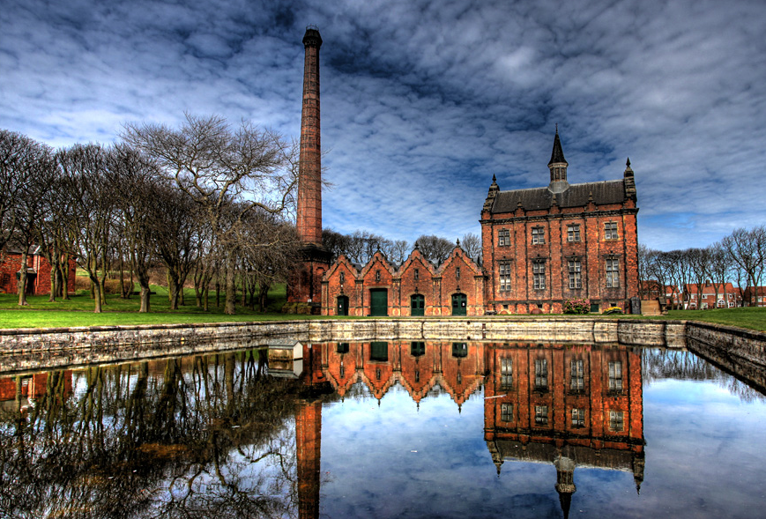
Cost
Single Master Unit - £2,300 + VAT
Hot Spots/Network + support + cameras - £10K - £15K
Expect 10-year life
Warranty 3 or 5 years
Notes:
[explain Ryhope installation as example]

Slide 12
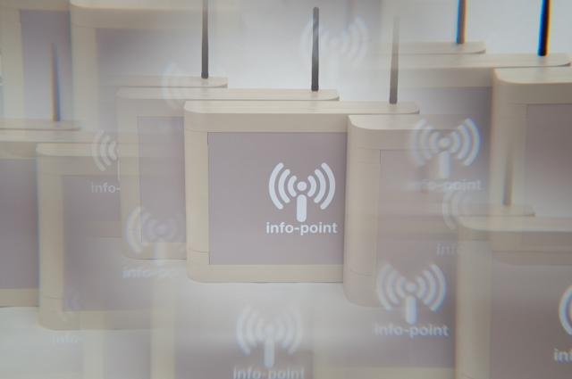
Wi-Fi Coverage
250 metres radius
Single Master Unit
Independent ‘Hot Spots’
Contiguous Network - up to 1.5 Km between nodes
(+ downloads)
Notes:
Each antenna can give up to 250 metres RELIABLE coverage
Three configurations
Plus - content to download and take away, such as walks and trails

Slide 13
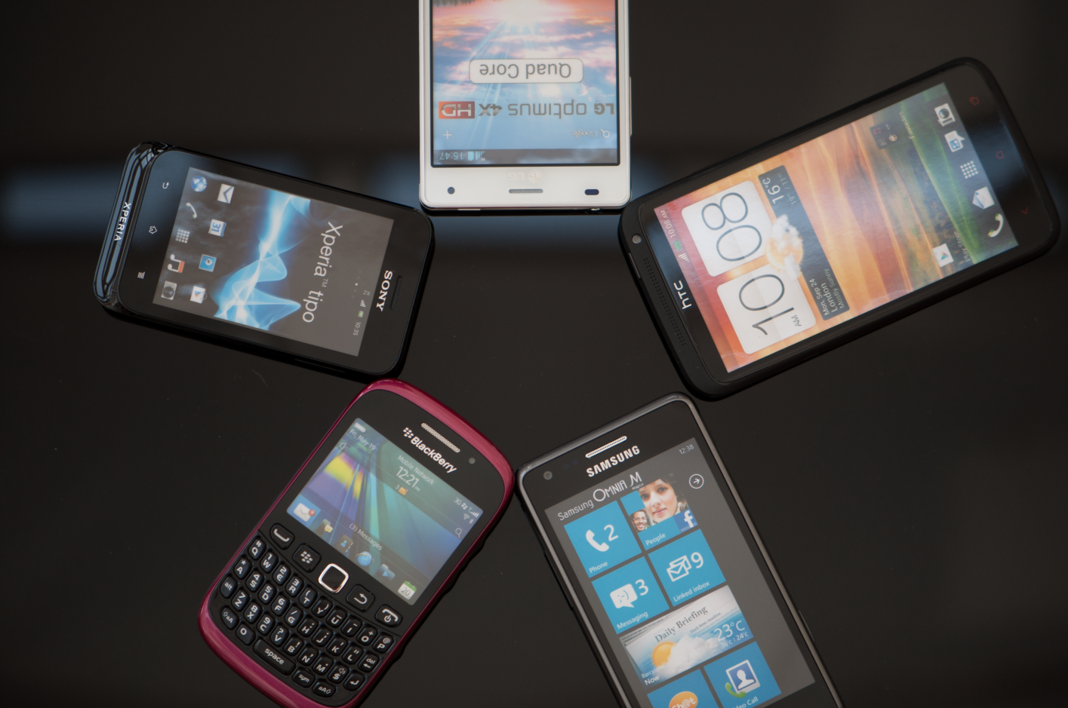
BYOD limitations
Can’t control the user device
Can’t control the user
Can’t do proprietary things

Slide 14
Give!
Notes:
Using this approach, what can you give to your visitors?

Slide 15
Content Capabilities
Simple (in-built CMS)
Text
Images
Audio
Video
Downloadables
Developer-built
Interactive Apps
Webcam features
Touch-screen Interactives
Location-triggered content
Augmented Reality
Notes:
On the left - relatively easy to create and manage without technical skills
Content Management System (CMS)
silver-haired volunteer - 20mins
Only as hard as eg. Facebook or YouTube
On the right - require appropriate technical knowledge
Ideally professional interpreter/developer with our support
Interactive apps could be games or ‘collect pilgrim tokens’

Slide 16
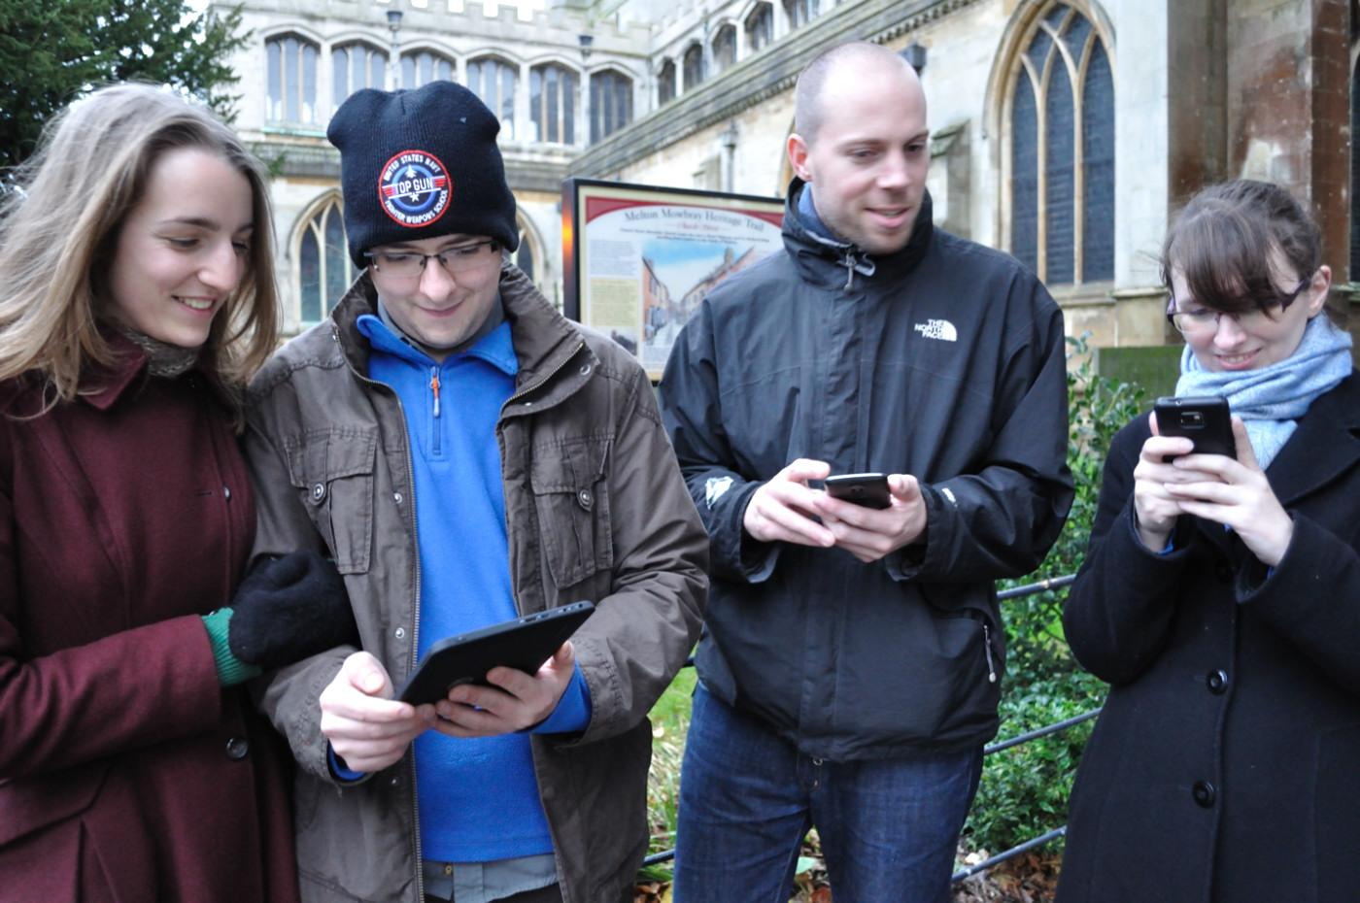
Personalisation
Age
Subject knowledge
Beliefs
Time available
Language
Notes:
Ability to deliver different content to different visitors - better than interpretation boards and physicl materials

Slide 17
Receive!
Notes:
What can you receive from your visitors?

Slide 18
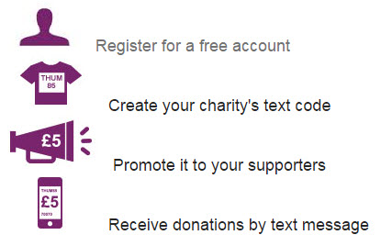
Visitor Donations
Via text-message
Point of motivation
Secure
Easy and universal
‘Connectionless’
Notes:
Important to ask at the point of motivation
No cash involved and no scamming etc.
Will complete when user is in range of their network

Slide 19
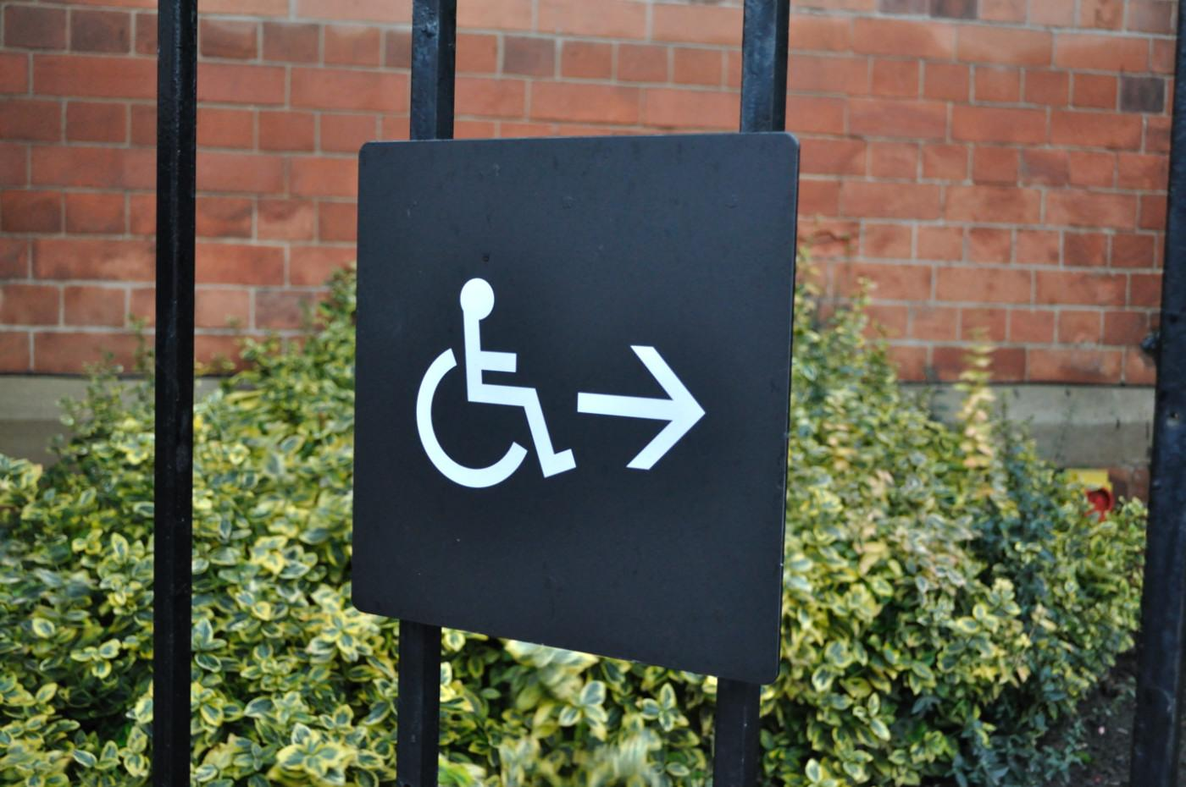
Funding
Capital cost
Warranty
Accessibility/Inclusivity (Physical and digital)
Webcams as substitute for physical access
Notes:
Ticking the boxes of HLF and other funders.

Slide 20
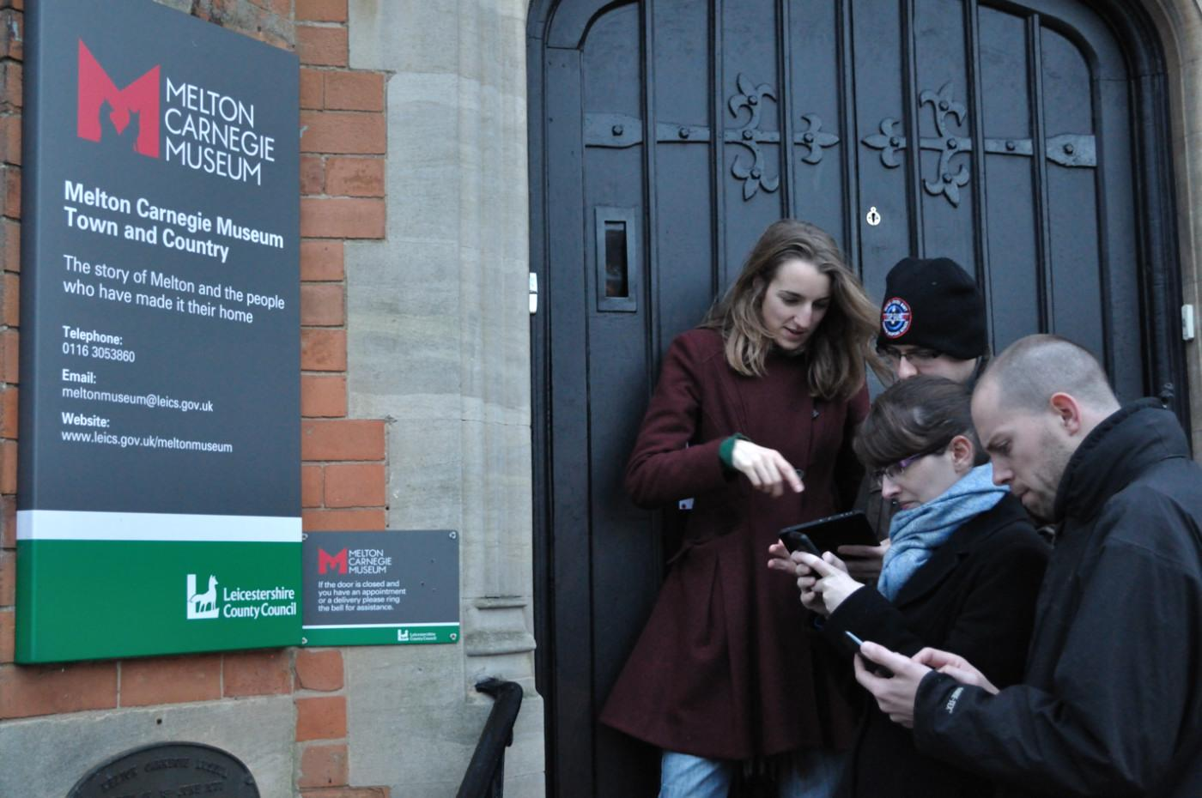
Feedback
Visitor statistics
Comments
Subscriptions
Notes:
Don’t forget the value of feedback and ideas from your visitors, including ongoing contact with potential supporters and volunteers.

Slide 21
Examples?
Notes:
Need to have confidence that a solution will work. Catch-22 when started out, but now have range of reference sites.

Slide 22
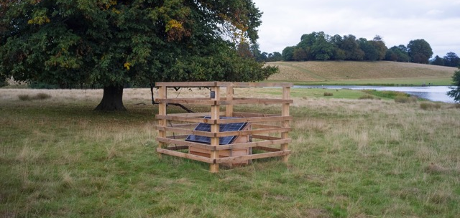
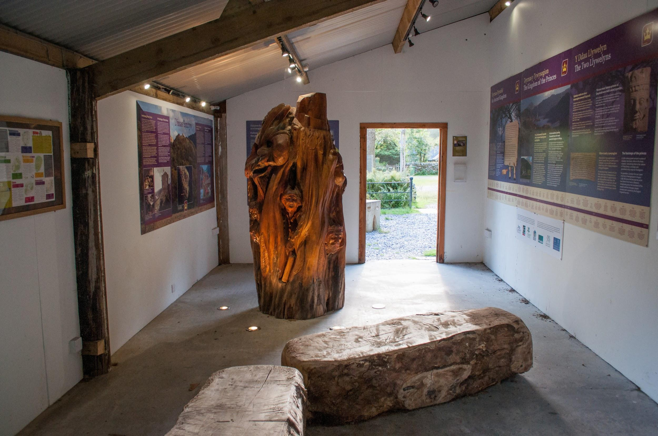
National Trust
Unmanned/Outdoor sites
Saddlescombe Farm
Petworth Park
Clumber Park
Lleyn peninsular
Snowdon Craflwyn
Orford Ness
National Trust for Scotland
Ben Lawers NNR
Notes:
To date the National Trust have 10 properties using Info-Point and others asking for it.
Other big names include NTS, Cadw, RSPB, Canal and River Trust, etc.
Also many small independent museums and heritage sites

Slide 23
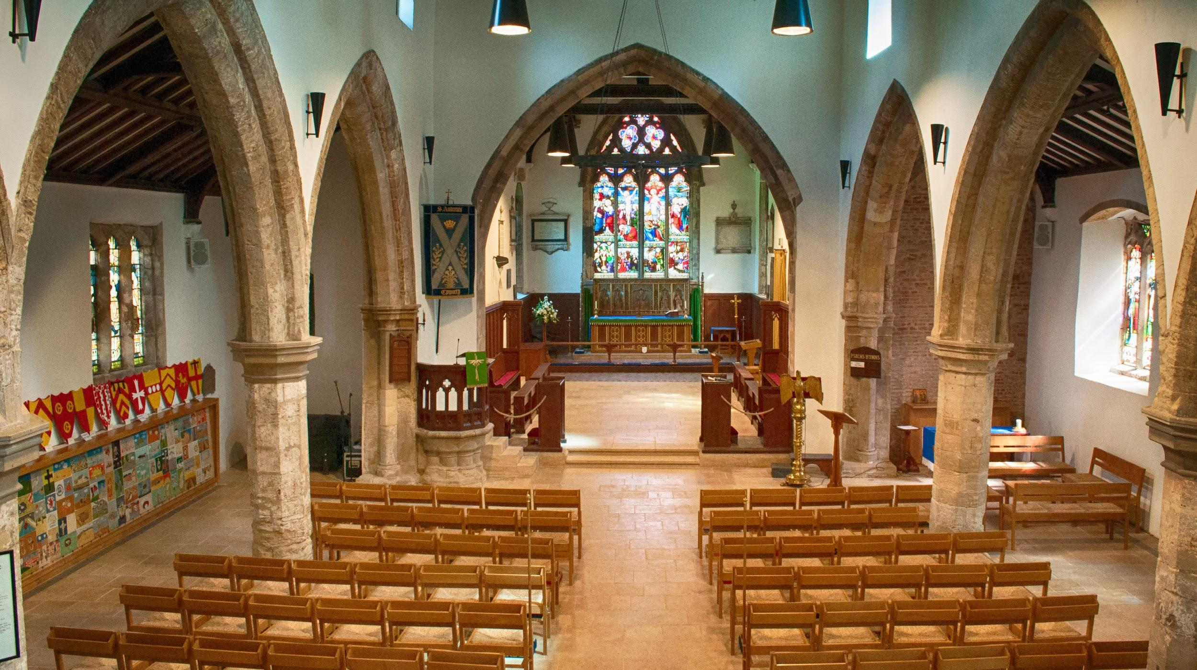
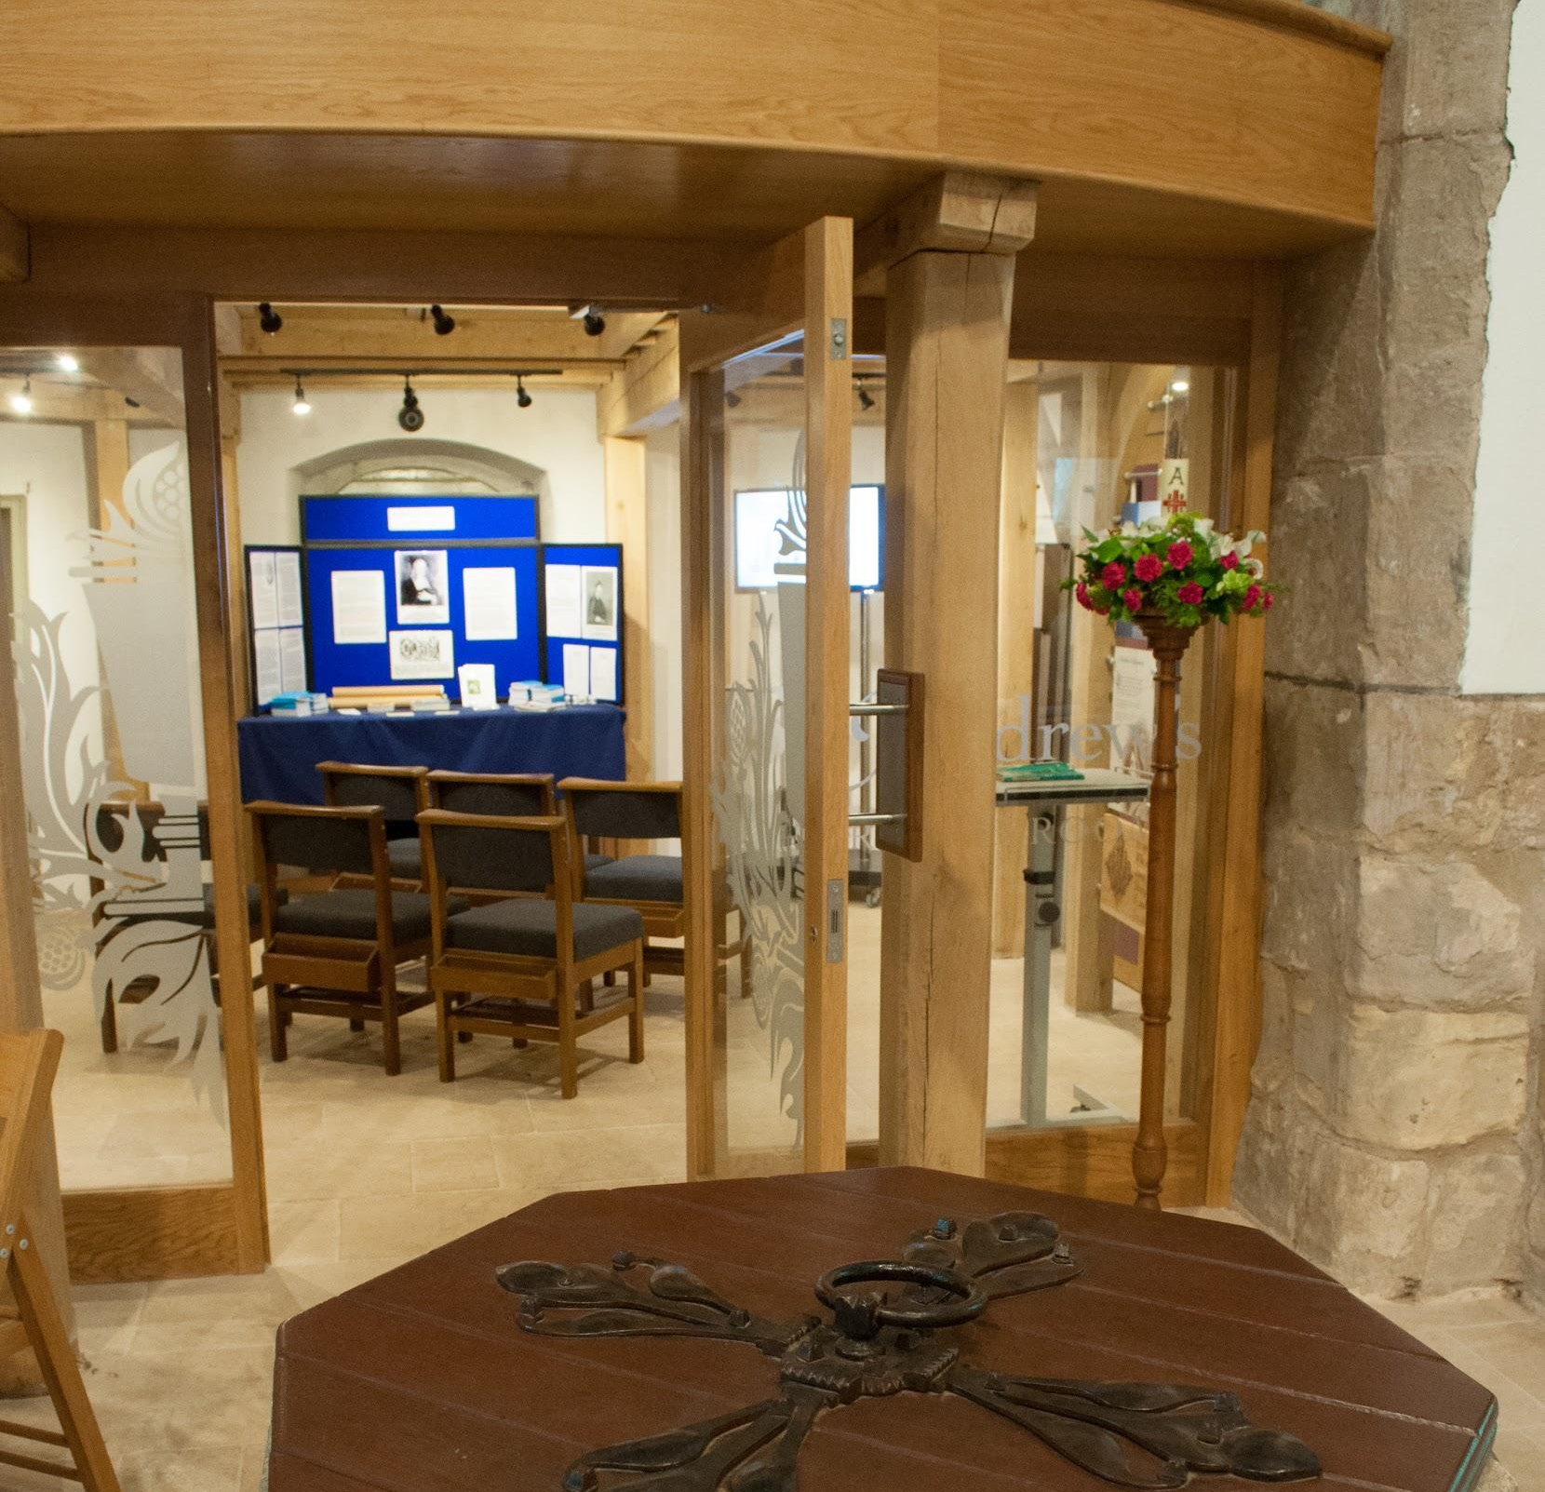
St Andrew’s,
Epworth
Wesleyan pilgrims
Active Anglican church
Improved usability
Interpretation facilities
Info-Point tours available 24/7
Notes:
Here is a very relevant example from a church that had specific issues.
Needed to improve general usability and accessibility.
Special need for heritage interpretation as birthplace of John Wesley (but not a Methodist church).
International visitors means it’s important to deliver this on demand, whether service in progress or church is closed.

Slide 24
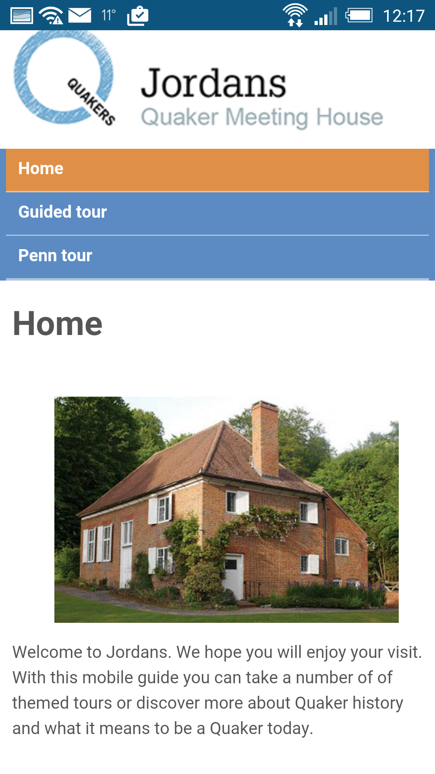
Jordans
Quaker Meeting House
Audio tours
Limited budget
Professional interpreter
24/7 availability
Notes:
Many religious buildings have a story to tell. This one is told via a set of audio tours delivered via Info-Point.
Again, they are available when the building is closed.

Slide 25
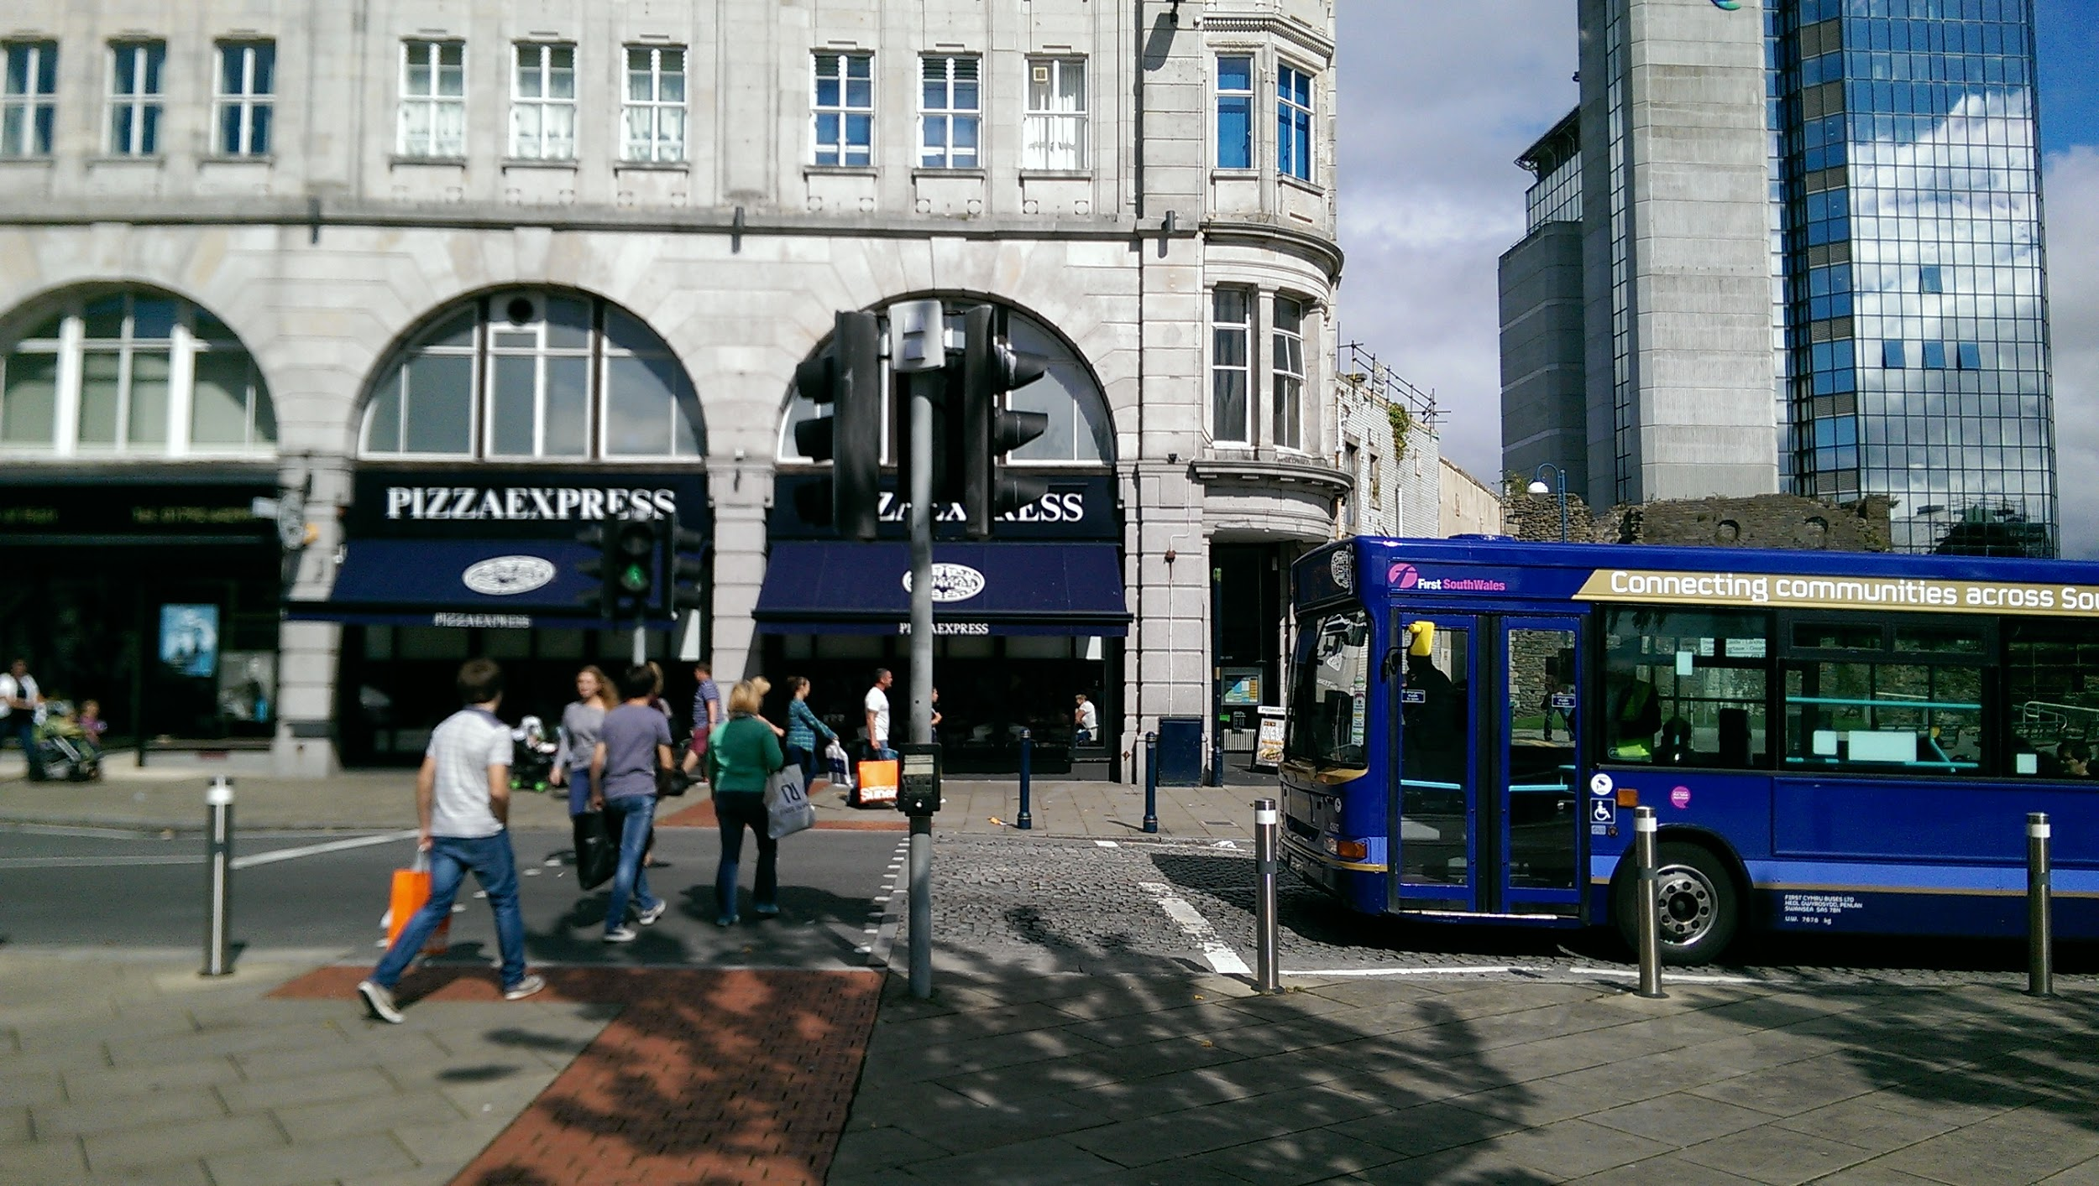
Swansea
Castle
Spot the Info-Point?
Notes:
Can have applications in urban environments.
Issue here was ‘lively’ evening scene - anything obvious would get stolen or vandalised.
Hidden in, and powered by, Traffic Lights.

Slide 26
Message
The Mobile Generation is already here, so go to
BYOD
If you don’t have easy Internet access
BYOI
Notes:
Finally, my message is simple

Slide 27
Give and Receive
With the Mobile Generation
Neil Rathbone - Info-Point

