Slide 1
Stephanie Norris
Partner, Purcell
‘Getting Building Work Done’
HRBA/Purcell event
09 June 2016

Slide 2
What should your inspecting architect or surveyor offer you?
Understanding of your building’s history
Sympathy with how you want to use it
Track record of understanding building defects and managing repair programmes
Track record of guiding alteration projects
Knowledge of the local consents processes
Knowledge of where to find specialist advice
Knows when archaeological advice will be needed
Knowledge of funding for church projects
Enthusiasm for working with your team

Slide 3
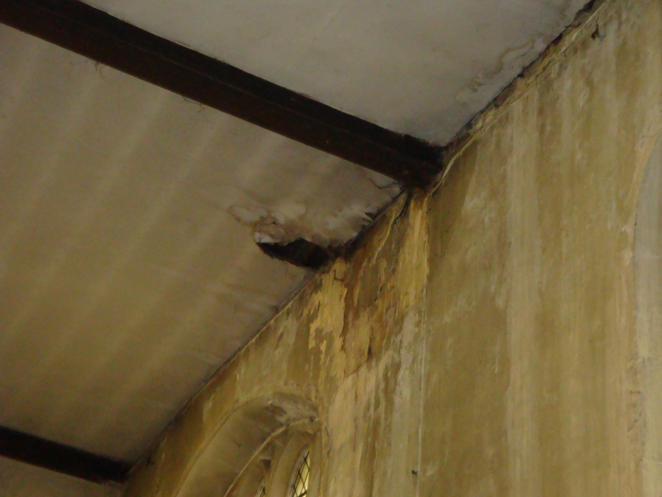
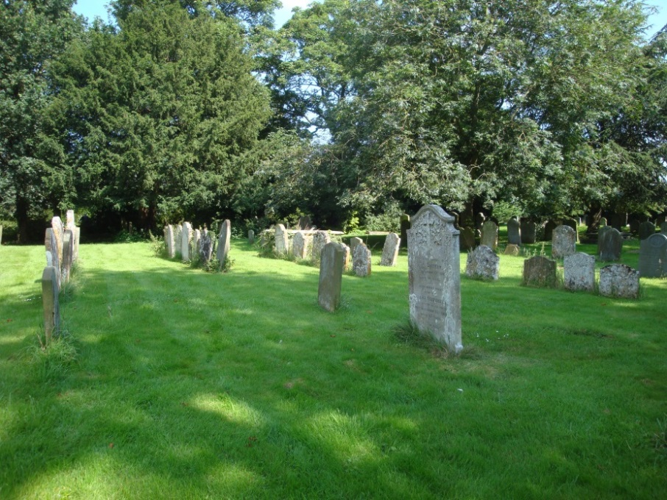
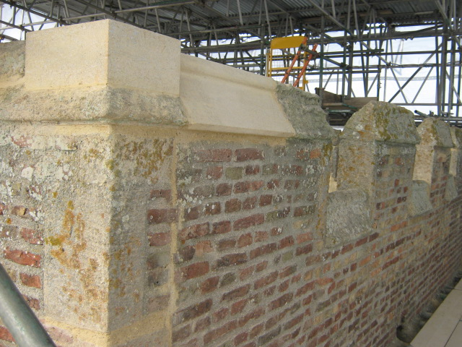

Slide 4
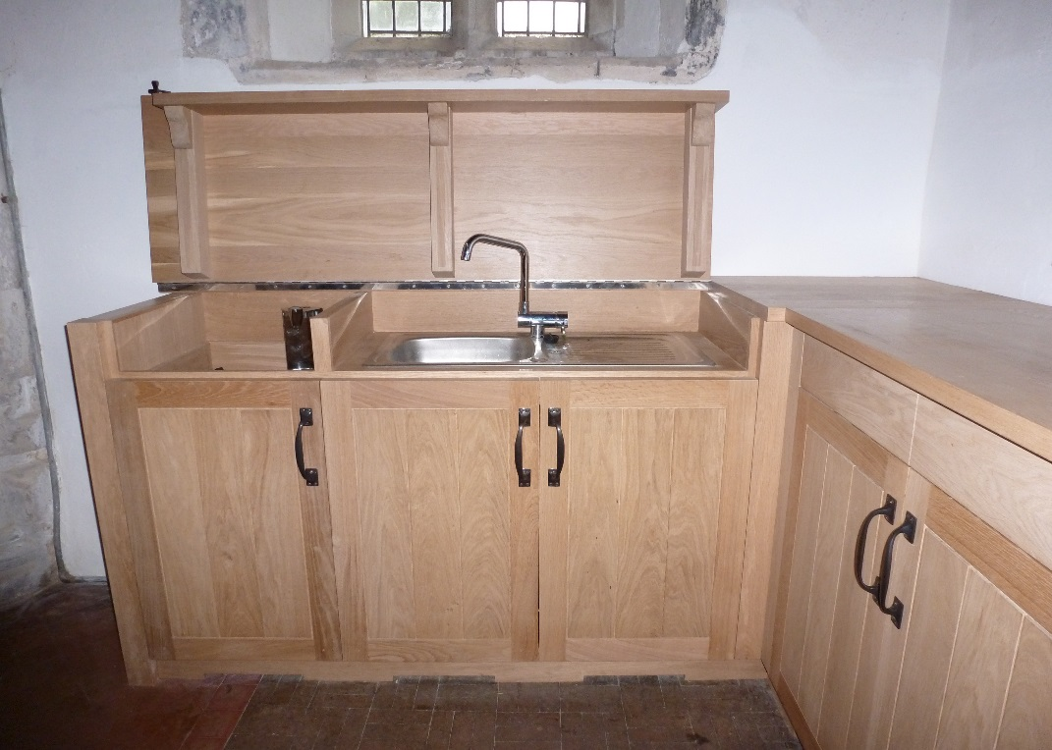
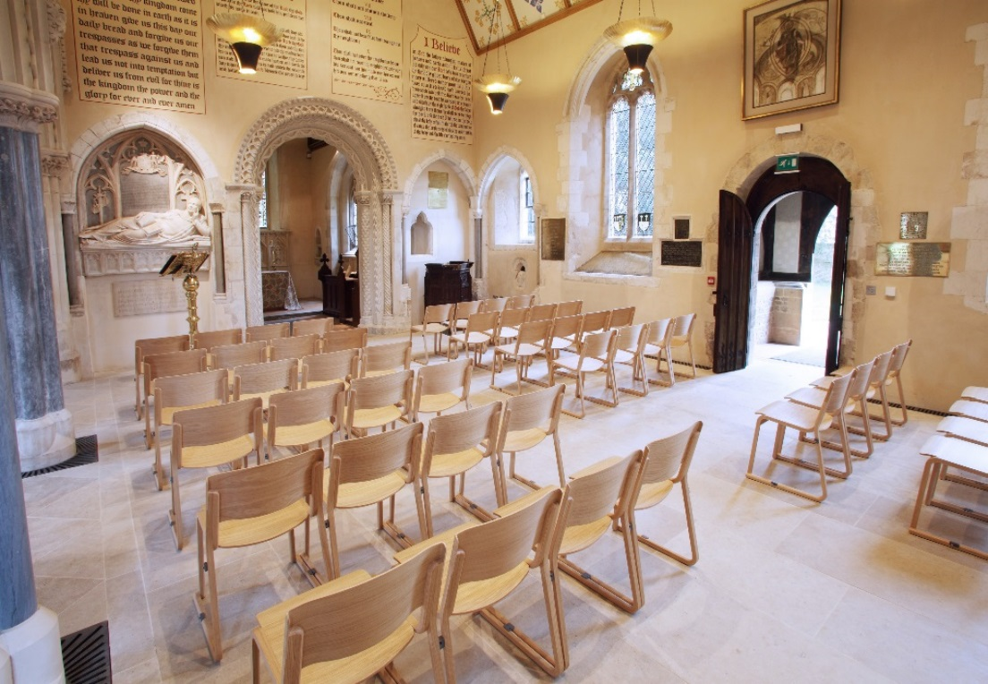
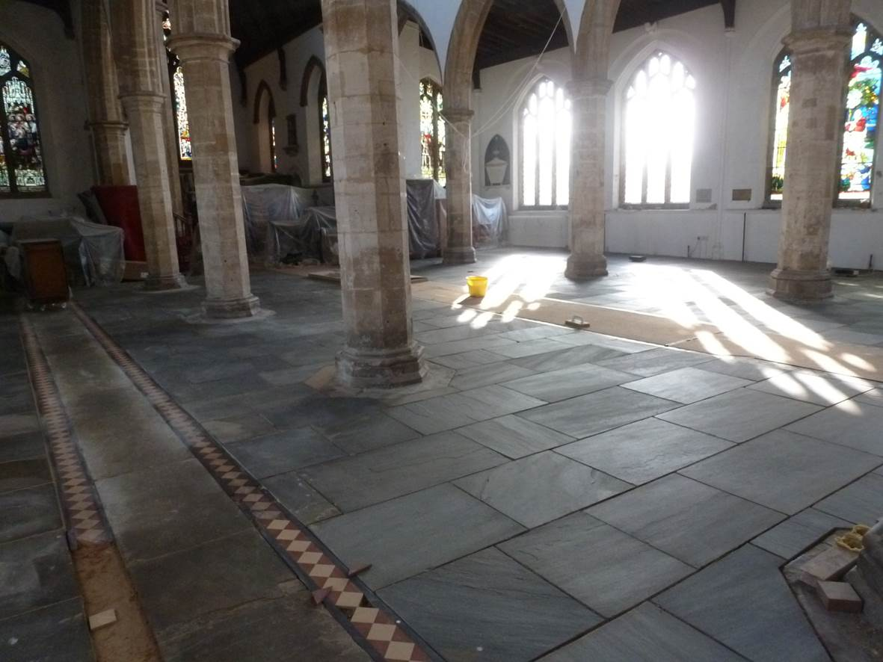

Slide 5
CHOOSING AN ARCHITECT
The right architect – what are you looking for?
Core technical skills
Trust and personality fit
Ask for advice
DAC secretary or equivalent
Neighbouring parishes
Name of key person
Experience - look at work elsewhere
Similar work
Type of your project

Slide 6
CHOOSING AN ARCHITECT
Shortlisting and interview
Technical and Design skills
Your inspecting architect
References and visits
Size
Availability
Day to day contact
Knowledge of churches and the planning processes

Slide 7
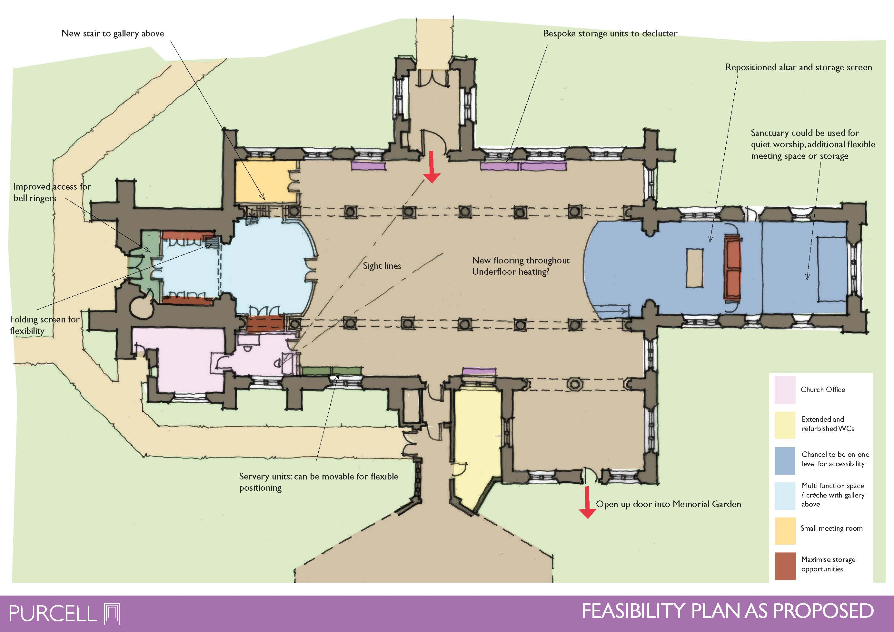

Slide 8
CHOOSING AN ARCHITECT
Shortlisting and interview
Cost
Overall value not necessarily lowest cost
Fee for different parts of the service
Faith
Is it important for your project?
The retired architect on the PCC
Best use of their skills

Slide 9
BUILDING THE REST OF THE DESIGN TEAM
CDM Principal Designer
New CDM Regulations since 6th April 2015
Deals with H&S compliance
Quantity Surveyor
Financial management
Importance of an initial budget plan
Full service

Slide 10
BUILDING THE REST OF THE DESIGN TEAM
Services Engineer
Heating, Lighting, Ventilation
Best to incorporate from Feasibility stage
Structural Engineer
Structural elements
Sometimes underground drainage
Either at early design stages or after Planning
Building Inspector
Local Authority vs Approved Inspector

Slide 11
WHO ELSE MAY NEED TO BE INVOLVED?
Party Wall Surveyor
Building close to a boundary
Foundations within 3 metres
Acoustic Engineer
For new worship space
Concern over noise pollution
Audio Visual Engineer
Is multi-media important?
Basic AV can be through Services Engineer

Slide 12
WHO ELSE MAY NEED TO BE INVOLVED?
Lighting Designer
Complex lighting controls
Creating particular effects
Kitchen Designer
Café or commercial kitchen
Environmental Health requirements

Slide 13
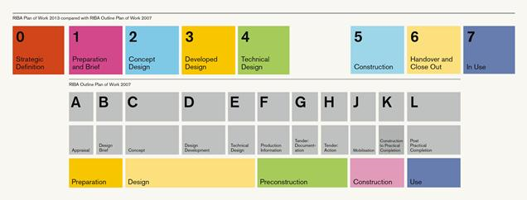
THE RIBA STAGES
RIBA Plan of Work 2013 revision
Important to understand how the stages fit together and typical timescales
Actual building work in Stage 5 - everything else is preparation!

Slide 14
SO WHAT ARE THE STAGES?
Stage 0 – Strategic Definition
Deciding whether or not you have a project
Feasibility study
Stage 1 – Preparation and Brief
Commissioning surveys
Statement of Need
Stage 2 – Concept Design
Sketch proposals
Preliminary budget estimate
Stage 3 – Developed Design
Formal applications to statutory authorities

Slide 15
SO WHAT ARE THE STAGES?
Stage 4 – Technical Design
Coordination of design information
Tendering
Stage 5 – Construction
Building the building!
Stage 6 – Handover and Close Out
Receiving the completed building
Defects period
Stage 7 – In Use
Post-occupancy evaluation and reflection

Slide 16
LEADERSHIP WITHIN THE CHURCH COMMUNITY, BRIEFING AND DECISION MAKING
Consultation
Wide discussion
With the PCC, congregation, wider user groups
Majority voice
Briefing
Clear and agreed
Considered against your needs and aims
Relevant for selection of architect and project brief

Slide 17
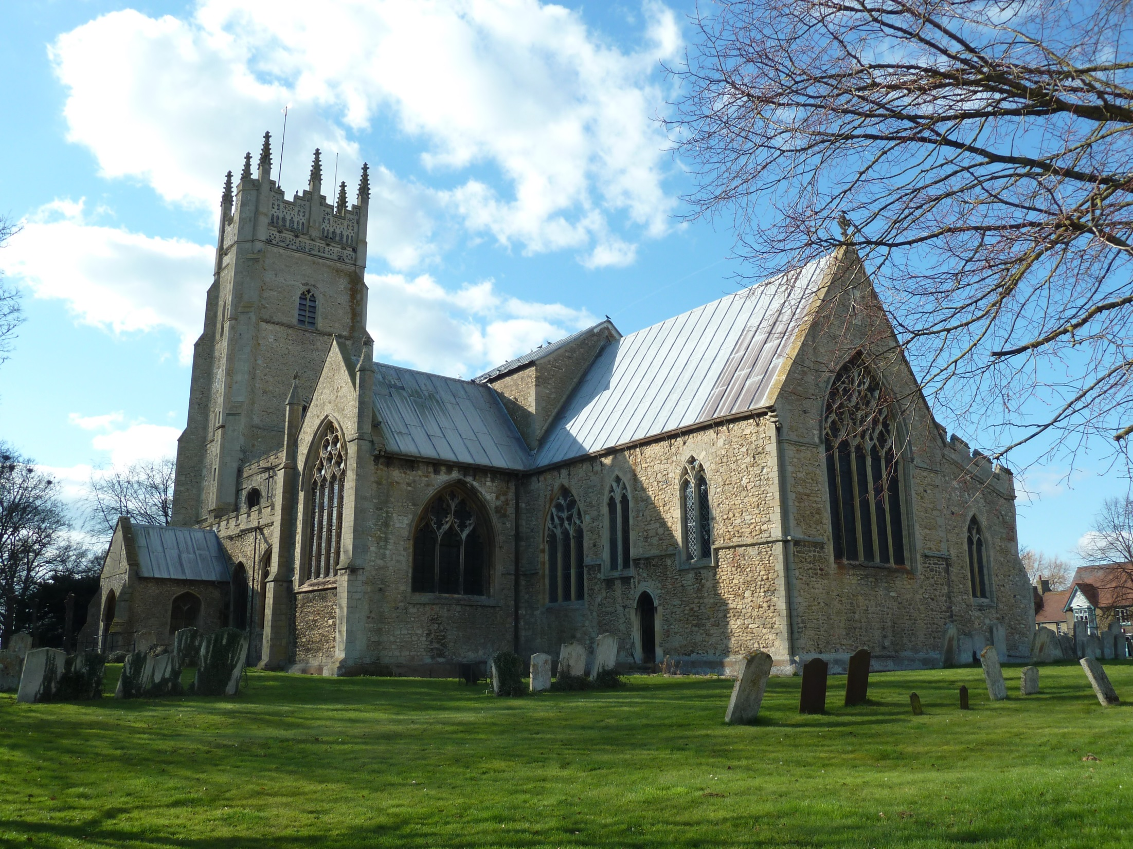

Slide 18
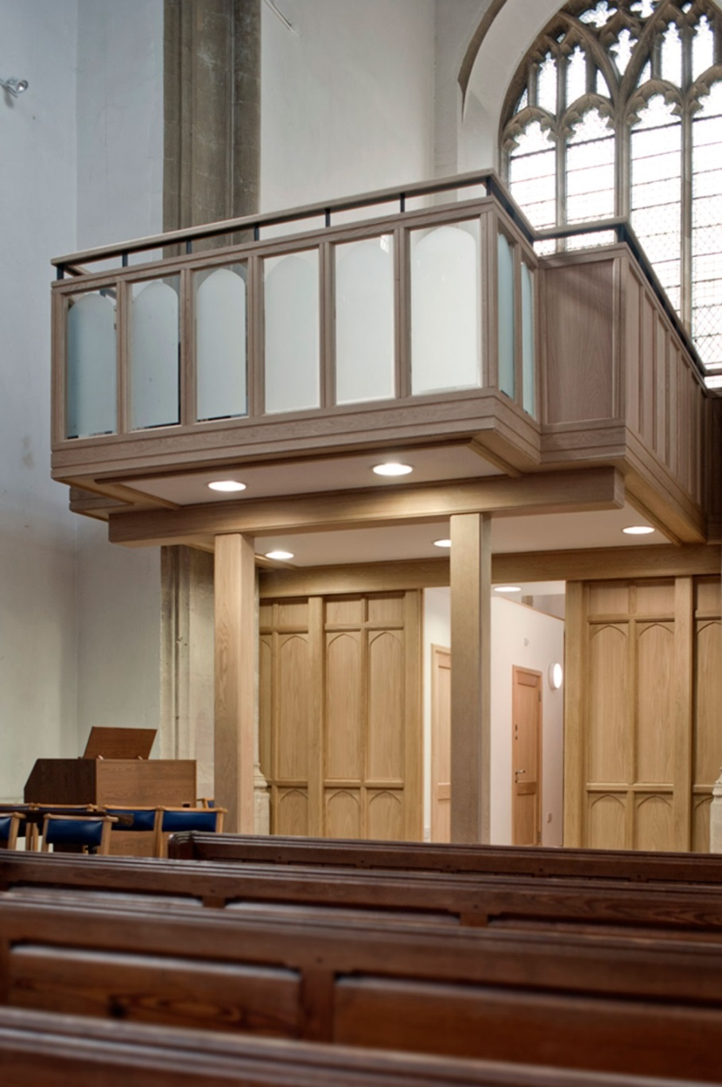
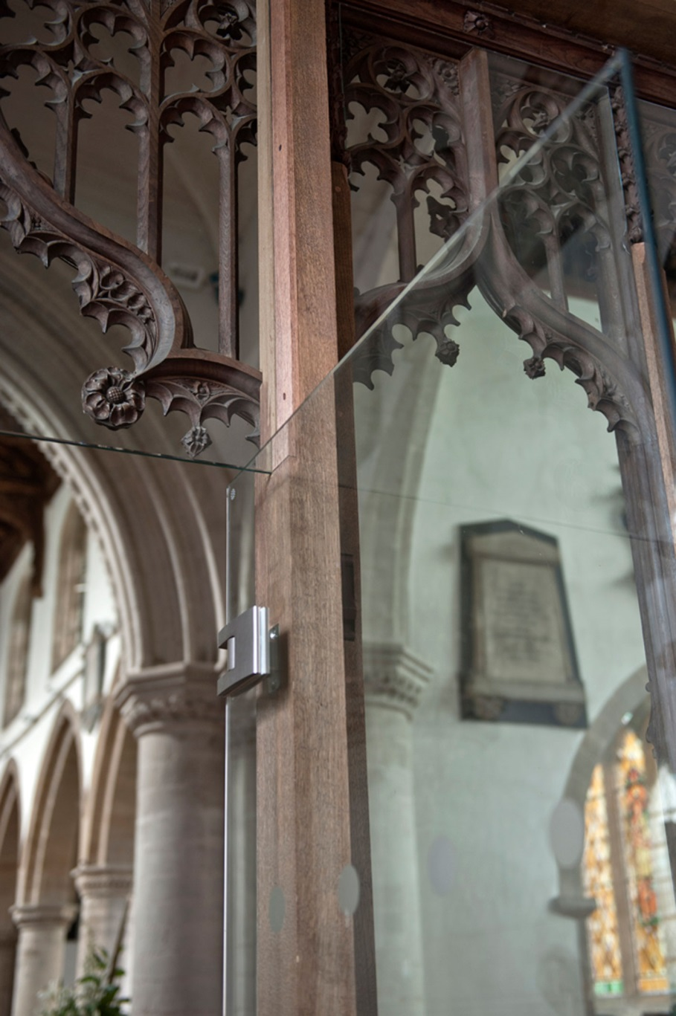

Slide 19
LEADERSHIP WITHIN THE CHURCH COMMUNITY, BRIEFING AND DECISION MAKING
Leadership and delegation
Single client project manager
Easily contactable
Sense of authority and lines of communication
Demanding and important role
When is it appropriate to have a paid Project Manager?
Traditionally undertaken by architects
Helps define success criteria, monitor risk and programme
Good idea for certain size of project

Slide 20
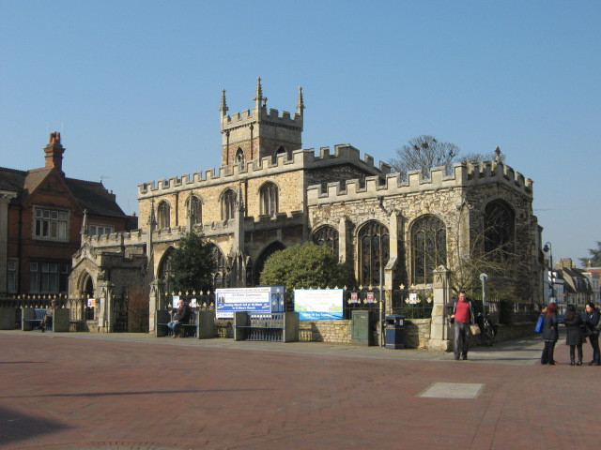

Slide 21
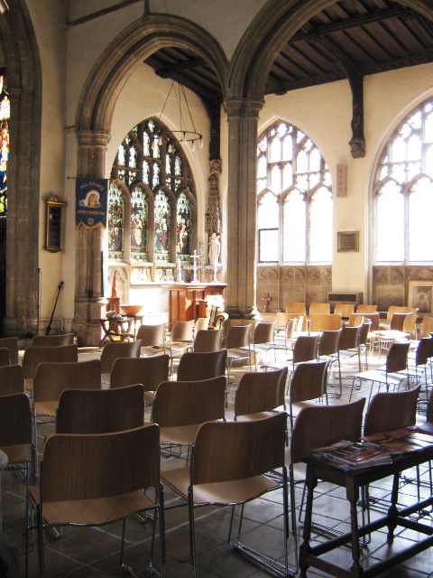
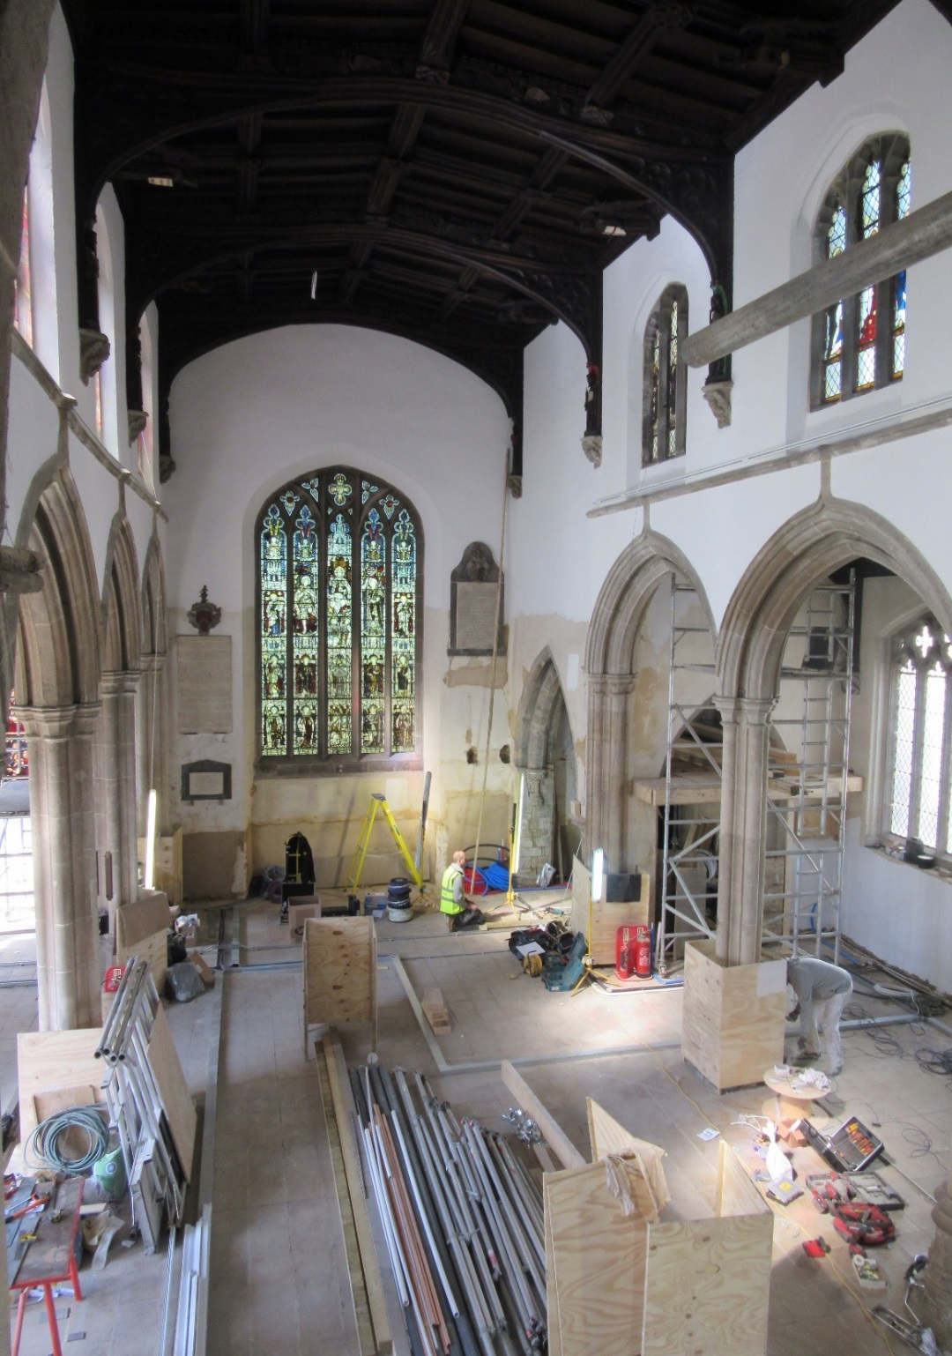

Slide 22
MANAGING THE CONSTRUCTION PROCESS
Choosing the Right Builder
Huge impact on quality of completed project and experience of getting there
References from previous clients
Ensure relevant experience in the Sector
Ensure they have experience of projects of your size and complexity
Carry out financial checks
Procurement and Tendering
Traditional contracts
Choosing builder earlier on:
‘Design and Build’ vs ‘Two Stage Tendering’

Slide 23
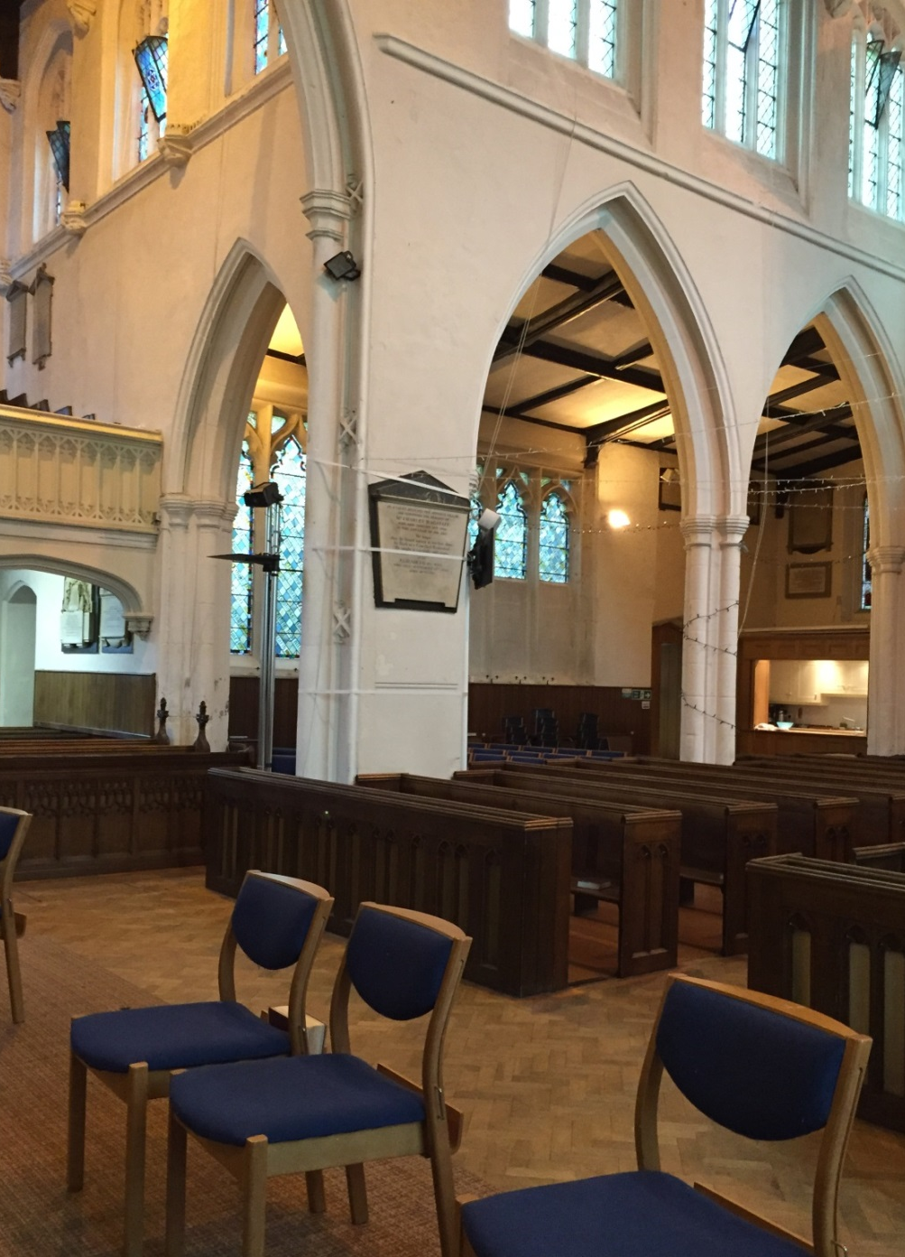
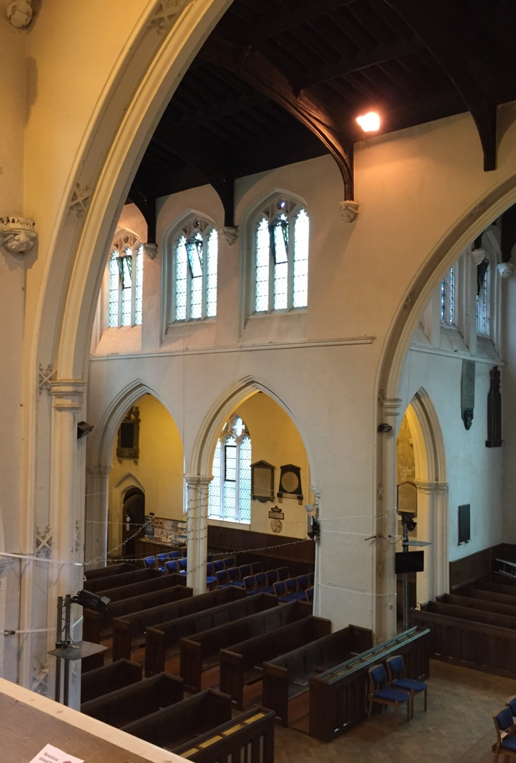

Slide 24
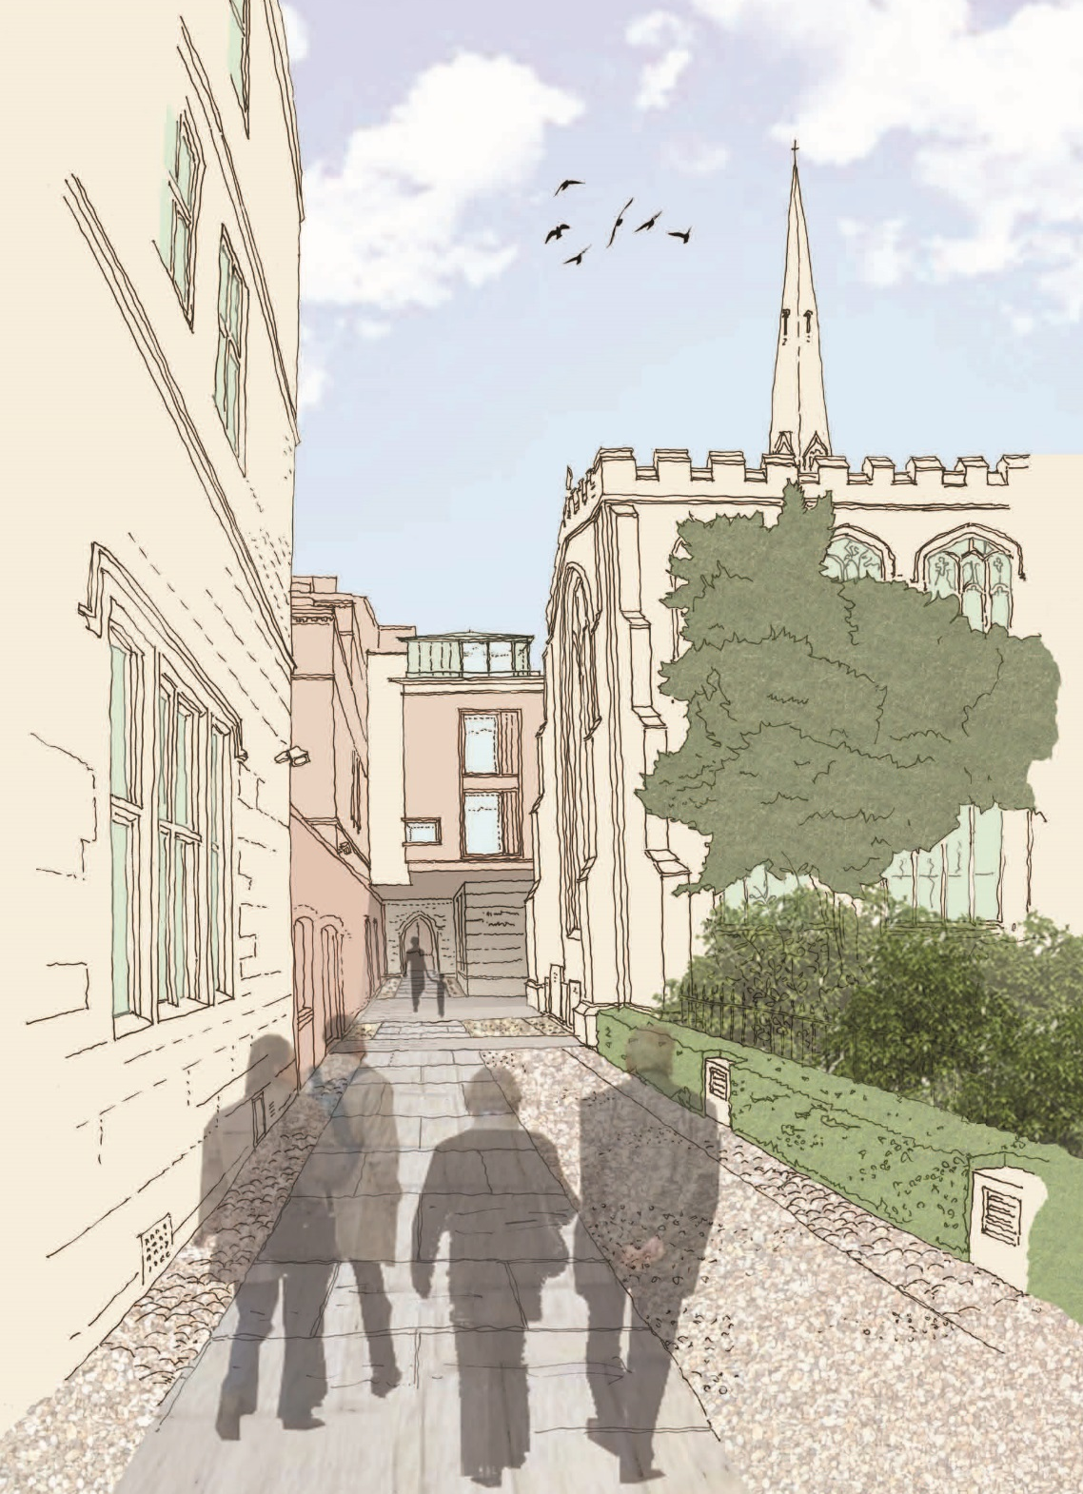
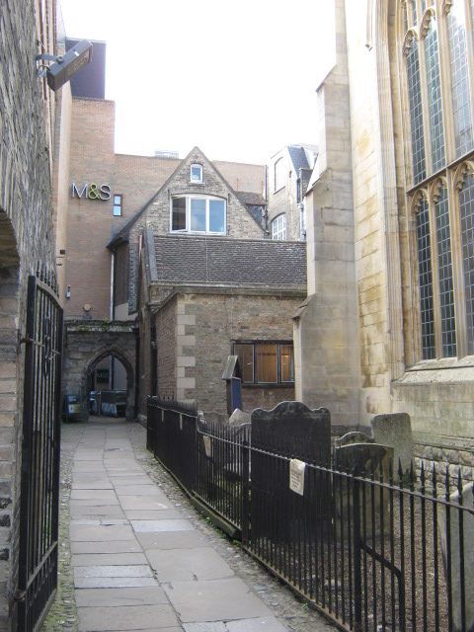

Slide 25
MANAGING THE CONSTRUCTION PROCESS
Managing Change and Cost Control
Expected part of construction process – it happens!
Reasons for change
Clear communication
Record changes in ‘as built’ drawings
Review and monitor budget regularly

Slide 26
KEEPING THE TEAM WORKING TOGETHER FOR A SUCCESSFUL OUTCOME
Maintaining momentum
Beginning, middle, end
Key individuals driving the project
Client Ownership
Full engagement through all decision making
Managing Design Change
Signing off processes for each stage
Reasons for change and implications
Keep overall goals in mind

Slide 27
KEEPING THE TEAM WORKING TOGETHER FOR A SUCCESSFUL OUTCOME
Agreeing and maintaining a programme
Stick to it
To guide everyone
To focus fundraising
Establish regular pattern of meetings
Handover
Celebrate and enjoy your vision!

Slide 28
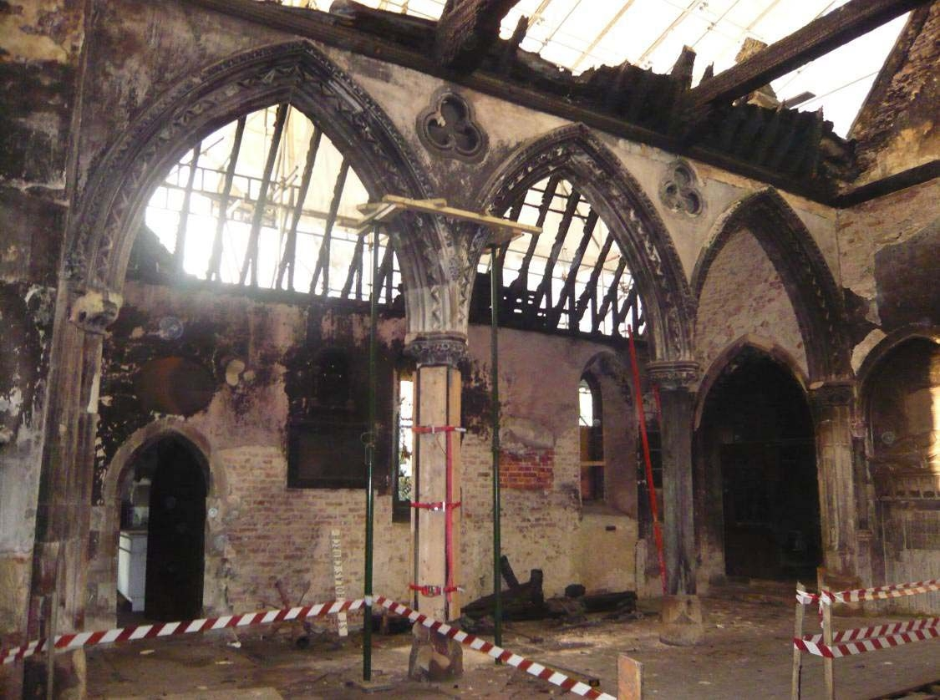

Slide 29
