Slide 1
PROJECT VIABILITY AND DEVELOPMENT GRANTS PILOT
Nigel Mills
Grants and Development Officer
National Churches Trust
Registered Charity Number: 1119845

Slide 2
NATIONAL CHURCHES TRUST
The National Churches Trust is the only national, independent, non-profit organisation dedicated to promoting and supporting church buildings of historic, architectural and community value across the United Kingdom.
We offer support, advice and funding to Christian places of worship of all denominations..
For information on all of our activities please visit www.nationalchurchestrust.org

Slide 3
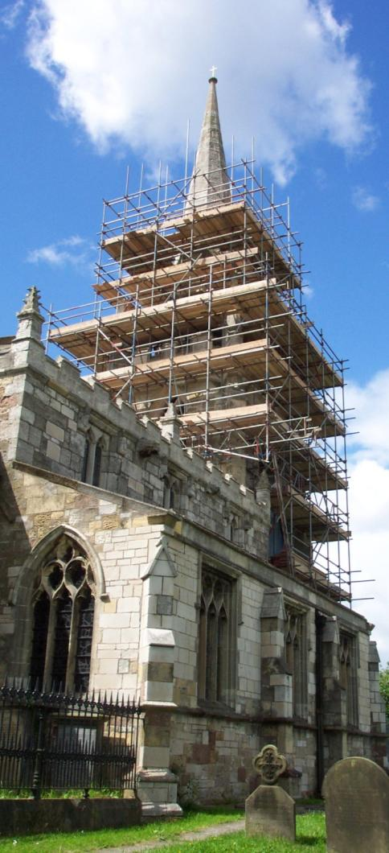
Introduction
Churches often struggle to development funding bids to the Heritage Lottery Fund and other major grant funders, especially during the early project development phase. Some of the issues include:
Identifying the cause of a problem
Preparing architectural specifications to RIBA Stage 1
Proposing a competitive programme of learning and public engagement events
Demonstrating the viability of their business planning
Finding people to help with all the above.
Architectural Heritage Fund provide grants to building preservation trusts (BPTs) to fund the above, but do not award development or viability grants to churches.

Slide 4
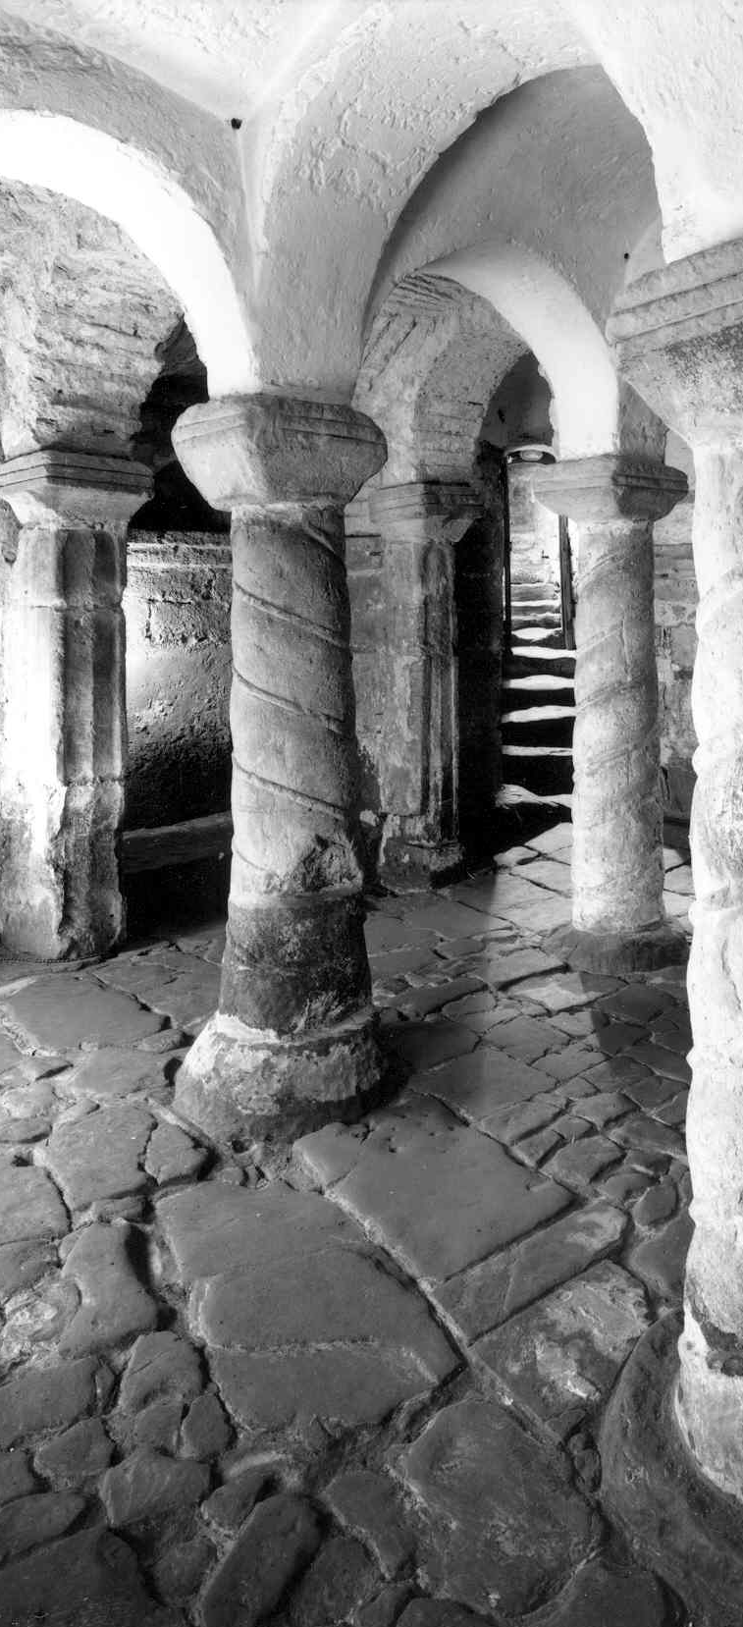
Project Viability/Development Grants
Intended to support churches to become more sustainable through:
the diagnosis of issues affecting the church
testing the viability of proposed solutions to improve sustainability
and the development of guiding policies and plans that will be implemented through an application to the Heritage Lottery Fund or other large church heritage funders.

Slide 5
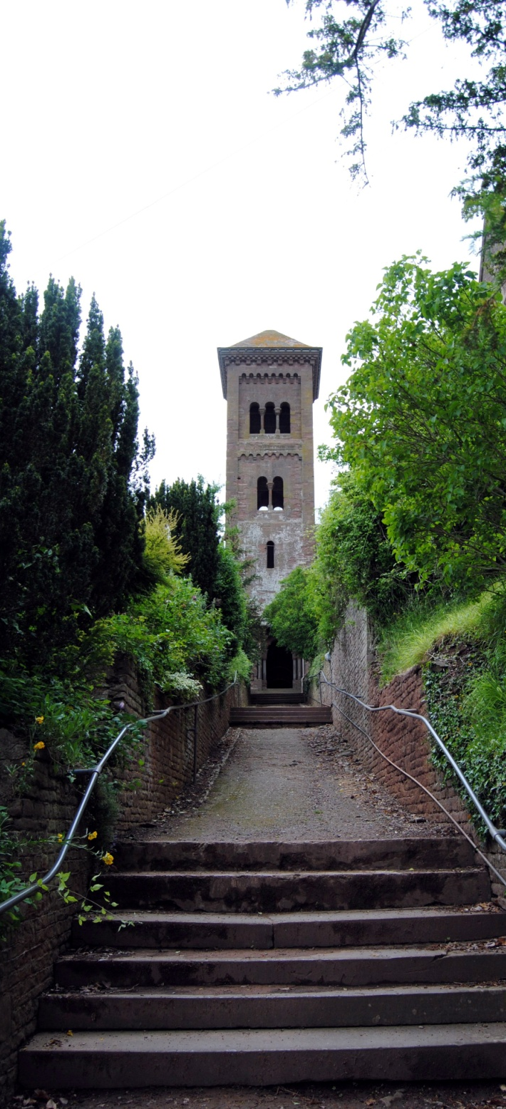
Project Viability Grants
Diagnose problems affecting the church to identify a suitable solution (e.g. HAR category C churches – slow decay, no solution found)
An assessment of the viability of new facilities, sustainability models, or new services ahead of a potential application to key funders
Enable churches to explore the evidence of need for a suggested use, or uses, for their church and the sustainability of that use
Churches will need to produce a project viability report following the format recommended by either the Architectural Heritage Fund or the Heritage Lottery Fund
Grants of up to £3,000, with a 50% match funding requirement.

Slide 6
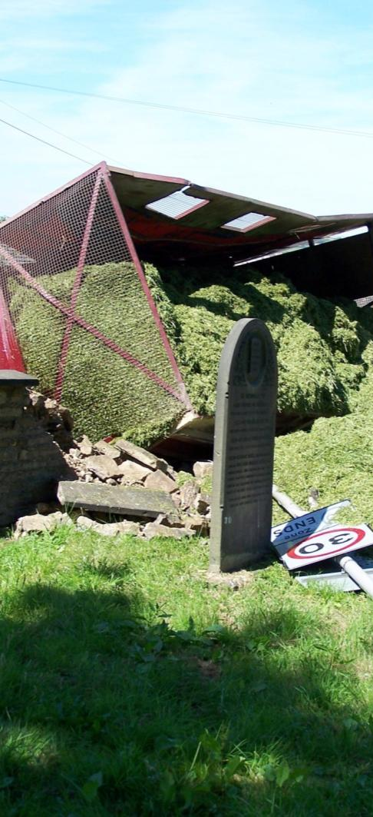
Project Development Grants
Funding for preparing the detailed application documents required by large funders such as the Heritage Lottery Fund
Business planning to build on the viability appraisal
Condition surveys, costings and architectural plans to RIBA Stage 1
Outline activity plan
A Project Manager
Grants of between £3,000-£10,000, with a 50% match funding requirement.

Slide 7
Pilot launch
Programme opened 1 June, deadline 12 September, decisions notified December 2016
Budget of £60,000
Anticipate awarding 10 grants
Applications are welcome from any Christian place of worship in the United Kingdom.
Assessments
When we assess your application, we will consider the following:
Why is an NCT grant required?
Is the project well planned?
Is the project financially realistic?
Will the capital project be sustainable?
How urgent is the project?
Once you’ve done it, you can do it again and again!

Slide 8
For more information:
Nigel Mills
Grants and Development Officer
07702812406
nigel.mills@nationalchurchestrust.org
www.nationalchurchestrust.org
Registered Charity Number: 1119845

