Slide 1
Defining the Project Vision and Planning and Organising for the Job Ahead

Slide 2
St Michael’s Byker

Slide 3
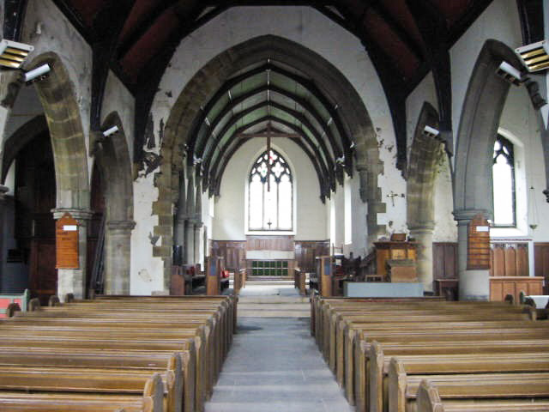

Slide 4
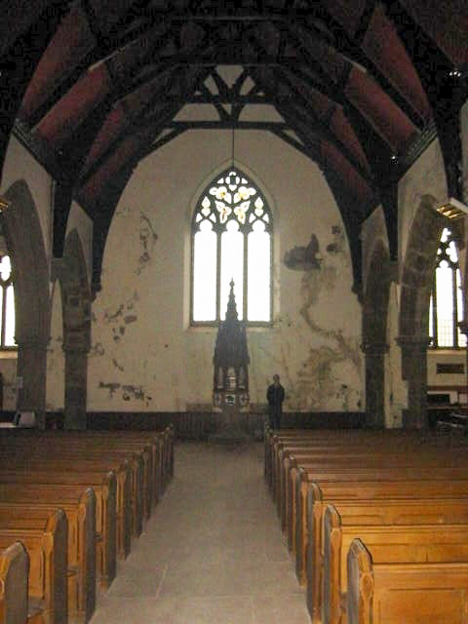

Slide 5
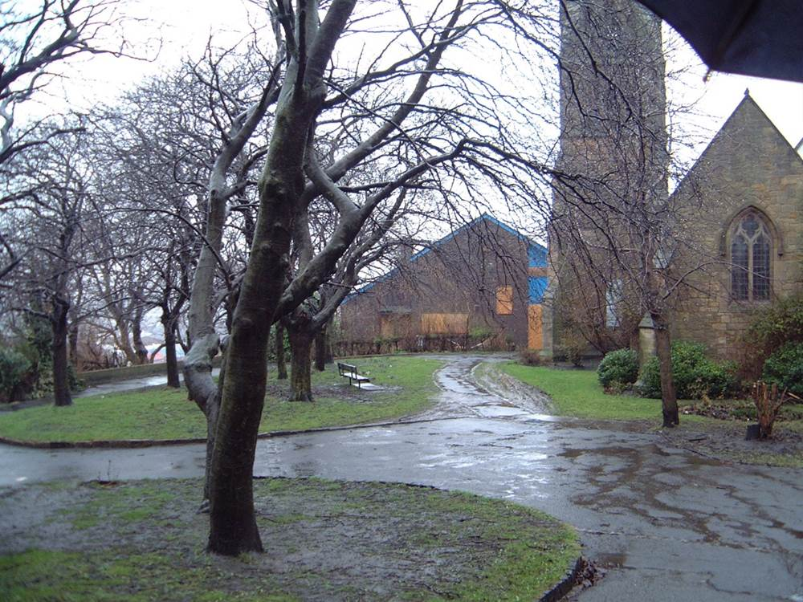

Slide 6
WHAT DO YOU DO?

Slide 7
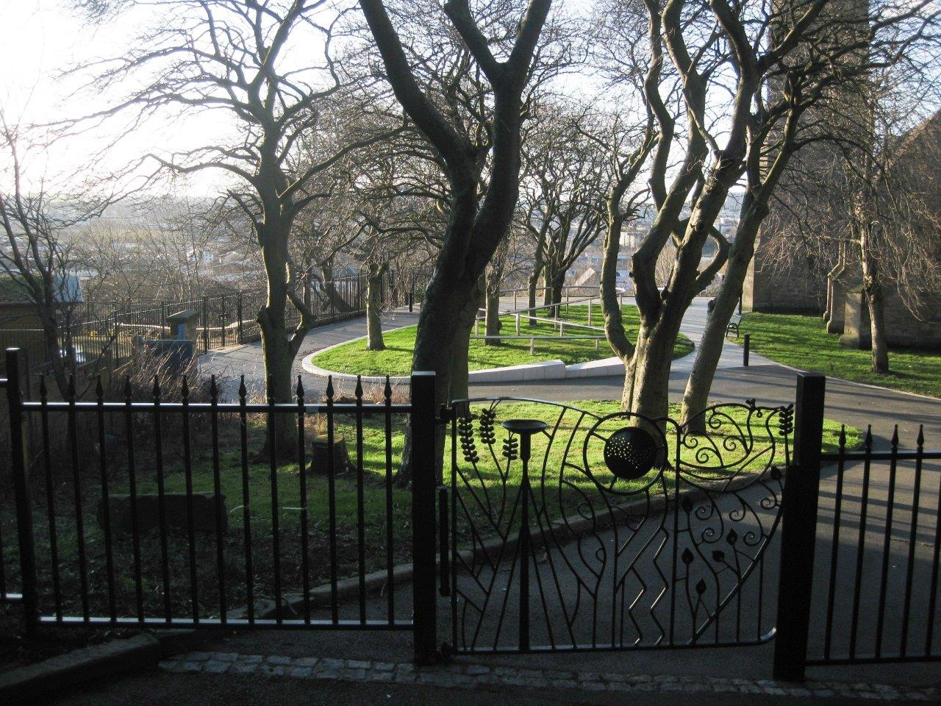

Slide 8
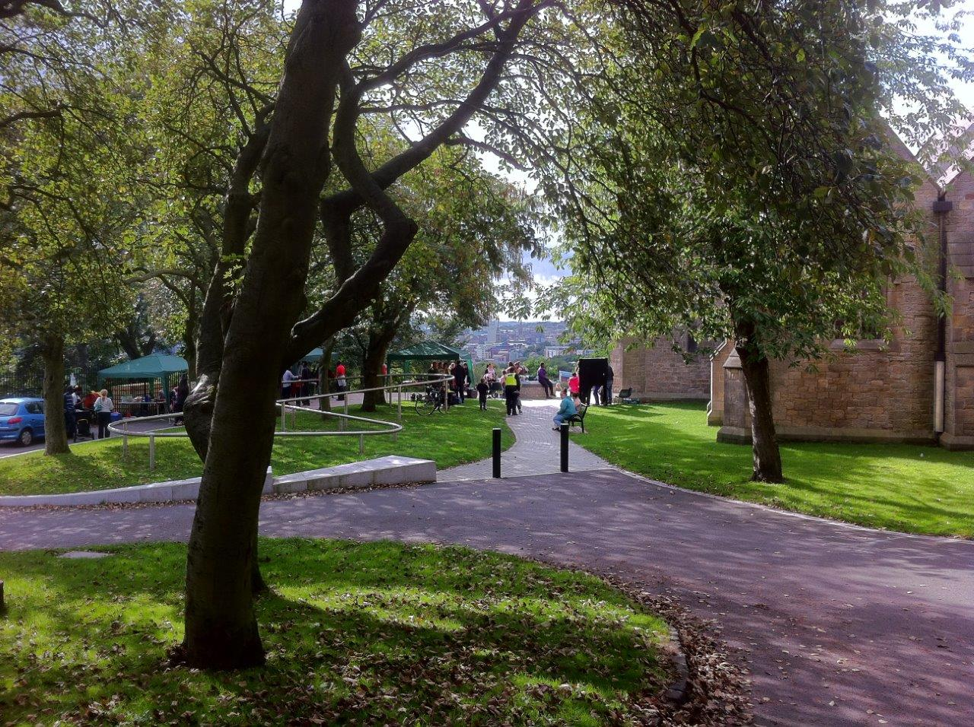

Slide 9
St Martin’s Monkchester

Slide 10
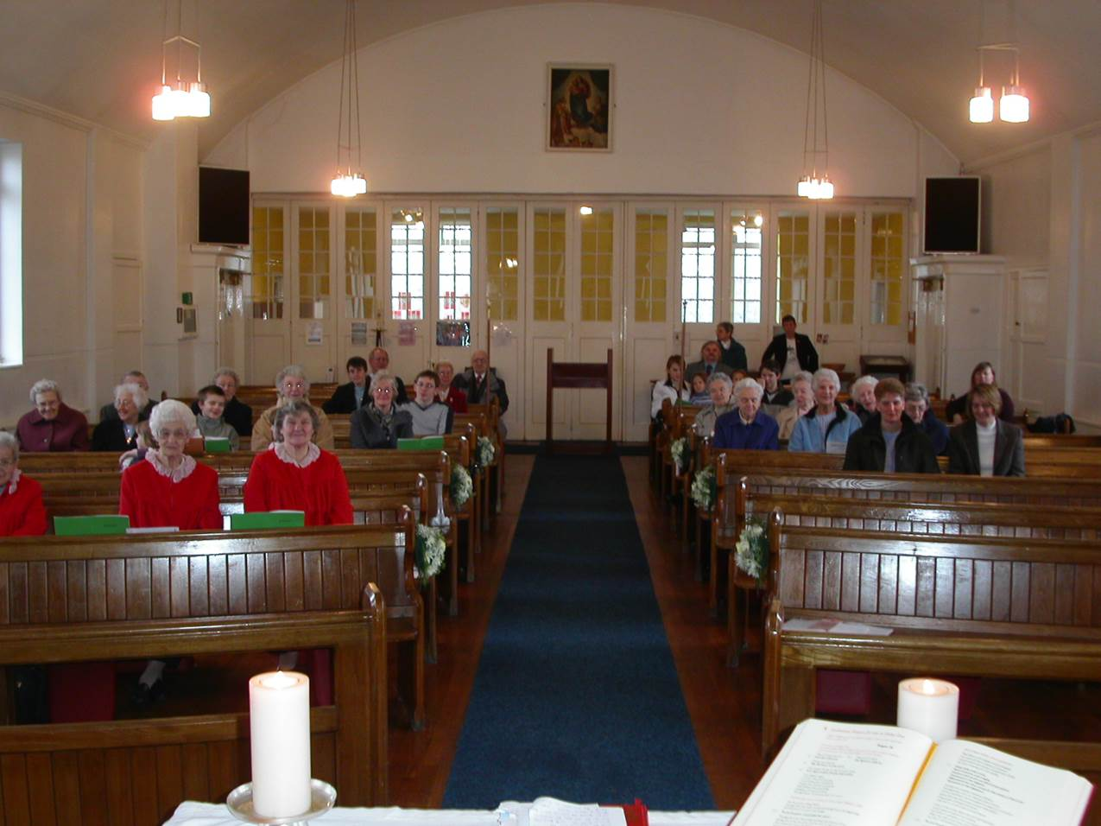

Slide 11
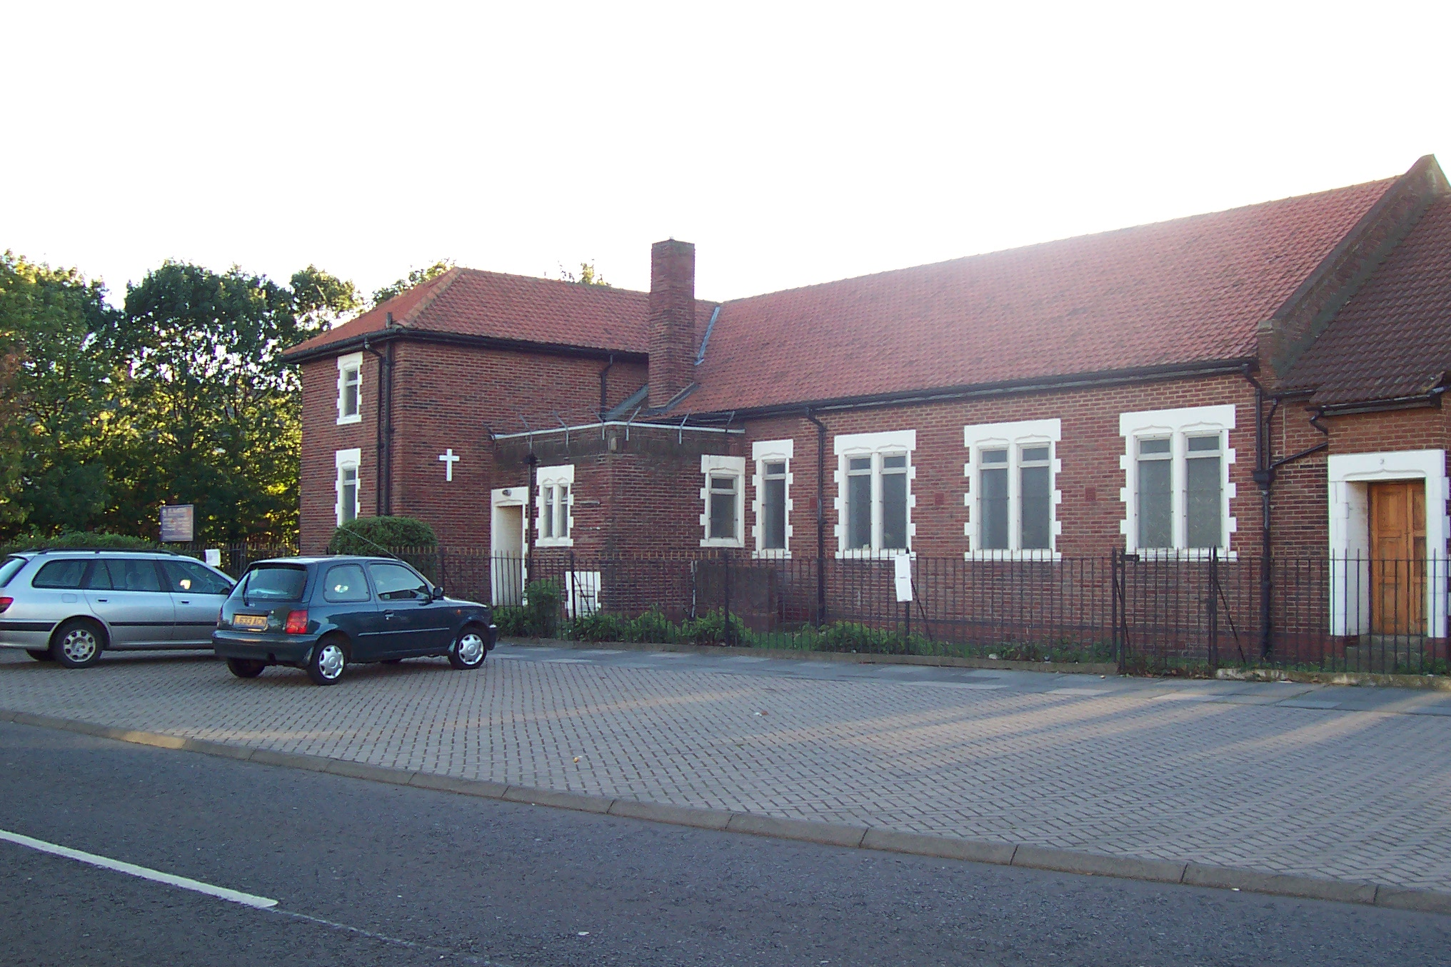

Slide 12
WHAT DO YOU DO?

Slide 13
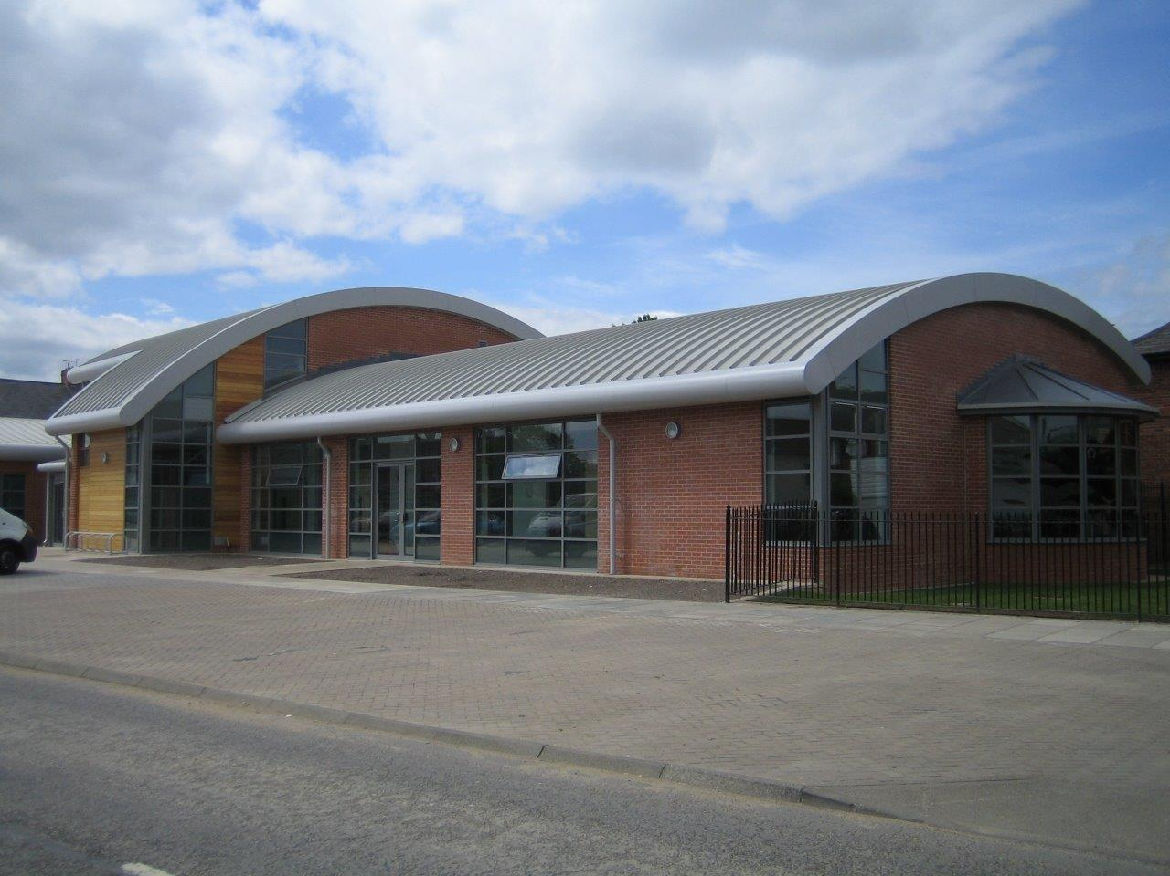

Slide 14
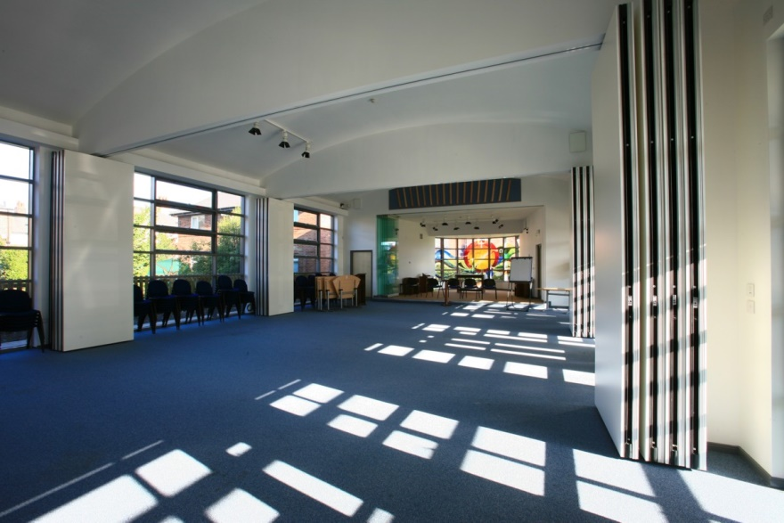

Slide 15
St James’ West Hampstead

Slide 16
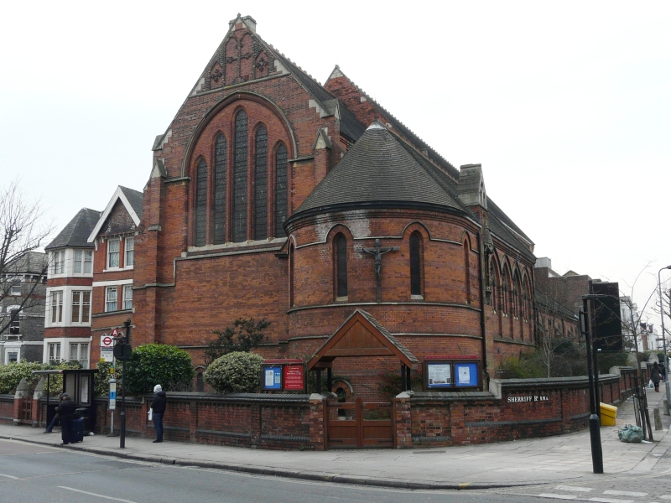

Slide 17
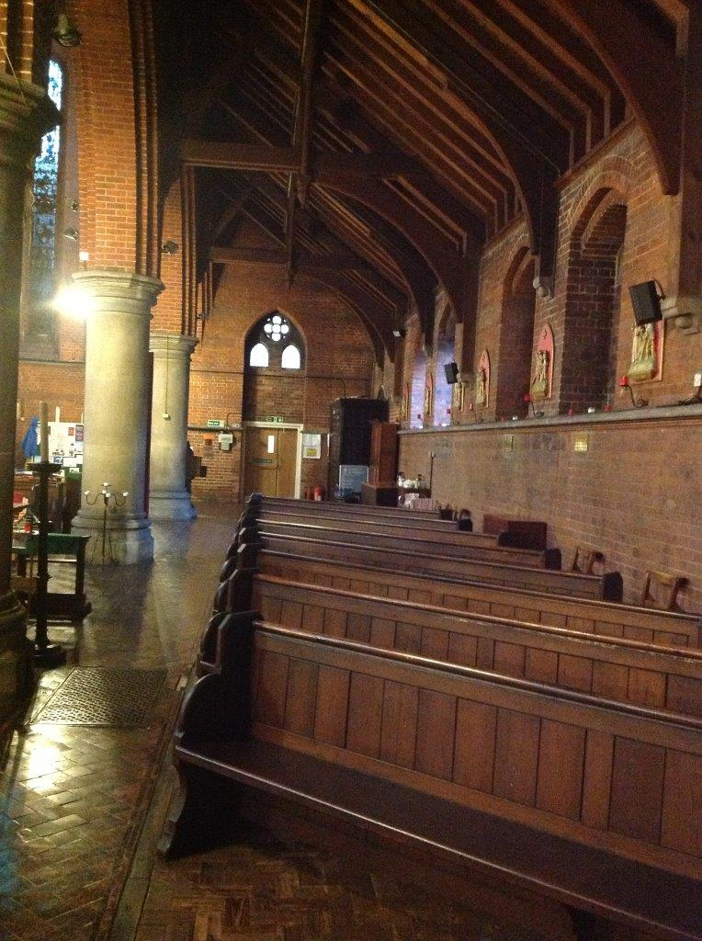

Slide 18
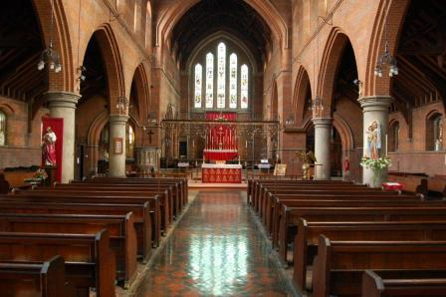

Slide 19
WHAT DO YOU DO?

Slide 20
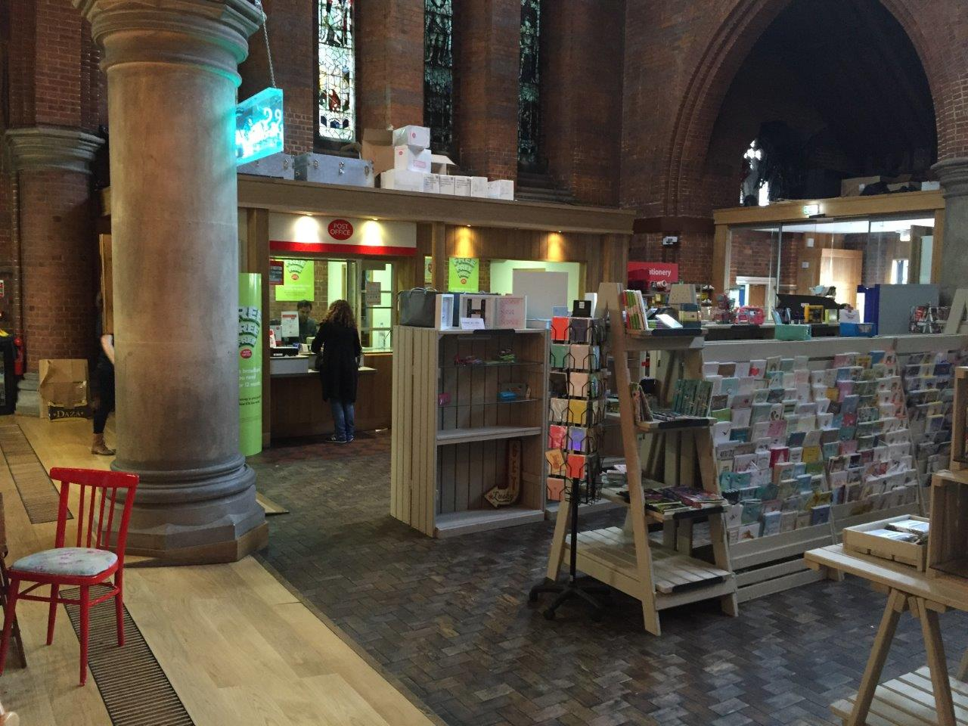

Slide 21
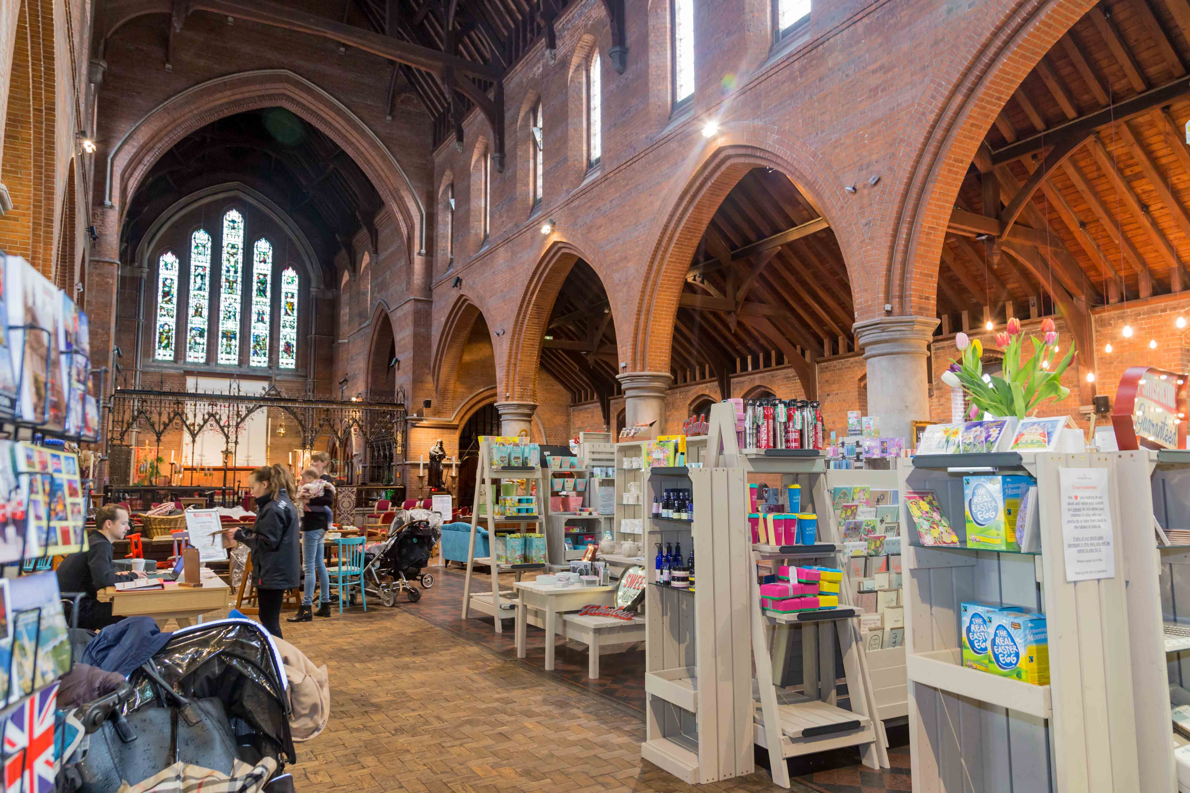

Slide 22
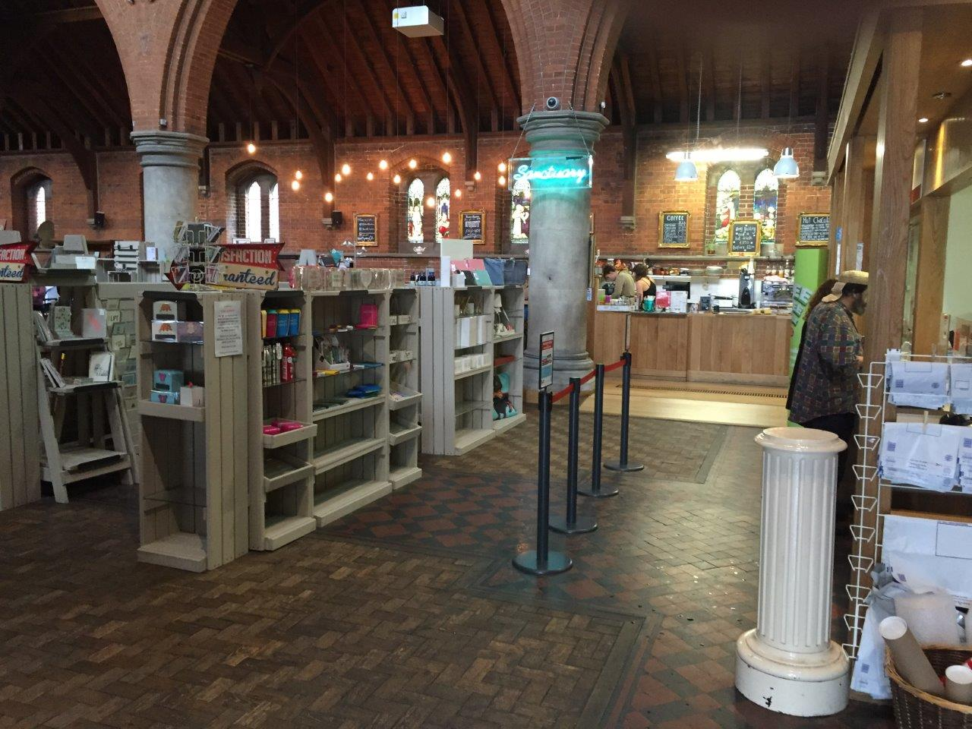

Slide 23
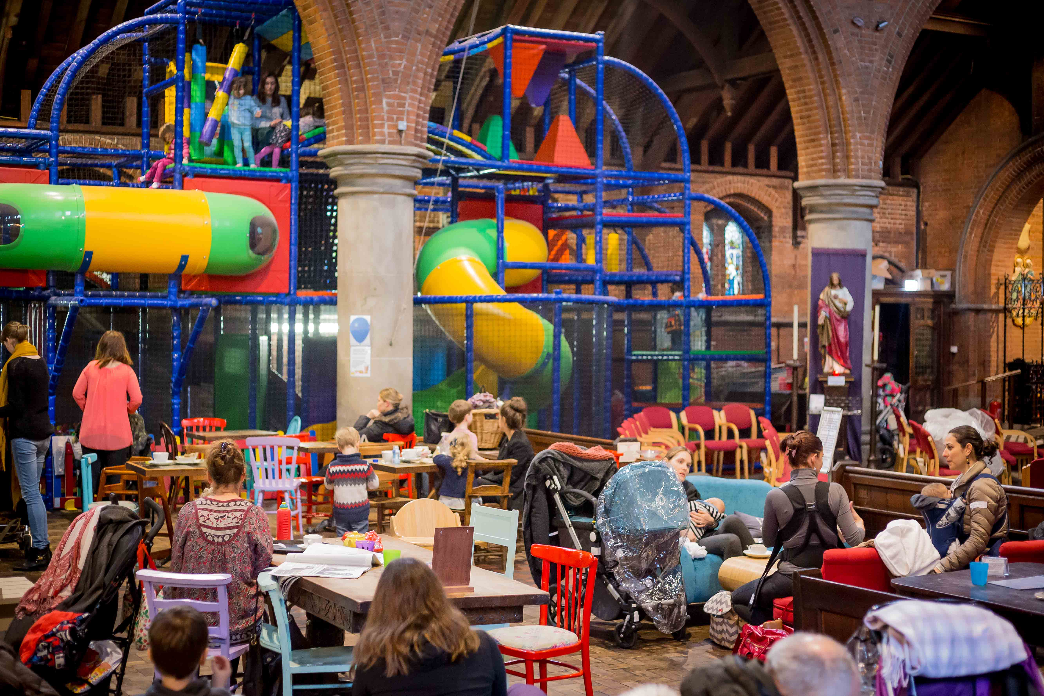

Slide 24
What do you do?
What is God calling you to be and to do?

Slide 25
Where do you start?
What are we for?
What could we become?
What do we need to become it?
What gets in the way of becoming it?

Slide 26
In the light of all that ….
How do you decide what to do?
Think creatively and ‘out of the box’.
What opportunities are there?
Don’t be possessive.
Who could you work in partnership with?
What is your building’s vocation?
How can it be used to make a real difference, as well as contributing to God’s work of bringing about his Kingdom of health and wholeness, peace and generosity, love, beauty and justice?

Slide 27
BUT … some major questions:
Why do you want to do it?
Who are you planning to do it for?
Who wants the things you are suggesting?
How do you know that’s what people are looking for?
Who’s going to do it?
Who is going to be the DRIVER?!

