Slide 1
CHRIS COTTON
PARTNER
PURCELL

Slide 2
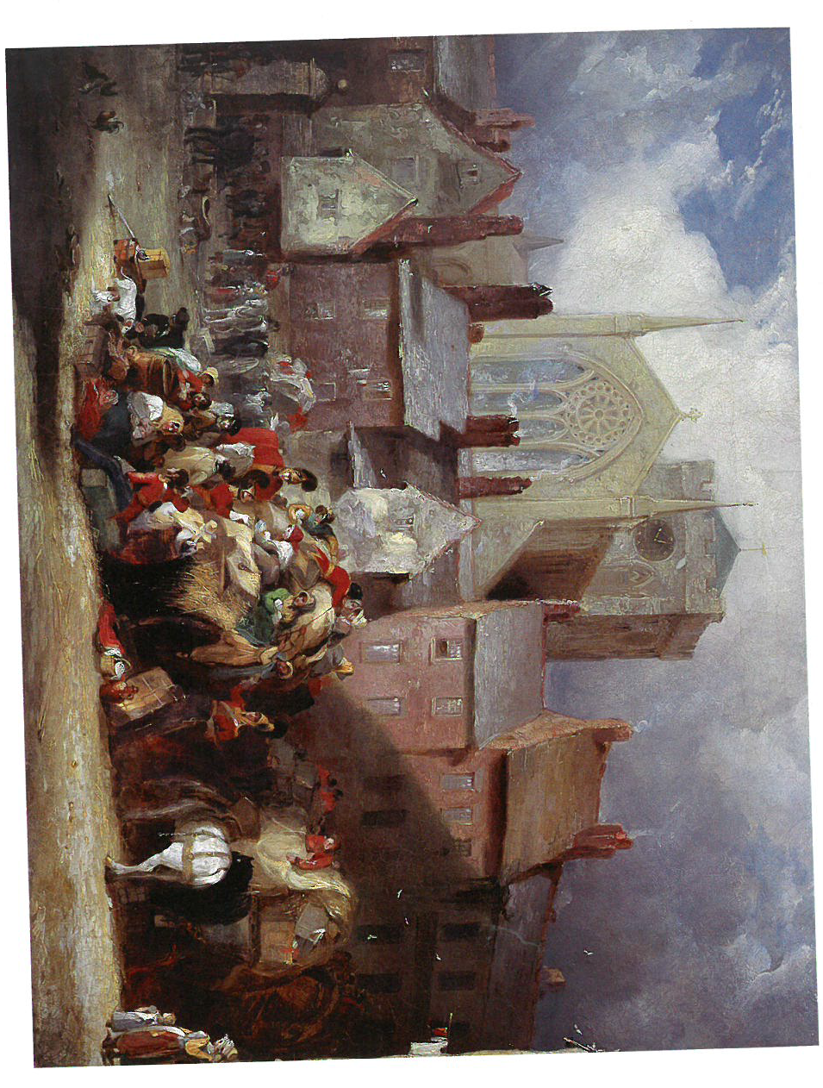
HEXHAM ABBEY PROJECT
Case Study
CHRISTOPHER COTTON RIBA AABC
Abbey Architect, HEXHAM
PURCELL: ARCHITECTS, HERITAGE CONSULTANTS

Slide 3
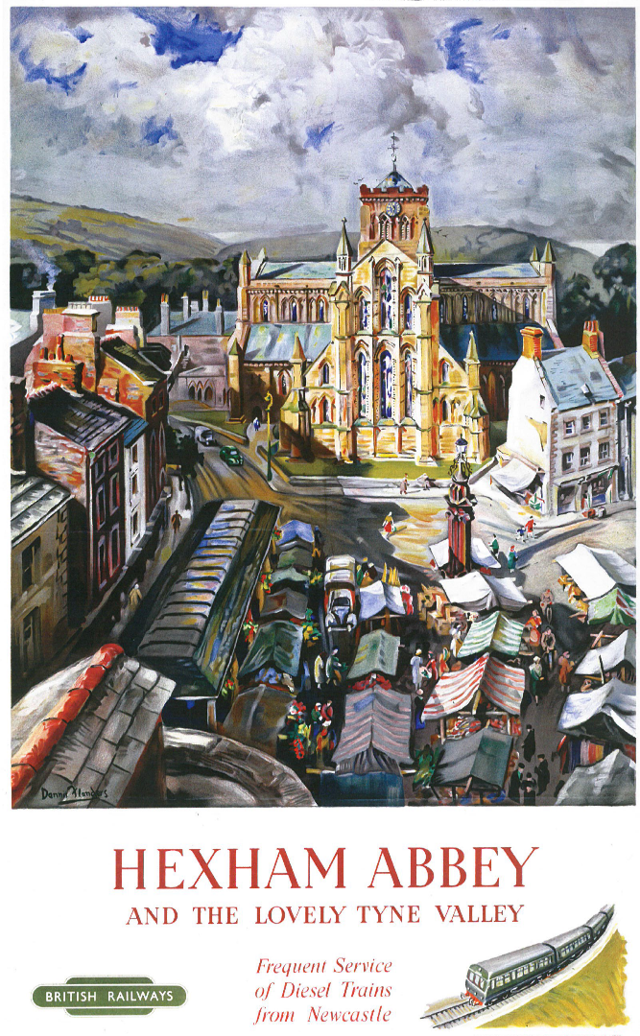
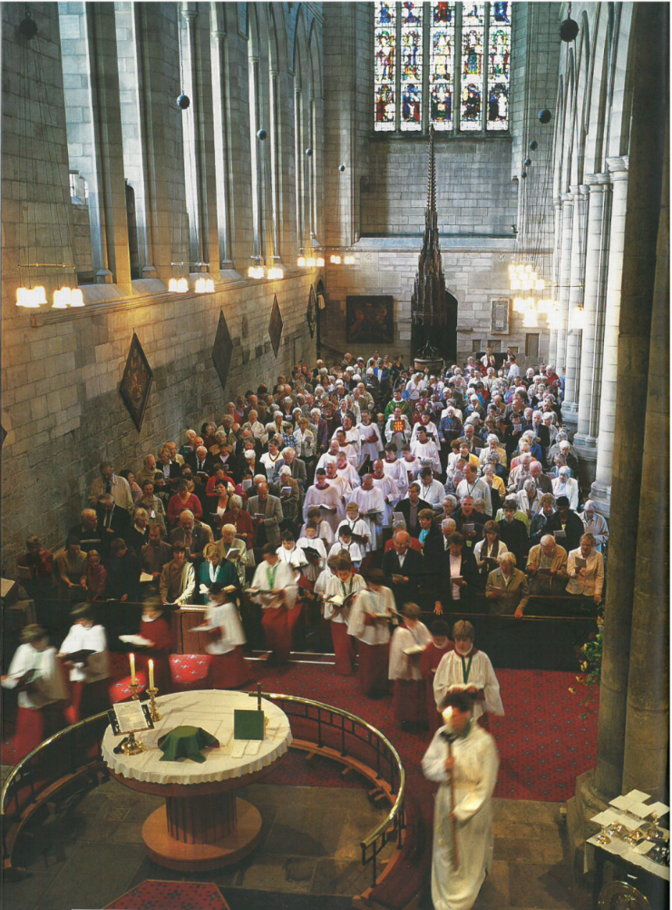
Hexham Abbey:
a Parish Church
a Place of Worship Prayer & Mission
a Community
Heritage, Culture & Tourism
the Heart of the Town
Project Objective:
To Support the Life and
Mission of the Church

Slide 4
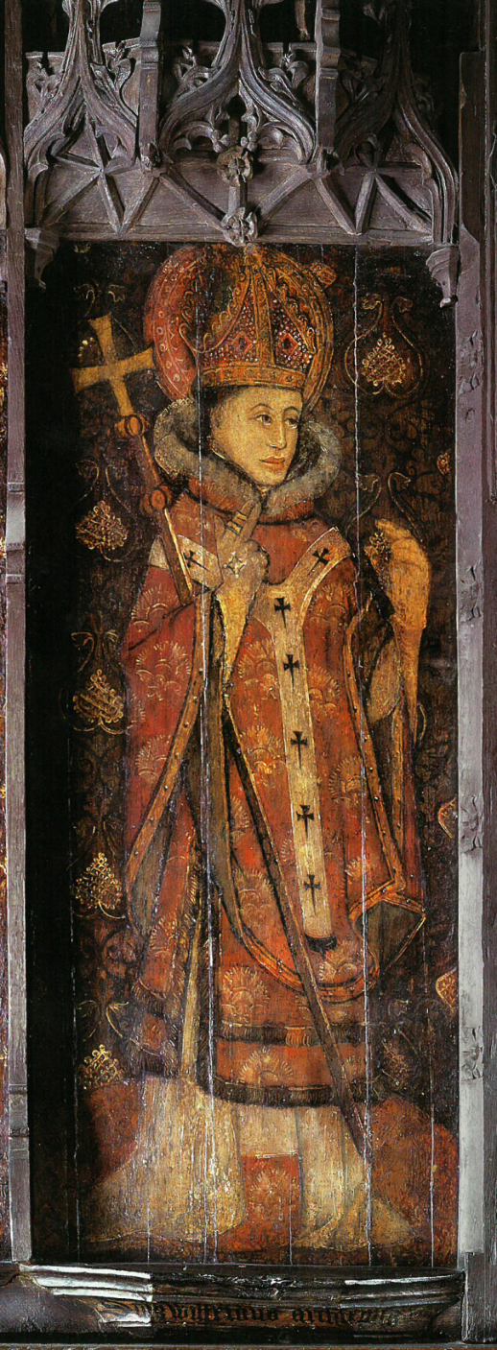
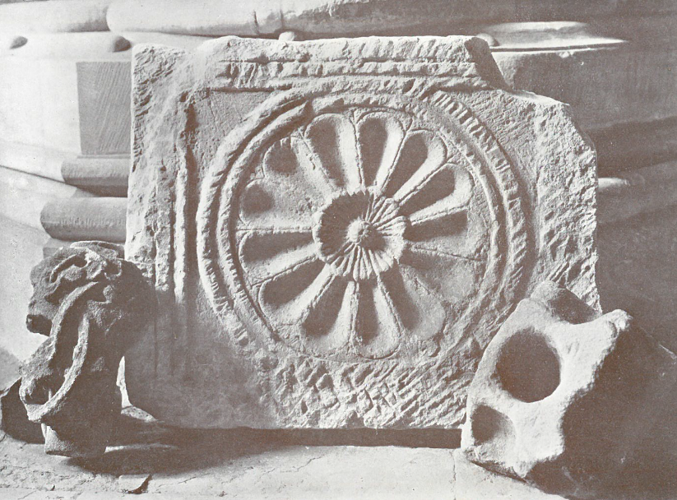
What is the Story of the Abbey Buildings:
St Wilfred’s Roman Saxon Church c.674
The Augustinian Priory c.1113
Prior Rowland Leschman c.1470-90
The Dissolution of the Priory c. 1537-8, the Pilgrimage of Grace & the last Prior Jay
Sir Reginald Carnaby c.1516-43
Diana Beaumont c. 1765-1831
Rev E. Sidney Savage and Temple Moore c.1908
21st century restoration and renewal

Slide 6
OPPORTUNITY AND OUTCOMES:
Heritage, People and Communities
The BRIEF
Education, Communities, Interpretation & Display, Welcome & Hospitality, Accessibility, Ancillary Support,
Activities Programme
Sustainability

Slide 7
COLLABORATION
The Abbey Team, The Abbey Community, The Town Community, Funding Bodies and Donors, DAC, Conservation Officers, Historic England, the Archaeologist, the Heritage Lottery Fund, Heritage Consultant, Construction Consultants.
Conservation Architect
Understanding, significance, archaeological investigation, capacity for change, condition,
Funding, Statutory Protection and Control

Slide 8
BESPOKE DESIGN PHILOSOPHY
Conserve the fabric and enhance the significance
Create spaces that reveal the heritage of the buildings
Create sustainable and strategic solutions
Be bold and imaginative!

Slide 9
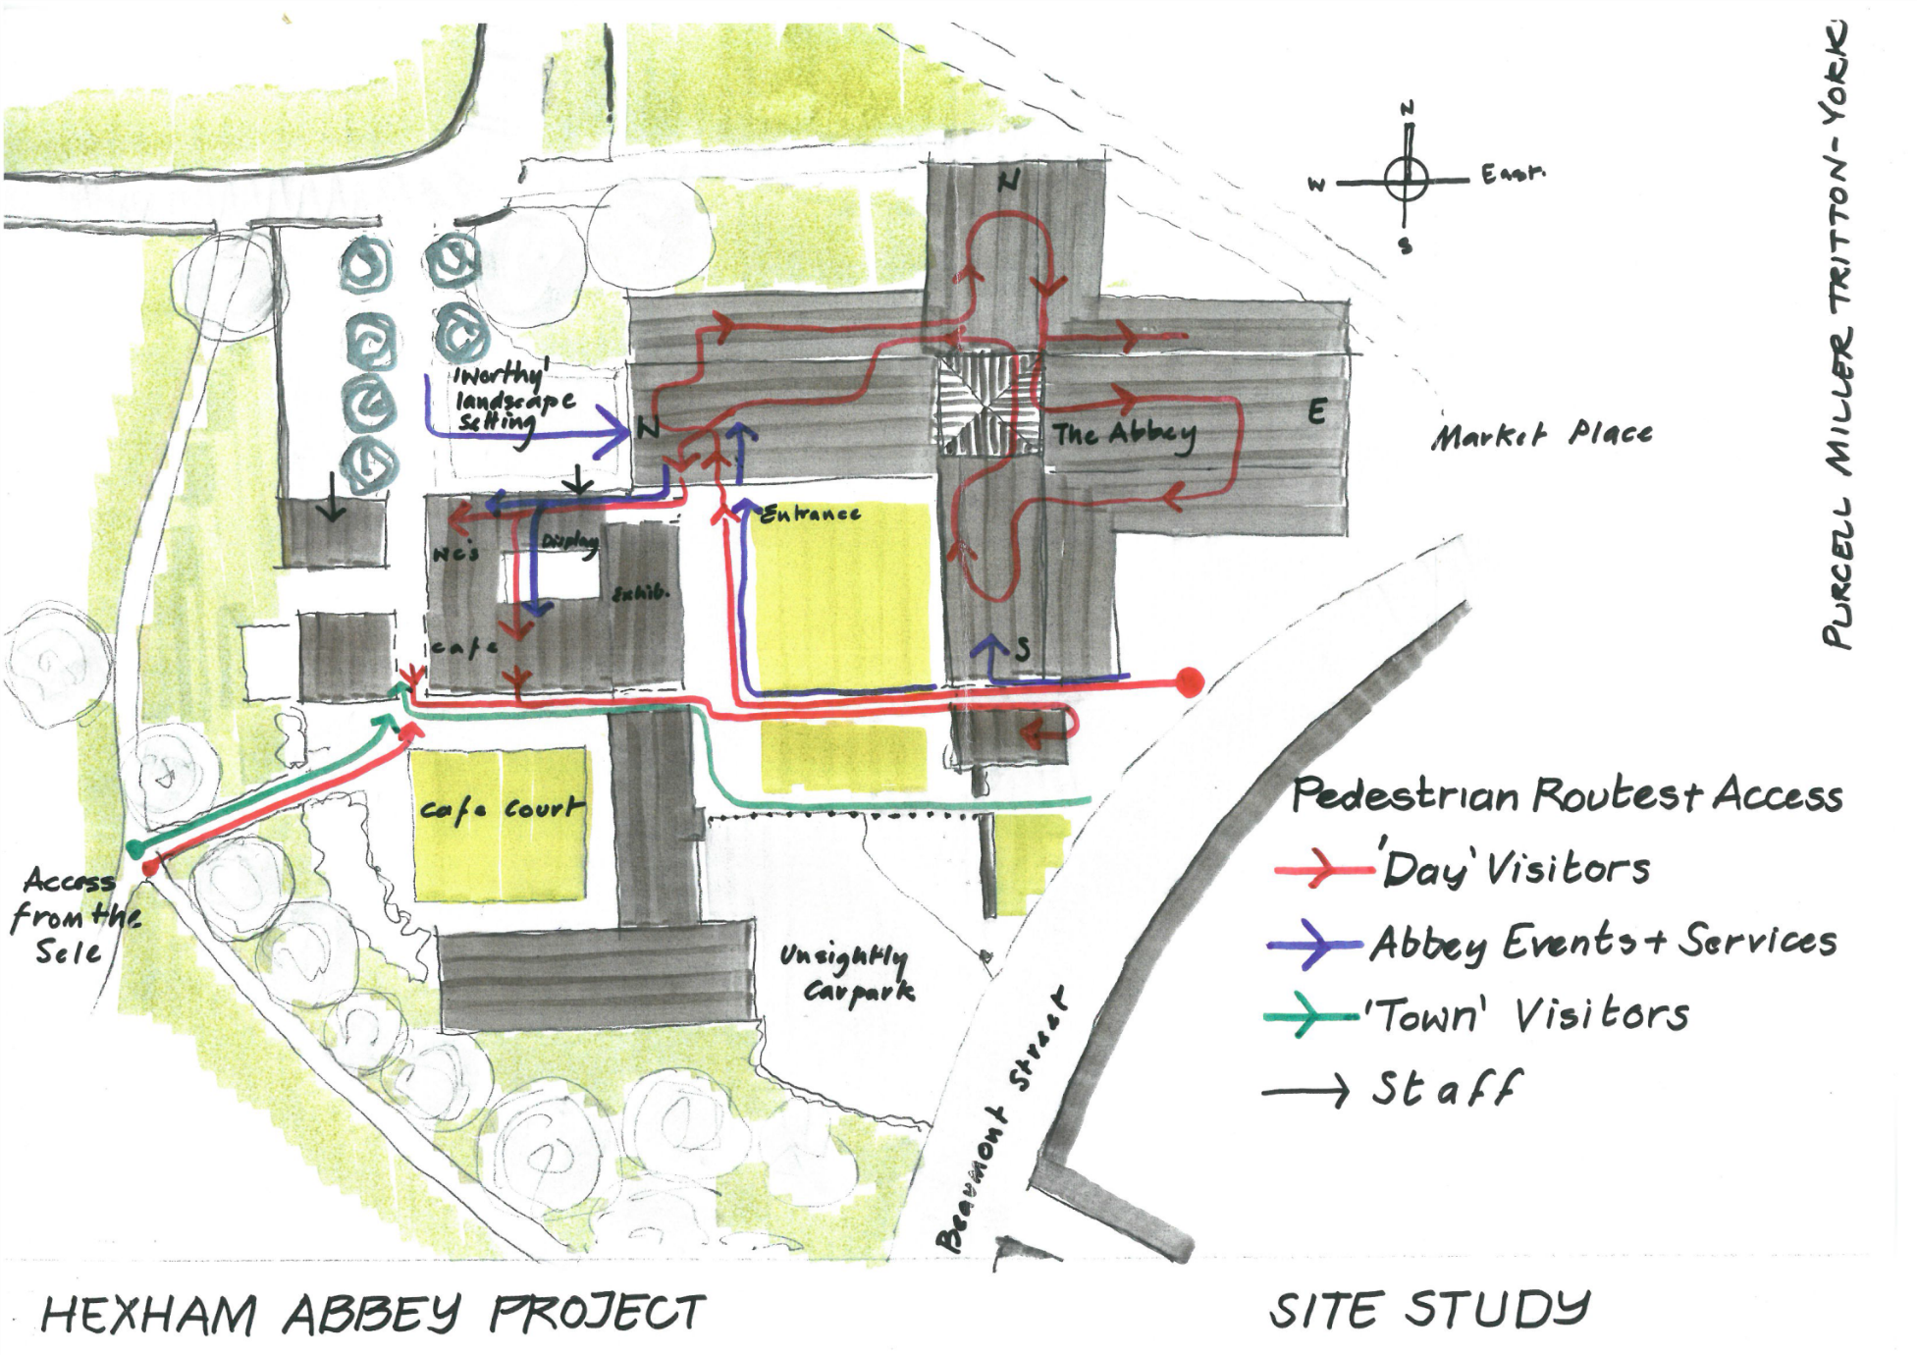

Slide 10
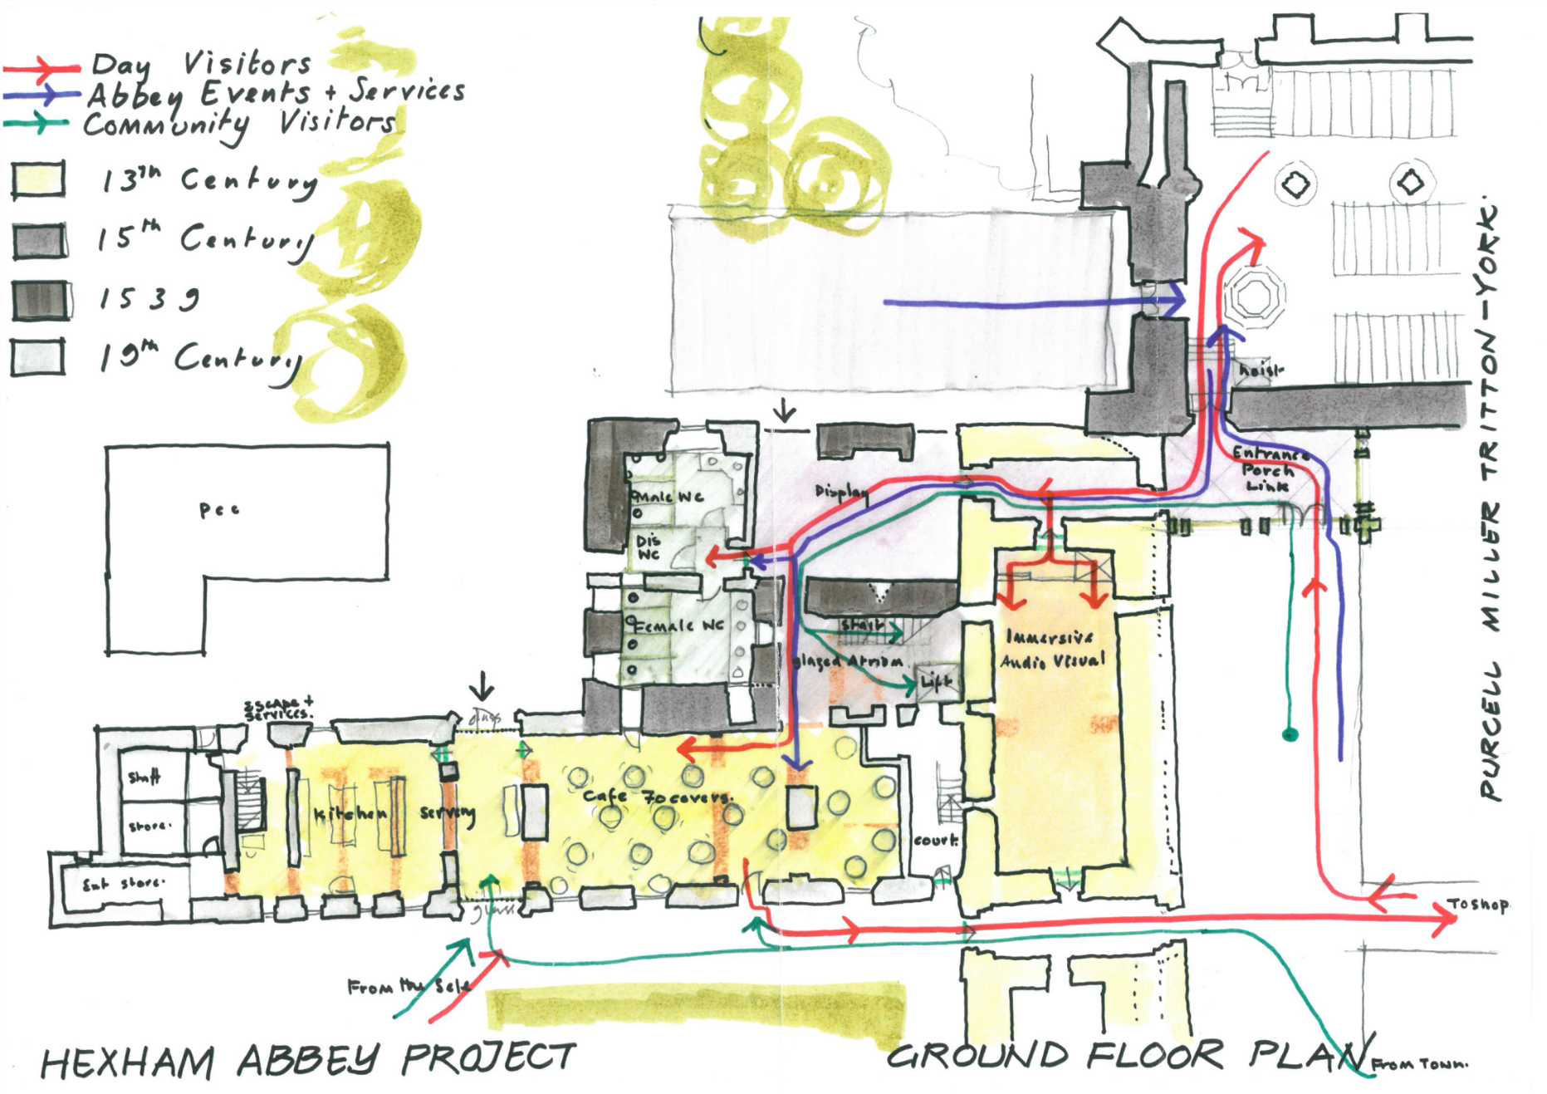

Slide 11
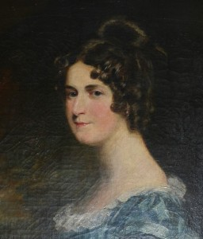
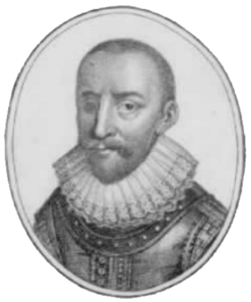
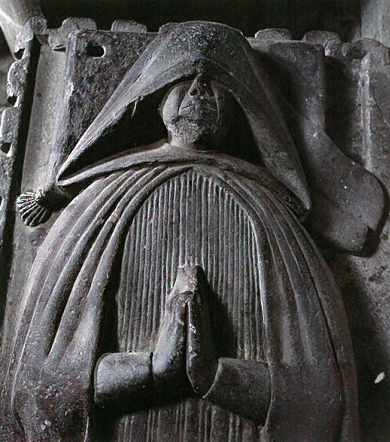
The story is told through the inspirational people who have loved and made these buildings
GREAT PROJECTS NEED CREATIVE AND DETERMINED LEADERSHIP

Slide 12
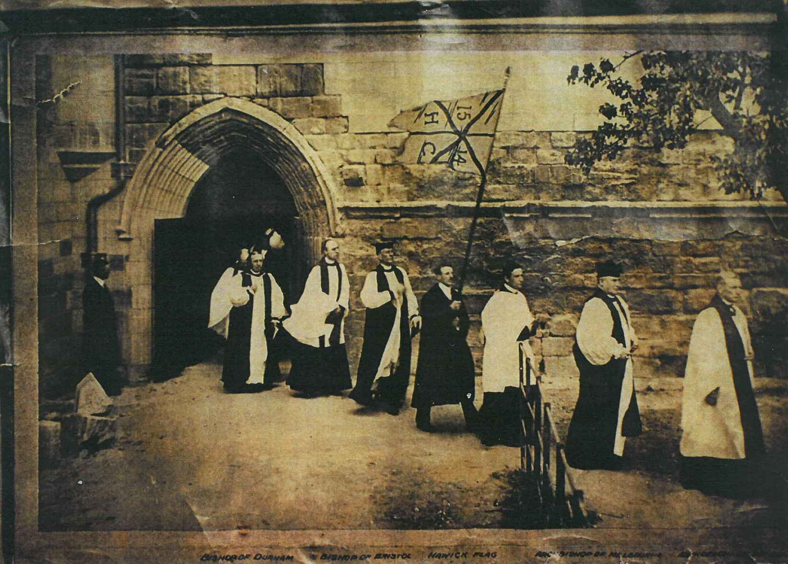
Rev’d E. SIDNEY SAVAGE’S Great Abbey Restoration
Archt. TEMPLE MOORE c.1908

Slide 13
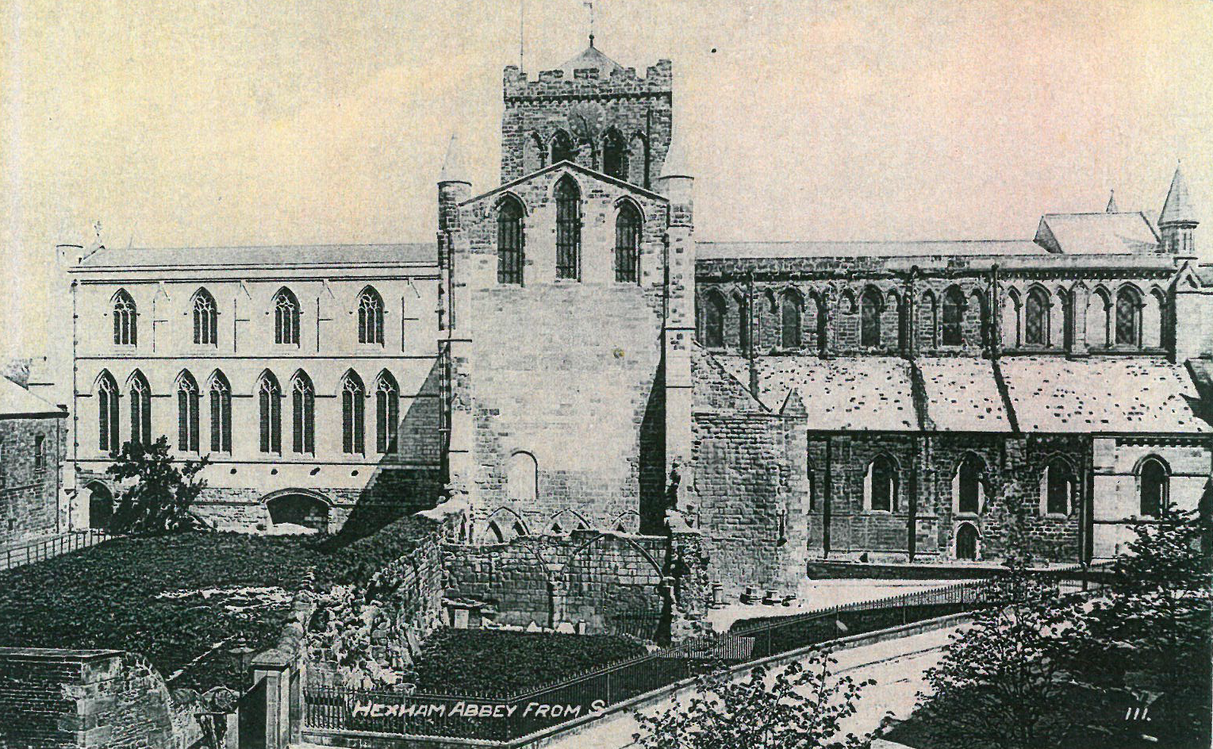

Slide 14
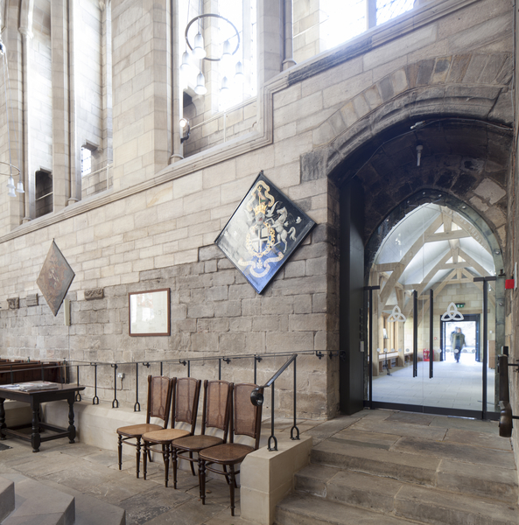

Slide 15
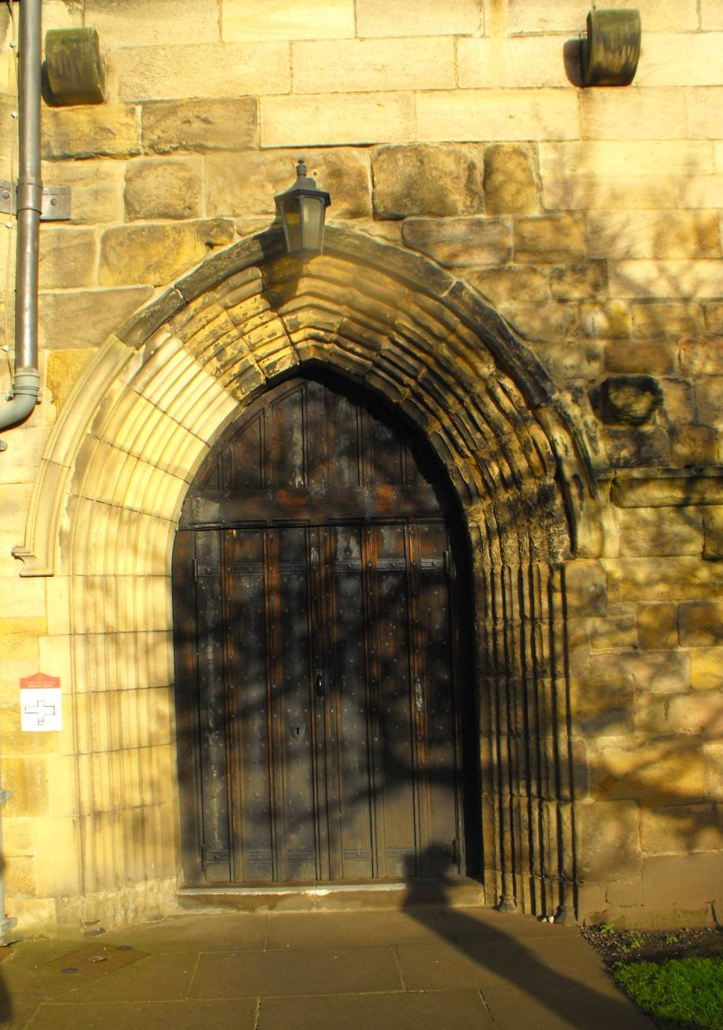
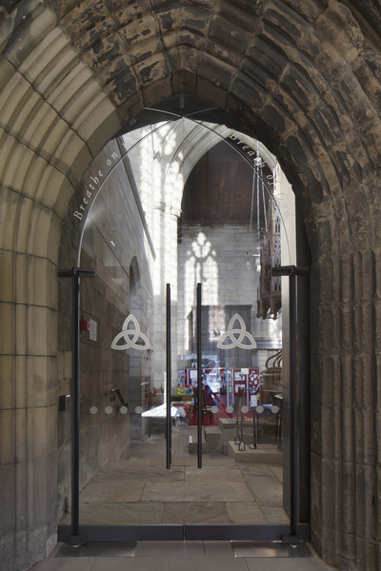

Slide 16
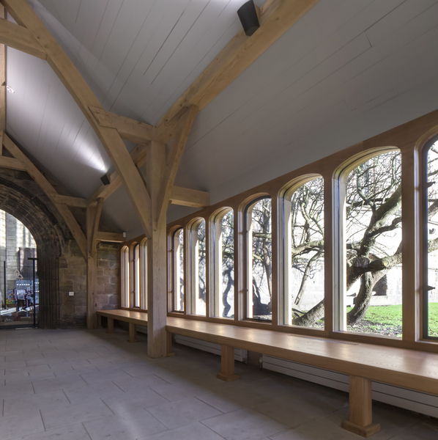

Slide 17
The Great ‘Madame’ DIANA BEAUMONT
ABBEY HOUSE c. 1792-1831 Archt. J Dobson

Slide 18
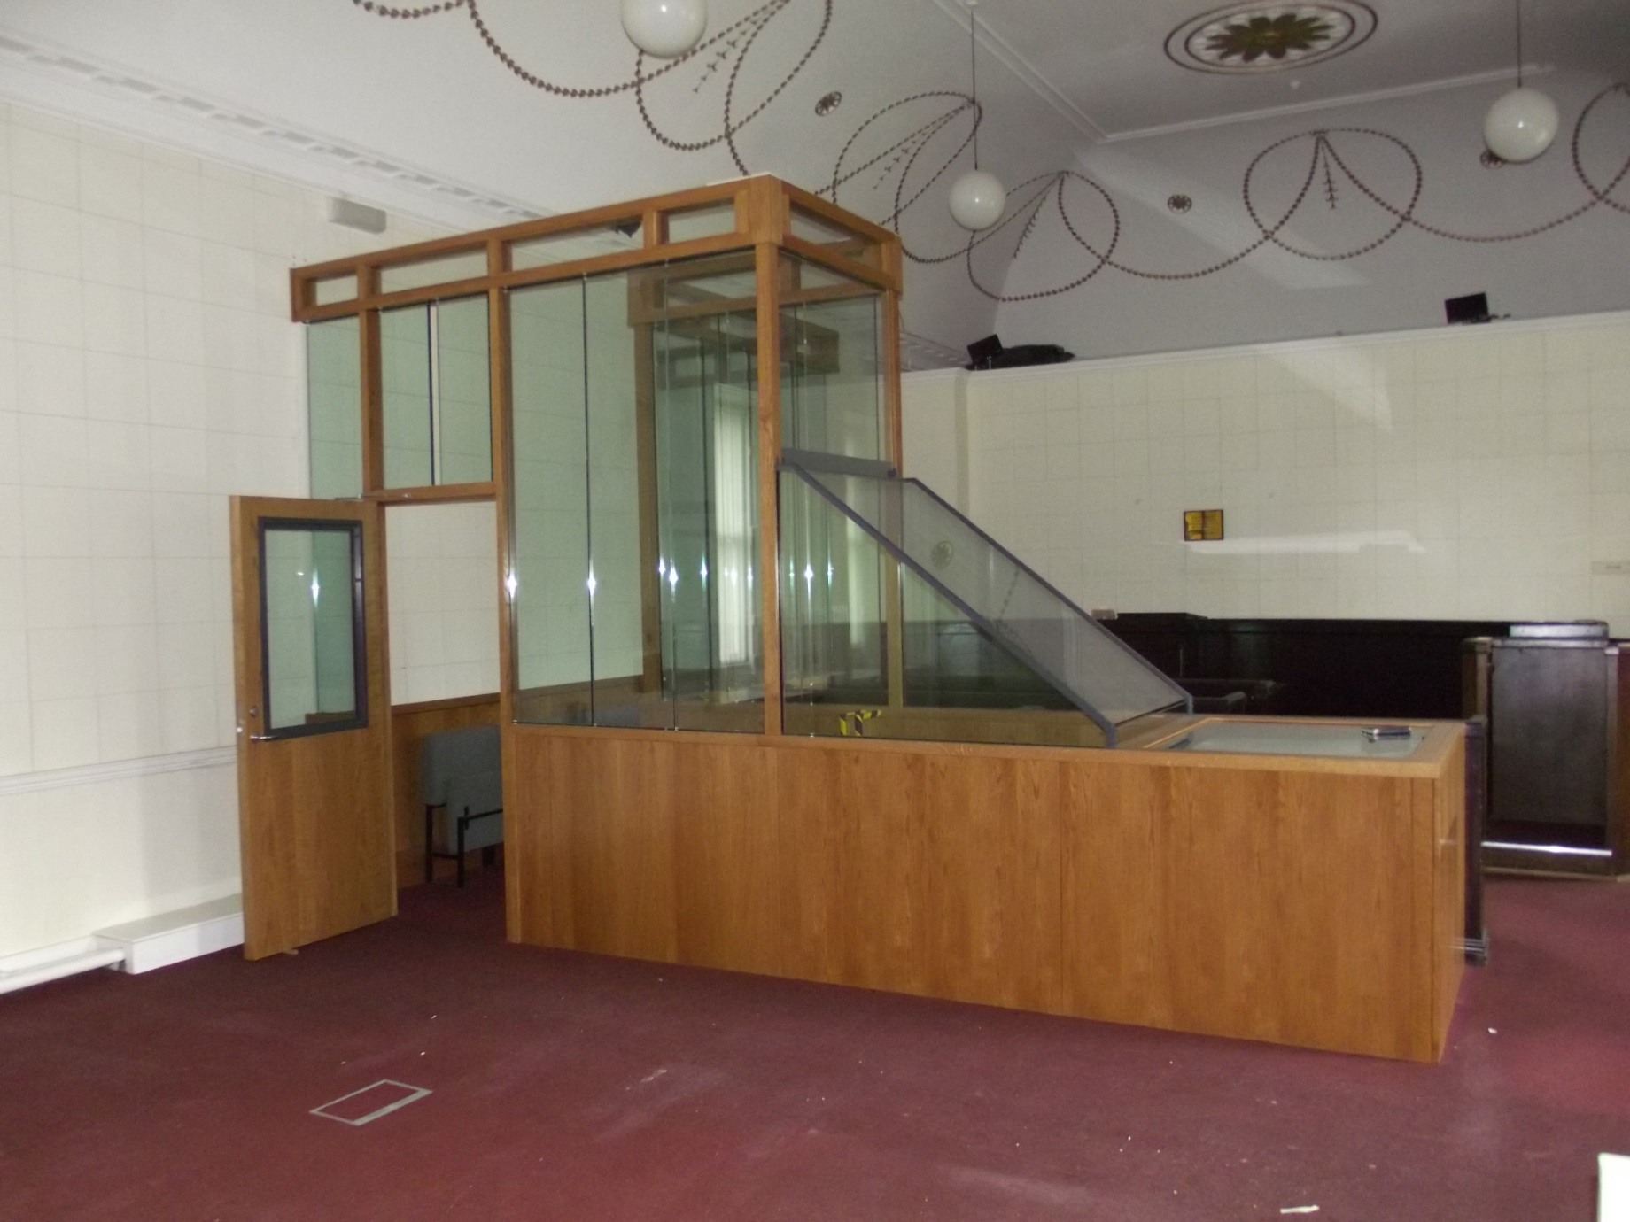

Slide 19
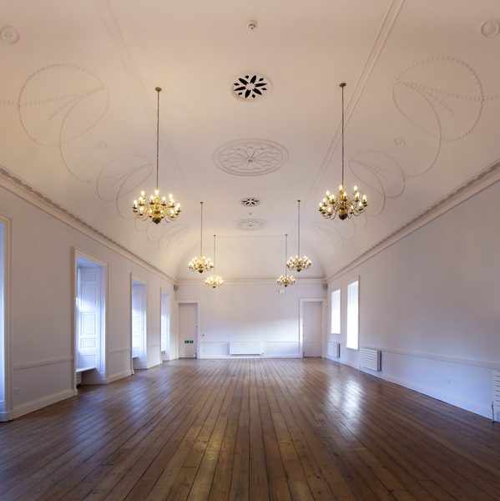

Slide 20
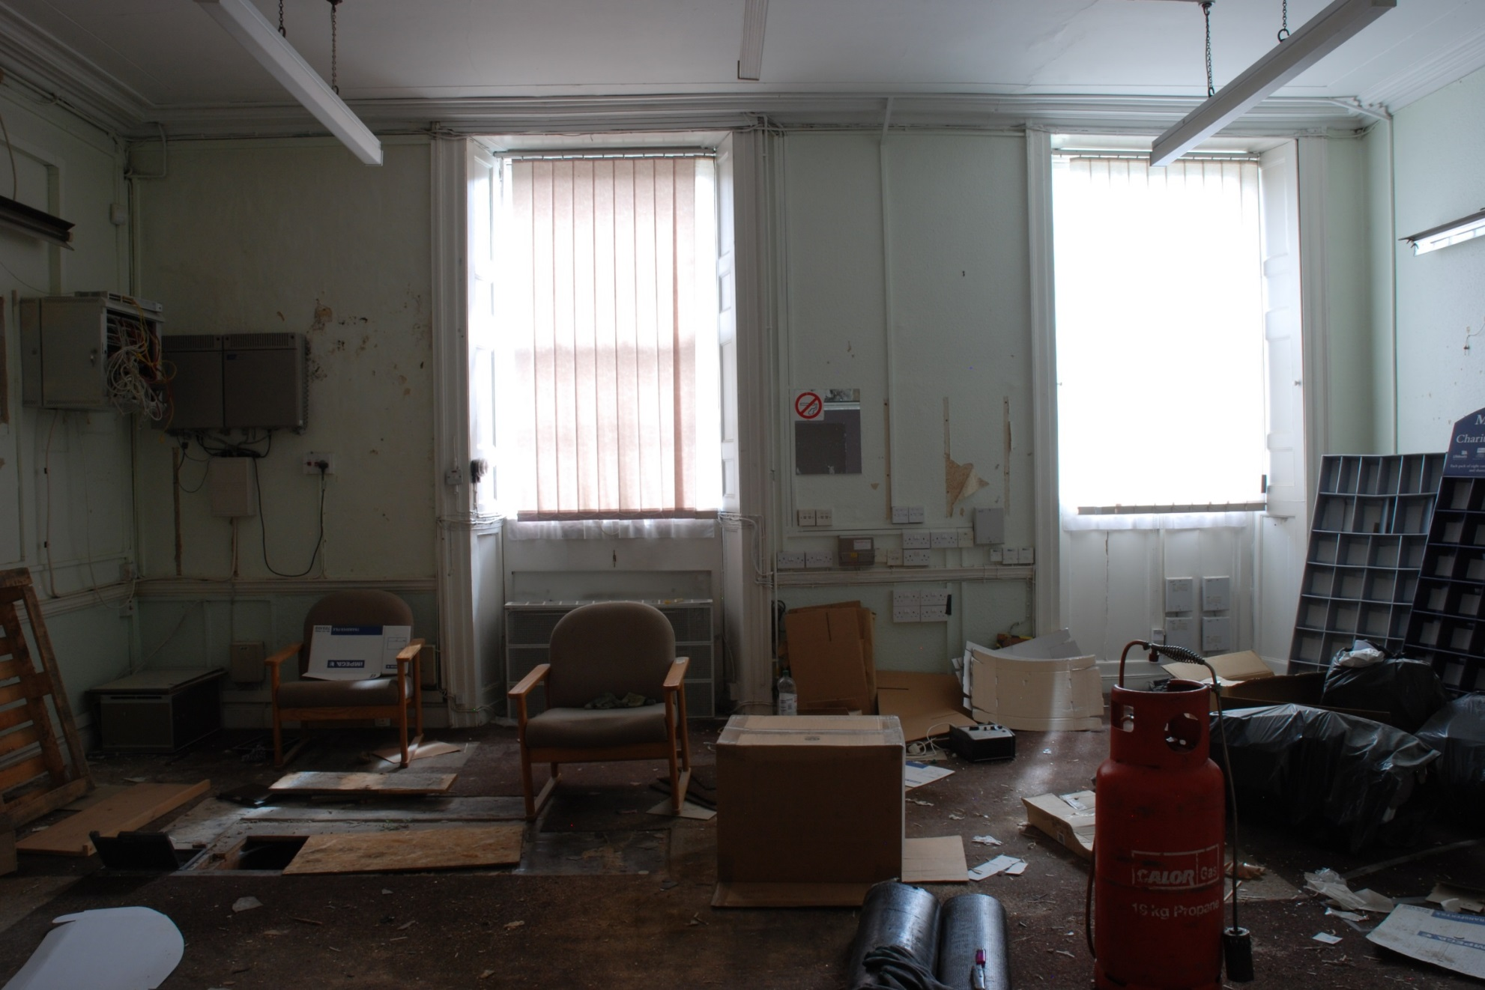

Slide 21
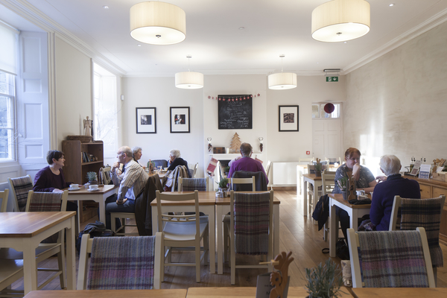

Slide 22
SIR REGINALD CARNABY’S FORTIFIED HOUSE
c. 1539

Slide 23
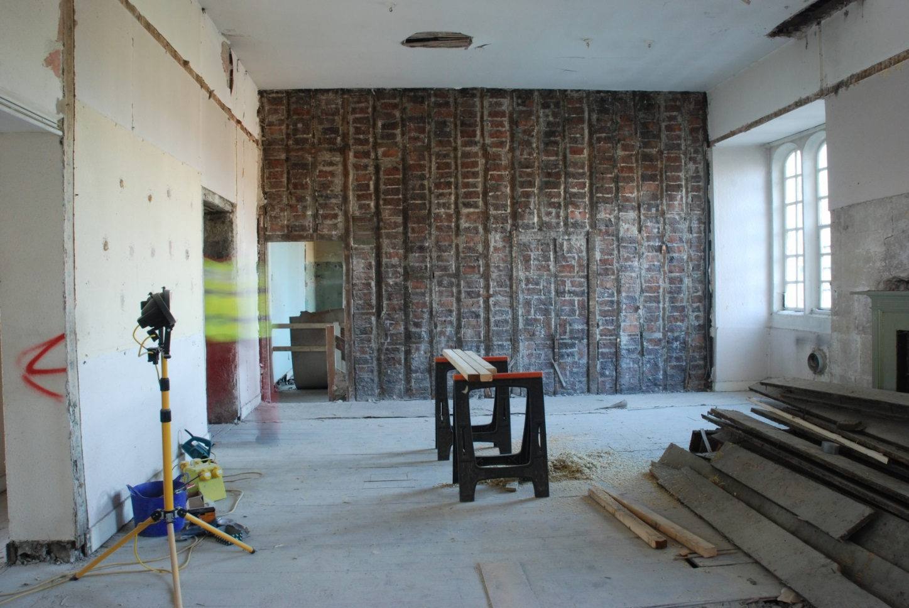
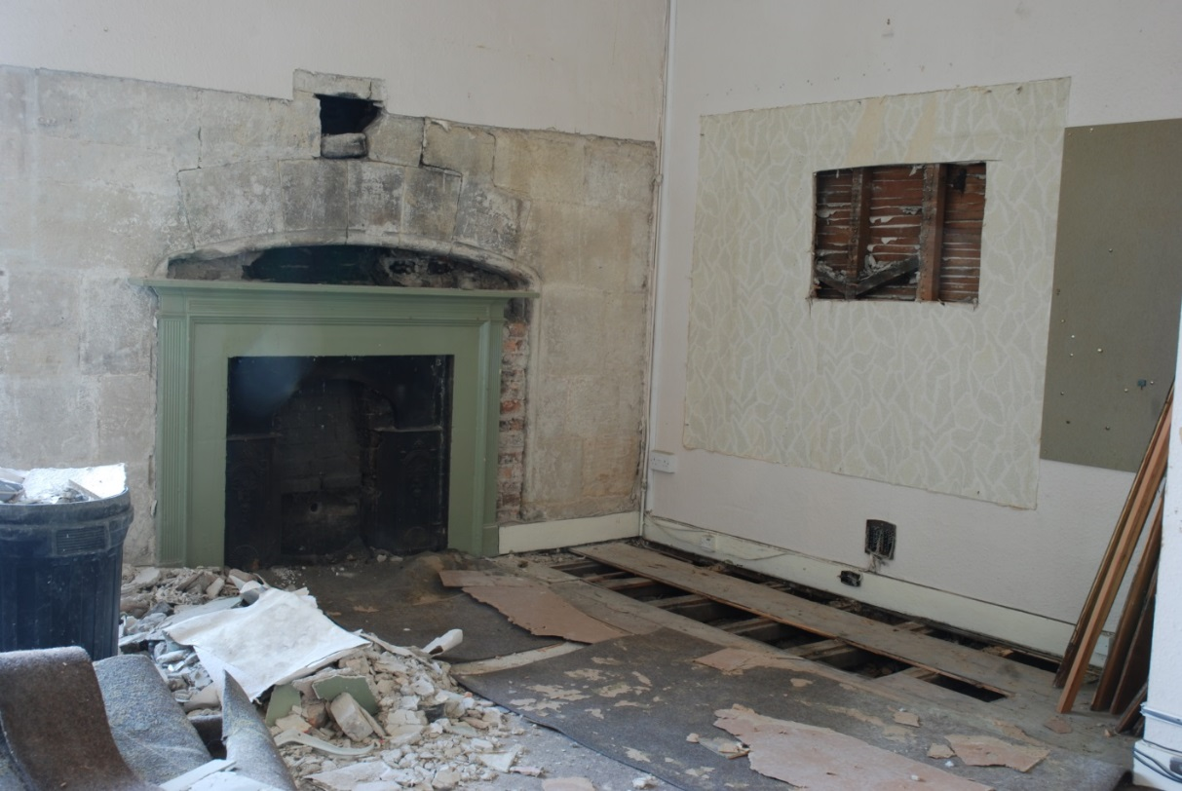

Slide 24
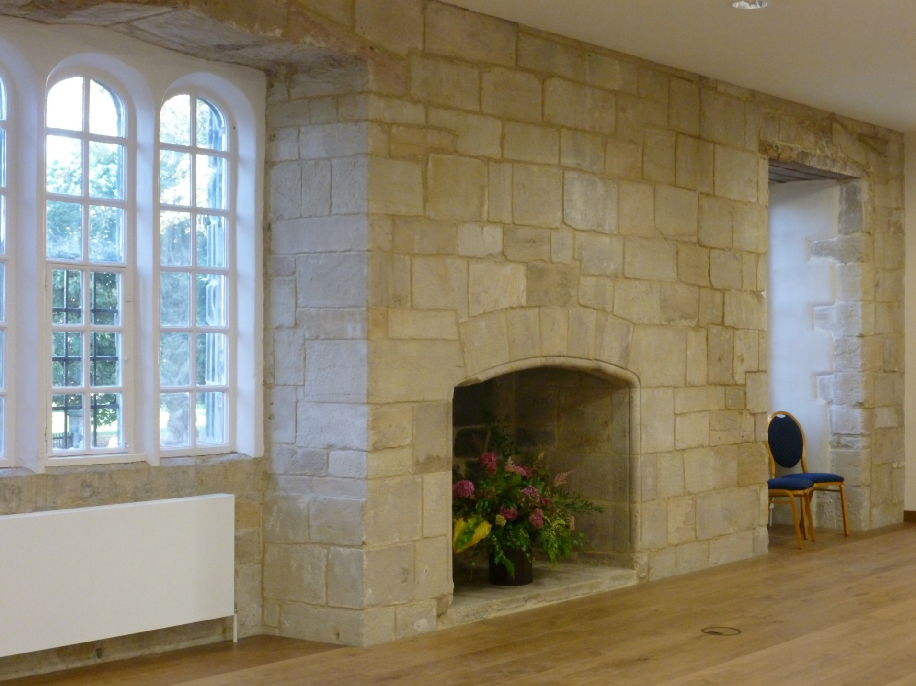
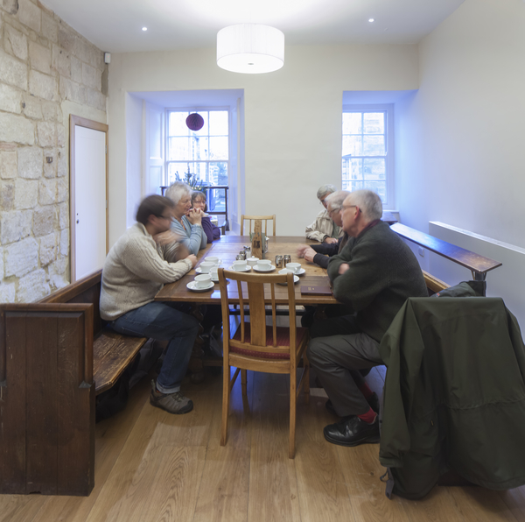

Slide 25
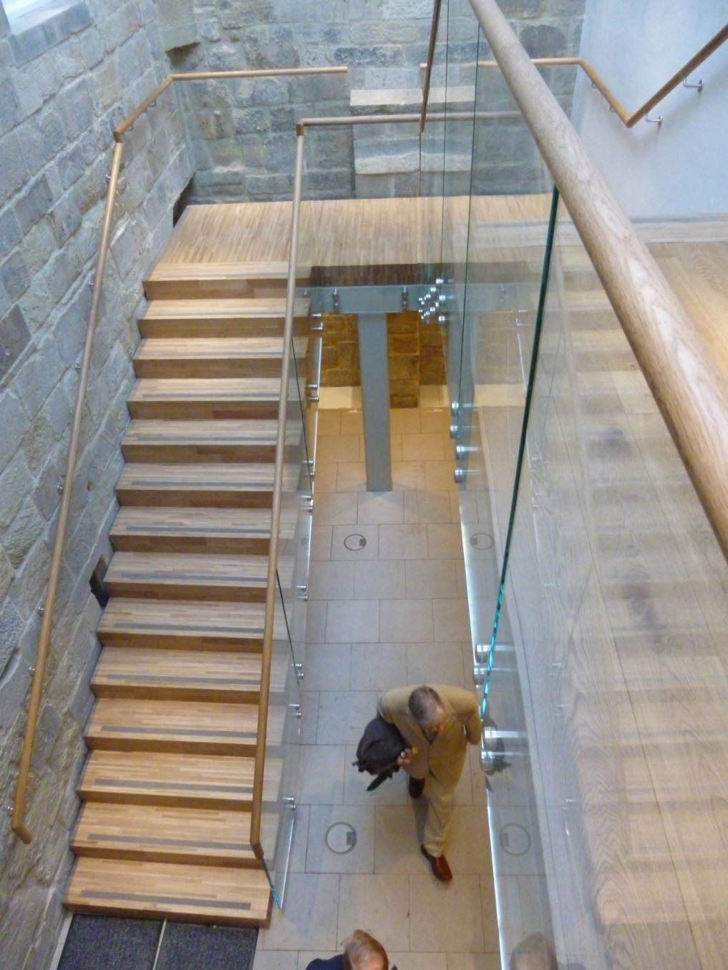
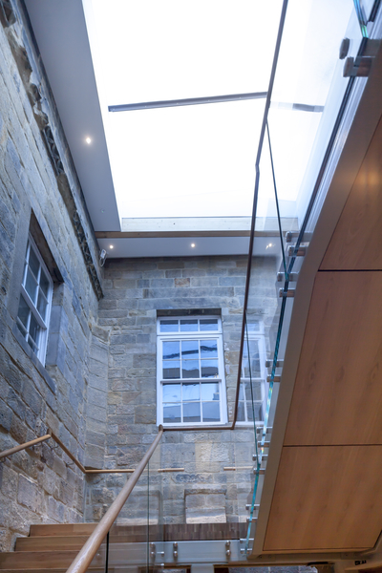

Slide 26
THE MEDIAEVAL MONASTIC BUILDINGS
& PRIOR LESCHMAN c. 1470-90

Slide 27
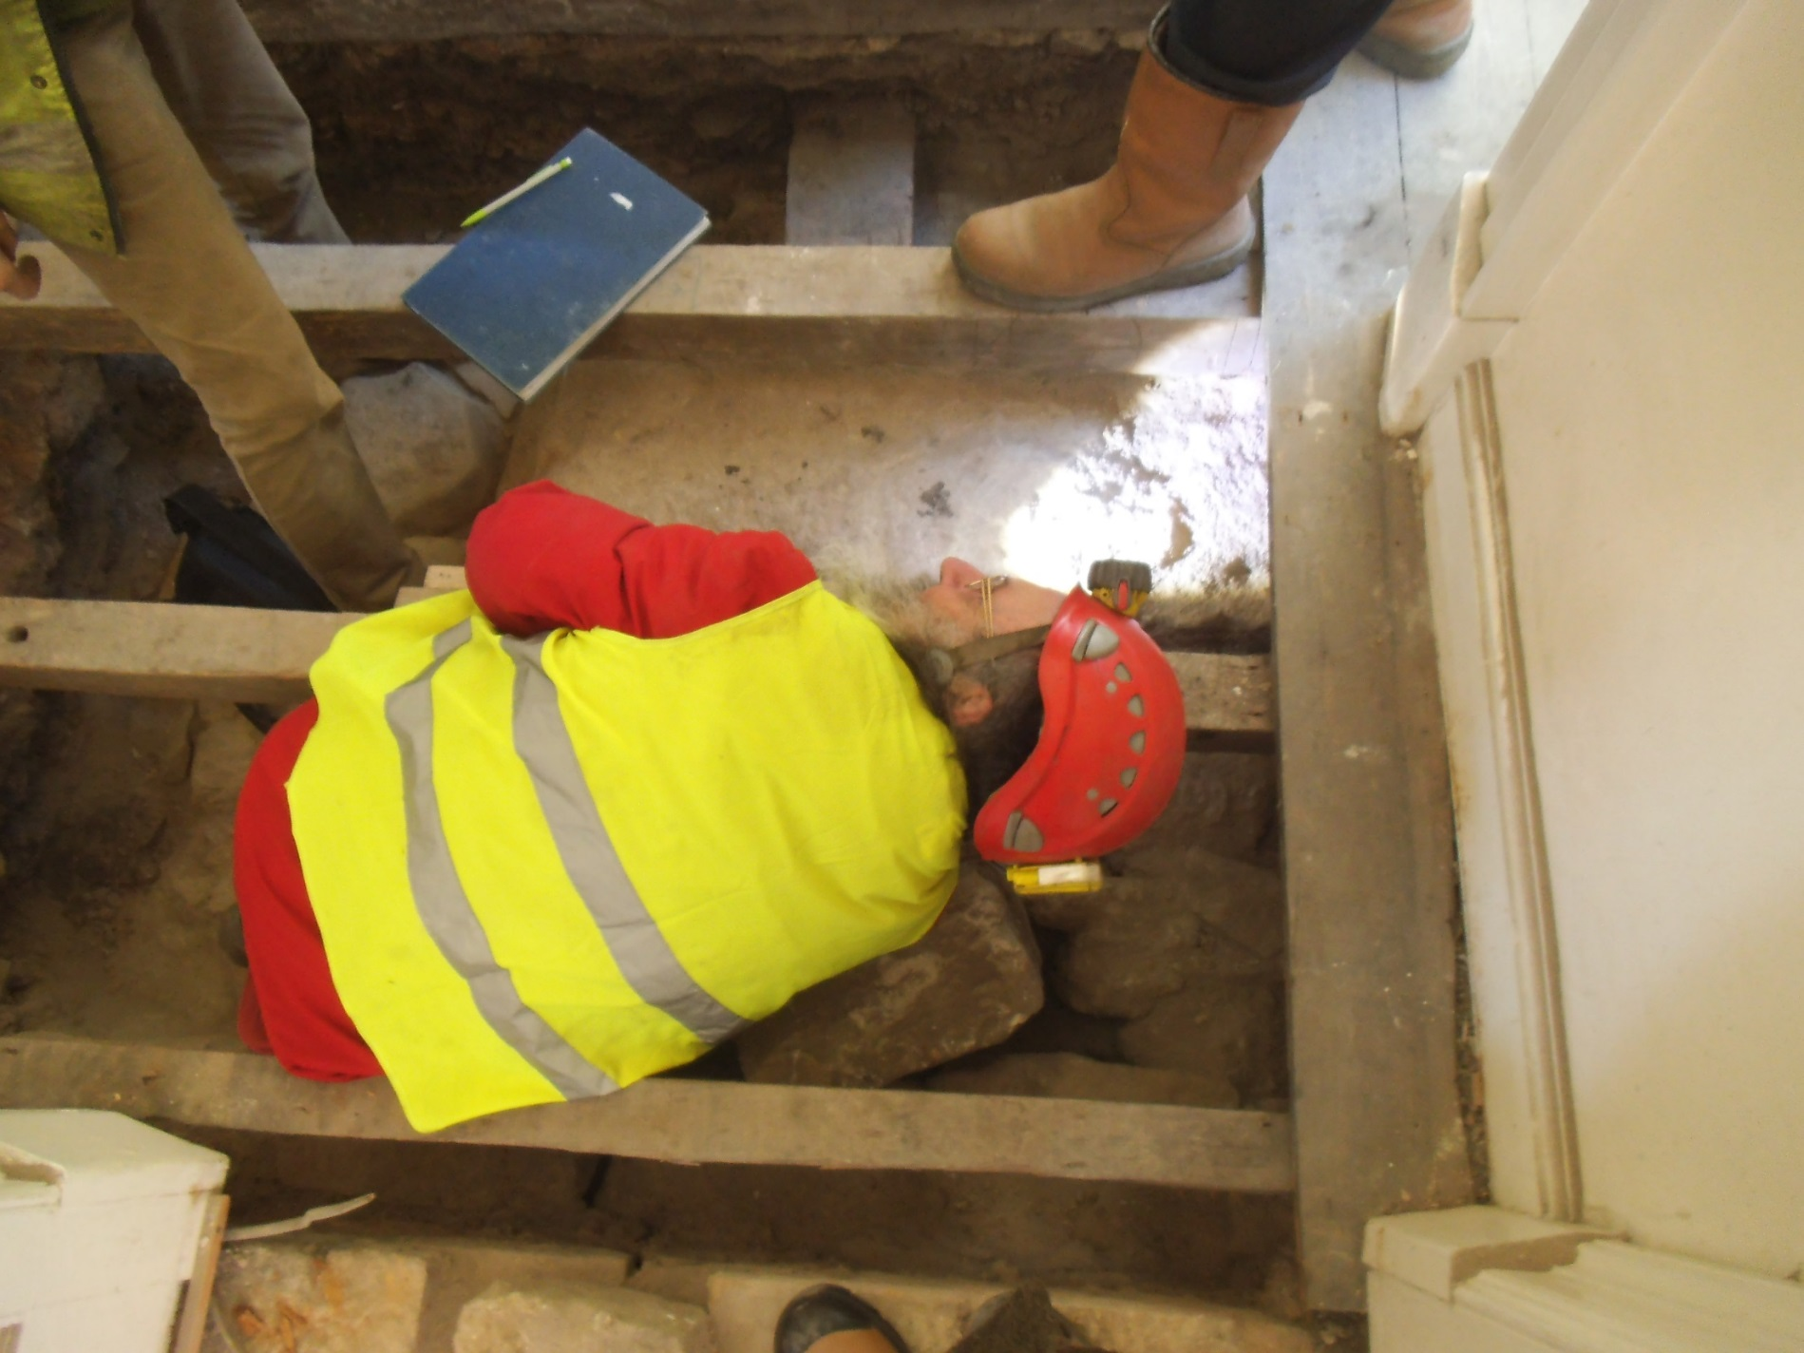

Slide 28
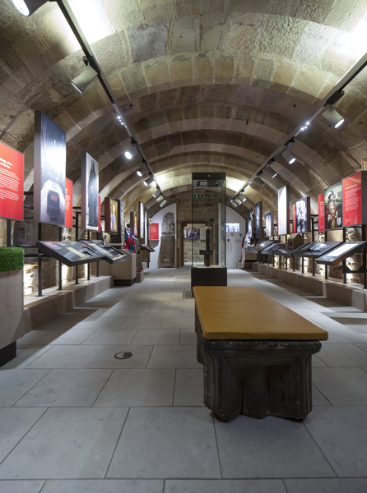

Slide 29
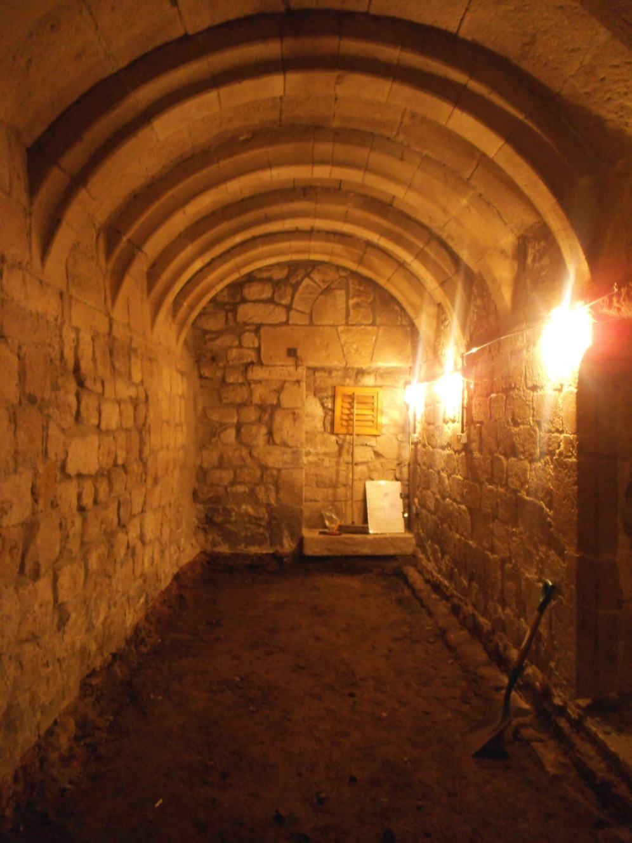
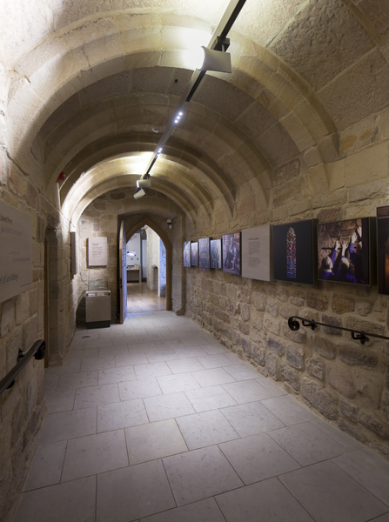

Slide 30
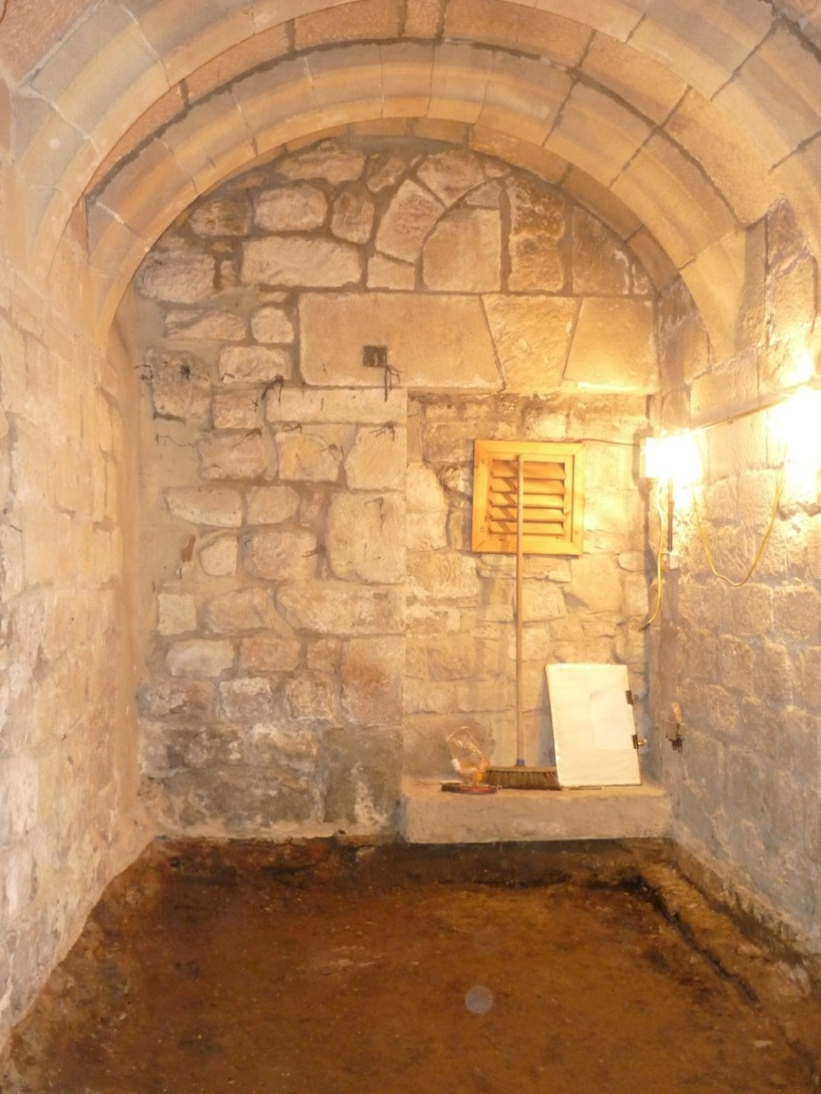
Did we find St Wilfred’s
Benedictine Monastery?

Slide 31
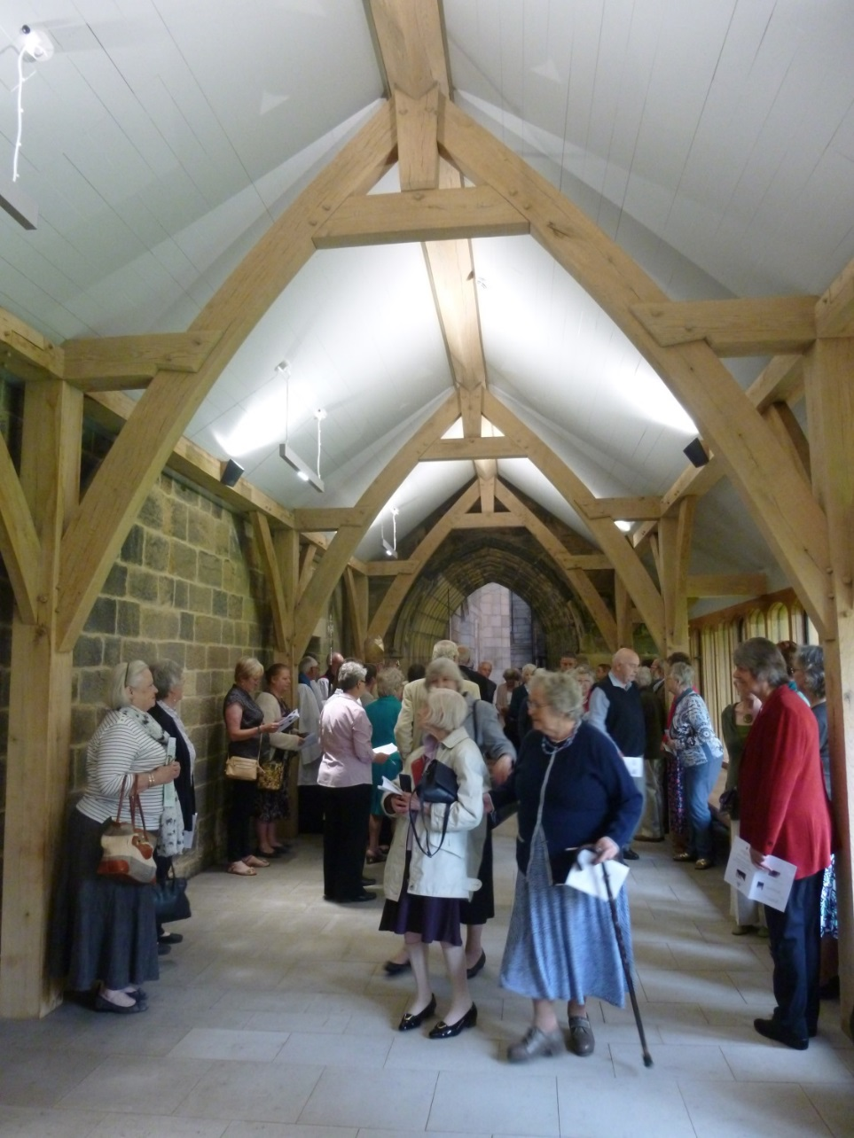
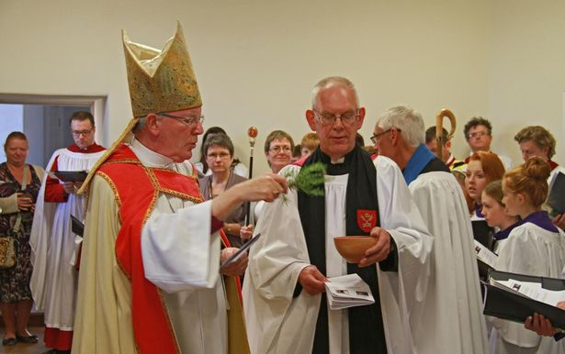
September 2014
The Celebration and Blessing
by the
The Bishop of Newcastle
Rt. Revd Martin Wharton on his last visit to Hexham Abbey after 17 years as Bishop

Slide 32
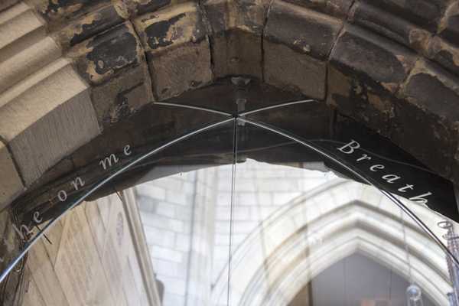
THANK YOU
CHRISTOPHER COTTON RIBA AABC
Abbey Architect, HEXHAM
PURCELL

