Slide 1
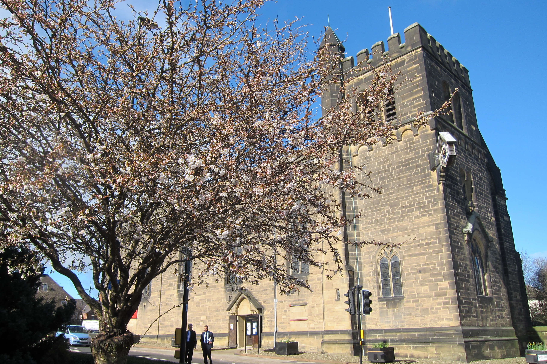
St. james’ & St. Basil’s church fenham
newcastle upon tyne

Slide 2
The project vision
Why?
Serving coffee after
regular services
Providing facilities for
funerals & special
services
Creating facilities for
fund raising events/
coffee mornings.
Mission Action Plan:
to create a space for hospitality

Slide 3
DESIGN STATEMENT
What do you want to deliver?
a kitchen with modern facilities
easily accessible storage
dishwasher
cooker
sink
constant hot water
fridge
What is the design brief?
What is the budget?

Slide 4
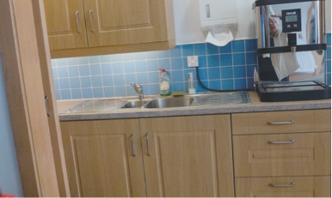
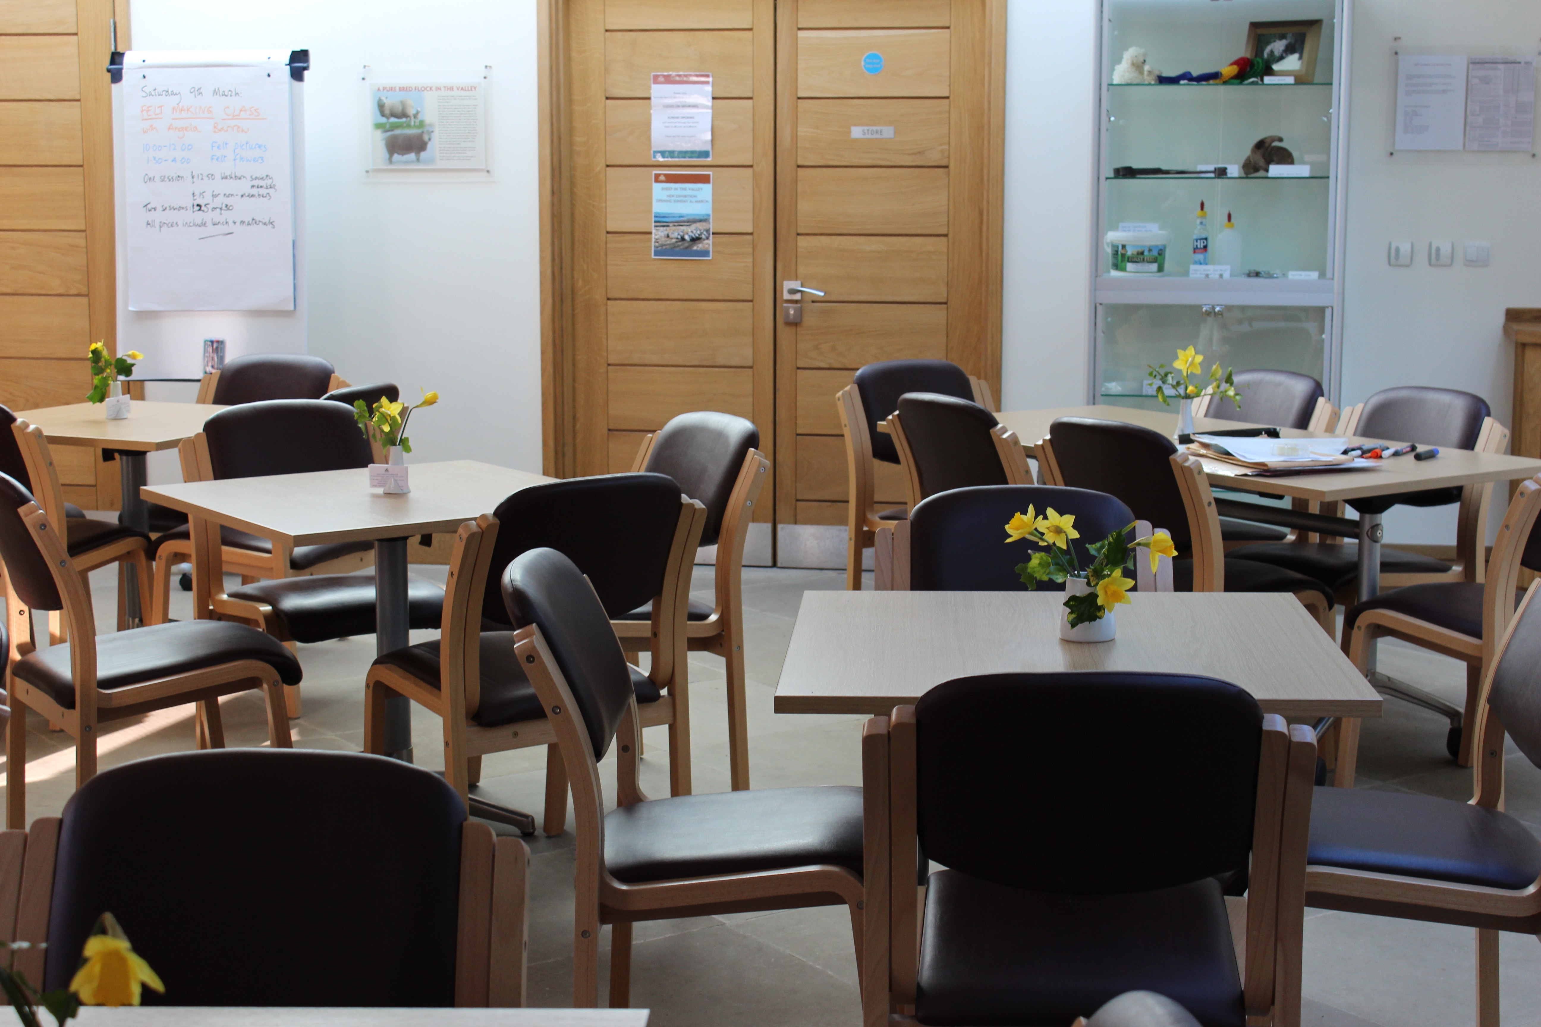
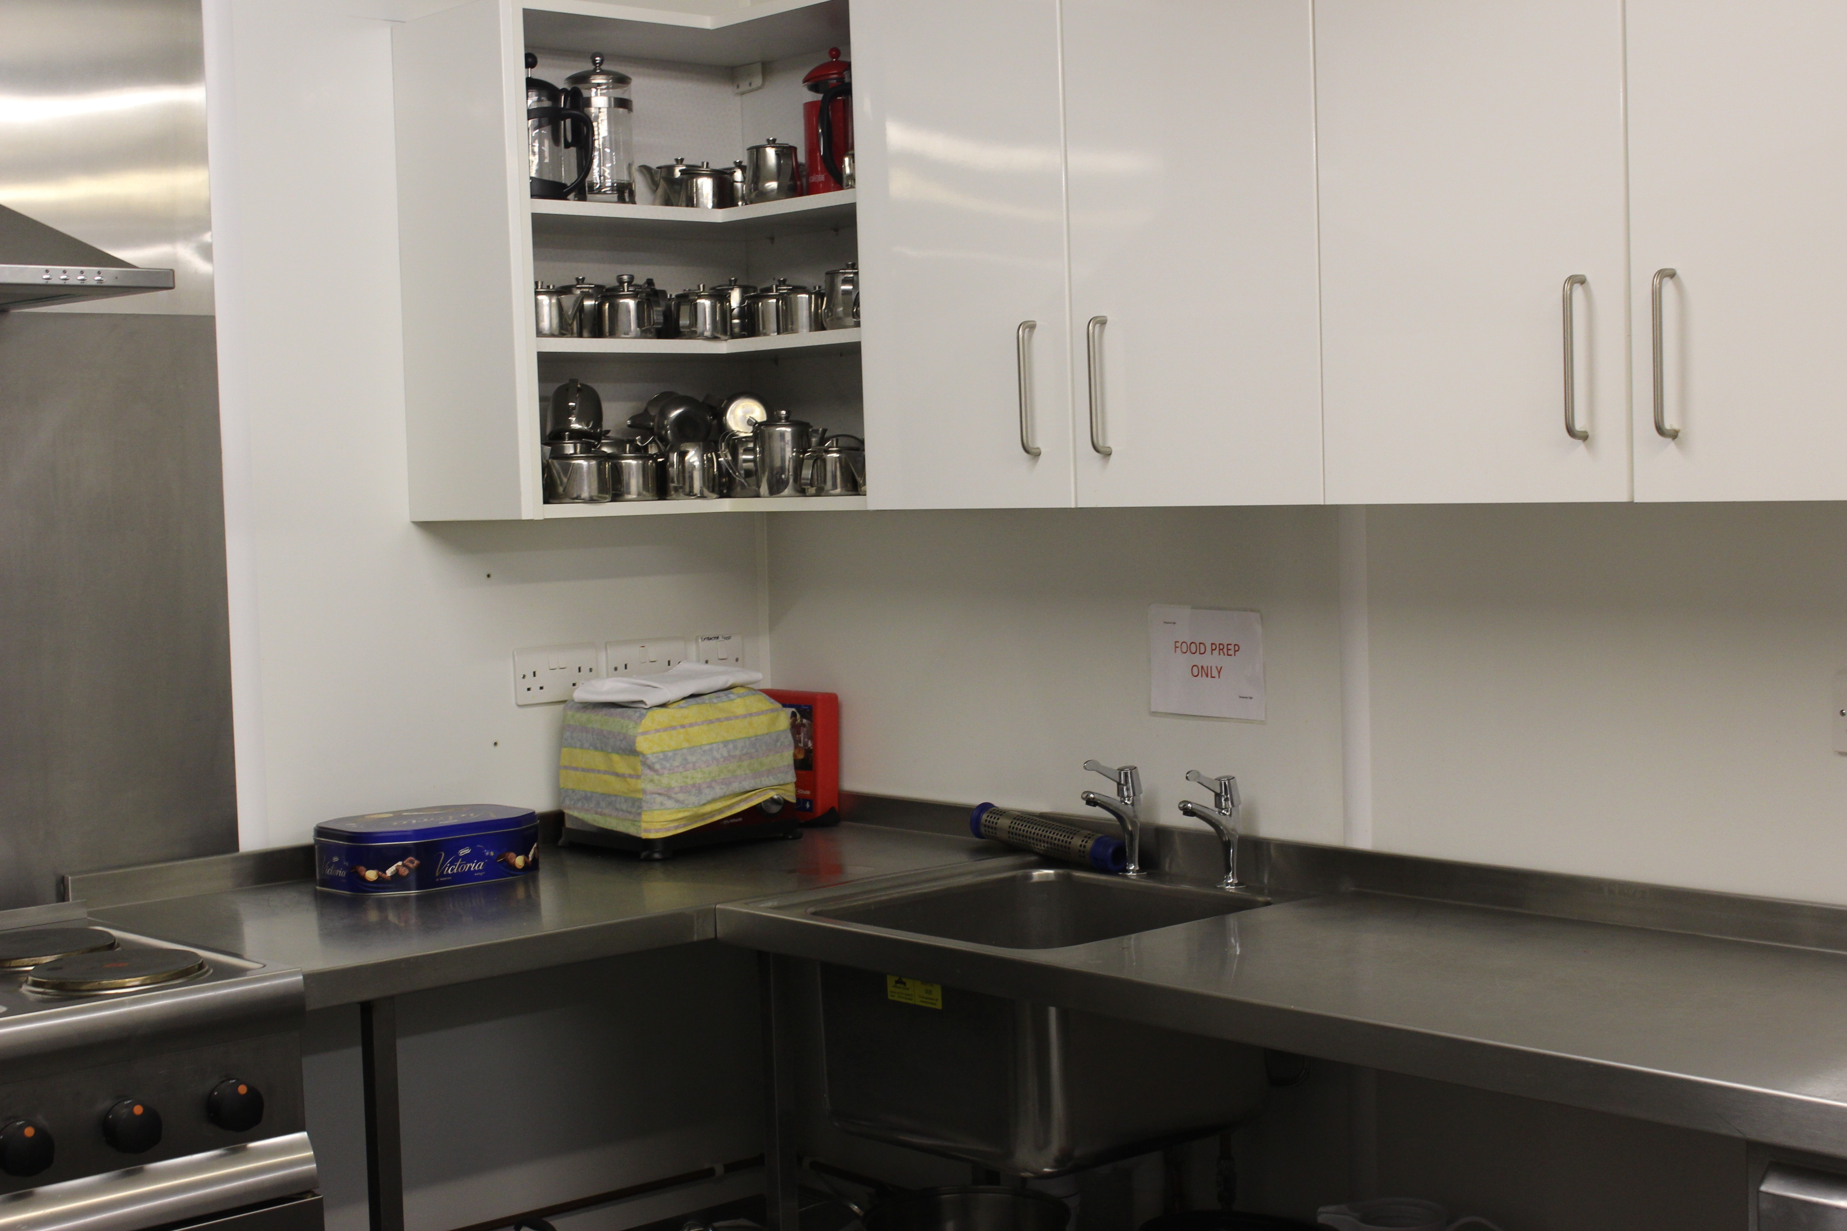
RESEARCH
What is possible?
Visit and investigate

Slide 5
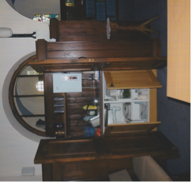
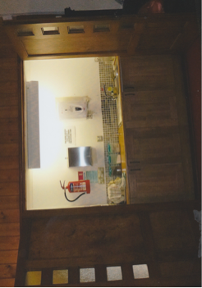
Refine our thinking
ideas for our project were reinforced by visiting other projects

Slide 6
The new siting?
the big decision
Where will the new kitchen be sited?
What will the impact be on the Church?

Slide 7
project delivery plan
Establish group of people to lead project
At PCC meeting formally pass resolution to endorse ideas and discuss funding
Approvals sought and gained e.g. Faculty/building regulations(health & safety)
Tender for Architect to realise vision of project
Tender for the building work
Share ideas with the congregation and community to keep people informed of project progress
Public notice and project time line established
Project delivery

Slide 8
funding
Fund raising
Legacy
Who?
How?
What?
When?
Donations
Grants

Slide 9
Applying for a Faculty
“Churches are important not only as ‘places of worship’ but also as a physical focus of community activity”
Amongst other considerations a faculty is needed
if your building is:
the parish church
a building consecrated for public worship
Seek the help of the Diocesan Advisory Committee

Slide 10
The project is delivered

Slide 11
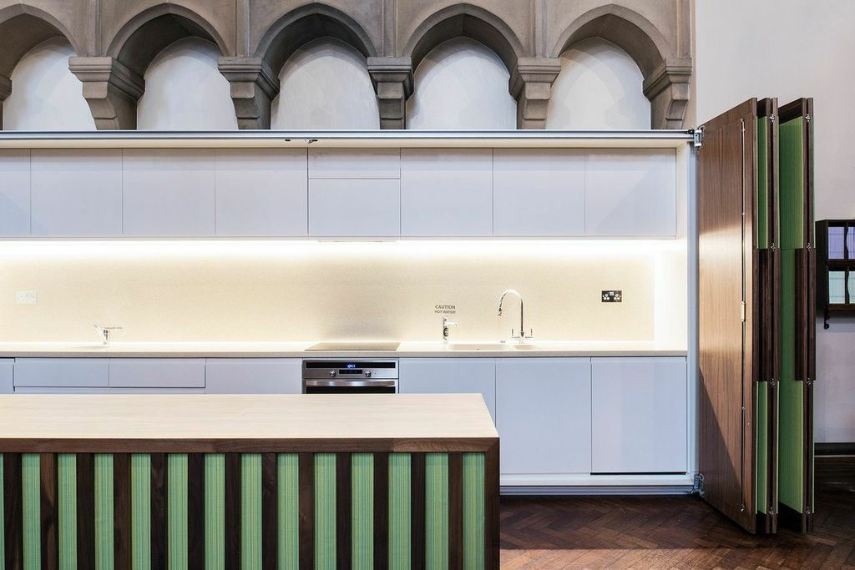

Slide 12
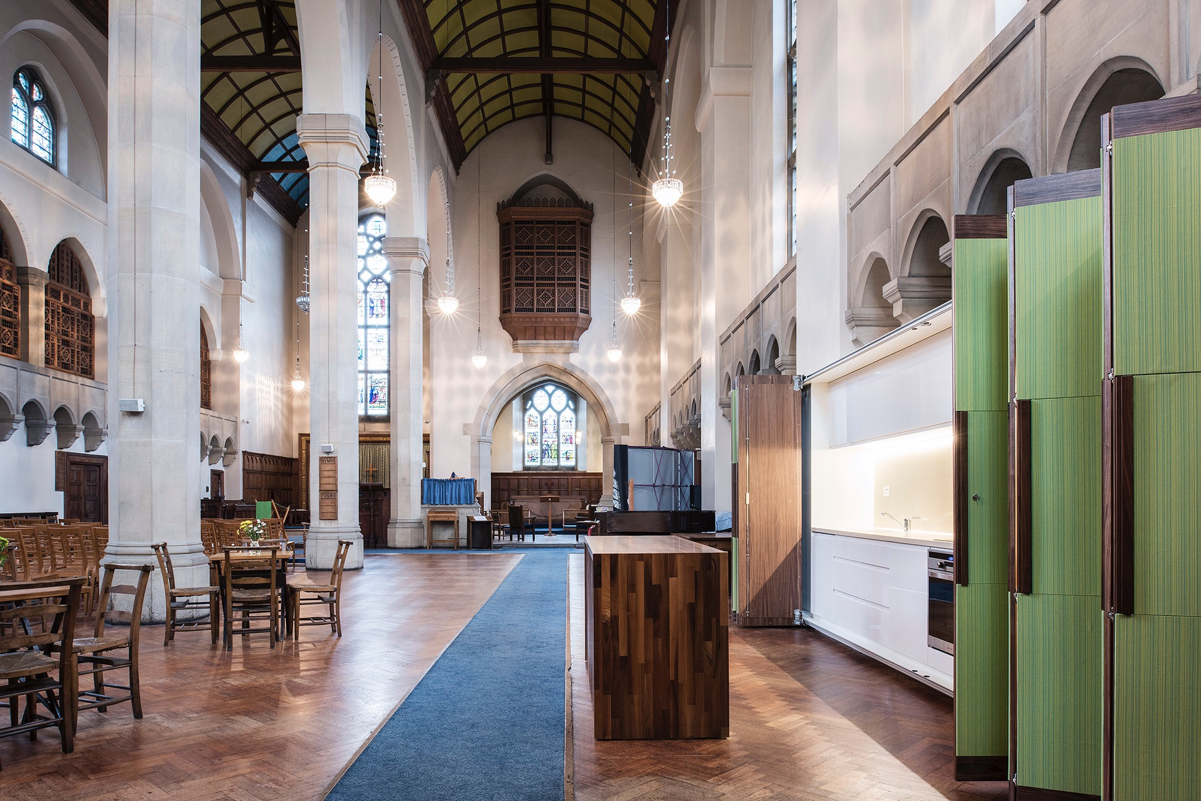

Slide 13
the way forward
Maintenance plan
How is this facility going to develop in order to
address the Mission statement of extending
hospitality?
How will this facility meet the needs of the
community?
How will this facility enhance the wellbeing of
the church?

Slide 14
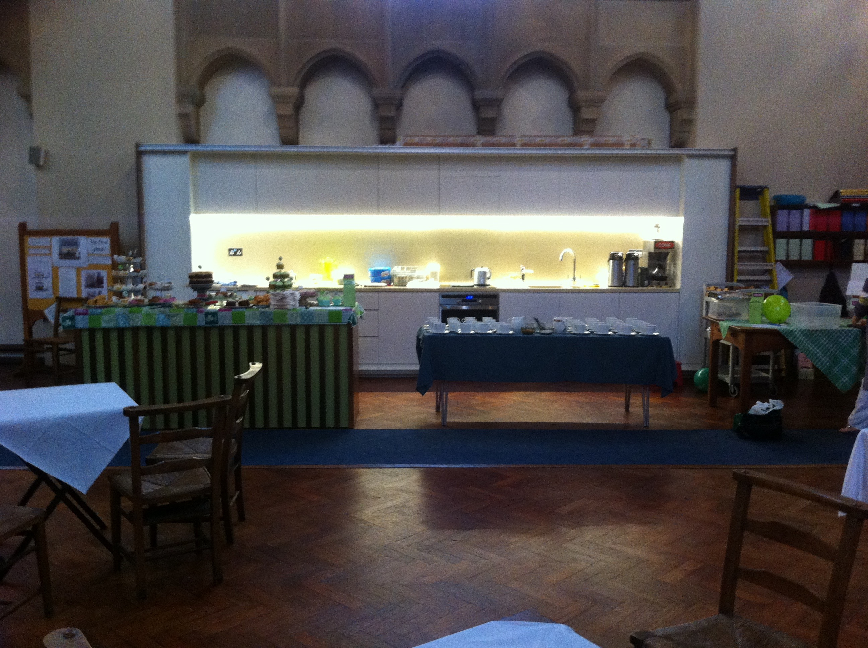
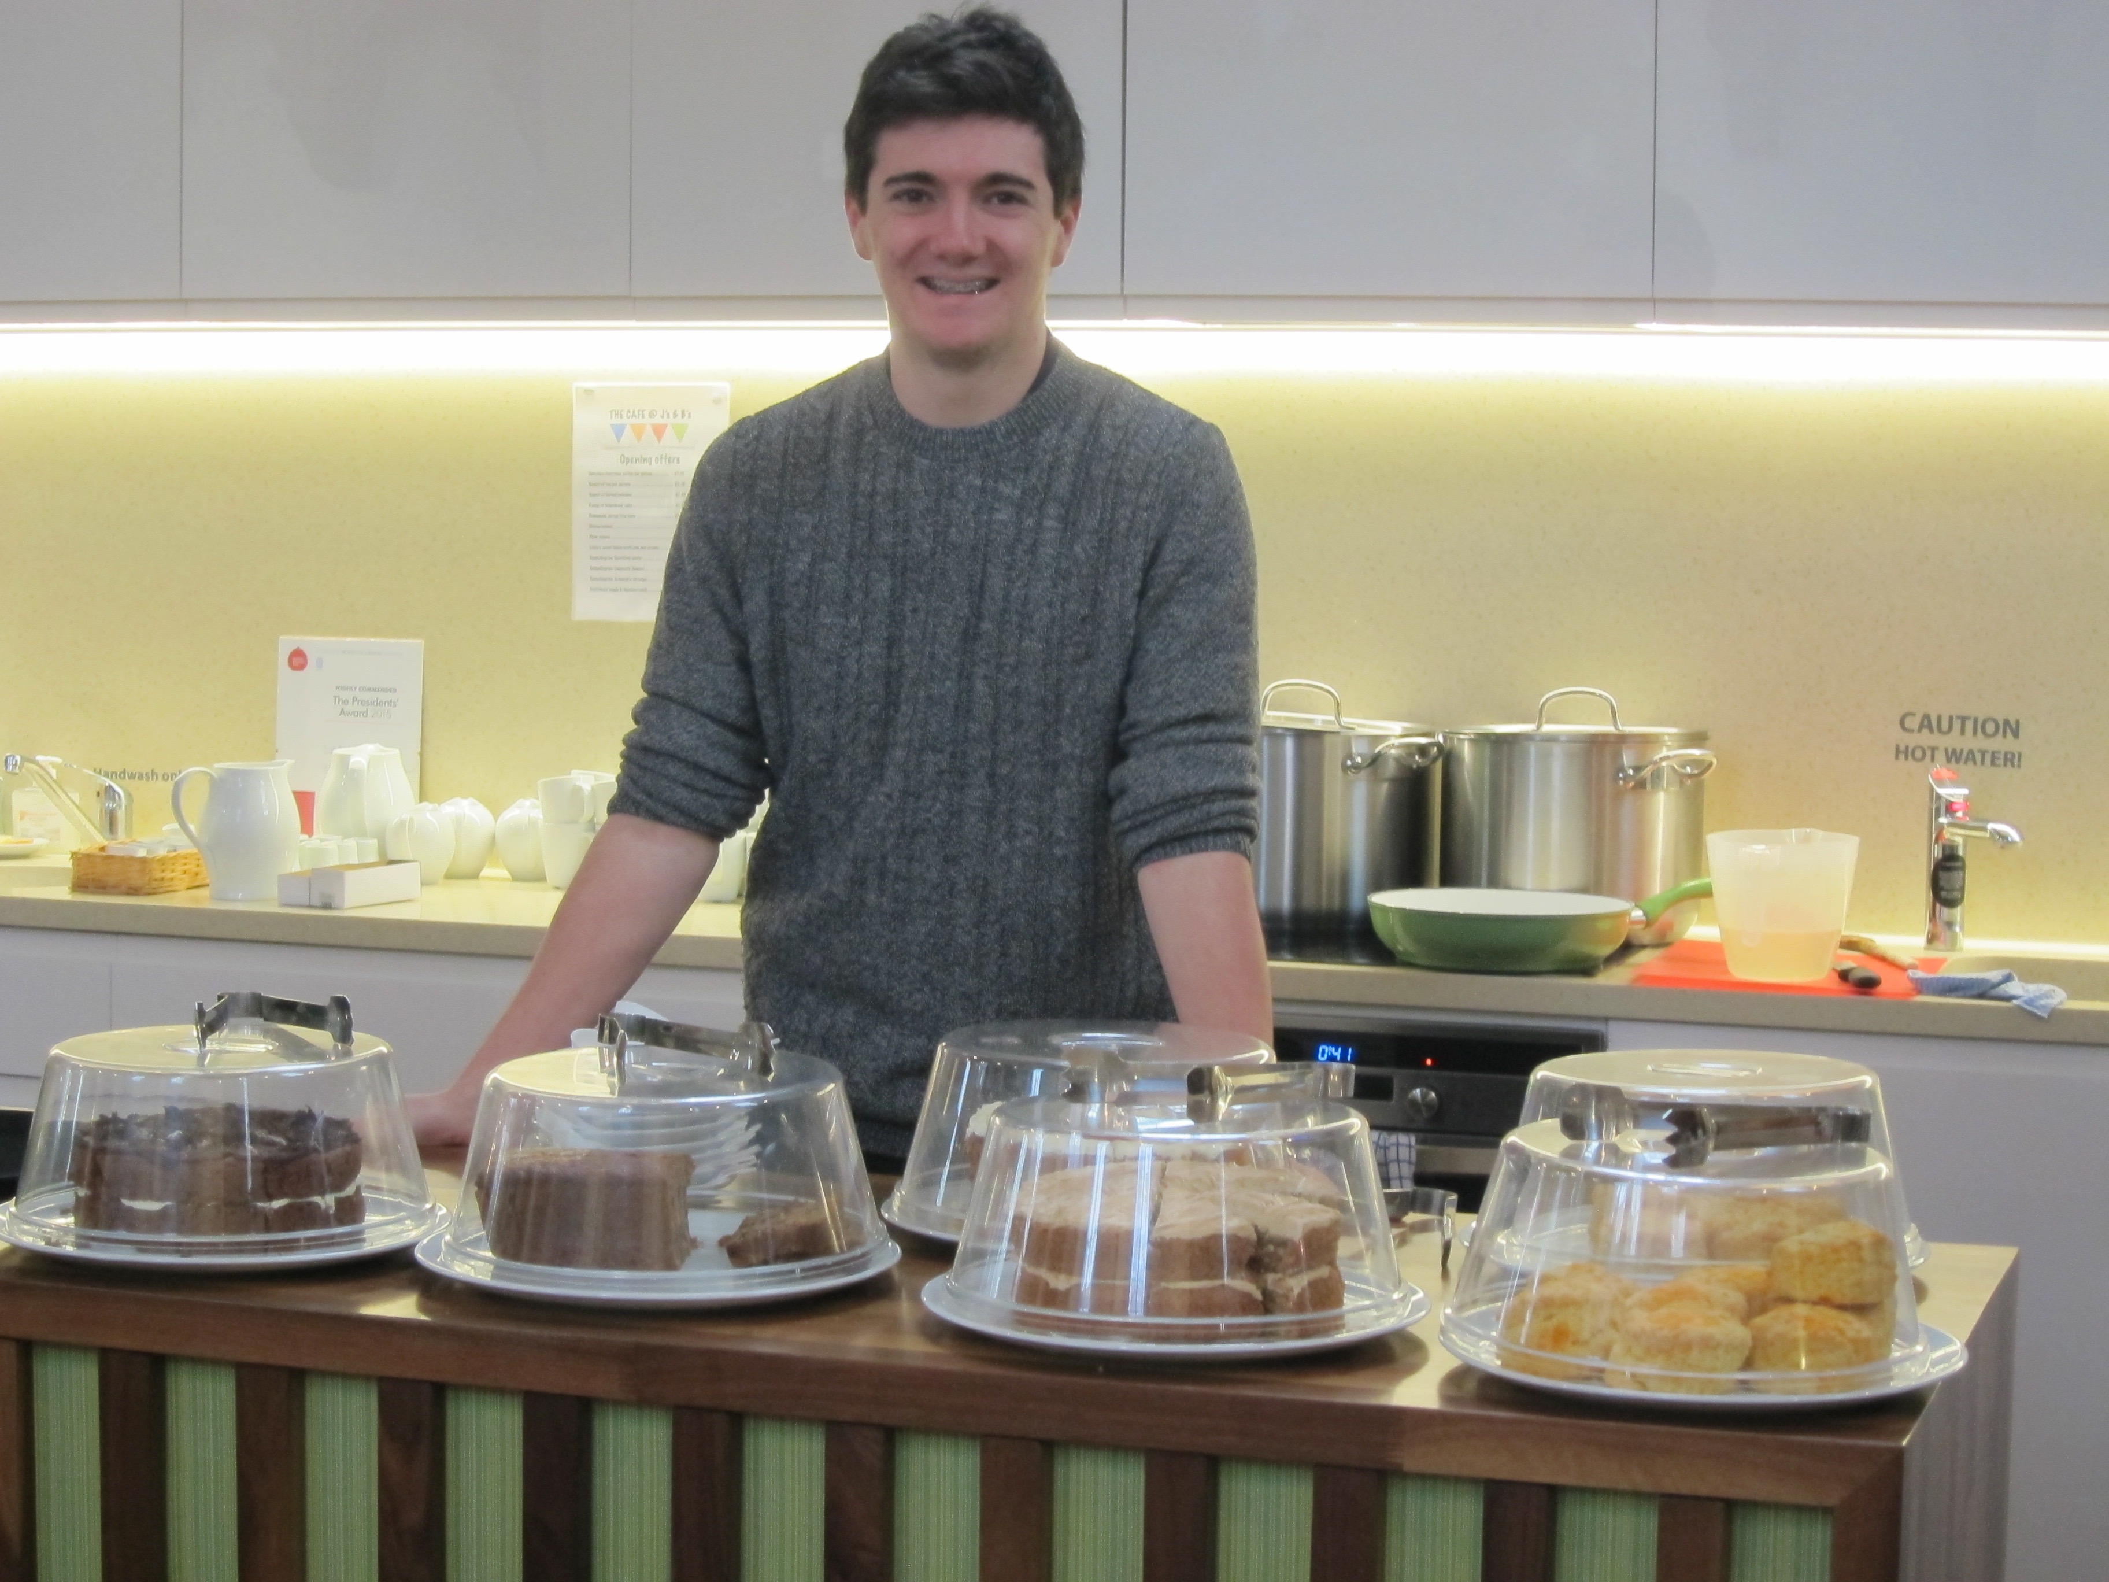
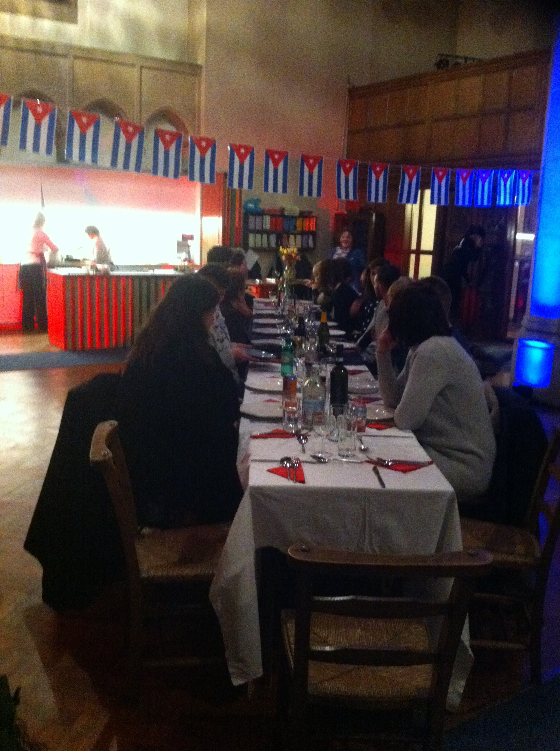
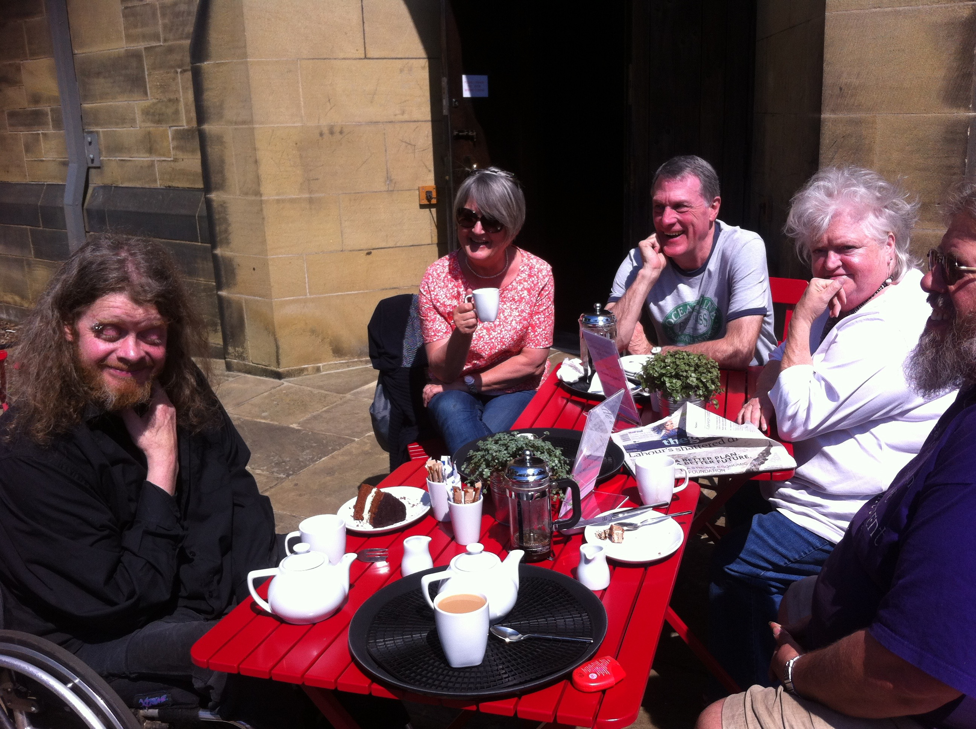
The Cafe @ J’s & B’s
A Macmillan coffee morning
A volunteer working
in the cafe
A secret paladare
Enjoying the Memorial gardens on a cafe day

Slide 15
Thank you to :-
Canon Nicholas Darby for his constant support
Win Smith who left us a legacy used to start the project
The National Churches Trust for their grant
Partners in Community Action for their grant
The Blakelaw ward committee for their grant
The Fenham ward committee for their grant
The community of Fenham who all seem to love eating cake!!

Slide 16
Recognition & thanks go to:-
Architecture, Design & Direction by
Christoph Oschatz :Kiosk Architecture & Design
The construction by Nick James designer:maker
Professional photographer: Jill Tait
Project consultant Harry James FRICS,FAPM
The PCC of St. James’ & St. Basil’s for their brave decisions

