Slide 1
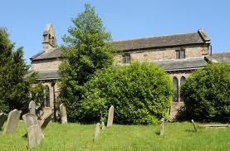
St Michael’s Bishop Middleham
Re-ordering of the west end of the church

Slide 2
Background
The project was almost 20 years in the making.
It began as a response to a number of factors about the church:
the fact that the church was much larger than its current congregation needed.
the inflexibility of the interior furnishings.
the lack of toilet facilities.

Slide 3
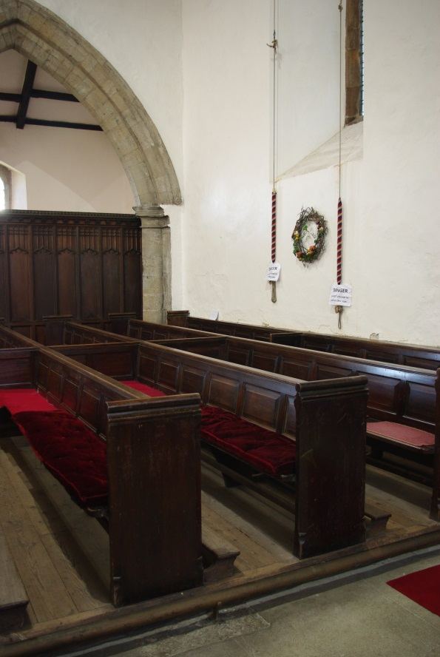
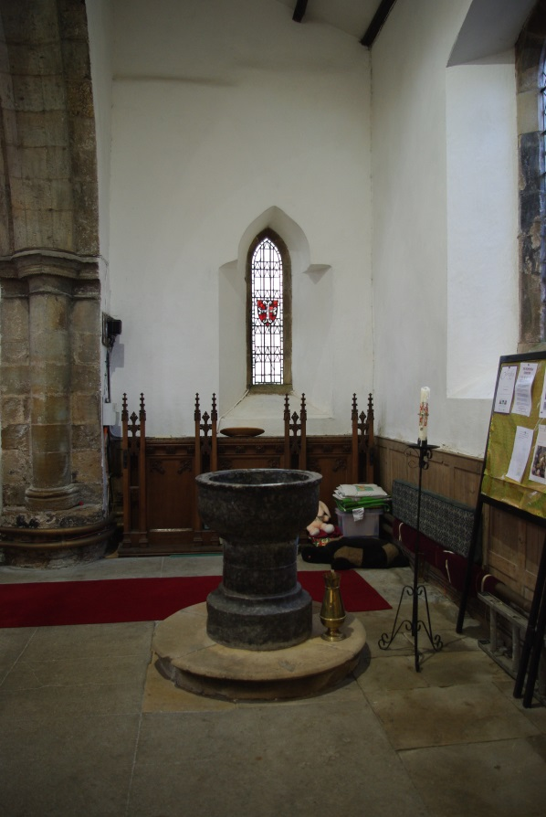
West end of nave before re-ordering

Slide 4
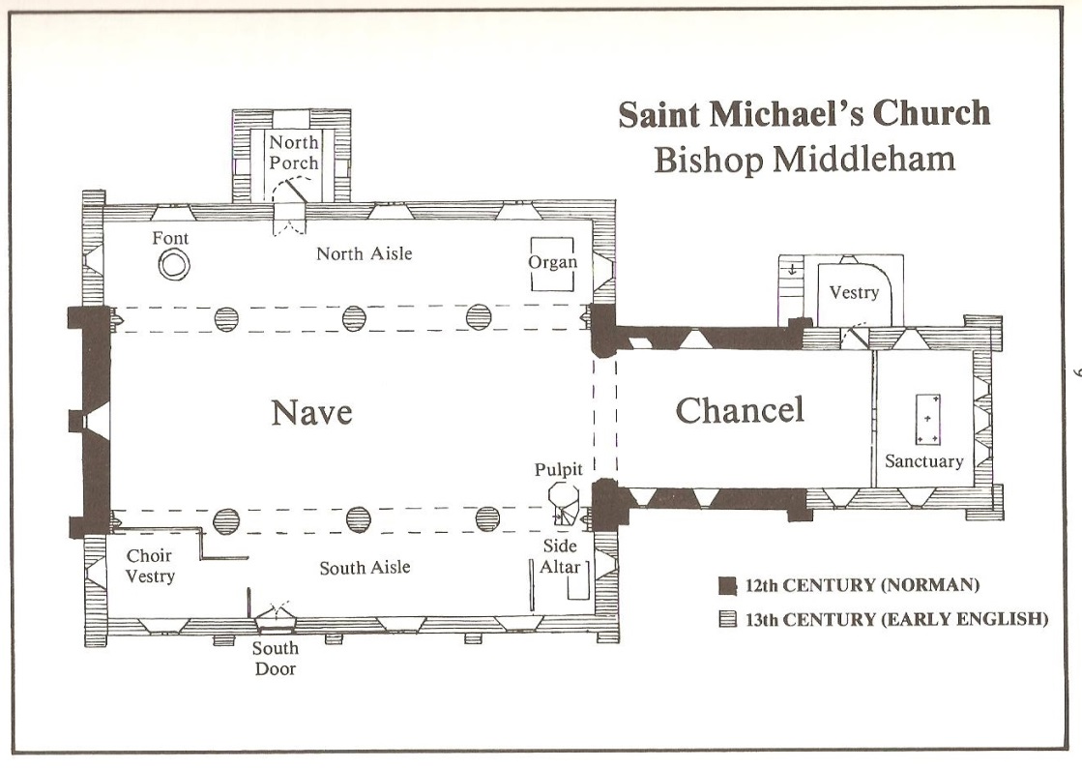
Background
There were four different phases:
The transformation of the west end of the nave into a meeting room with toilet facilities.

Slide 5
The installation of a toilet beside the north door.
The installation of a toilet and small kitchen against the west wall of the nave.

Slide 6
Background
Each of these plans was abandoned.
The church roof needed to be replaced.
The church boiler needed to be replaced.
The plan was postponed while problems with the churchyard wall were dealt with. When it was revived, the DAC expressed reservations that the proposed installation would be too obtrusive.

Slide 7
Phase 4 – the final plan
Toilet and
Kitchen
Font
Meeting
room

Slide 8
Managing the process 1
Reaching agreement was never difficult.
Consensus on need.
Developing agreement which led to changes.
Notes:
Reaching agreement was never difficult. The need for toilet facilities was widely accepted. As time went on, DCC members were keen to add a small kitchen and a meeting room. There was also agreement on the need for a more flexible space to enable a wider variety of worship and a range of social activities.

Slide 9
Managing the process 2
Consultation.
Meetings with regular congregation.
Letters to wider community.
Word of mouth – some negative comments.
Notes:
Consultation. We held a series of meetings with the regular congregation to allow them to ask questions and express opinions. The result was a wide degree of support.
The only real reservations came from outside the church – from people who were not, or were no longer, regular attenders. Most of these comments expressed resistance to any change to the church building.

Slide 10
Managing the process 3
Raising the money
Problems in previous years.
A substantial bequest.
Grants.
Contributions from community.
Notes:
Raising the money had been the main obstacle over the years. Community support for the church has always been present but on the first two occasions when we were considering this, other, higher, priorities intervened. Appropriate grant-giving bodies, both local and national, were identified and applications made.
The combination of grants and bequest made it unnecessary to seek financial support from the community, although some contributions were received.
The turning point was a substantial bequest from the sister of a former vicar. This gave us a firm foundation for financing the project.

Slide 11
Managing the process 4
Delegating the tasks
DCC
A sub-group of the Team Rector, DCC Chair and DCC Treasurer
The Team Rector
The DCC Chair
The Treasurer
Notes:
Delegating the tasks
The system in the parish delegates the planning of such tasks to the DCC which discussed the project regularly.
A sub-group of the Team Rector, DCC Chair and DCC Treasurer carried out the detailed work.
The Team Rector liaised with the DAC, English Heritage etc.
The DCC Chair was responsible for liaising with the architect, contractors and completing the faculty application.
The Treasurer was responsible for grant applications.

Slide 12
Managing the project 5
Working with partners
The architect
The DAC
English Heritage
Church Buildings Council

Slide 13
Managing the project 6
The faculty application
Make sure that you have dotted the i’s and crossed the t’s.
Have all necessary paperwork in place.
Seek any further advice.
Don’t underestimate the time it takes.

Slide 14
Managing the process 7
Work in progress
Role of architect
Named liaison person
‘Church-friendly’ builders
Anticipate practical difficulties
Notes:
Architect – project management, advice on tenders, supervision of work – firmness
Our experiences
Access – light switches – funeral – prepare people for what church will look like – need to cover organ

Slide 15
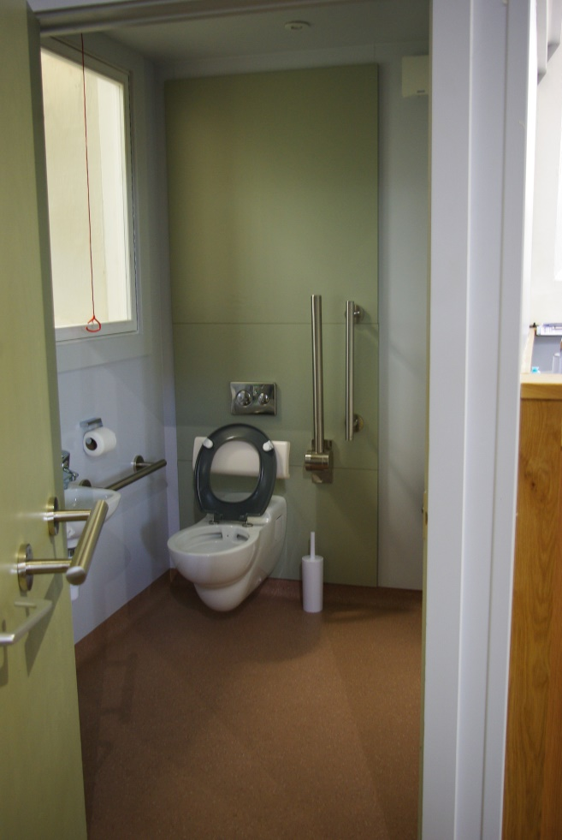
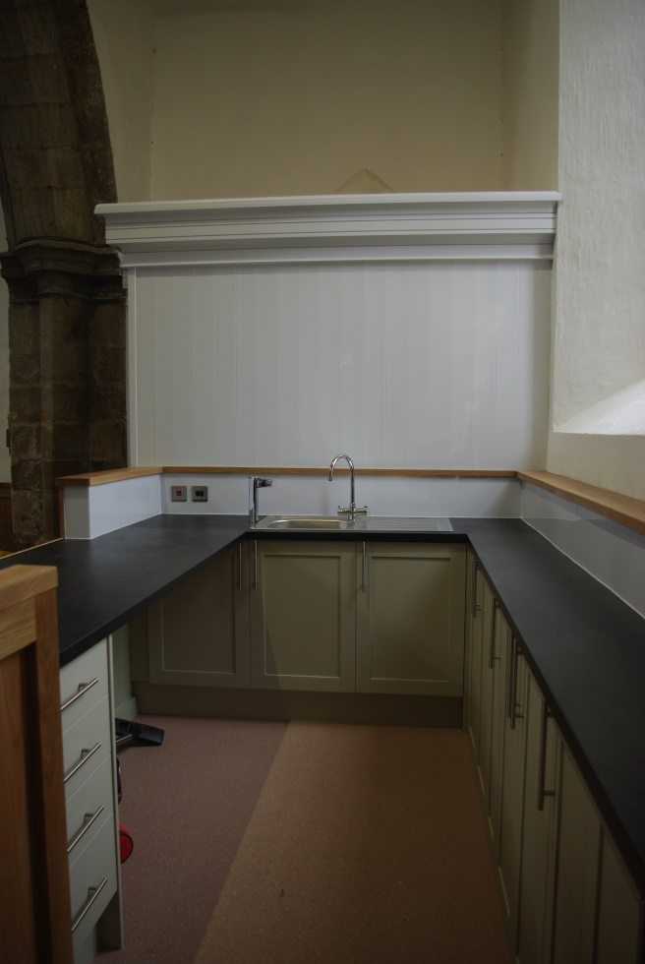
The finished project 1
Toilet and kitchen facilities

Slide 16
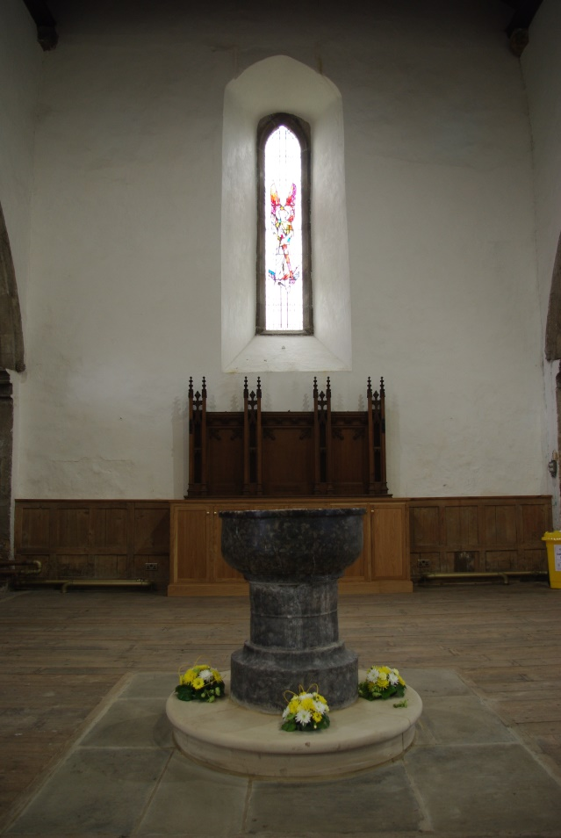
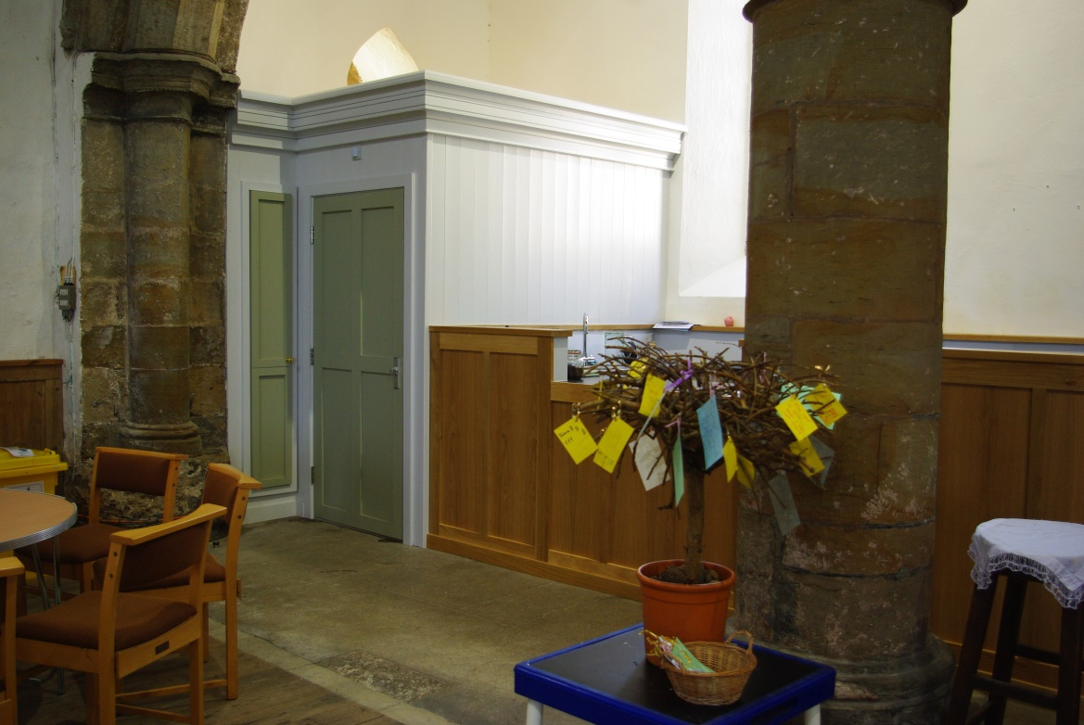
The finished project 2
A flexible space at the west end and the relocation of the font

Slide 17
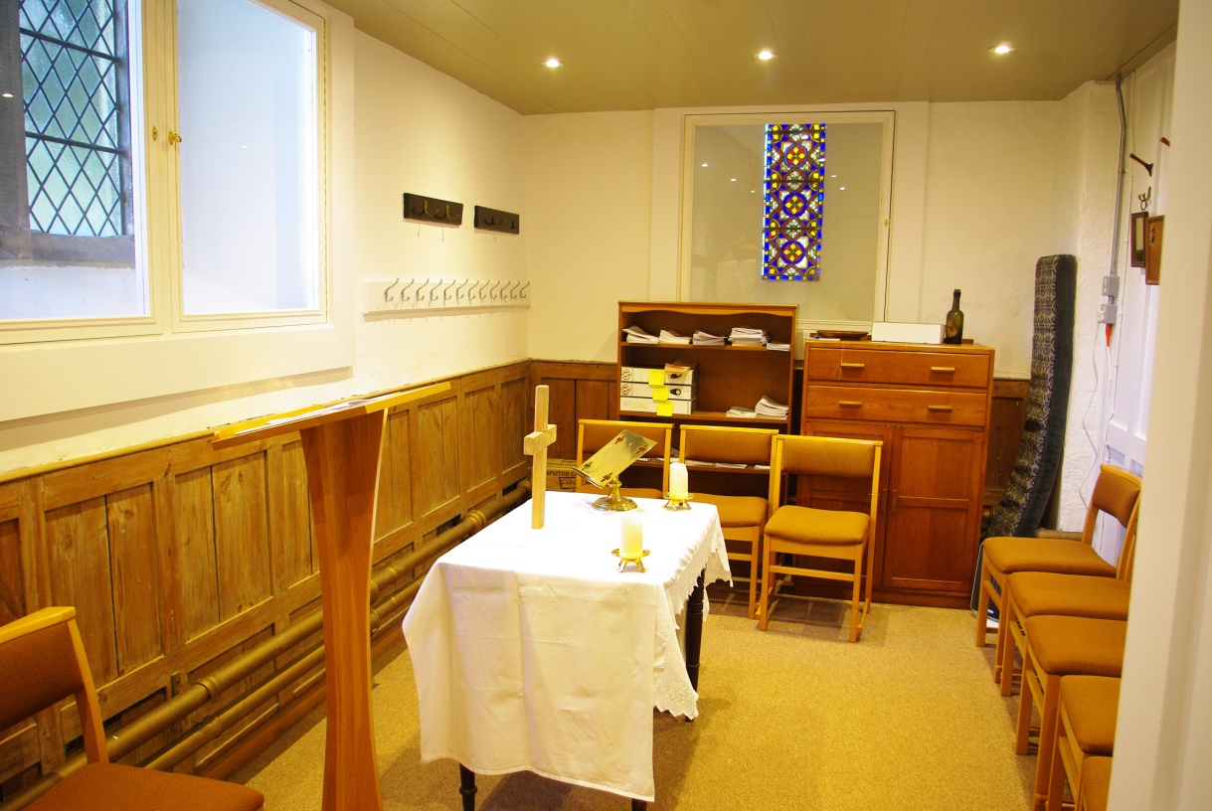
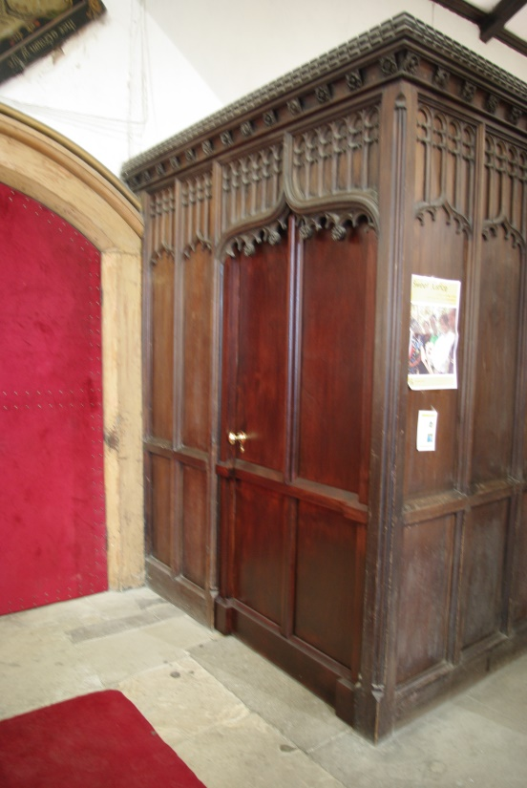
The finished project 3
A meeting room

Slide 18
How have we used the new facilities?
Baptisms
Family services
Toilet facilities
Coffee after services
Weekday Eucharists
DCC (and other) meetings
Police surgery
Music groups
Social and community events
Notes:
Baptisms now take place in a more central space – improved visibility – room for families around font. Also use for services like Candlemas and Easter.
Flexible space for children’s activities – dedication service.
Regularly used – regulars as well as visitors – invaluable for family services – school services.
Part of regular church life.
No need to heat whole church – reduction on bills and carbon footprint – 40% over winter.
Previously met in people’s homes – other meetings e.g. PCC never held at St M’s.
Fund-raising tea, Heritage Open days, Pie and pea supper.

Slide 19
What have we learnt from the project?
Make sure that the finances are secure and that there are no other major issues pending.
Talk to the DAC (and other interested bodies) at an early stage.
Clear delegation of tasks.
Establish a good relationship with architect and contractors.
Remember that costs will increase.
Ensure that everything is in place for the faculty application – a list of contents might be useful.
Notes:
Main reason for 20 years in making
More than willing to give advice – means more likely to approve formal application
Clear lines of communication – appreciated by professionals involved
Our experiences – DB in audience – builders’ willingness to help
Faculty process – three points for clarification – font, drainage ditch

Slide 20
Has it been worth it?
A resounding

