Slide 1
Managing Major Projects
Getting Started
9th June 2016

Slide 2
Ask the Right Questions
Where are you starting from? The Statement of Significance
What use do you need from your church? The Statement of Need
What do you want your architect to do? The Brief. It is prudent to consult the DAC before taking this step.
What can you reasonably hope to afford? The budget.

Slide 3
Do NOT Ask the Wrong Questions
How can we beat the system?
Can we decide everything before we consult anyone?
Can we just do it and not tell anyone?
Can we raise money first, so we know how much we have?

Slide 4
Working with Partners
Incumbent, Churchwardens, & PCC (or equivalent in another denomination)
Quinquennial Inspector or project architect
Archdeacon, DAC, & Chancellor (or equivalent)
Church Buildings Council, Historic England, Local Authority, Amenity Societies. EIG.

Slide 5
CO-OPERATION
Build a team. Lead co-ordinator, motivate and delegate. Do not dominate, nor abdicate
Use your Quinquennial Inspector
Seek help from the DAC (or equivalent); from an early stage and throughout.

Slide 6
The Diocesan Advisory Committee for the Care of Churches (The DAC)
In the Church of England, but other churches have something similar
An appointed panel of experts
Dual role:
To advise the parish
To advise the Chancellor.

Slide 7
The Online Faculty System
New from 2015
Already the norm
So how does it work?

Slide 8
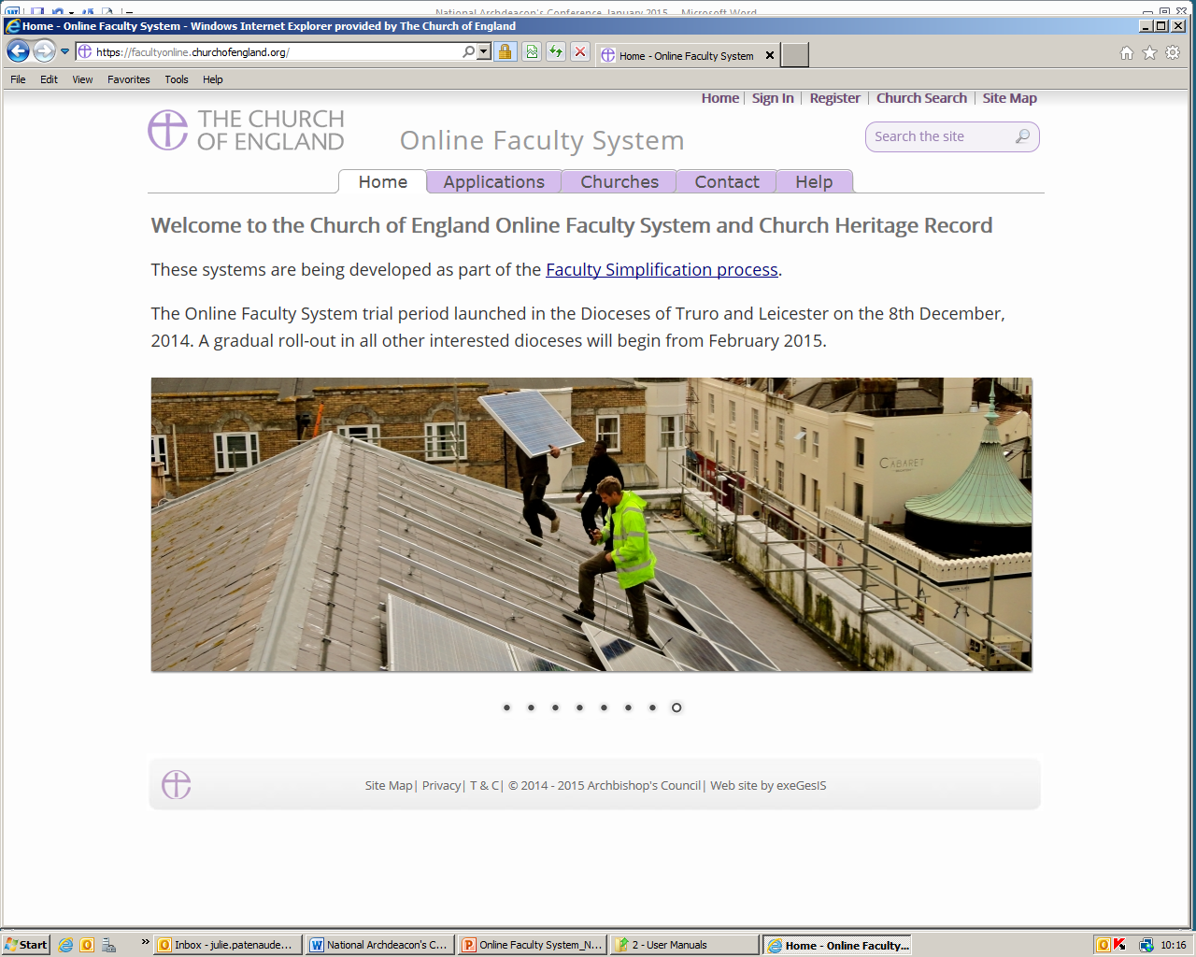
What can “The System” do for you
What is the System?
An online planning portal
Accessible at all levels
Faculty applications for alterations, additions or repair works.

Slide 9
Restricted Access
No Public Access
Registered Users only
Different levels of access according to user’s role.

Slide 10
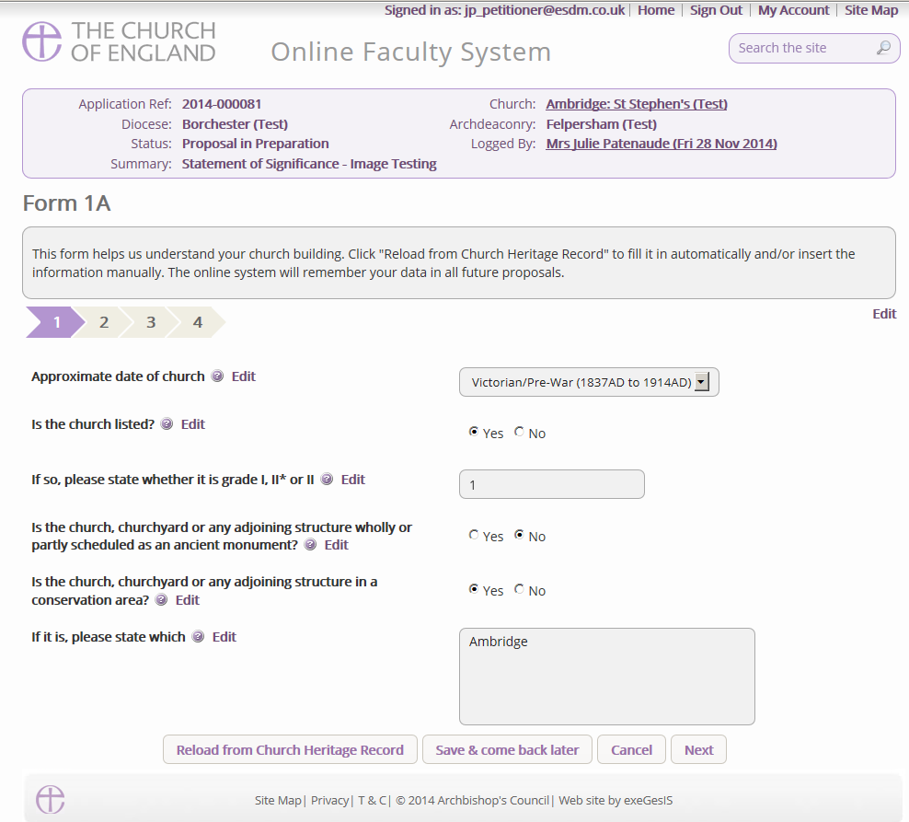
Standard Information

Slide 11
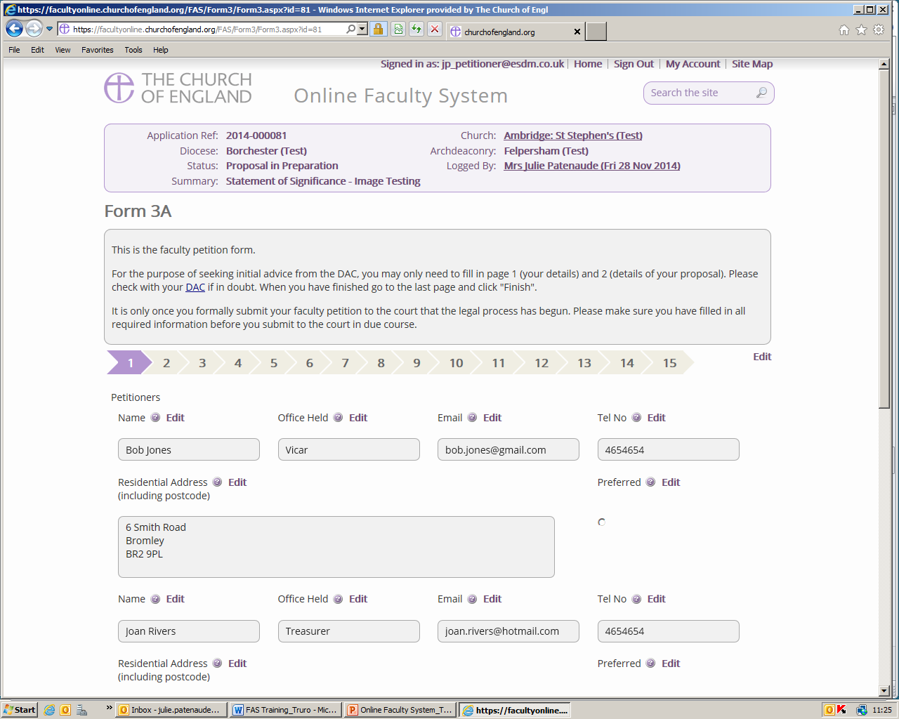
Petition

Slide 12
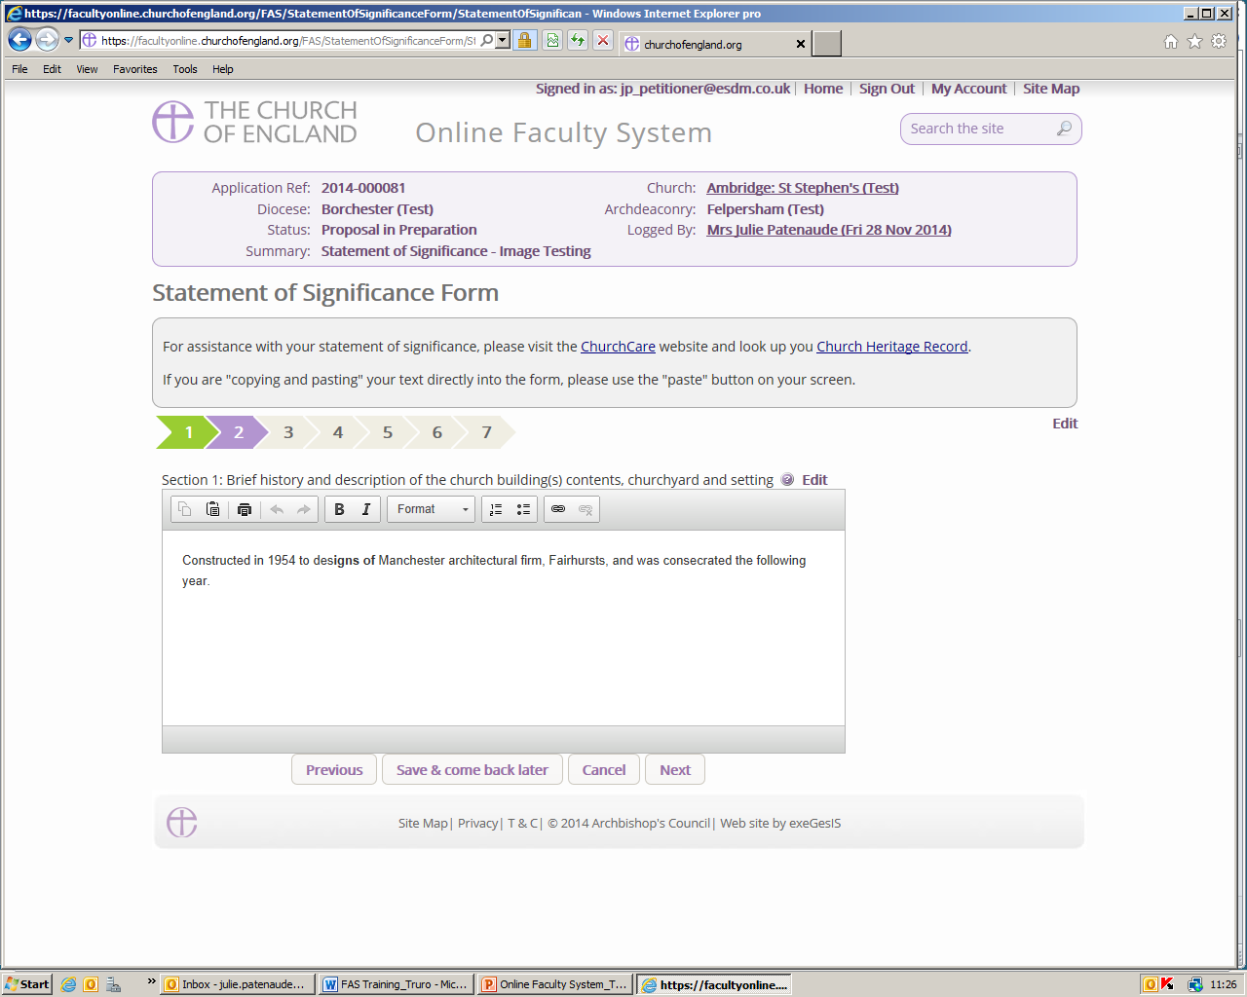
Statement of Significance

Slide 13
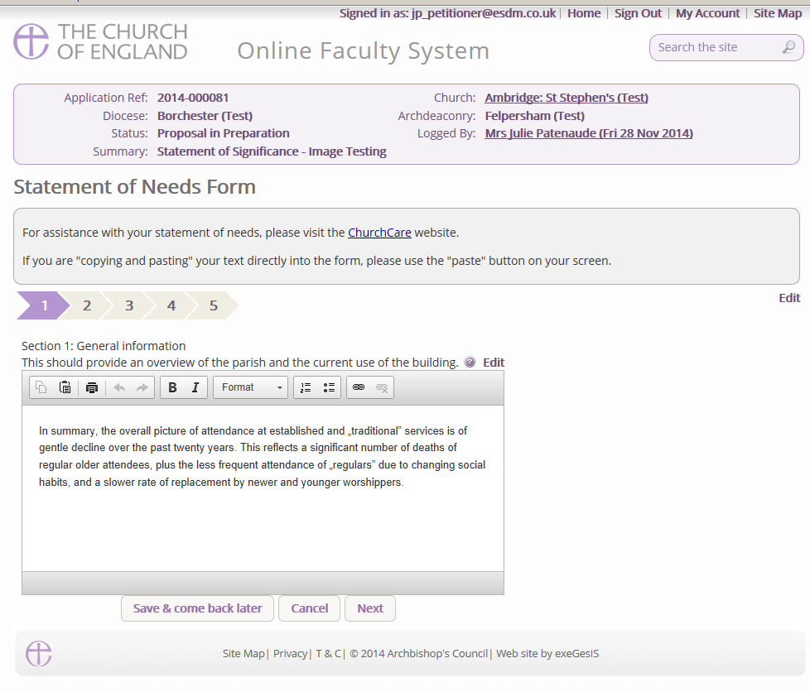
Statement of Needs

Slide 14
DAC Informal Advice

Slide 15
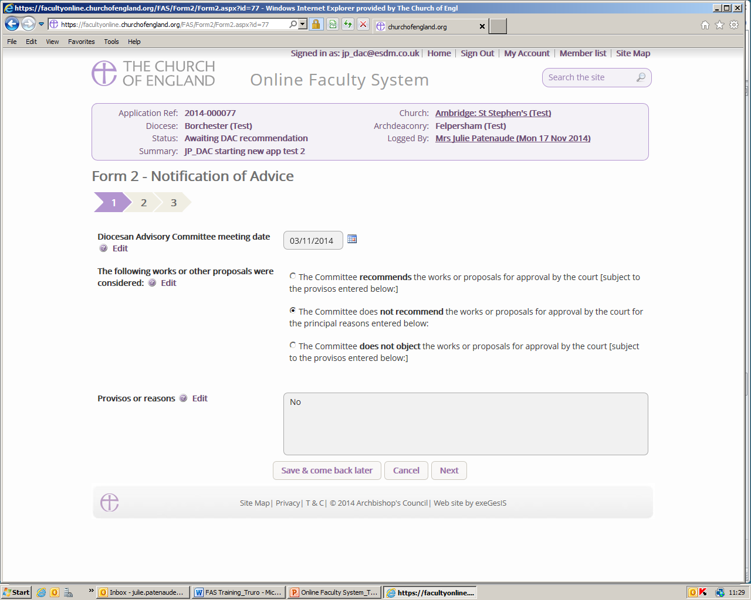
Notification of Advice

Slide 16
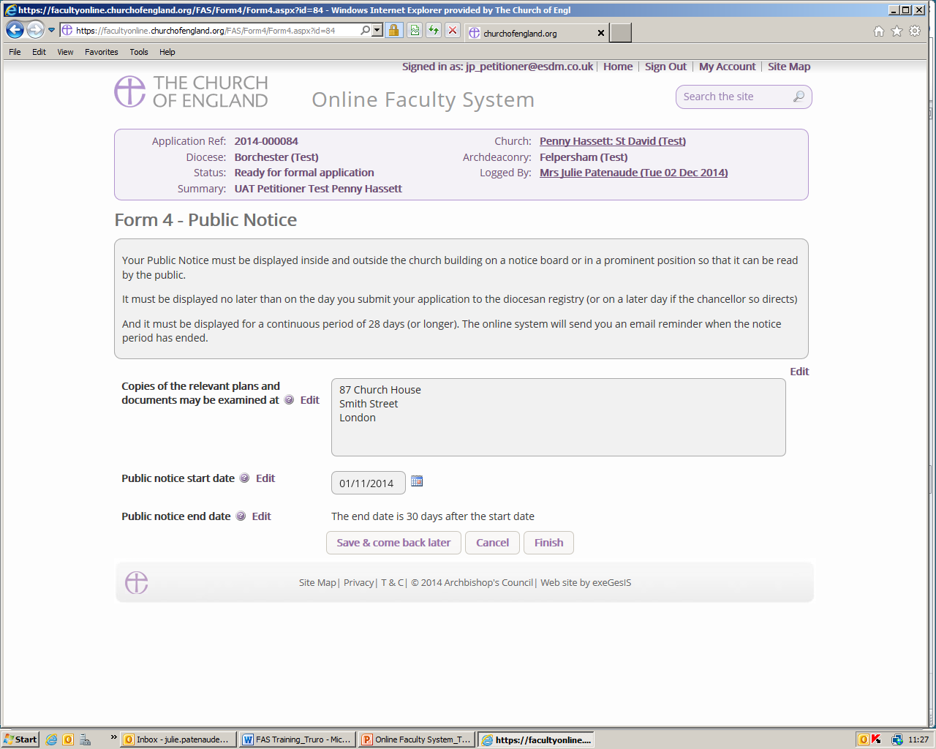
Public Notice Form

Slide 17
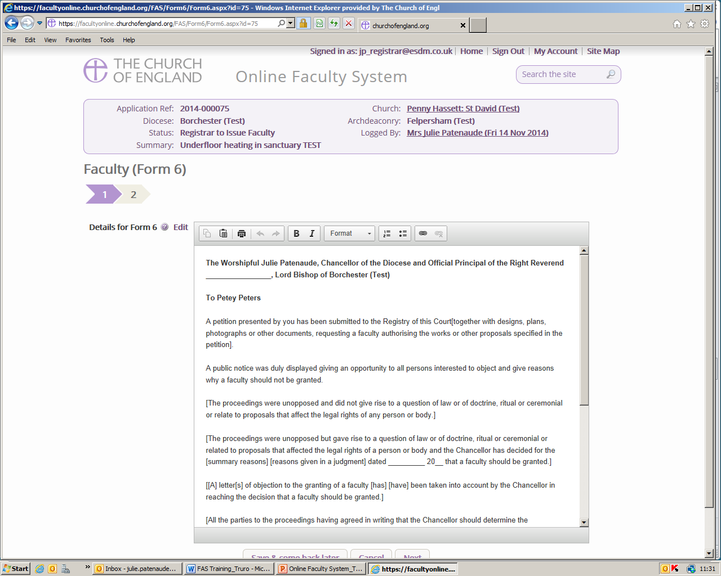
Faculty Approved

Slide 18
CONCLUSION
Ask the right questions
Work with partners in and beyond the church
Follow the guidance
Keep it simple. If it is not simple, it is wrong!
G W Heslop
Email: churches@durham.anglican.org
Notes:
test

