Slide 1
54%

Slide 2
46%!

Slide 4
Establishing a fundraising strategy
Why apply for charitable grant-aid?
Choosing the funders to approach
Filling in the application form
Justifying your proposals
Working with the local community

Slide 5
What are our priorities? Where are we now and where do we want to go? Do we know how much we need? Do we know when we need it? Do we know who can offer it?
The fundraising strategy

Slide 6
Why apply for grant-aid?
Funding Source | Amount
Heritage Lottery Fund | £350,000
Charitable trusts and funds | £120,000
Volunteer time | £80,000
Church reserves | £20,000
Fabric fund | £80,000
VAT reclaim (LPWGS) | £130,000
Local fundraising events | £15,000
Private donations | £45,000
Total | £840,000

Slide 7
Choosing the funders to approach

Slide 8
The application process

Slide 9
Justifying your proposals
“Most charitable giving is 80% emotion and 20% logic. The best way to get to someone’s emotions is to tell a good story.”

Slide 10
Working with the local community
“No one had ever become poor by giving.”
Anne Frank

Slide 11
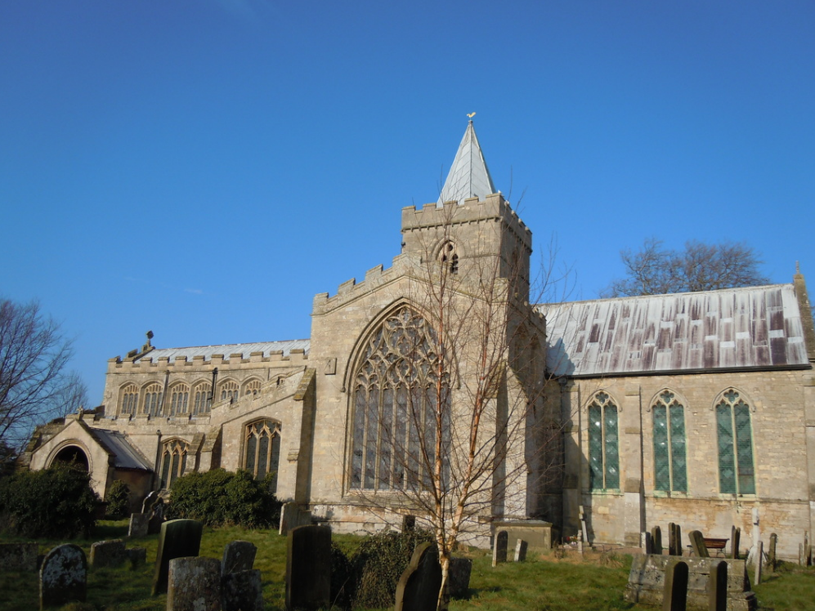
SS Peter and Paul, Algarkirk, Lincolnshire

Slide 12
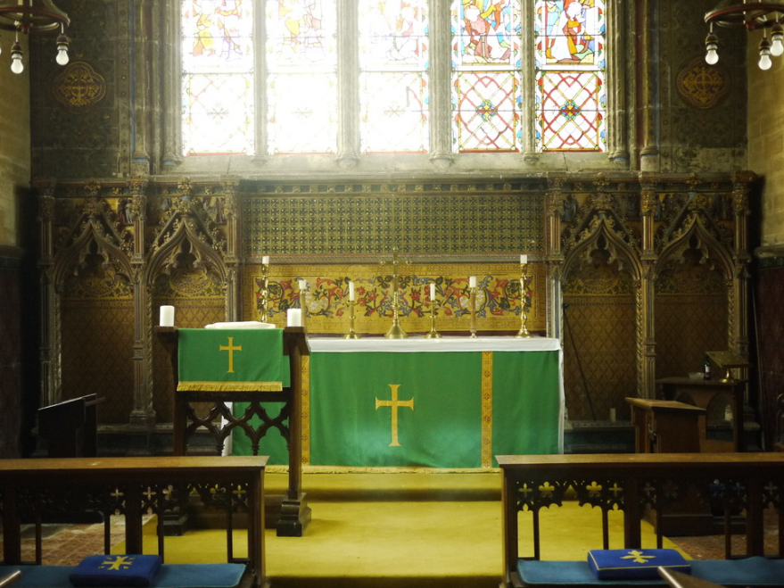

Slide 13
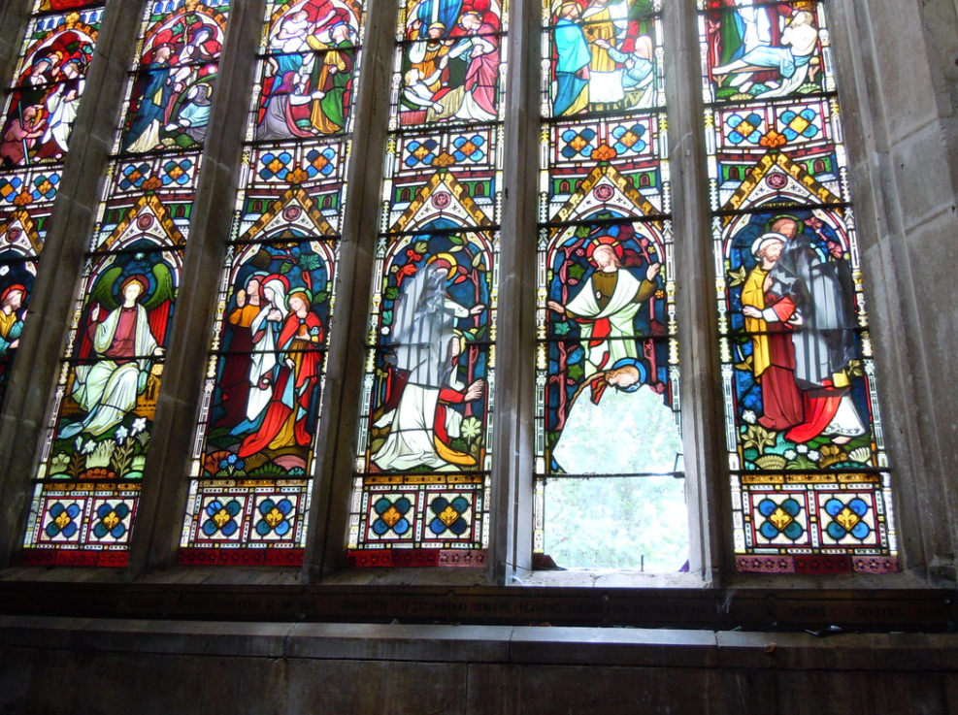

Slide 14
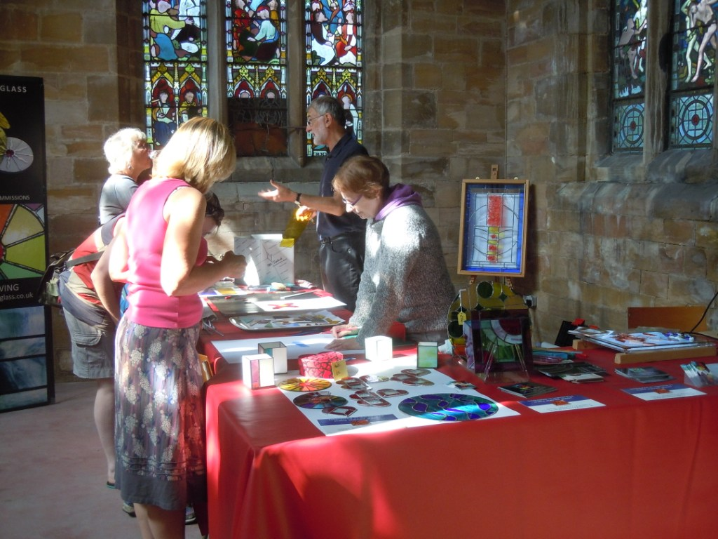
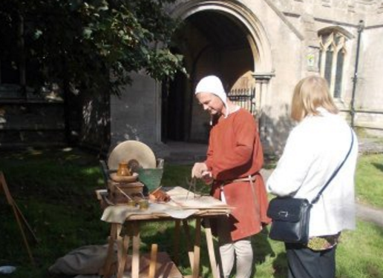
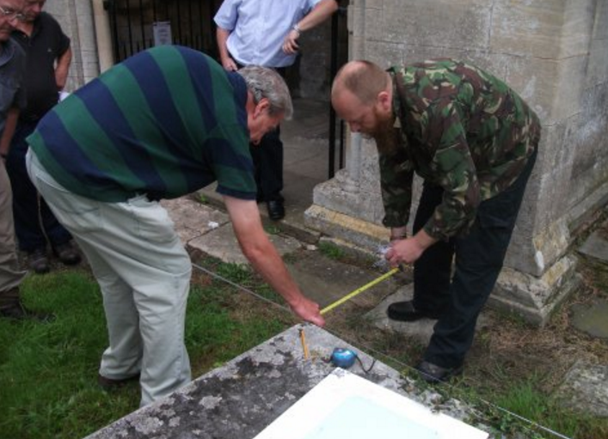
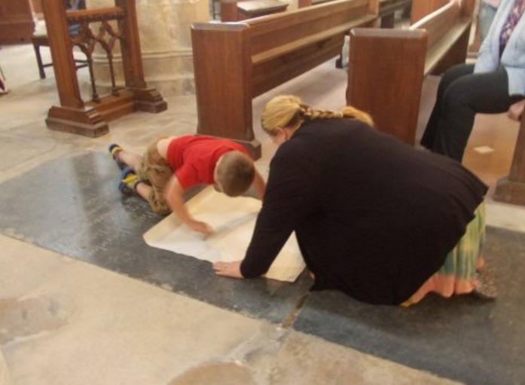

Slide 15
Top Tips

Slide 16
Rebecca Burrows
Senior Heritage Consultant
Rebecca.burrows@purcelluk.com

Slide 17
Useful Links
An online search engine, with access to over 4,000 grants, contracts and loans
www.fundingcentral.org.uk
A guide for anyone looking to repair, restore or convert a historic building
www.ffhb.org.uk
A selection of funding guidance documents, from setting a budget to VAT recovery
www.parishresources.org.uk
Particularly the Charitable Grants for Churches document
A guide for anyone looking to repair, restore or convert a historic building
www.theheritagealliance.org.uk/fundingdirectory
Listed Places of Worship Grant Scheme: for reclaiming VAT
http://www.lpwscheme.org.uk/
Heritage Alliance Funding Directory
http://www.theheritagealliance.org.uk/fundingdirectory/main/fundinghome.php
Notes:
I have included a list of useful links to funders and directories, which can be found in your conference packs.
The charitable grants for churches document on Parish Resources is particularly useful and lists over 200 funders that you could approach.

