Slide 1
HRBA event, Hexham
Andrew Duff
9th June 2016

Slide 2
Why ‘Inspired Futures’?
Inspired North East experience
Needs and opportunities
Project concept – a way of working:
Influential precedents…
A ‘task team’ approach...
A ‘cohort’ working model...

Slide 3
Stage 1 (2015)
‘Way Forward’ reports and Heritage assessments for 18 churches
Over 120 volunteers engaged
Over 200 training days
Audits, pilot heritage activities, etc
Recommendations for Stage 2 treatment
(report available on www.inspirednortheast.org.uk)

Slide 4
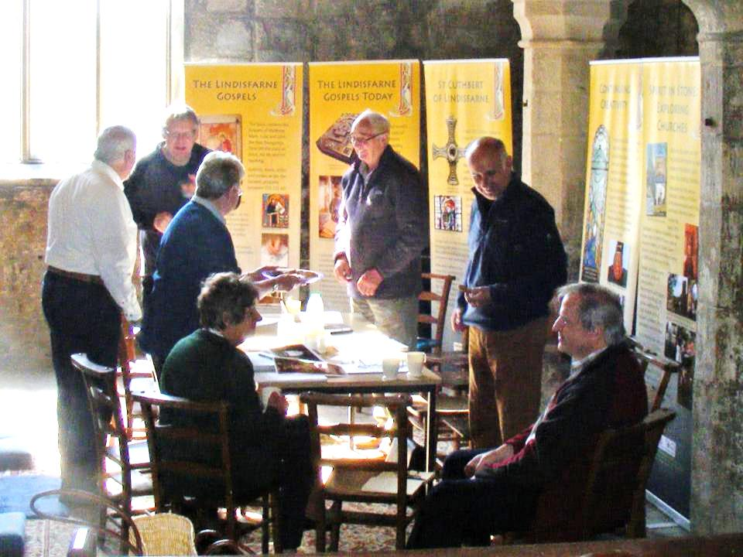
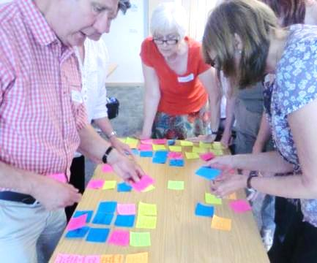
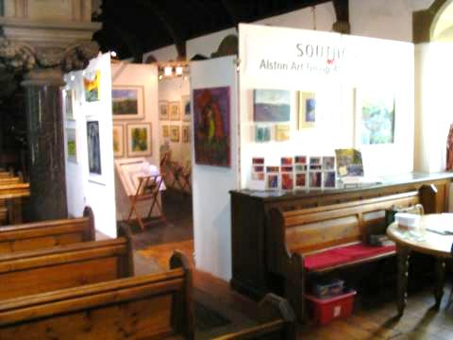
Elsdon local project group
Community Engagement
Workshop, Bensham
Alston art show

Slide 5
Stage 2 (2016-2019)
Project partners:
Newcastle Diocese & Durham Diocese (C of E)
The Churches Conservation Trust (CCT)
Historic England
National Churches Trust
Northumbria Historic Churches Trust
Project team:
Project Officer – to be appointed
Andrew Duff & David Lovie - Newcastle Diocese
Peter Biggers - Durham Diocese
Matthew McKeague & Regeneration Team – CCT
Jo Scott Associates – Heritage Consultant
Nicola Bell - Evaluation Consultant

Slide 6
Stage 2 Vision & Aims
Create sustainable futures for historic churches, build upon heritage and wider community opportunities, and strengthen capacity of those caring for this heritage.
Demonstrate new models, practical tools and concepts for working with historic places of worship and getting resources to where they are needed.

Slide 7
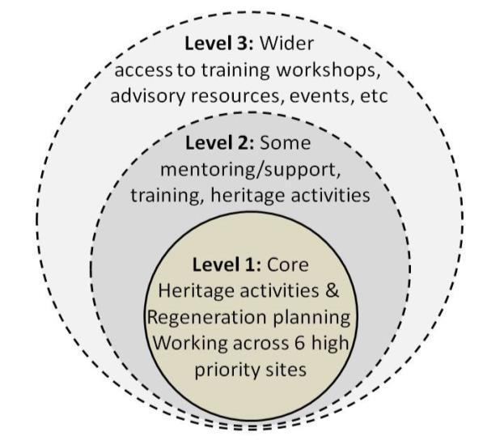
Three levels of activity
Open to other churches to share in events & tools
12 churches for Mentoring & Advice action
6 churches for Regeneration & Heritage action

Slide 8
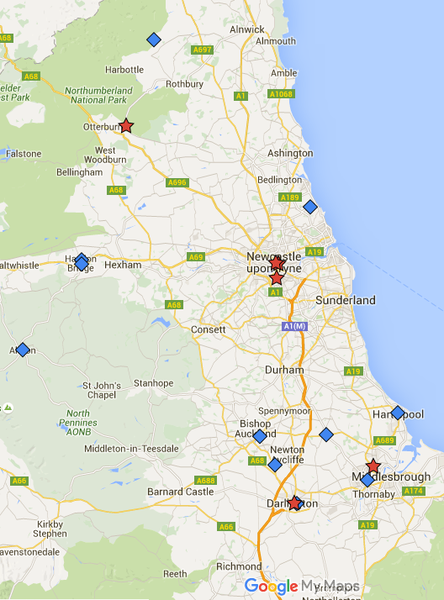
Sites proposed for ‘Level 1’ action:
Elsdon St Cuthbert’s
Haymarket St Thomas’
Shieldfield Christ Church
Bensham St Chad’s
Darlington St Cuthbert’s
Billingham St Cuthbert’s
Plus 12 other sites for ‘Level 2’ support.

Slide 9
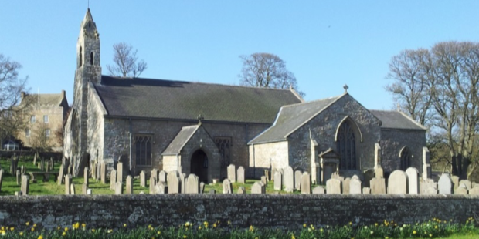
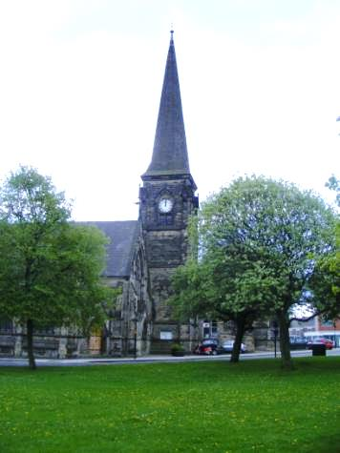
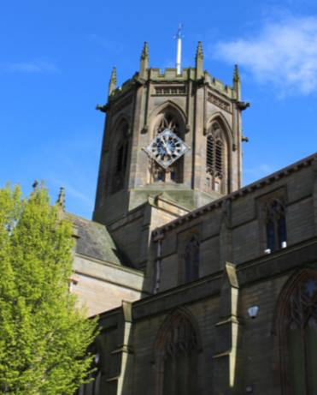
EXAMPLES
Deeply rural community…
Inner city transition…
Arts & Crafts gem…

Slide 10
Stage 2: ‘Level 1’ focus
6 churches receiving specialist regeneration support to produce detailed options appraisals, business plans, fundraising strategies, heritage activity and interpretation plans, proofs of concept and design specifications for any repairs and adaptations.
The 6 churches will also have heritage interpretation displays, learning resources and digital content, and linked in a ‘treasures’ trail.

Slide 11
Stage 2: ‘Level 2’ and beyond
12 other churches receiving targeted mentoring and advisory support, training and networking opportunities.
A 3-year training and skills programme - to be open to other churches.
Planning tools, video guide, online resources, case studies, etc - to be widely available.
A regional conference to share examples and insights for church regeneration projects.

Slide 12
For more details of the Inspired Futures project
visit: www.inspirednortheast.org.uk

