Slide 1
Inspiring Ideas:
Virtuous Circles
Accommodation Pod
Vowchurch and Turnastone PCC

Slide 2
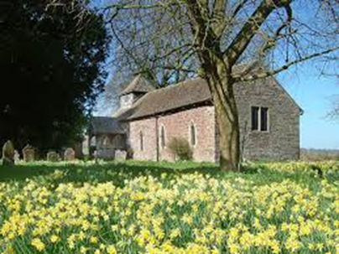

Slide 3
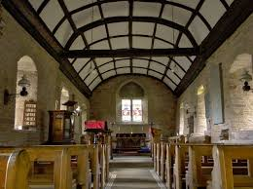

Slide 4
Approved Outcomes
Develop plans for the installation of an environmentally sustainable holiday accommodation pod in a church building.
Produce a Design and Business Development Guide to support others in pursuing similar proposals in their own buildings.

Slide 5
How will the outcomes be achieved?
Development Officer - to work with the partners, Vowchurch and Turnastone PCC, the church and wider community.
The support of partners, member churches and volunteers

Slide 6
How will the outcomes be achieved?
Architects have already been appointed.
Fergus Connolly and Charles Wellingham

Slide 7
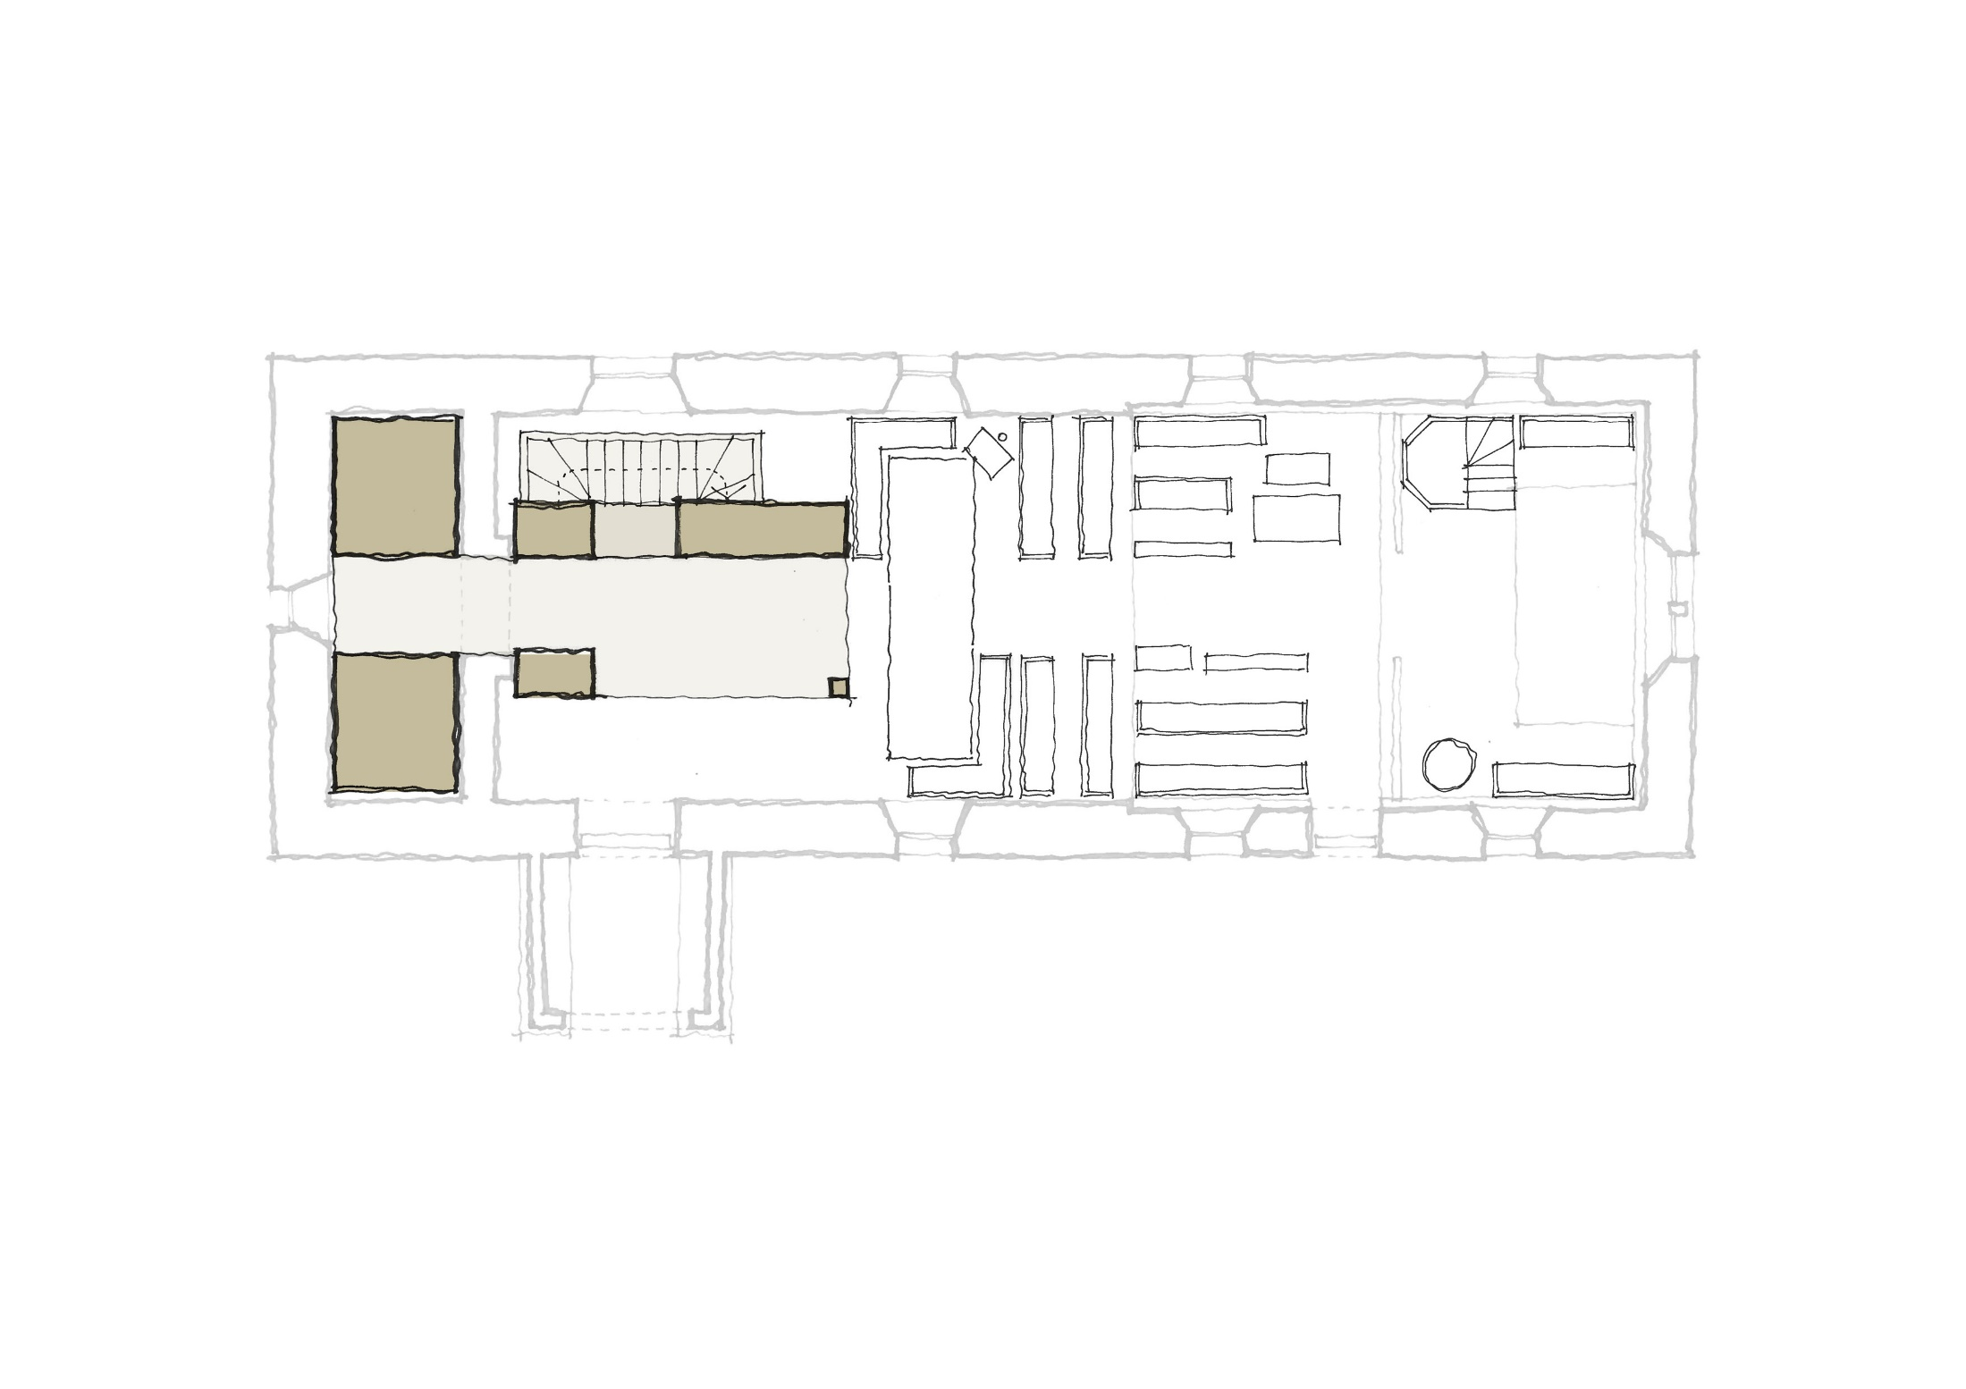
Shower
Kitchen Dining
WC
05. Pilot Project

Slide 8
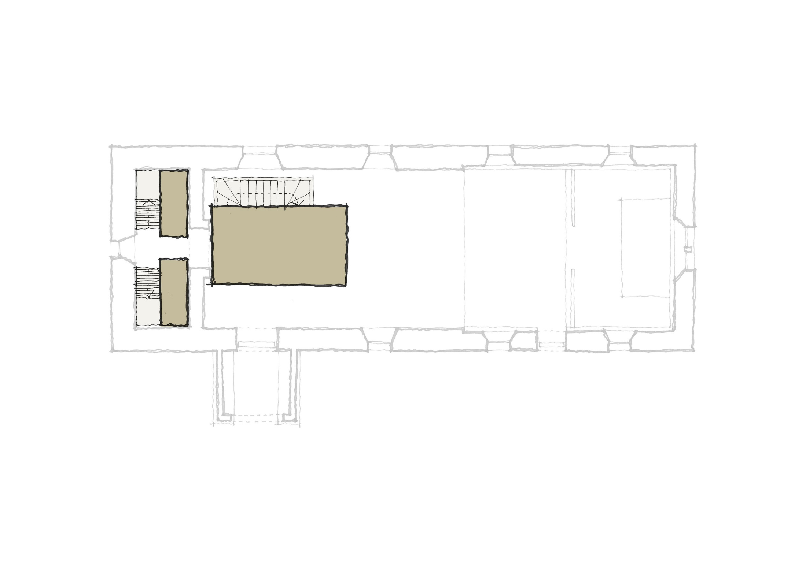
Cabin bed
Master bed & snug
Cabin bed
05. Pilot Project

Slide 9
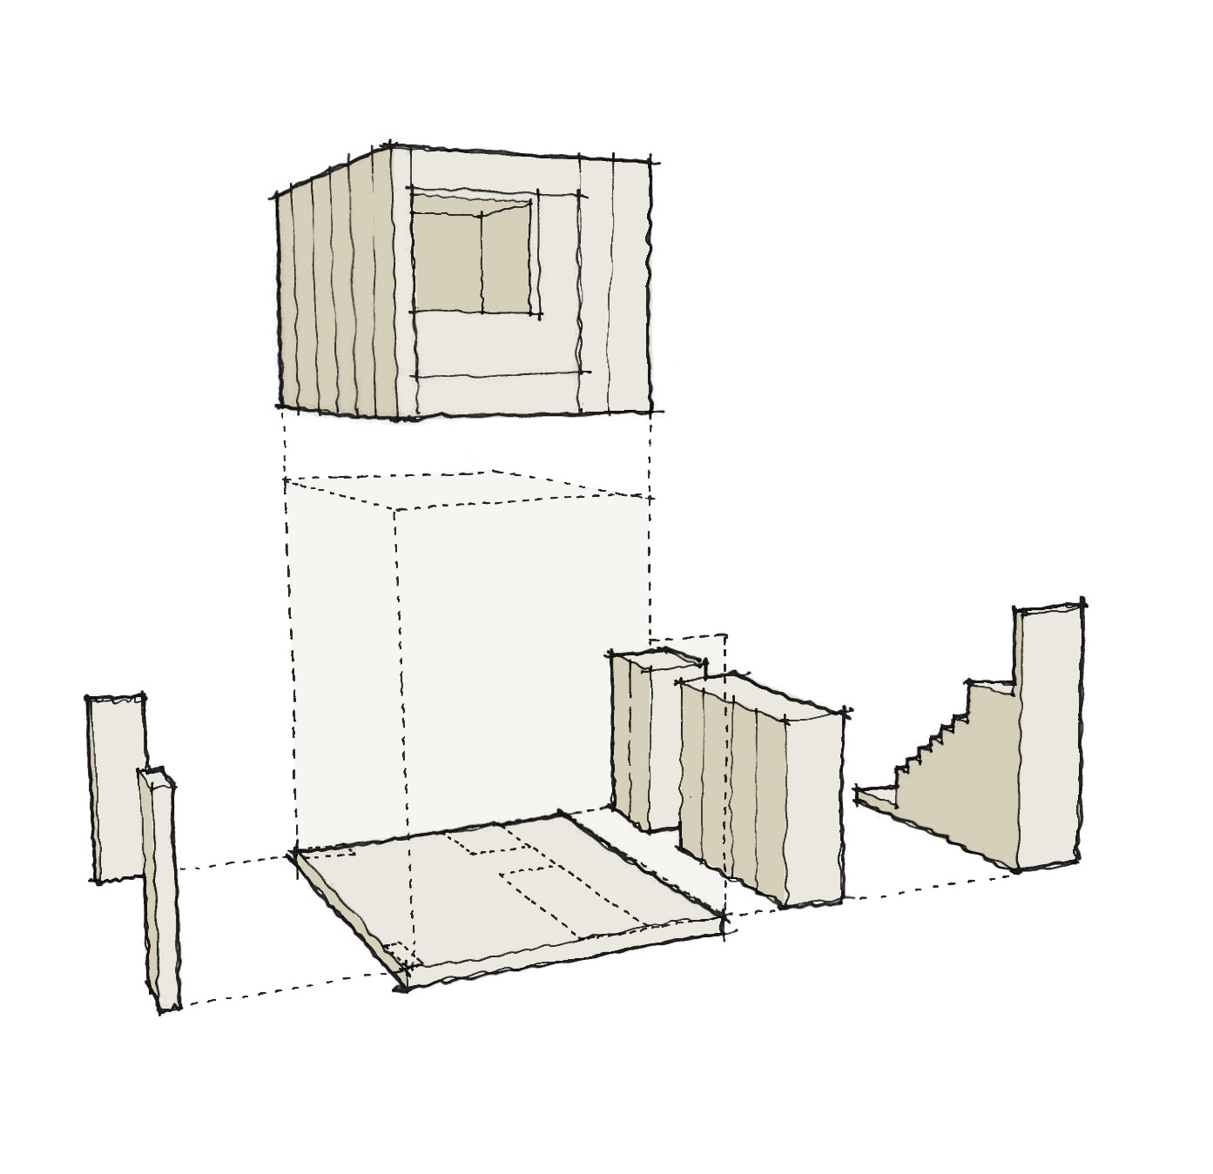
05. Pilot Project

Slide 10
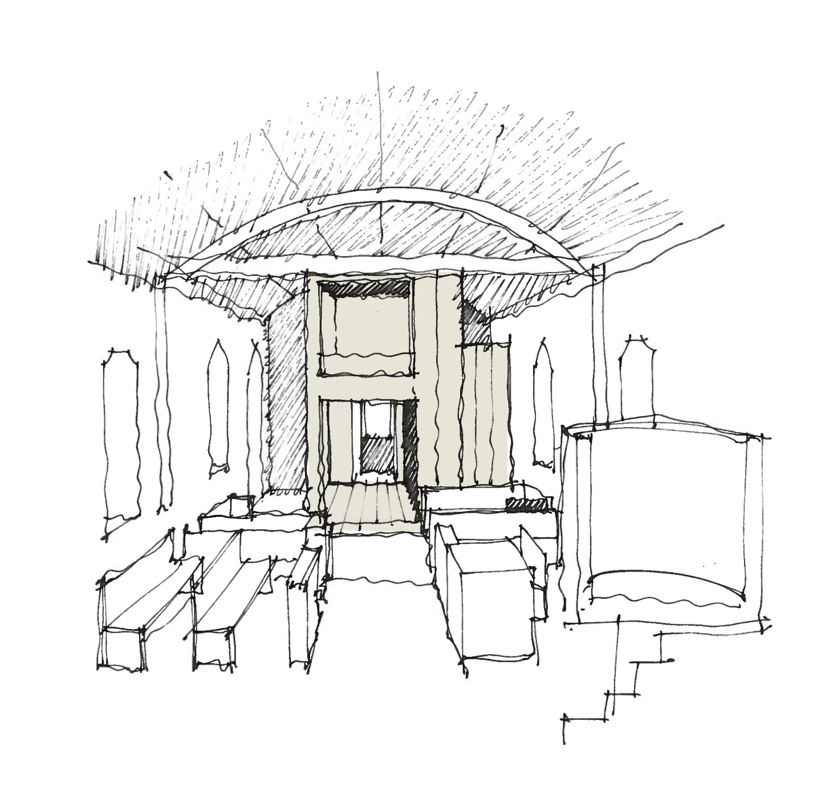
05. Pilot Project

Slide 12
Mission & Mortar.
Local Context: Diocesan Strategic Priorities arising out of MAPping process:
SP1 – Spiritual and numerical growth.
SP2 – Serving the common good.
SP3 – new patterns of ministry.
Notes:
Diocesan map showed that people were keen to engage in mission but buildings took a lot of energy. Working to find a way to simplify things for parishes.

Slide 13
Mission & Mortar
At every Mapping Event, care, development and maintenance of Church Buildings was raised, either as an opportunity or as a concern.
We needed to more effective in helping parishes to either take advantage of those opportunities or address the concern – but with no increase in financial resources.
Came up with the idea of developing an intuitive piece of software that would tailor resources based on the individual parish circumstances and encourage self help.
Tool is for hundreds of volunteers across the country who care for these amazing buildings on a daily basis; tested on real parishes and people – they were our guide.

Slide 14
Mission & Mortar
We already had some great projects, lots of good practice – Crossing the Threshold.
Identified over 300 other resources – from across the spectrum of church organisations, voluntary sector, other denominations.
The National Lottery Heritage fund supported us with a grant, and we are so proud to launch this today.

Slide 15
Mission & Mortar
On line resource, which you need to register for but which is free.
Carry out a ‘diagnostic survey’ based loosely on a number of categories, and which will recommend a series of resources based on your answers.
Categories are based on levels of encounter – so, include tourism, festival churches, local mission churches and major mission church.
Still in the pilot stage – which runs till June 2020.

Slide 16
Mission & Mortar
Church Projects and Funding Support Assistant – desk based resource and to update resources.
Project Visits through DAC Site visits.
Programme of training based on categories – cascades down – Diocese, Archdeaconry level, Deanery Level – workshops and surgeries.
Moving to a model of self help.

Slide 17
Mission & Mortar
Next Steps?
We want people to use it – so please share it with your networks and let as many people know about it as possible.
We want to keep testing it and keep tweaking it – but based on feedback.
Next Spring we will hold a conference to continue to raise awareness of the tool and to also look at other Church Buildings Topics.
Develop a training programme to support the tool.
Need to find more funding – to maintain it, to grow it and adapt it and to keep people in post to sustain the tool.

Slide 18
Mission & Mortar

