Slide 1
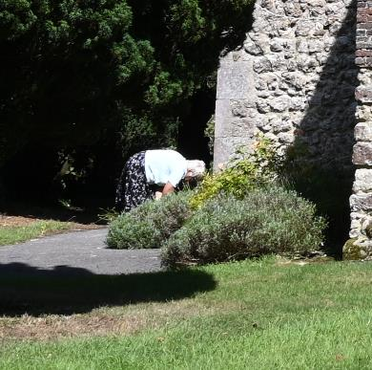
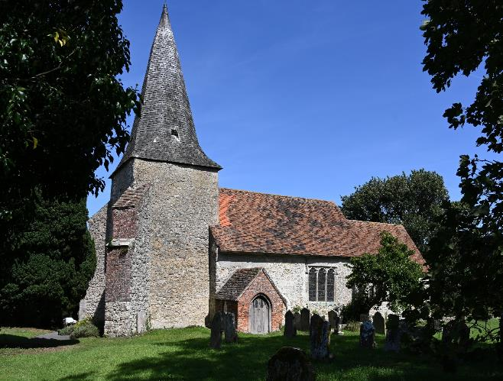
Problems and Possibilities for the Isolated Rural Church
or
In an ideal world,
what should I have been able to say to Mrs Warden?
Trevor Cooper
hrballiance.org.uk

Slide 2

The isolated rural church
Problems
Possible solutions
. . . close look at ‘community use’
Situation now
Dear Mrs Warden

Slide 3
Many churches supported by tiny communities
Nine percent (9%) of the churches of this country
are in places
where one third of one percent (0.33%) of the population lives
Source: Archbishops’ Council, 2018

Slide 4
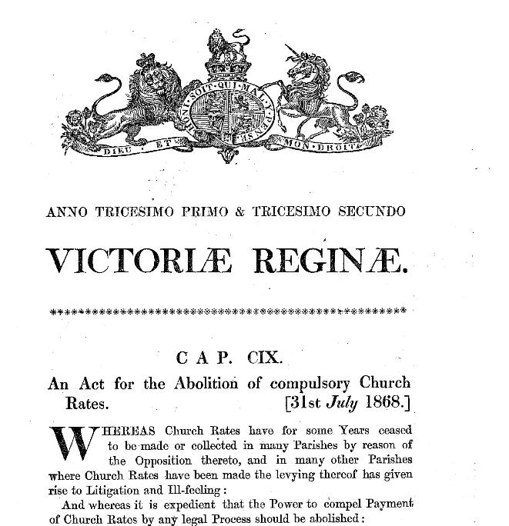
Act for abolition of compulsory Church Rates (1868)

Slide 5
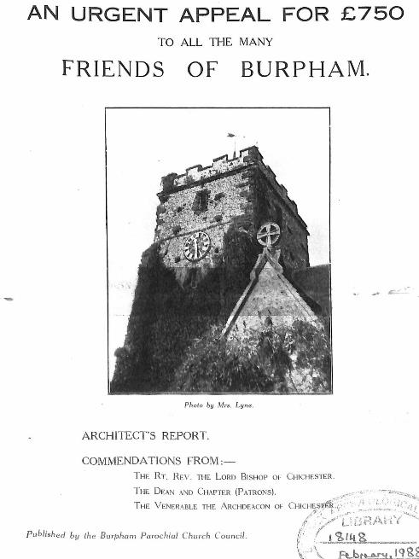
1936 appeal leaflet for
Burpham church, West Sussex

Slide 6
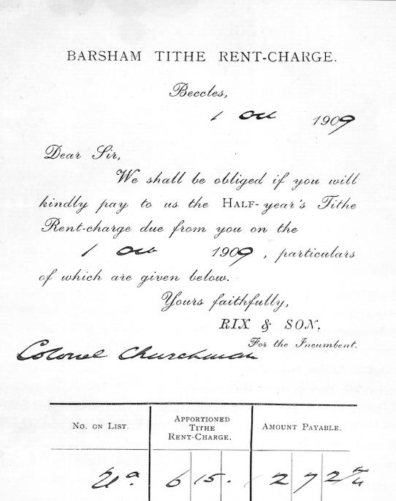
Tithe demand, 1909 (from Carol Twinch, Tithe Wars)

Slide 7
CofE trends, 1968 to present, eight rural dioceses
normalised: 100=start 1970 (attendance)
rural = Exeter, Gloucs, Hereford, Lincoln, Norwich, Peterborough, Salisbury, St Edmundsbury & Ipswich
set to 100
47
rural Sunday attendance
47
Source: Church Year Book, Church Statistics, Statistics for Mission (all various years). Attendance is uSa

Slide 8
Sunday attendance
Tiny congregations
2000 churches: 10 or fewer
of which
700 churches: 5 or fewer
Source: Archbishops’ Council, 2018

Slide 9
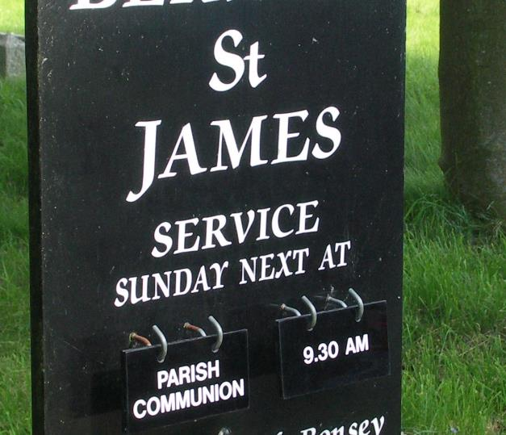

Slide 10
The three P’s
People
Pounds
Purpose

Slide 11
The isolated rural church
Problems
Possible solutions
. . . close look at ‘community use’
Situation now
Dear Mrs Warden

Slide 12
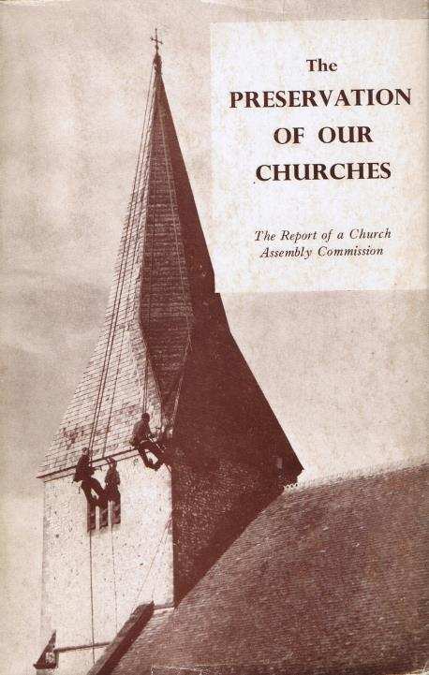
The
Preservation
of our
Churches
1952

Slide 13
1952
1970s
later
Proposed solution
X
Pooled donations
Financial support

Slide 14
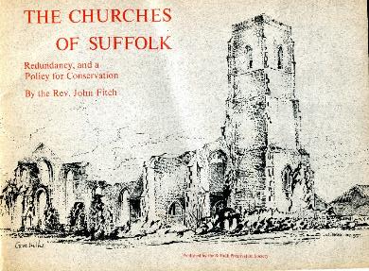

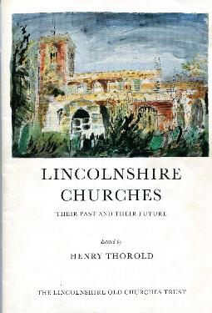
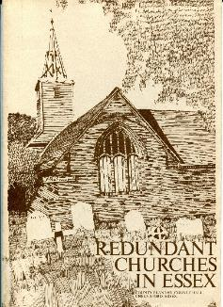
1976
1974
1972
1977

Slide 15

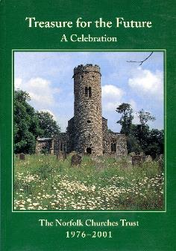
1976
1974
1972
1991
1977
2001

Slide 16
1952
1970s
later
Proposed solution
X
Pooled donations
Financial support
Government money
X
X
Friends Groups
X
Parish Councils
X
Meeting rooms, mobile library or post office
X
Free nave of fixed seating for multi use
Additional
use
X
X
Exhibitions, concerts : later tourism
X
Sleeping loft etc for ‘pilgrims’
X
‘Shrine’, no services
X
Estate church to big house
X
Use as village hall, not church
Remove
from PCC
CCT, FoFC : later Norf Chs Trust, etc
X
X
X
Lease to Diocese
X
Use part only, de-roof rest
Other
X
Festivals only, locals paying
X
Festivals only, parish pays (=chapel of ease)
X
Congregation rents church from Trust

Slide 17
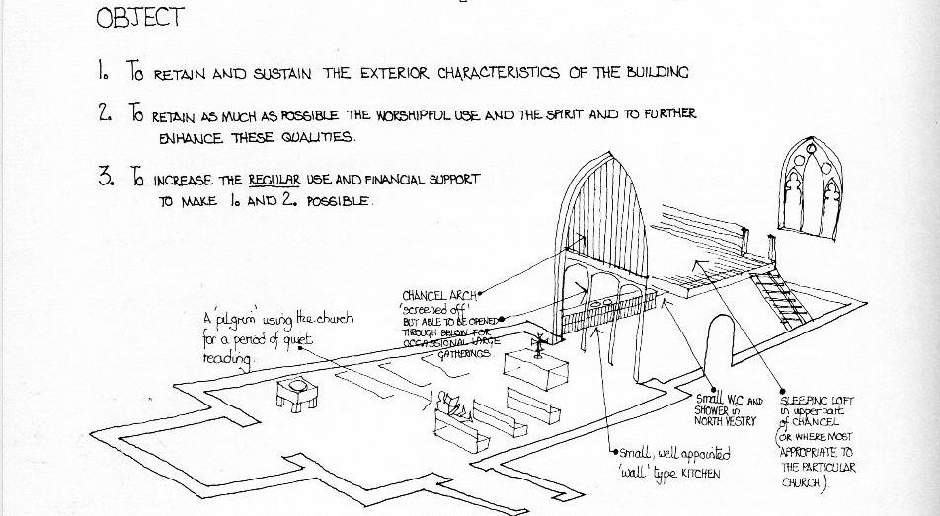
A pilgrim church (1972)
From Norfolk Country Churches and the Future, 1972

Slide 18
1952
1970s
later
Proposed solution
X
Pooled donations
Financial support
Government money
X
X
Friends Groups
X
Parish Councils
X
Meeting rooms, mobile library or post office
X
Free nave of fixed seating for multi use
Additional
use
X
X
Exhibitions, concerts : later tourism
X
Sleeping loft etc for ‘pilgrims’
X
‘Shrine’, no services
X
Estate church to big house
X
Use as village hall, not church
Remove
from PCC
CCT, FoFC : later Norf Chs Trust, etc
X
X
X
Lease to Diocese
X
Use part only, de-roof rest
Other
X
Festivals only, locals paying
X
Festivals only, parish pays (=chapel of ease)
X
Congregation rents church from Trust

Slide 19
The isolated rural church
Problems
Possible solutions
. . . close look at ‘community use’
Situation now
Dear Mrs Warden

Slide 20
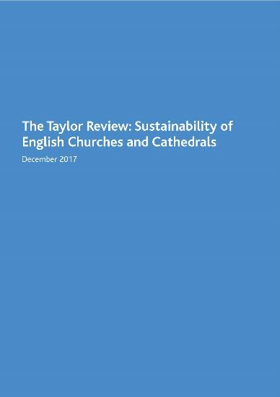

Slide 21
1820
1952
1970s
later
Proposed solution
X
Government
X
Pooled donations
Financial support
Government money
X
X
Friends Groups
X
Parish Councils
X
Meeting rooms, mobile library or post office
COMMUNITY USE
X
Free nave of fixed seating for multi use
Additional
use
X
X
Exhibitions, concerts : later tourism
X
Sleeping loft etc for ‘pilgrims’
X
‘Shrine’, no services
X
Estate church to big house
X
Use as village hall, not church
Remove
from parish
CCT, FoFC : later Norf Chs Trust, etc
X
X
X
Lease to Diocese
X
Use part only, de-roof rest
Other
X
Festivals only, locals paying
X
Festivals only, parish pays (=chapel of ease)
X
Congregation rents church from Trust

Slide 22
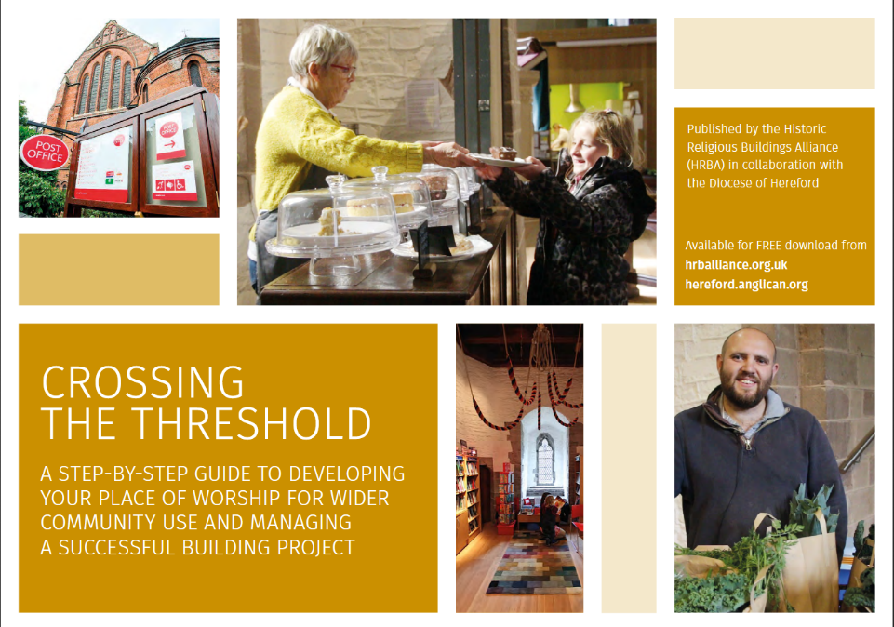

Slide 23
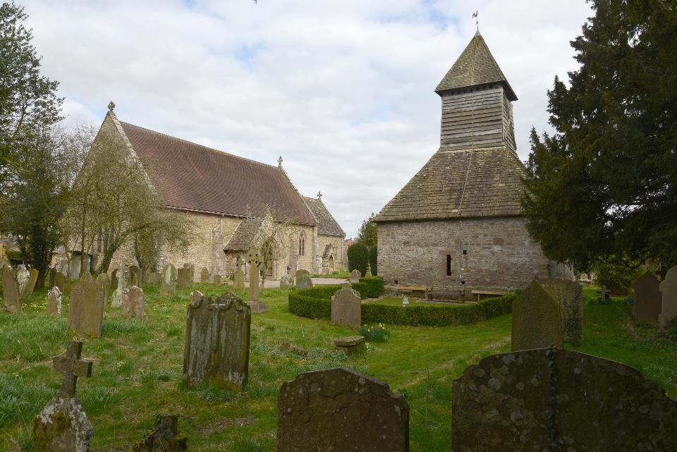
Yarpole, Herefordshire

Slide 24
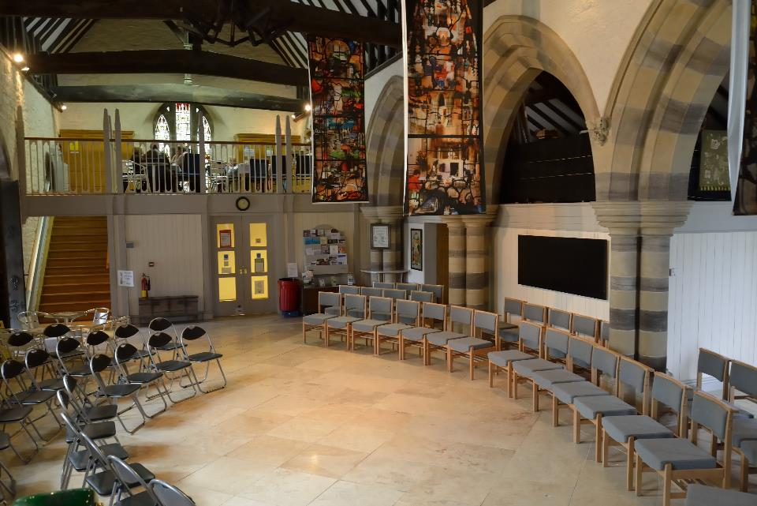
Yarpole, Herefordshire

Slide 25
Hoped for impact from community use
more people
getting involved
more community use
more ability to
get things done
more income
more sustainability
more public benefit
(e.g. wellbeing)

Slide 26
Hoped for impact from community use
How feasible?
How many?
more people
getting involved
more community use
How much?
more ability to
get things done
more income
more sustainability
more public benefit
(e.g. wellbeing)

Slide 27
Rural hamlets and villages,
Churches lacking both toilets and kitchen area
Banded by average number of people attending at least one day in the week
People
attending
0-5
6-10
11-15
16-20
21-25
26-30
31 or more
Percent of
churches
84%
77%
66%
57%
49%
41%
21%
Number
of churches
(rounded)
600
680
560
370
220
170
500
Source: Archbishops’ Council, 2018

Slide 28
Village halls
At least 85% of settlements have a hall
90% running below full capacity
30% of inadequate quality
54% don’t cover running costs
Sources: Countryside Agency, Acre

Slide 29
The isolated rural church
Problems
Possible solutions
. . . close look at ‘community use’
Situation now
Dear Mrs Warden

Slide 30
The three P’s
People
Pounds
Purpose

Slide 31

search for: Growing the rural church Exeter

Slide 32
The isolated rural church
Problems
Possible solutions
. . . close look at ‘community use’
Situation now
Dear Mrs Warden

Slide 33
Dear Mrs Warden
I am emailing you from a parallel universe, to which I appear to have been teleported . . .
. . . .
So I am sure there is an exciting future for the church– with new sources of money, new people involved, and a fresh purpose.
I suppose I ought to teleport back, but I rather like it here.
With best wishes
Trevor

