Slide 1
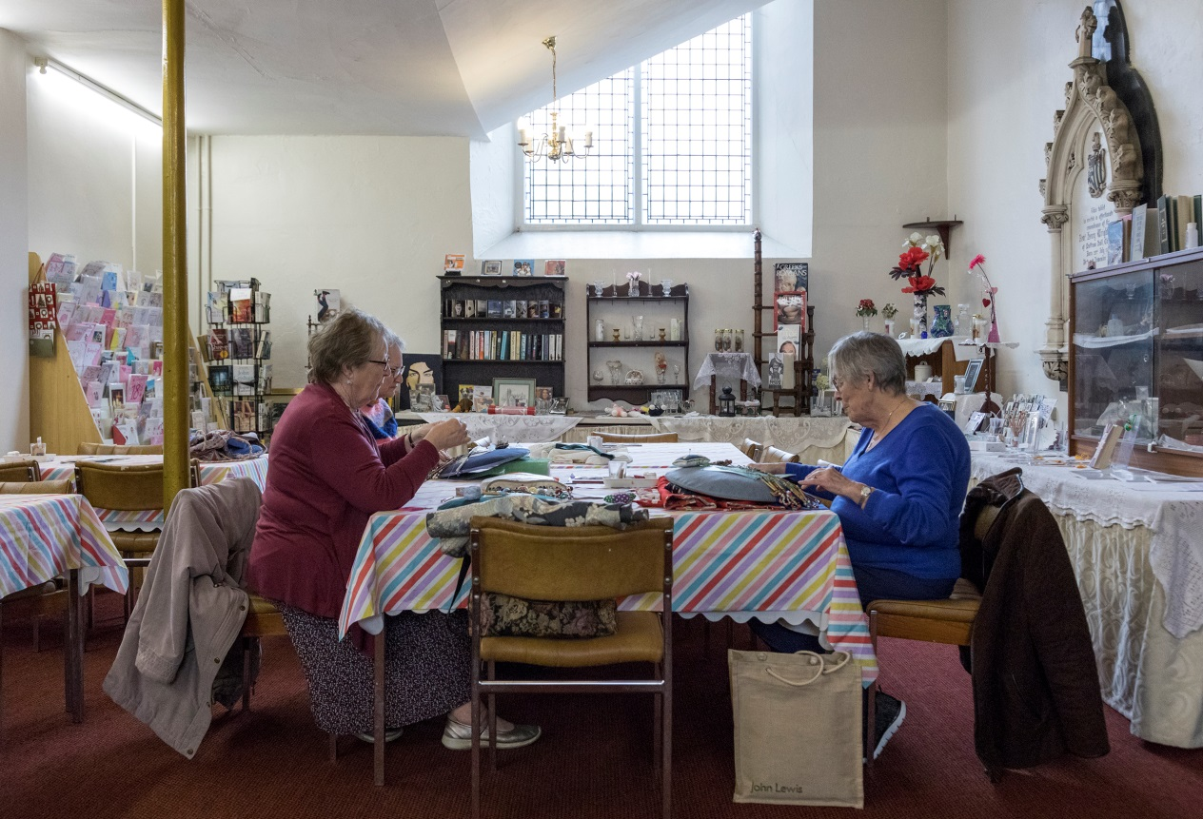
Taylor Review Pilot
Lucy More
Project Manager
All images © Historic England
All images are © Historic England

Slide 2
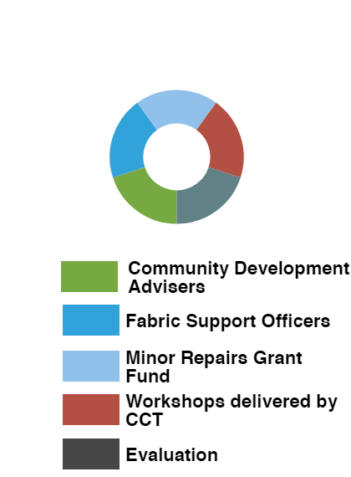
Pilot Scope

Slide 3
Progress to November 2019
377 places of worship in contact with or contacted by the pilot team
177 site visits to different places of worship completed
152 places of worship received community development support
985,051 grant funding committed for maintenance and minor repairs
Notes:
377 POWs of 862 engaged
177 site visits – some 1 visit = 1 day but Greater Manchester team visited five on one memorable day

Slide 4
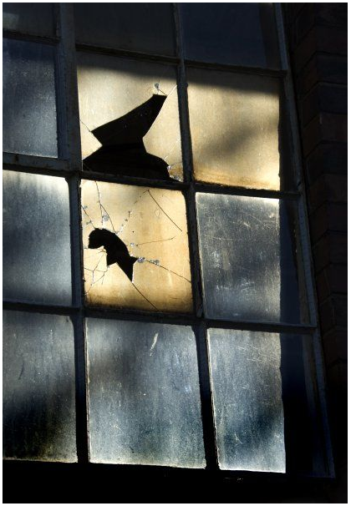
Can we do more to improve understanding of the value of regular maintenance activity?
Recognising the financial impact of neglecting maintenance
Notes:
Many do not recognise the financial impact of neglecting maintenance - The Value of Maintenance Report

Slide 5
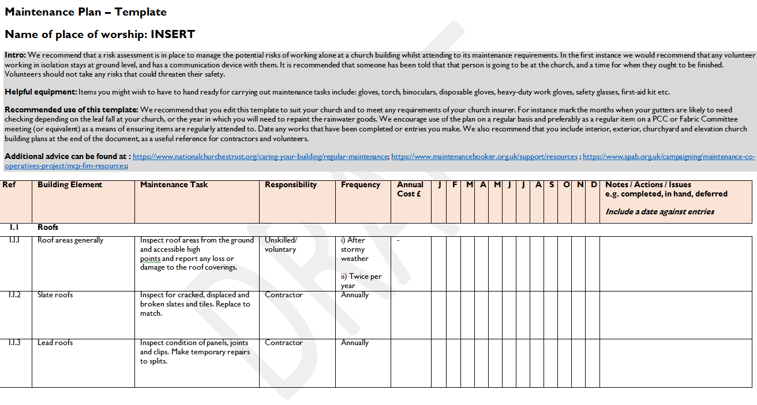
How can we help people to formalise their approaches to maintenance?
Lack of a written maintenance plan does not mean that there is no activity
Notes:
Creation of an updated maintenance plan template which includes a section for works highlighted in the QI

Slide 6
How can we better communicate the benefits of community development?
“We’ve already engaged the community”
Notes:
Thornham RL NHLF application
Creation of a CDA process map
Testing varied levels of support

Slide 7
How can we improve people’s understanding of health and safety?
Further training could be considered
Notes:
Applications have been rejected on the basis of concerns over H&S but there is much more work to do

Slide 8
Can we help to spread positive messages about consent and permissions?
Works without consent are often included in grant applications

Slide 9
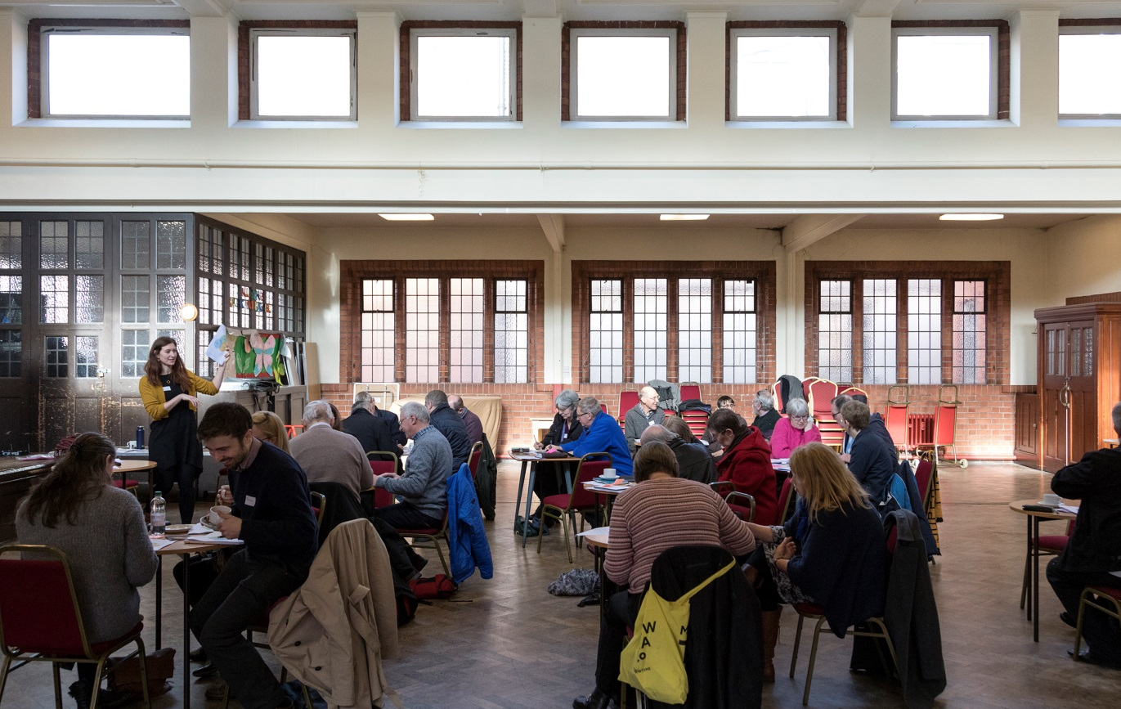
How can we emphasise the value of peer-to-peer support and learning?
Feedback on the Churches Conservation Trust workshops has been very positive

