Slide 1
St. Peter’s, Alstonefield
A PCC’s experience of installing a toilet
in a Grade 1 church
Jon Lane, voluntary Project Manager, December 2019
With acknowledgement to Chris Hesketh, CTD Architects, Leek

Slide 2
Problem:
Large, beautiful, old church, always open to visitors
Small village, tiny congregation, little money
Need to host more events and attract more visitors, but … no toilet!
Grade 1 listed, hence many planning restrictions

Slide 3
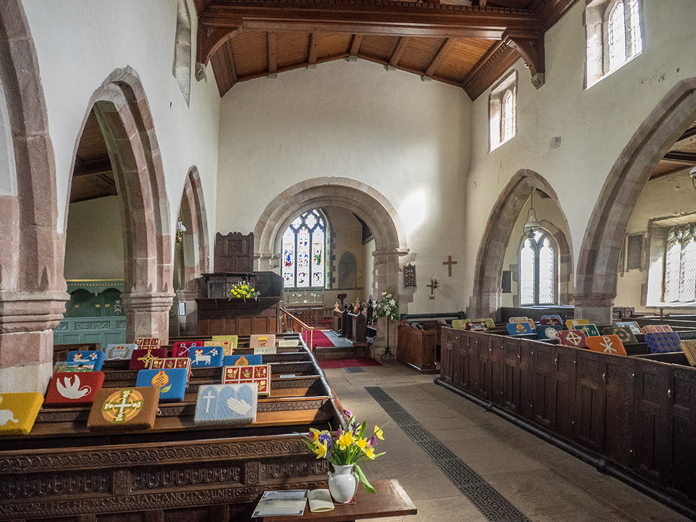
It is a beautiful church…

Slide 4
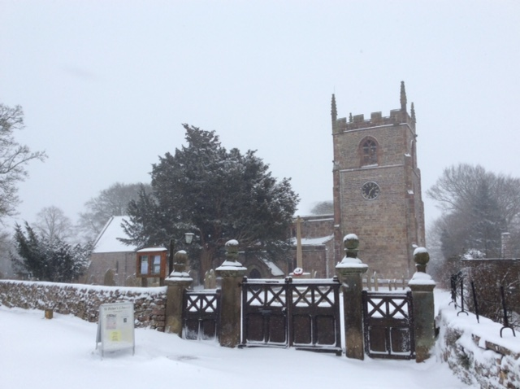
… which is open all the time

Slide 5
Design approach:
PCC sees a toilet as an investment, not a cost
Toilet to be top quality, wheelchair access, baby changing etc.
The whole toilet room to be removable without a trace
The unused South Porch was the agreed best location
To avoid excavation in the churchyard: a low-flush toilet with macerator and holding tank

Slide 6
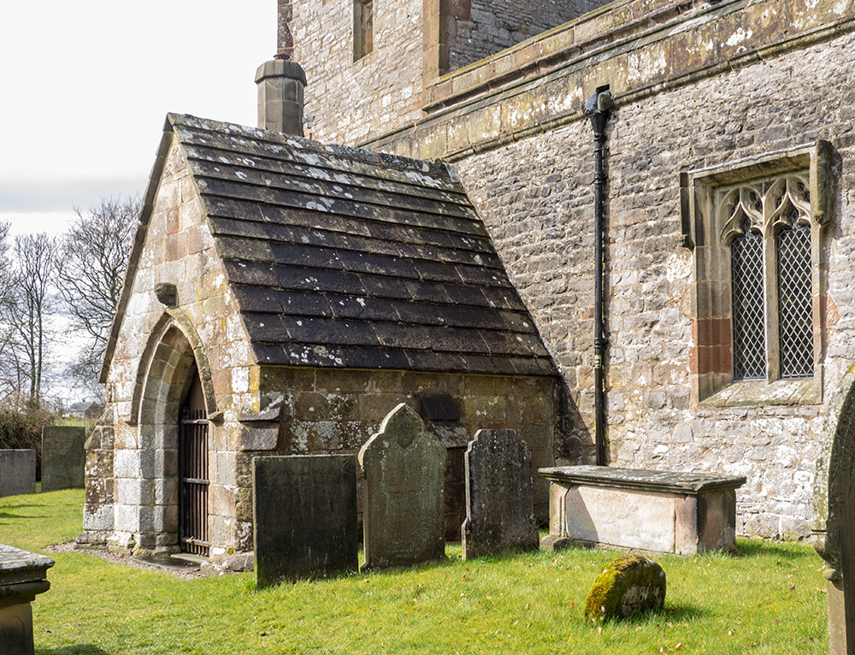
The 13th-Century South Porch…

Slide 7
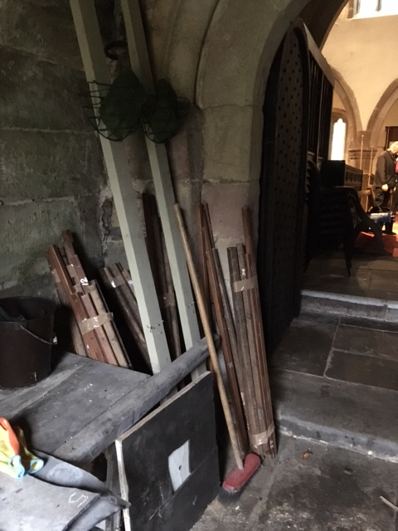
… which has been used only as a store-room since the 1880s

Slide 8
Approval procedure:
Lichfield DAC is the authorising body
Insists on design by Church Architect
Main interest is aesthetic, little interest in function or cost
This approval process took two years

Slide 9
Construction:
Obtained quotes from local contractors
DAC gave various authorisations easily
Construction itself was simple, took two months
Site supervision by Church Architect would have been costly – fortunately, DAC recognised Jon Lane as acceptable supervisor

Slide 10
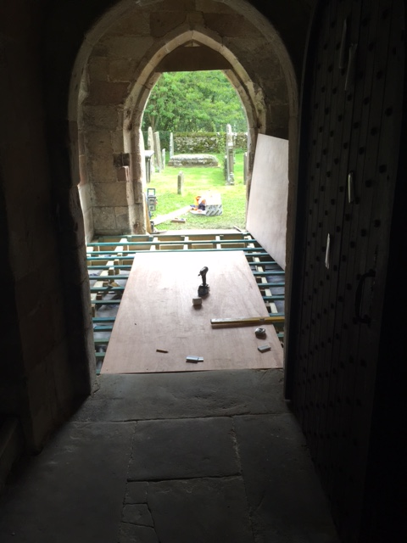
The toilet floor under construction, resting on the stone floor

Slide 11
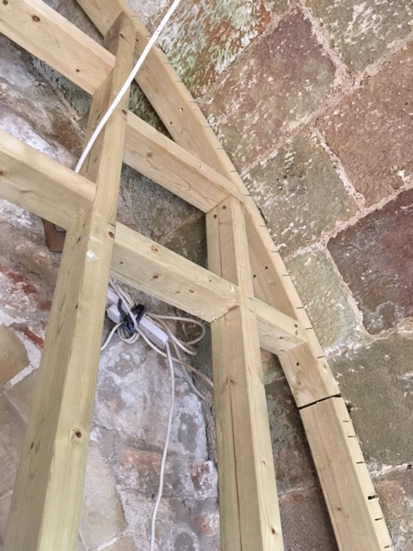
The partition walls going up, fixed only into mortar joints

Slide 12
The finished toilet:
Achieved the design aims
Convenient and pleasant to use
Admired by the community members
Quite high-maintenance e.g. emptying tank, checking that the macerator, alarms etc are working

Slide 13
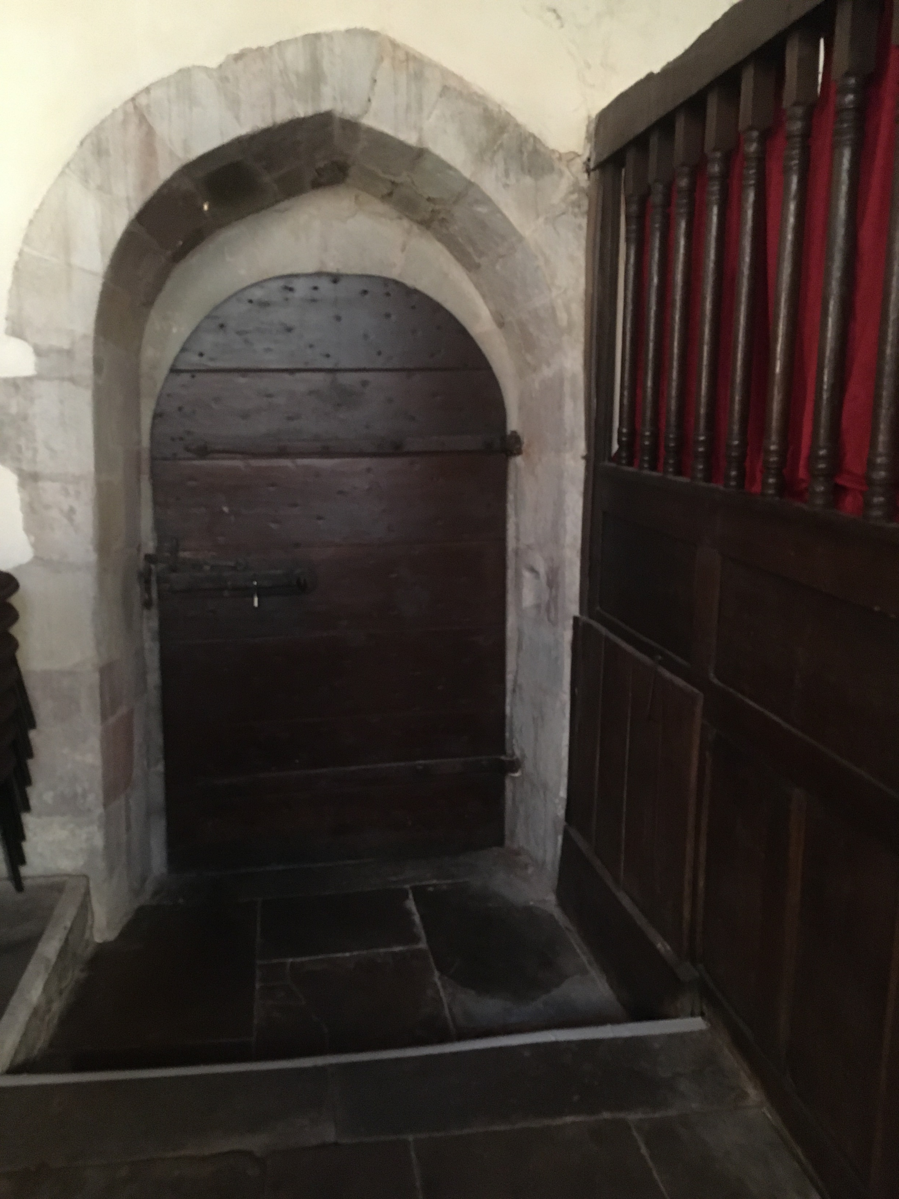
This is the existing door from the nave

Slide 14
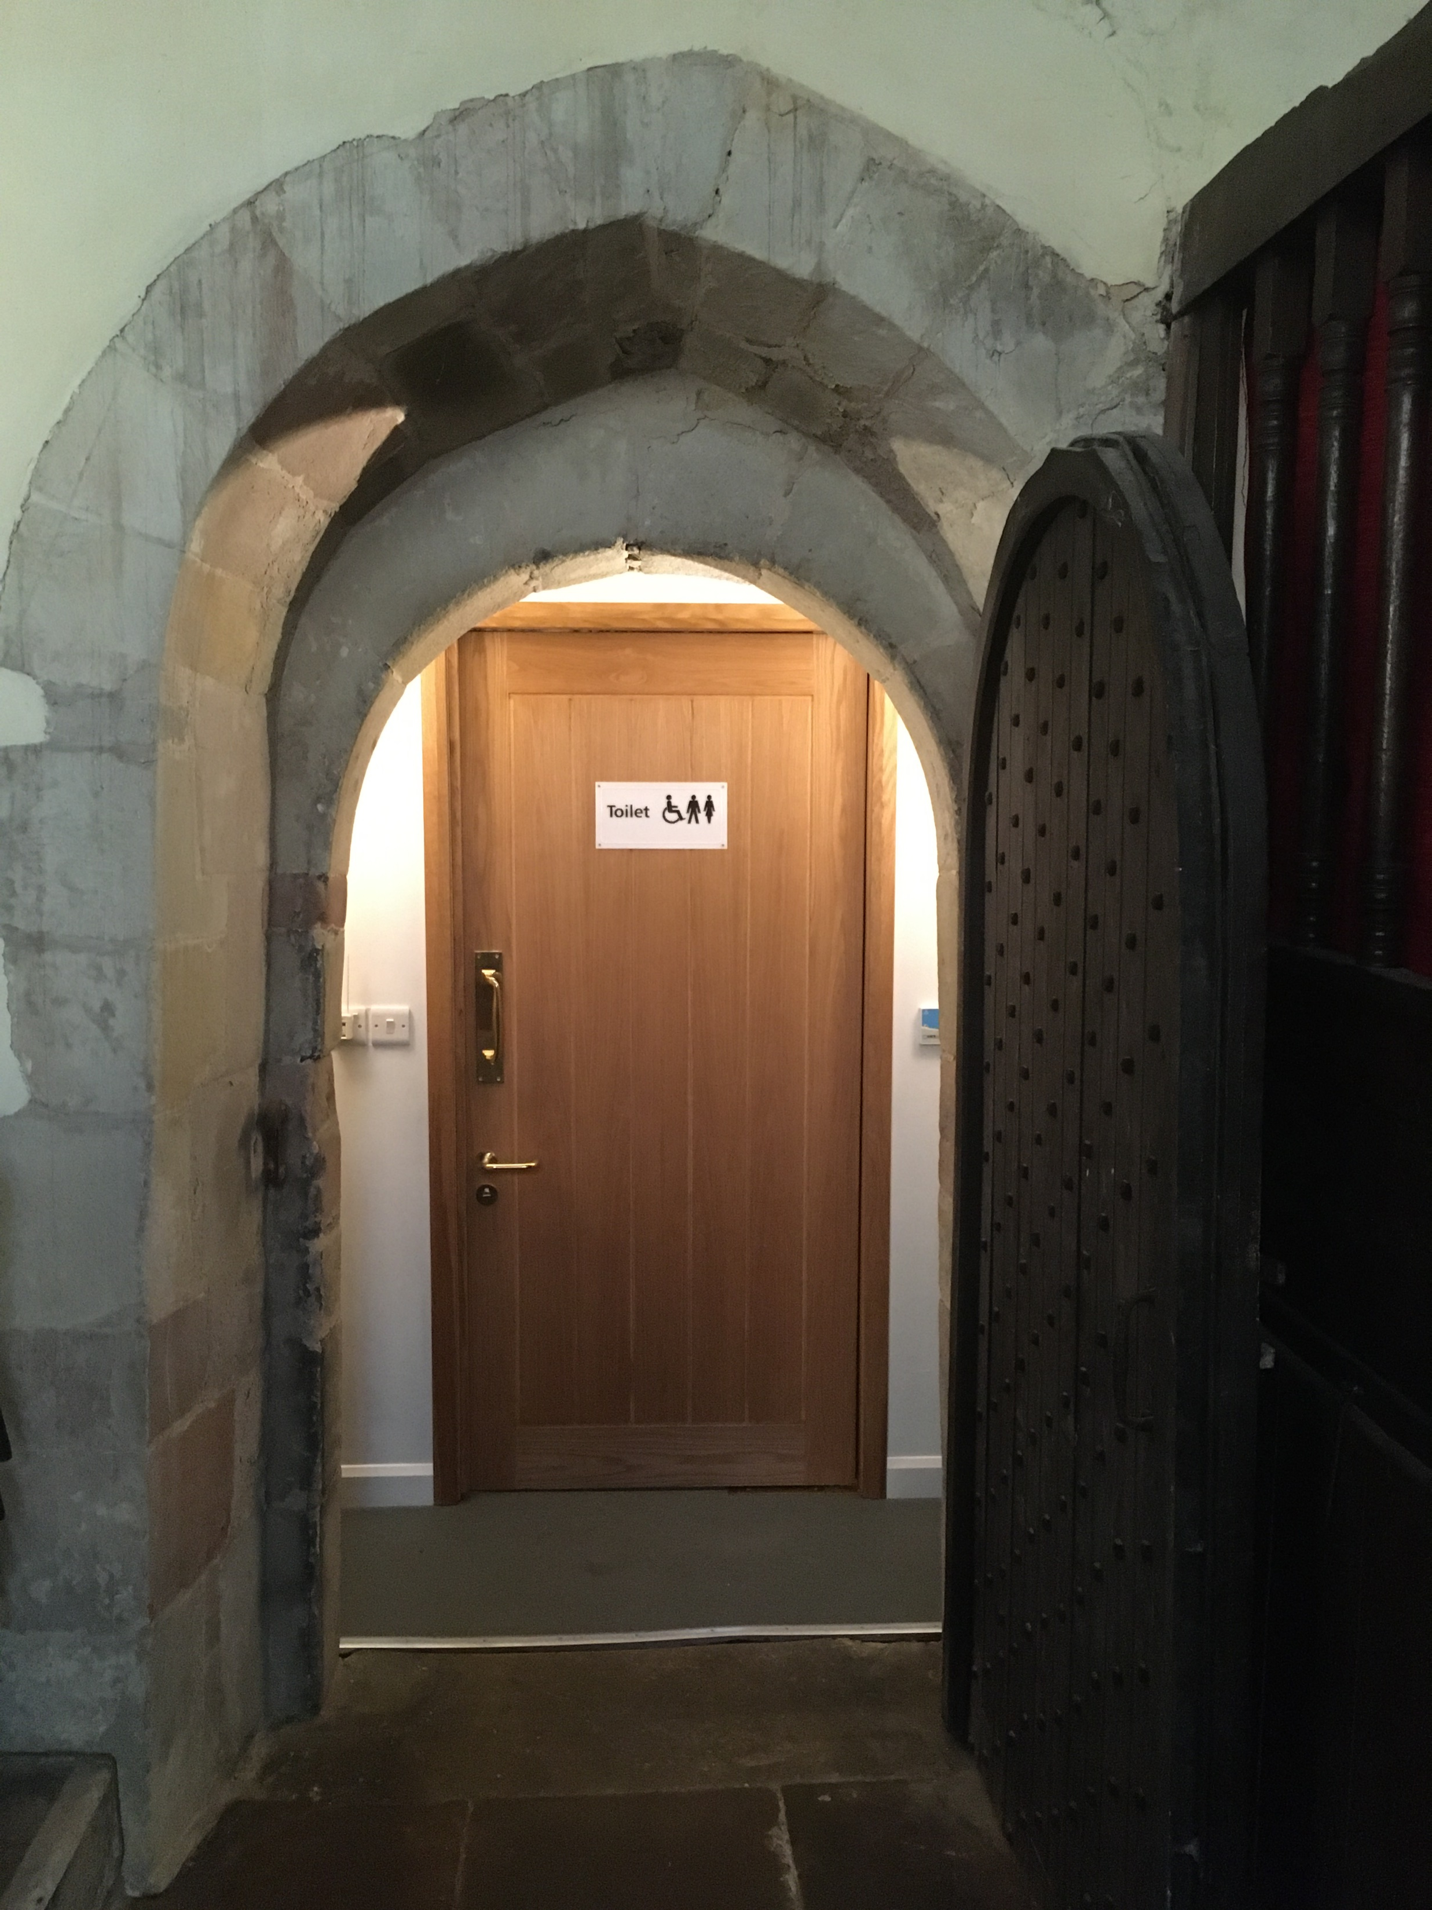
Behind it is the new partition wall and door

Slide 15
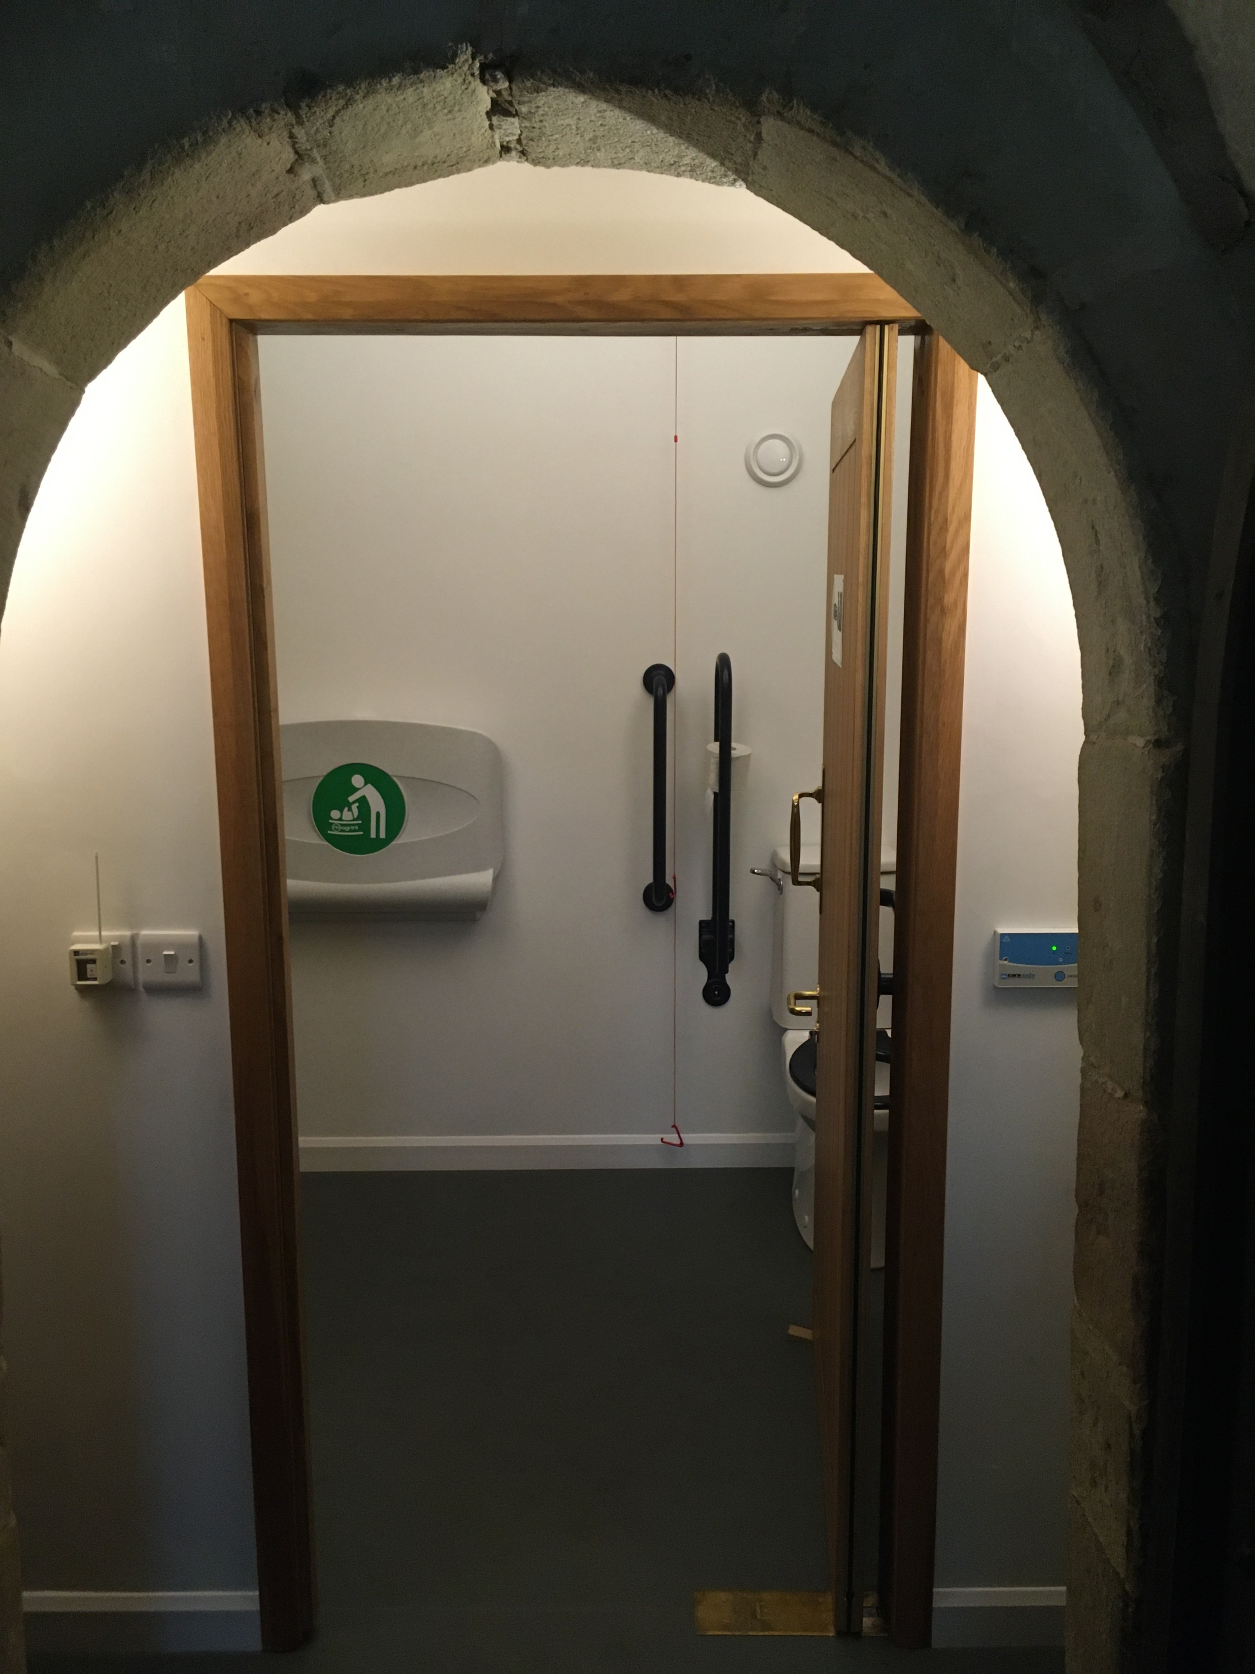
Behind that is the new toilet room

Slide 16
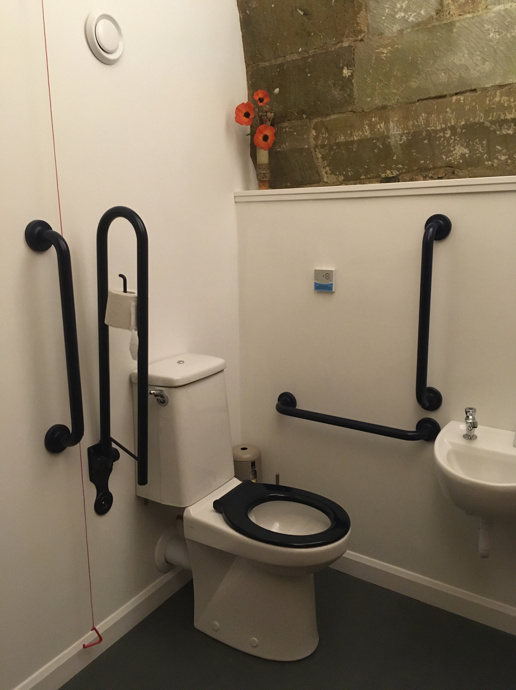
The toilet is to full Doc M wheelchair-accessible specification

Slide 17
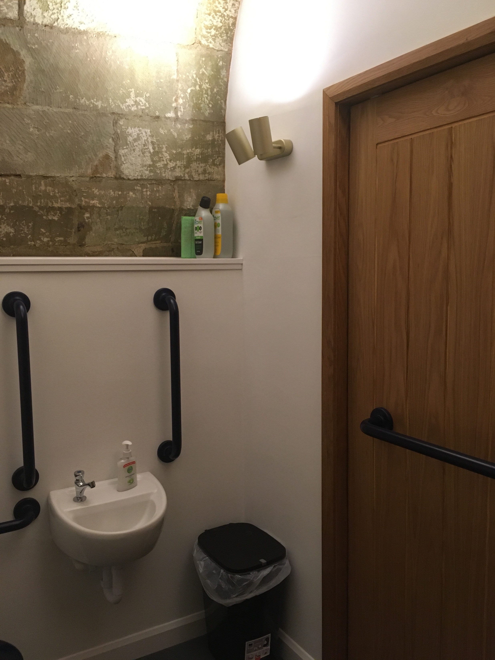
The handbasin and back of the new door, and the exposed masonry vault

Slide 18
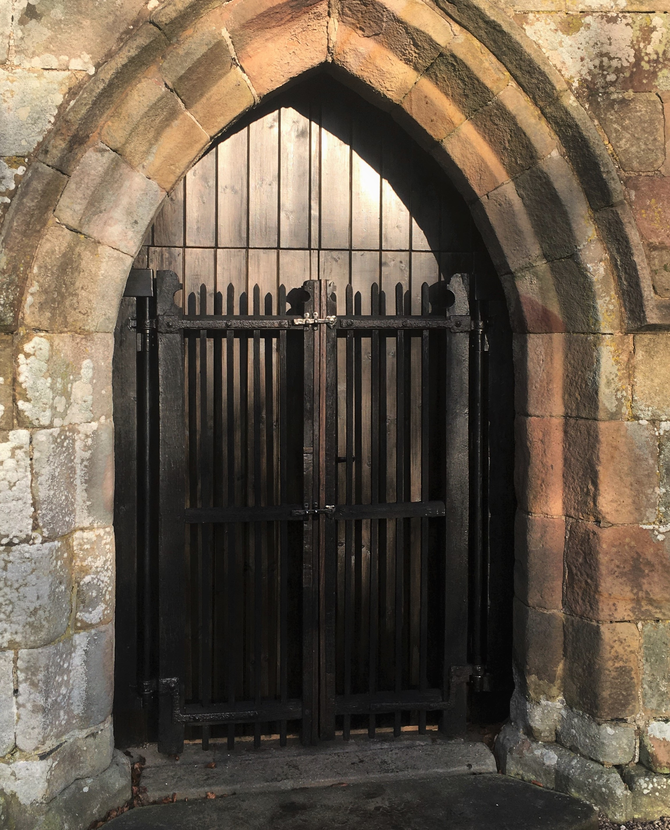
Outside the Porch, showing the new doors to the service area…

Slide 19
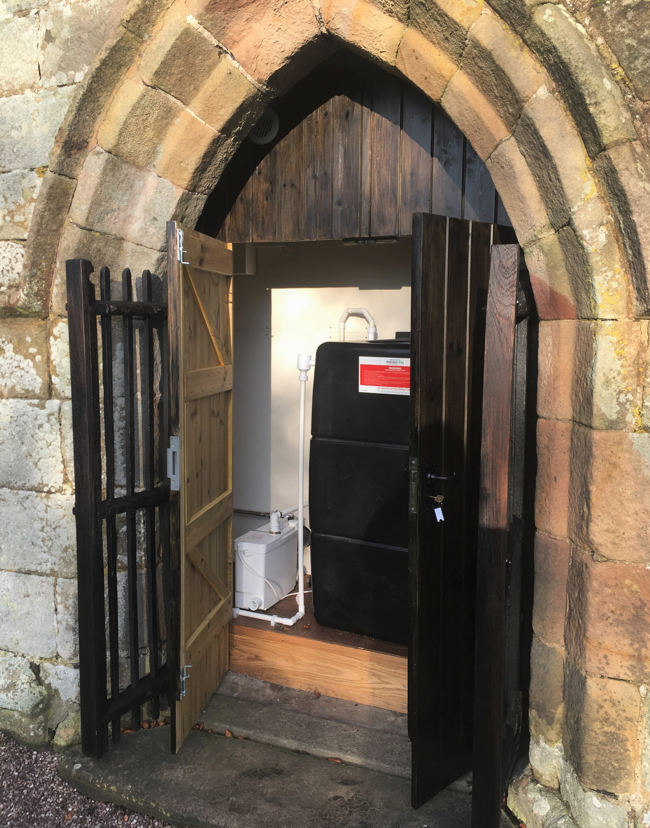
… containing the macerator and holding tank, which is pumped out from here when full

Slide 20
Financials:
Think of a budget and double it! – this cost £20k
Architect’s fees were ¼ of total cost
Funds were raised over three years from: special events, local individual donors, two Trusts

Slide 21
Thank you You are welcome to visit at any time: St. Peter’s Church, Alstonefield, Ashbourne, Derbyshire DE6 2FX

