Slide 1
Historic Religious Buildings Alliance
Developing Sustainable Churches
September 2012
Members Day
Nigel Robson – Director
www.ctfc.org.uk
Notes:
Info on CTfC

Slide 2
Context of Cumbria
Cumbria
635 Places of Worship
Almost 40% (250) are listed
Of these, 229 are C of E
361 - C of E
112 - Methodist
50 - RC
Pop: 0.5m ( 1:787)
Visitors: 15.3m pa

Slide 3
Context of Cumbria
No of Churches to maintain
Economic Deprivation
Historical distribution
Impact on agriculture/boom towns
Christian history
Borders / Northern Saints / Vikings /Wesley
Notes:
Info on CTfC

Slide 4
Philosophy/Approach
Churches must be sustainable!
Resource and catalyst
Website – data/information/case studies
Engage directly with Church Bodies
Training – focussed, responsive, publicised
Projects – making a real difference
Strategic Building Review
Notes:
Info on CTfC

Slide 5
Website - Looking after churches
Notes:
Info on CTfC

Slide 6
Direct Engagement with Churches
Direct Engagement with Churches
- Clergy Training Days
- Deanery Synods
- Methodist Superintendents Training Retreat
- County Methodist Deanery Day
- Bishop, Archdeacons
- Methodist Property Rep/District Chair
- Churchwardens
- Baptists, URC
- Churches Together – Declaration of Intent
DAC
Newsletter
Trust, relationships, purpose, constituency!
Notes:
Info on CTfC

Slide 7
Training
Topics – Maintenance, Social Housing, Funding, Renewable Energy, Traditional Materials, Skills
Tailored to Feedback/Requests
Themed
Initiative - Security in Cities
- Faith Trails
- Visitor Welcome/Christian Message
Inspirational Venues
Nos 40/50 – >180
Notes:
St Mary’s, Grade I & scheduled monument. C12th Cistercian Monastery. Only part of nave remains – still a vast building. Much buried remains. Fire 2006.

Slide 8
Projects
Rigorous selection – Need/Iconic/Sustainable
- Holme Cultram Abbey
- Methodist Central Hall, Carlisle
Church Architects Group
Churchwarden’s Forum
Faith Trails etc

Slide 9
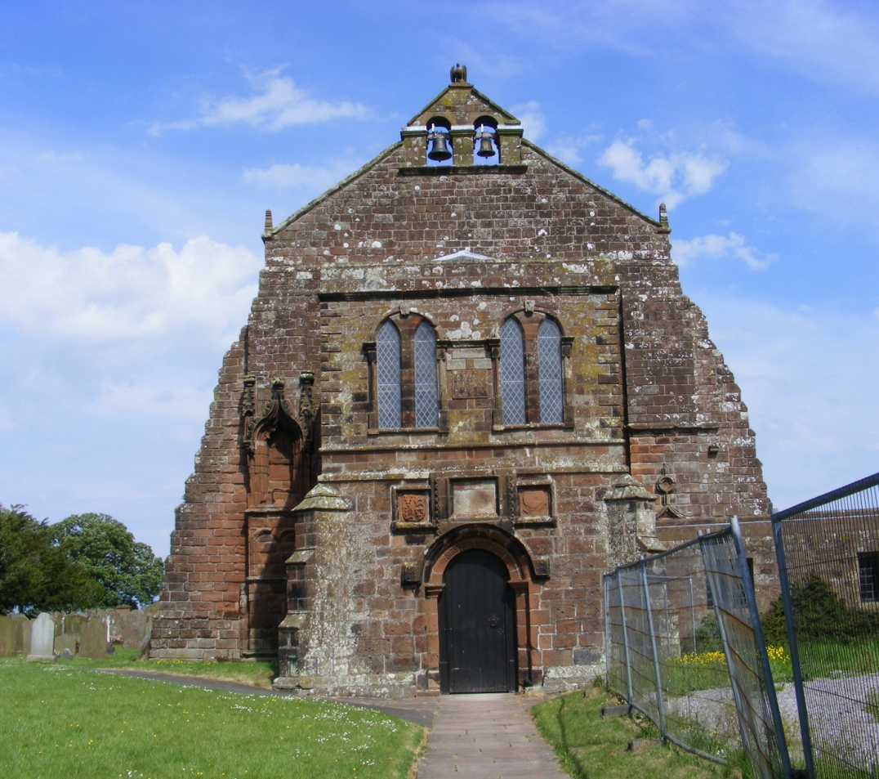
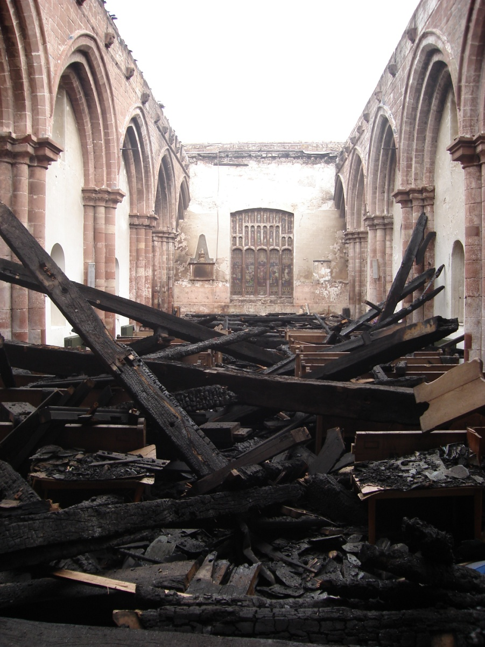
Holme Cultram Abbey
Notes:
Info on CTfC

Slide 10
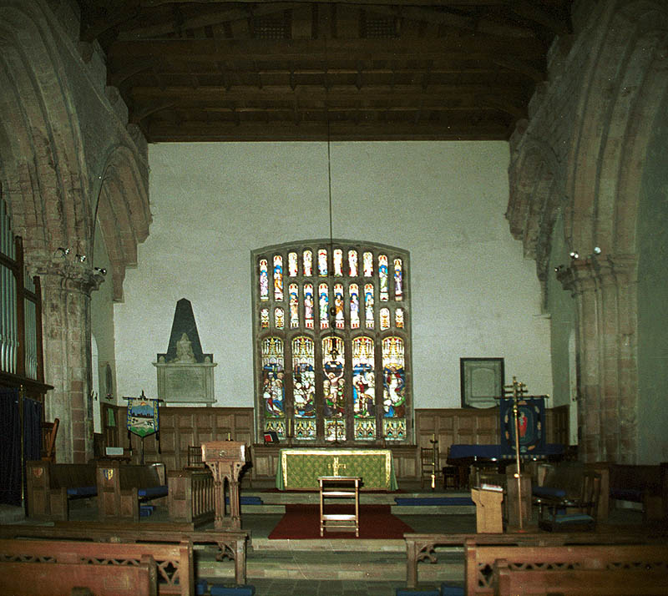
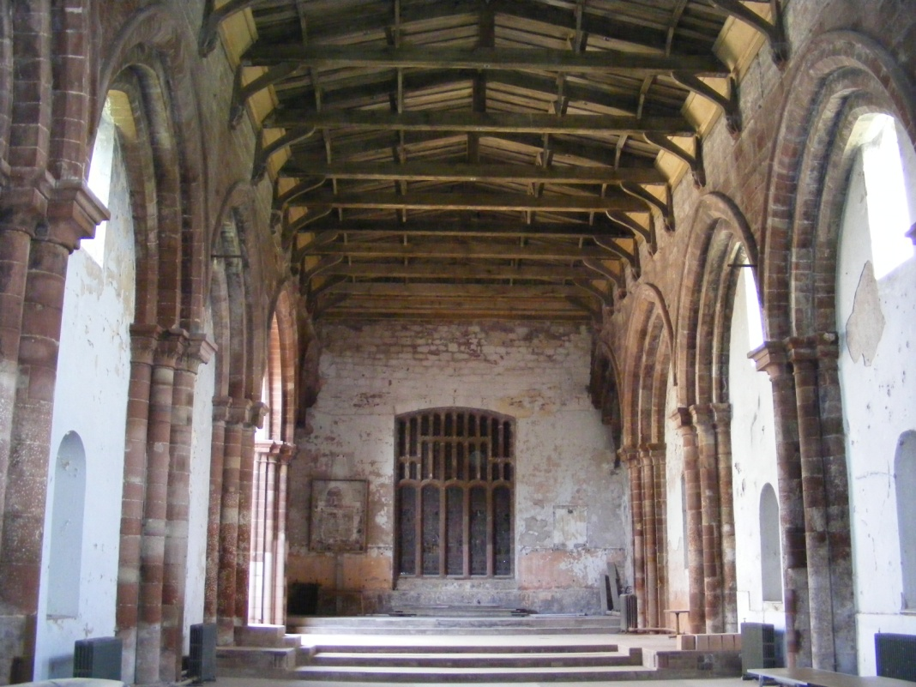
Holme Cultram Abbey
Notes:
St Mary’s, Grade I & scheduled monument. C12th Cistercian Monastery. Only part of nave remains – still a vast building. Much buried remains. Fire 2006.

Slide 11
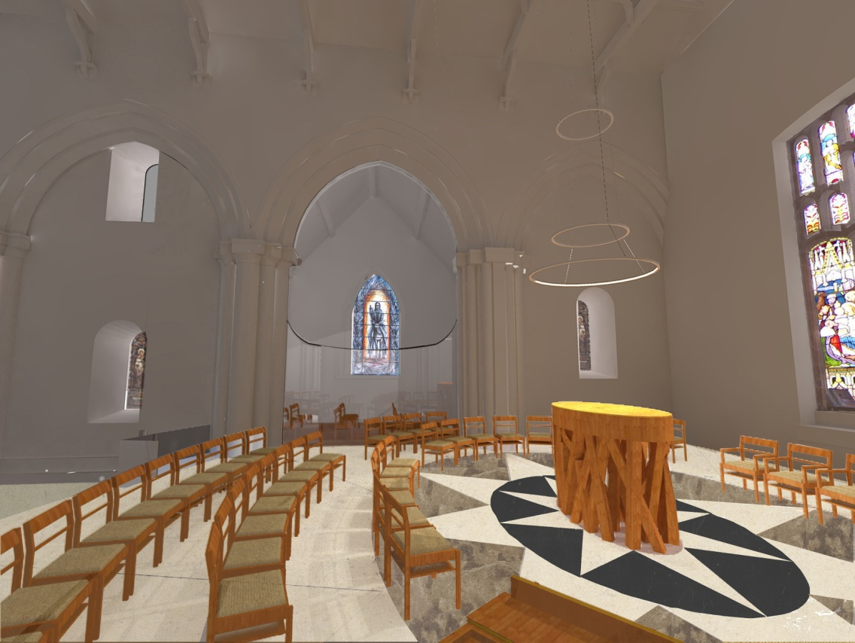
Holme Cultram Abbey

Slide 12
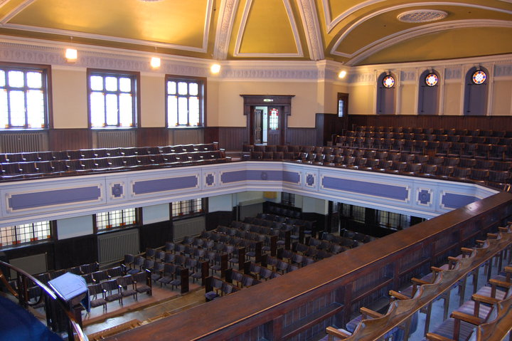
Methodist Central Hall, Carlisle
Notes:
St Mary’s, Grade I & scheduled monument. C12th Cistercian Monastery. Only part of nave remains – still a vast building. Much buried remains. Fire 2006.

Slide 13
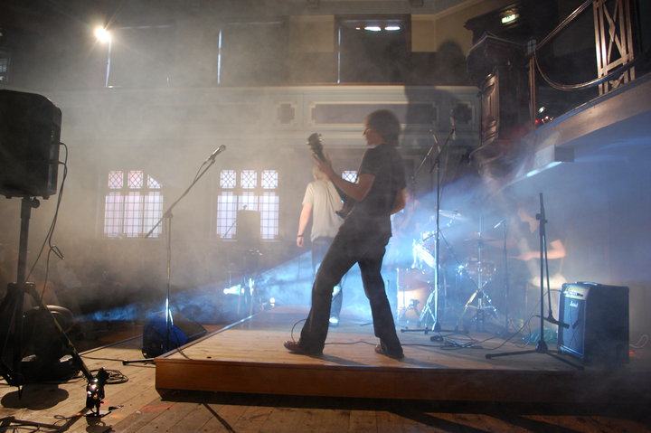
Methodist Central Hall, Carlisle

Slide 14
Church Buildings Strategic Review
Aim - Identify opportunities for a viable and
sustainable future for churches
Outcomes
- Individual Church action plans
- Aid future Deanery/Circuit strategic planning
- Aid future CTfC work programme

Slide 15
Church Buildings Strategic Review
Guiding Principles for Churches
Core function – worship of God but serving today’s needs
Resource for the wider community
Open and accessible to all
Work with ecumenical partners
Care for the environment

Slide 16
Process - Themed ‘homework’’
- Steering Group
Initial Meeting – Church Reps
Questionnaire probing:
- Finances, Attendance, People Resources, Leadership, QI Report analysis, Building info
- Mission Action Plan
- Useage - plus complementary uses
- Promotion & Accessibility
Energy Efficiency
Maintenance/QI
Self Assessment
Consultation within PCC, Congreg, Circuit and Community – approx 2 months
Feedback Meeting
Feedback Sheet – follow up by Steering Group

Slide 17
Objectives
Mirror
Where will your Church be in 5/10 years?
Current Situation > Viable Future > Sustainability
What does a viable Church look like?
Notes:
Info on CTfC

Slide 18
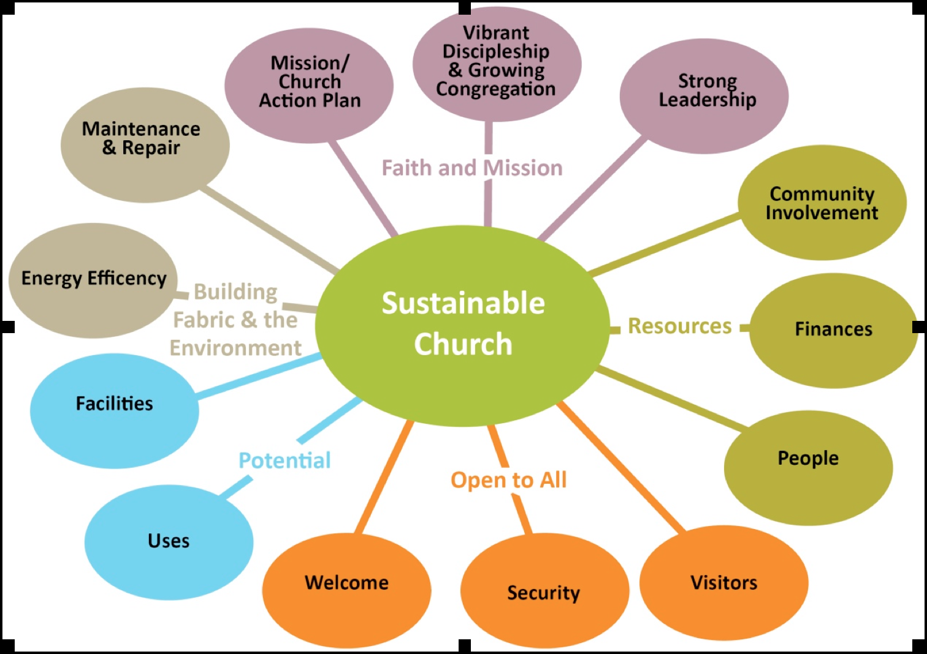
Sustainable Church?

Slide 19
Survey Results – Summary Pilot/Full to date
High level of returns – 89 -100%
Methodology – Records/Accuracy
Factual evidence / self assessment
Attendance data
Reserves
Financial Confidence - sponsor
Notes:
Info on CTfC

Slide 20
Survey Results – Summary Pilot/Full to date
Attendance over 10 years – C of E
23% lost 50%
20% lost 30%
37% within 10% either way
11% gained 30%+
Context and conclusion?
Bob Jackson says…
Notes:
Info on CTfC

Slide 21
Survey Results – Summary Pilot/Full to date
12% Congregation Strong/Vibrant – 36%
16% MAP/Priorities/Strategy – 51%
19% Financial Confidence – 56% v worried
13% Volunteers – 48% v worried – PCC/Offices
29% Good Community Support – 43% (islands?)
41% Closed (36% Pilot)
24% Additional Uses to increase life/viability – 57%
66% look after building v well – 11% struggling
Notes:
Info on CTfC

Slide 22
Survey Results – Summary Pilot/Full to date
Churches used once a week or less for worship only have issues
Age profile/support, 45% - 1 or less children
Appetite for Welcome/Interpretation/Trail courses
Feedback is lack of money for QI works
Assessments on sustainability disturbing, but also..!
Mother/Toddler
Banner/Tea
Donations
Faith trail
Dialogue
Notes:
Info on CTfC

Slide 23
Challenges!
Plan/Pace/Structures
Numbers – critical mass/age – children
Leadership
Volunteers
Money
Follow up support
Community/Ecumenical Engagement
Notes:
Info on CTfC

Slide 24
Historic Religious Buildings Alliance
Developing Sustainable Churches
September 2012
Members Day
Nigel Robson – Director
www.ctfc.org.uk
Notes:
Info on CTfC

