Slide 1
Factoring in Heritage
Challenges and Solutions

Slide 2
Background
Hierarchy of Catholic Church reinstated 1850.
Currently 22 diocese. Most recent is Wrexham, established in 1987.
Bishops’ Conference acts as a coordinating body. Permanent assembly of Bishops and personal ordinaries who provide for the common good and address issues affecting Catholics across England and Wales.

Slide 3
Does the Catholic Church in England and Wales have a heritage?
Catholic heritage in this country is under recognised and under-appreciated because comparatively recent.
Majority of churches are Victorian and C20.
Many have plain exteriors and occupy secondary sites.
Under represented in the statutory lists.

Slide 4
Challenges
Impact of pastoral review.
Dioceses considering how best to provide for the future given pressure of a decline in mass attendance, shortage of priests and population shifts.
Not just churches. Also the buildings of religious communities.

Slide 5
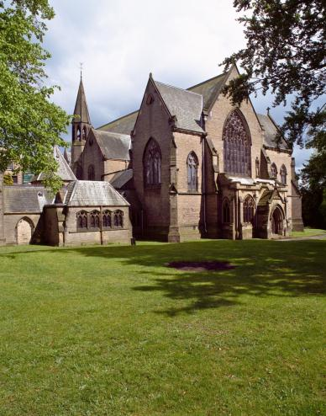
Ushaw College, Co. Durham

Slide 6
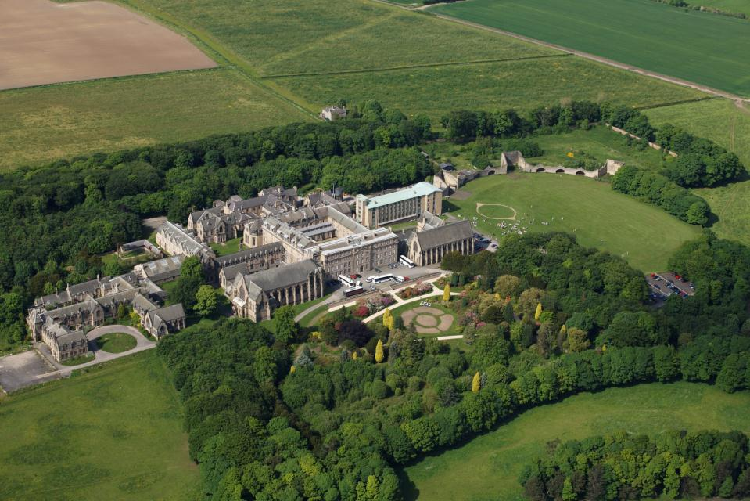
350 acre site.
In its heyday it was a totally self sufficient site, with 200 ordinands and an ancillary school. This was reduced to just 15 ordinands in 2011. The school closed in 1970.

Slide 7
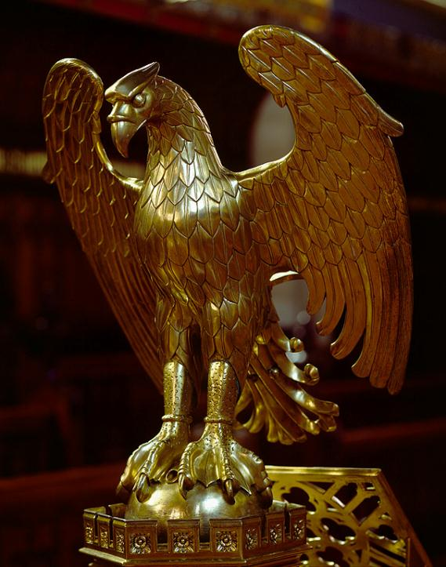
Ushaw comprises an exceptional collection of buildings, many individually listed.
Collections are of recognised international significance.
Library and chapel are Grade II*.
Many of the buildings are by eminent Catholic architects: AWN Pugin, EW Pugin, PP Pugin, Dunn and Hansom.
Listings are currently being reviewed.

Slide 8
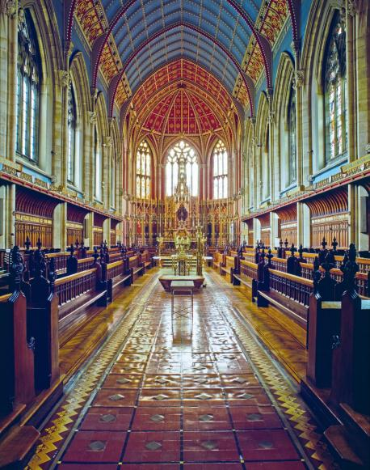
St Cuthbert’s Chapel

Slide 9
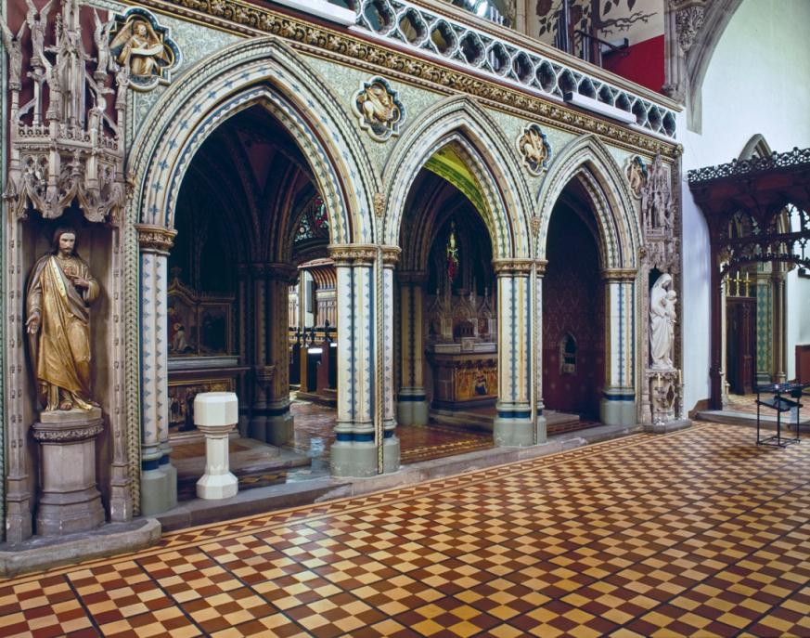

Slide 10
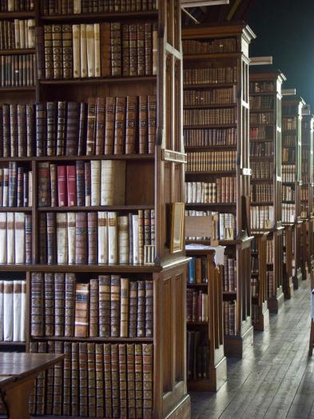
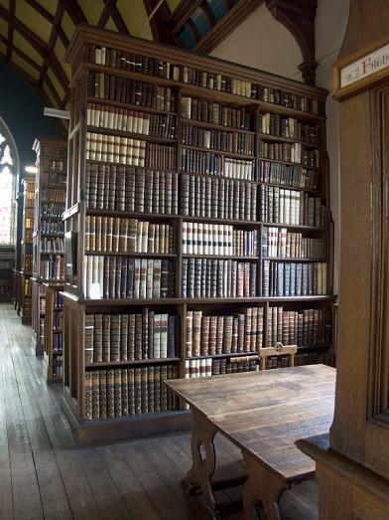
The Library, Ushaw

Slide 11
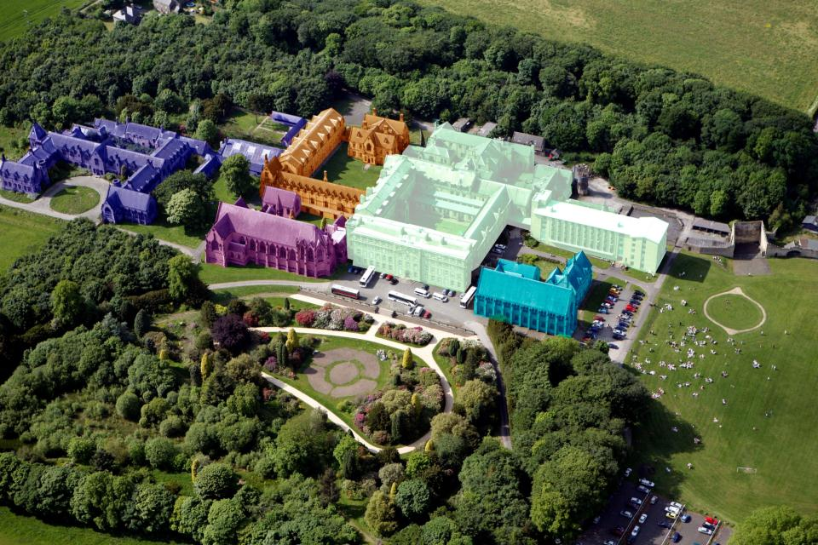
Durham University Business School has taken up temporary residence (see pale green area).

Slide 12
Future of Ushaw
Malcolm Reading Consultants have conducted a feasibility survey.
Current strategic vision is to use the site for a centre of Catholic scholarship, heritage, life and culture.
Also number of complimentary uses for wider site.
Future strategy based on partnership.

Slide 13
Sale of Treasures
Has become a much wider problem within the Catholic Church.
Increasing numbers of religious communities are selling buildings and artefacts when they disband or relocate.
We aim to produce guidance on ‘Hearts and Minds’ level.

Slide 14
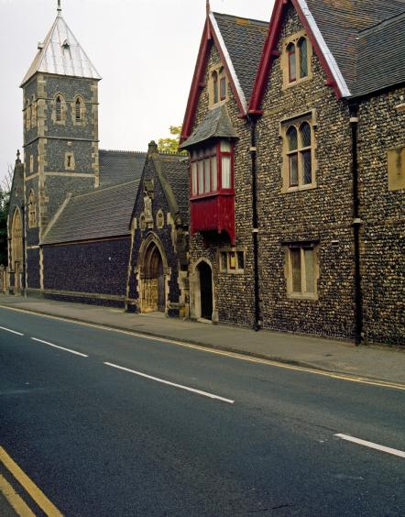
St Augustine’s Church, Ramsgate
Subiaco monks at St Augustine’s Monastery, Ramsgate, moved to a smaller premises, selling off their collection of plate.
Plate to be sold on open market with no consultation with conservation experts.
Patrimony Committee’s intervention saved several key pieces of Pugin silver.
These were then returned to St Augustine’s Church.

Slide 15
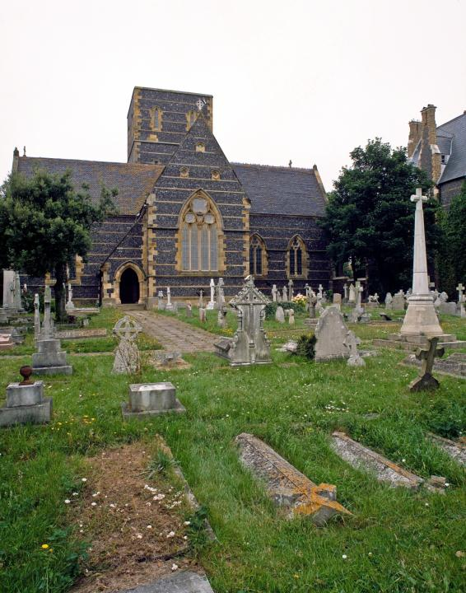

Slide 16
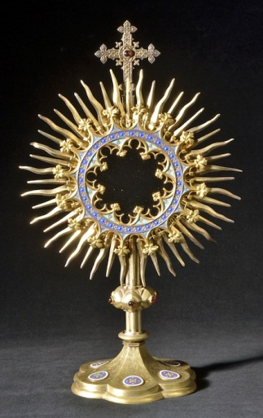
Pugin Monstrance

Slide 17
Poor Clares’ Reliquary
The Poor Clares moved from Darlington to Hereford. Consulted the Patrimony Committee on their plate.
Believed to be in possession of a salt dispenser.
On inspection by the V&A it was discovered to be a Tudor reliquary.
Currently on permanent loan at the V&A

Slide 18
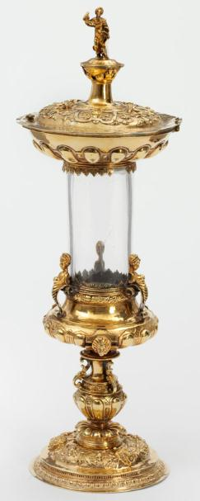
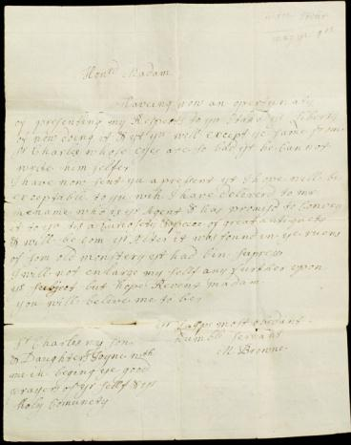
Poor Clares’ Reliquary

Slide 19
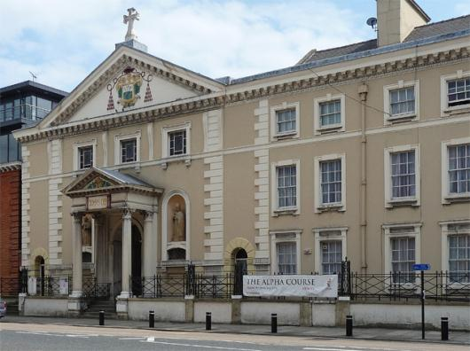
St Charles Borromeo, Hull
Built by French émigré priest in 1829. Unique in that it spans the period from the Emancipation Act of 1829 to the late Victorian period.
Interior heavily influenced by Austrian Rococo.
Now in a relatively run down area of Hull.

Slide 20
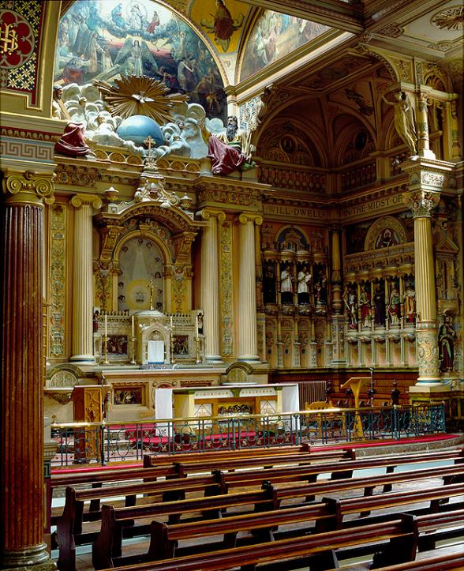

Slide 21
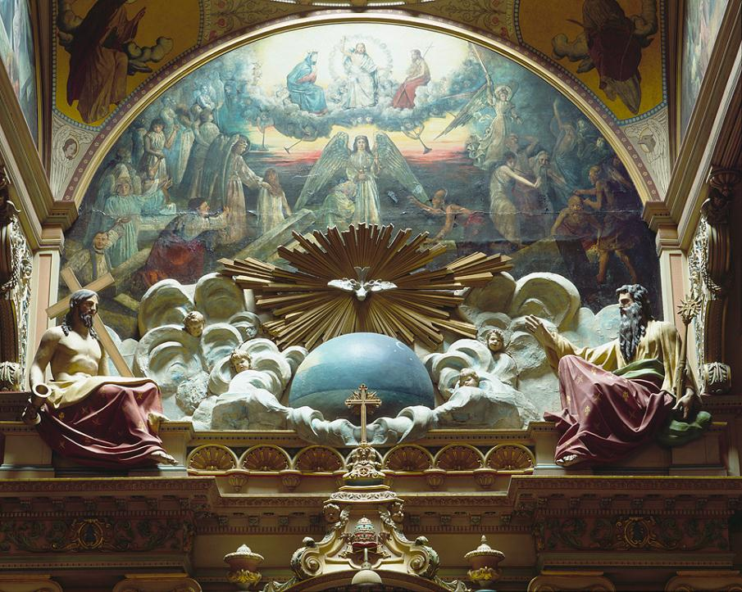

Slide 22
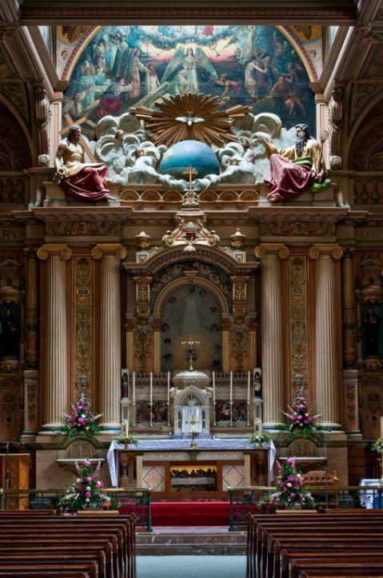

Slide 23
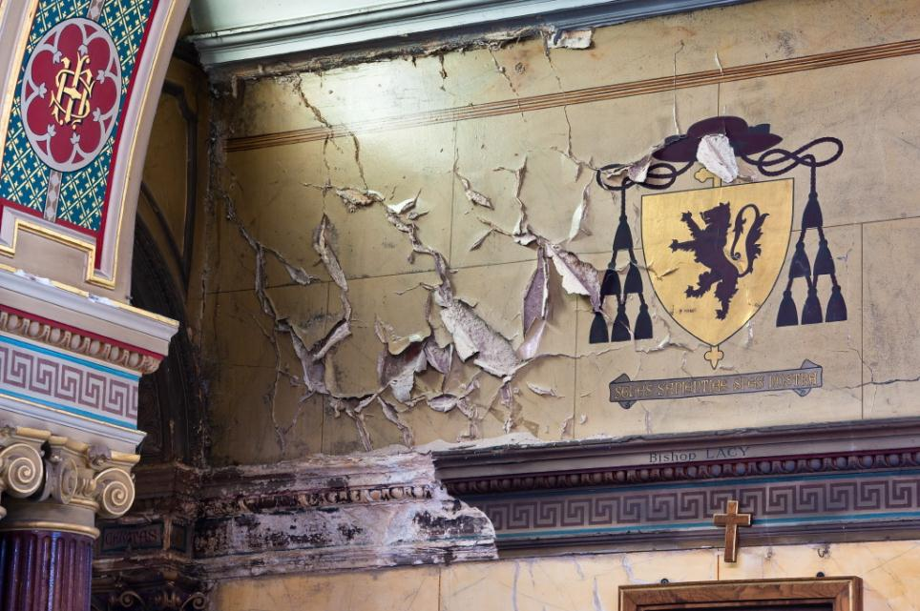
Architectural significance is vulnerable due to the poor condition of the plaster work to the external wall caused by past water ingress.

Slide 24
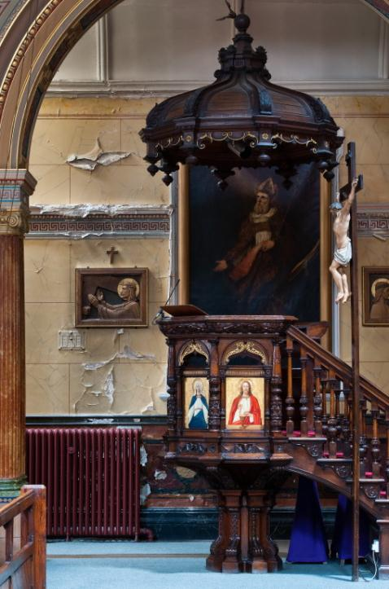
The priest and Historic Churches Committee for Middlesbrough are fully behind the project and have realised the problem is bigger than they are used to dealing with.
A project committee has been established and is being advised on the best way forward.
It is hoped that a bid can be put to HLF in March 2013.

Slide 25
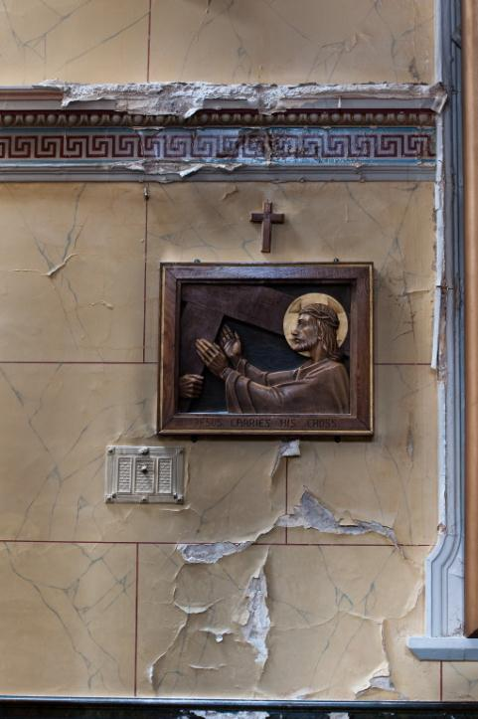

Slide 26
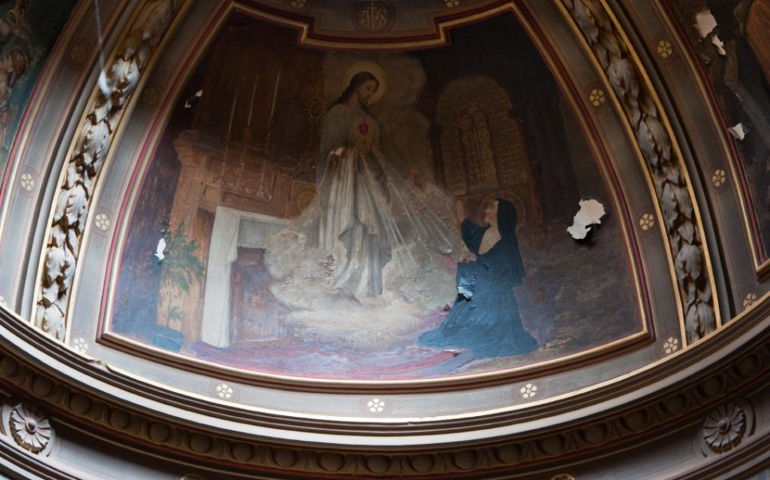

Slide 27
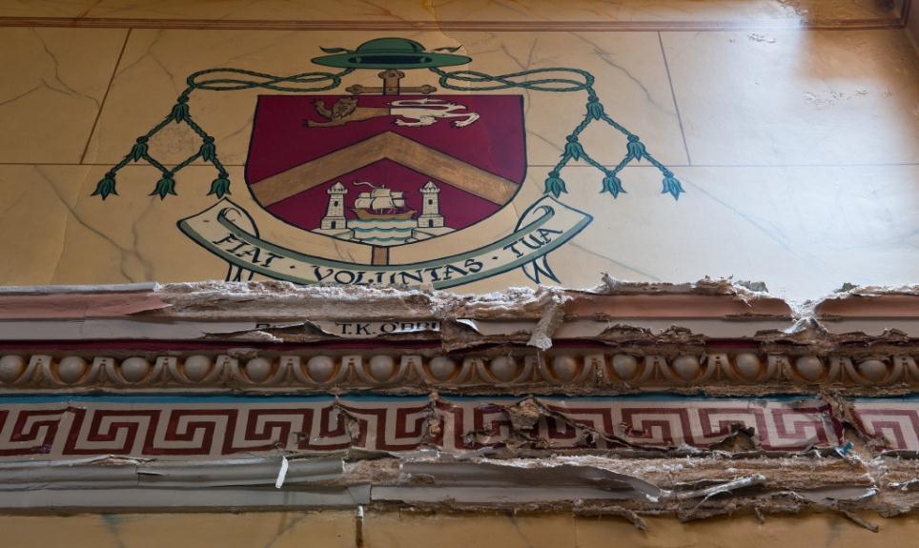

Slide 28
Taking Stock
Commissioned by EH and dioceses.
An assessment of all Catholic Churches across England and Wales, paying particular attention to the architectural and historic interests of the parish.
Project is first step to generating increased understanding of Catholic heritage.
About to go online.

