Slide 1
Building community leadership and engagement in design:
Four stories from historic places of worship
Theodore Zamenopoulos, Vera Hale, Katerina Alexiou,
The Open University
Sophia de Sousa
The Glass-House Community Led Design

Slide 2
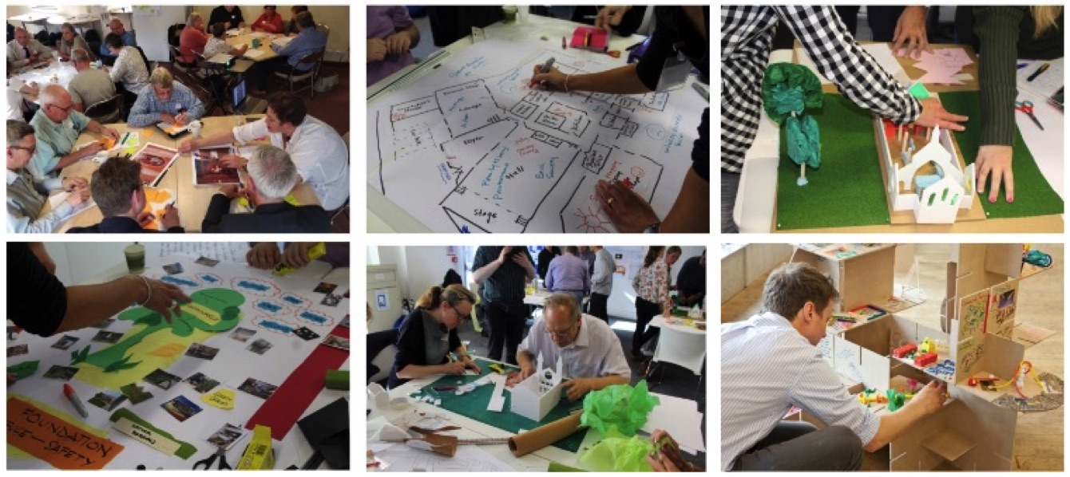
Stories from the AHRC funded project
historic places of worship as catalysts for connecting communities
Notes:
These stories are derived from a research project, entitled EDP, that has the objective to explore and evaluate approaches that would help groups to engage in the design and adaption of their building

Slide 3
Protection of Heritage
Community engagement in design
Faith communities

Slide 4
EDP has interacted with
Over 50 places of worship, from different denominations and faith groups, different listing status (from unlisted to Grade I), across urban and rural areas
Over 320 individuals that have received direct support or training.
Over 900 members of the public that have engaged in design-related EDP activities

Slide 5
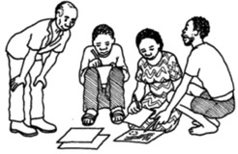
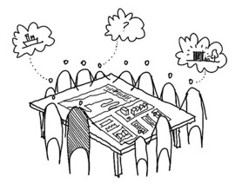
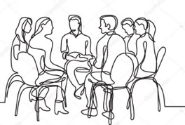
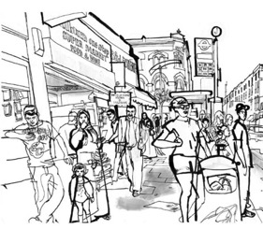
Building community leadership and engagement in design
Stories about the obstacles and approaches that helped groups who look after historic places of worship to take ownership of the process of working with their community and professionals to:
Develop
a vision
Define
options
Explore
needs
Test
impact

Slide 6
FOUR SHORT STORIES

Slide 7
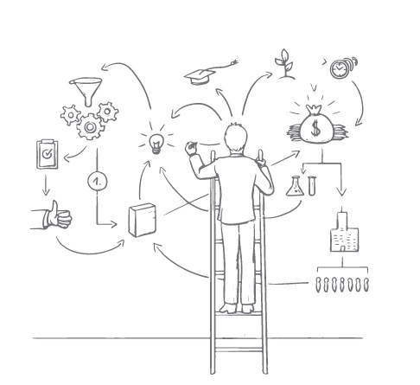
STORY 1: Connecting the dots
Community Design Leadership that comes with
the development of a shared strategic rationale on why and what change is needed

Slide 8
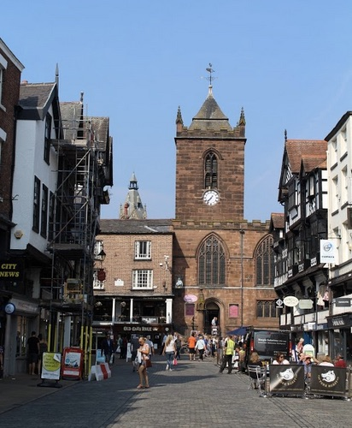
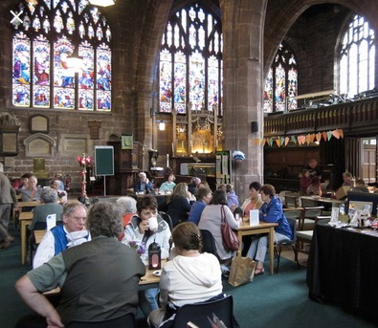
STORY 1: Connecting the dots
The St Peter’s Church in Chester

Slide 9
STORY 1: Connecting the dots
Obstacle: Difficulty of the church to decide priorities and focus on their needs and design thinking (e.g. accessibility, flexibility, visibility, facilities)

Slide 10
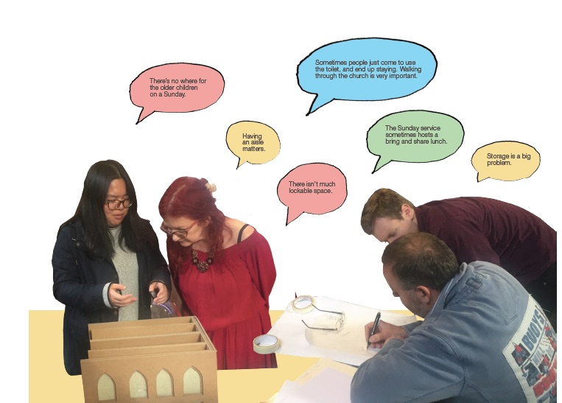
STORY 1: Connecting the dots
Obstacle: this lack of focus (strategic rationale) was compromising their ability to define and communicate a clear statement of needs and work with professionals (e.g. to select/work with architects).

Slide 11
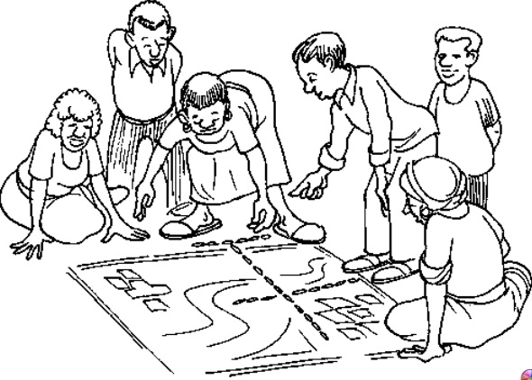
STORY 1: Connecting the dots
Strategy: help with the development of a process for creating a shared and well-evidenced narrative about the connections between three questions:
.
WHAT change is needed?
Ideas, concepts and impacts
WHY change is needed?
Issues, Assets and Vision for change
WHO needs to be engaged
and HOW?
The people and the activities of engagement

Slide 12
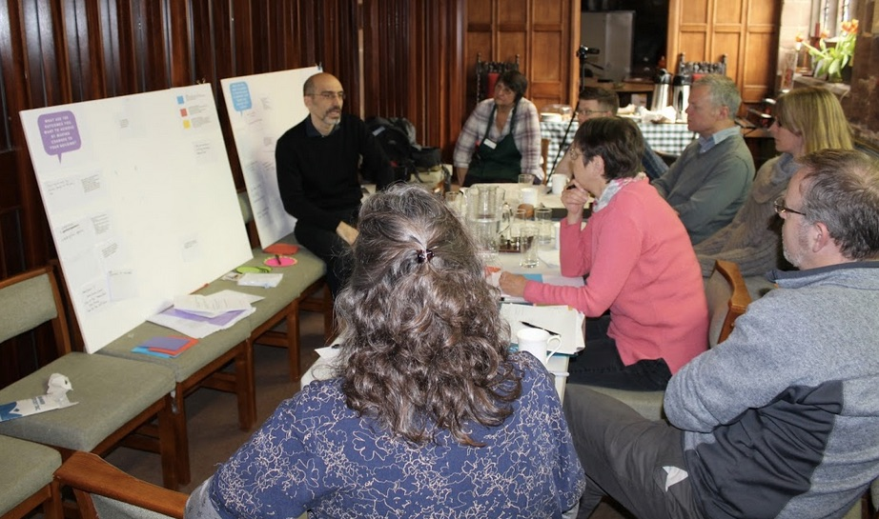
STORY 1: Connecting the dots
Strategy: gather worshipers and building users to connect the dots and identify areas of action
BOARD 1: Why are changes needed or wanted?
(issues and vision)
BOARD 2: What changes are needed or wanted? (ideas)
BOARD 3: Connect why & what (design rationale)

Slide 13
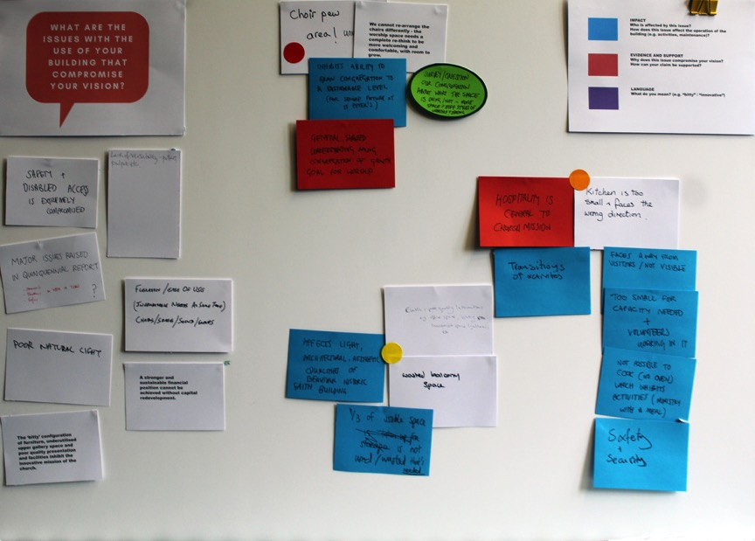
STORY 1: Connecting the dots
Strategy: collection of information on boards
Evidence: who needs to engage or have supported the claim
QUESTION
Action needed
Responses
(from statement of needs)
Impact: who benefits or is compromised

Slide 14
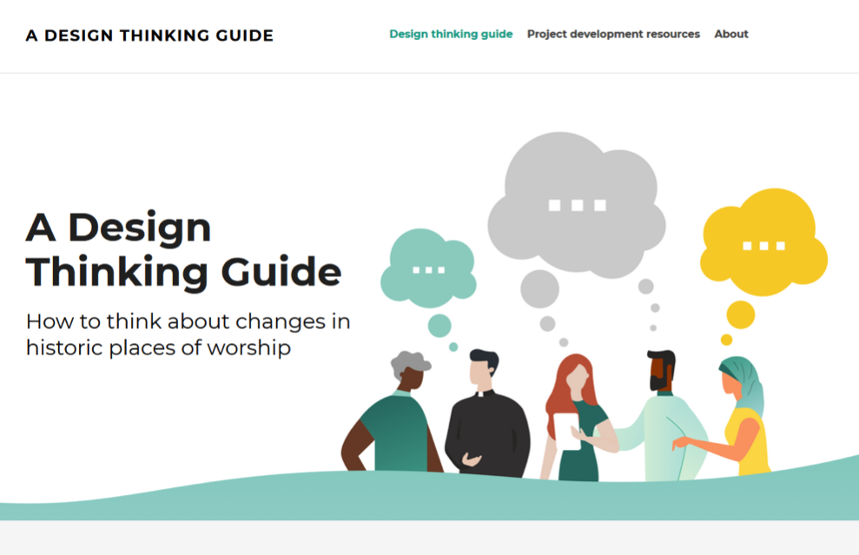
STORY 1: Connecting the dots
Resources:
Design thinking guide: How to think about changes in historic places of worship
http://design-thinking.empoweringdesign.net/

Slide 15
STORY 1: Connecting the dots

Slide 16
STORY 1: Connecting the dots

Slide 17
STORY 1: Connecting the dots
Outcomes
A better understanding and engagement with the development of a ‘statement of needs’
New understanding and confidence to lead the process and work with the architect
“we want an architect [to explore options] that would understand and work with our thinking – not an architect that would propose building plans for us”

Slide 18
STORY 2: Experimenting
Community Design Leadership that comes with
an experimental attitude when groups prototype/test ideas (for new uses, physical alterations or partnerships with others)

Slide 19
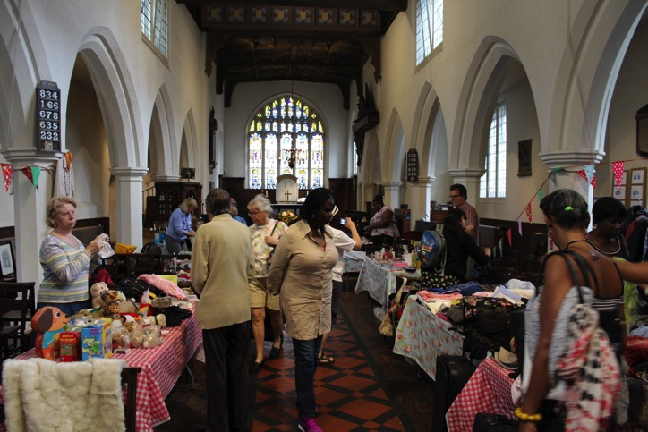
STORY 2: Experimenting
Bow Church: St Mary & Holy Trinity in Tower Hamlets

Slide 20
STORY 2: Experimenting
Obstacle: Uncertainty about the impact of new activities on the place but also the value of turning connections with local community into collaborations or partnerships
Notes:
But one of their key obstacles…

Slide 21
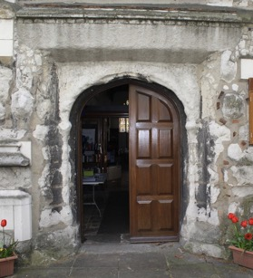
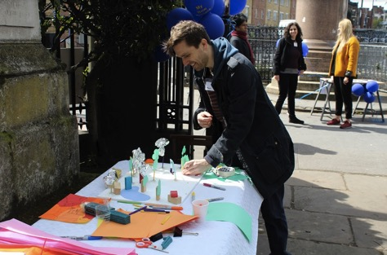
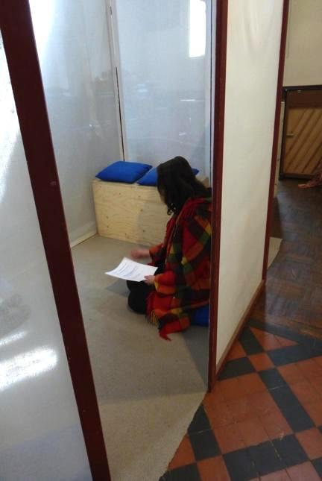
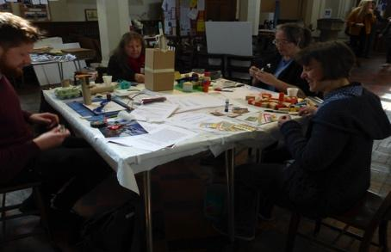
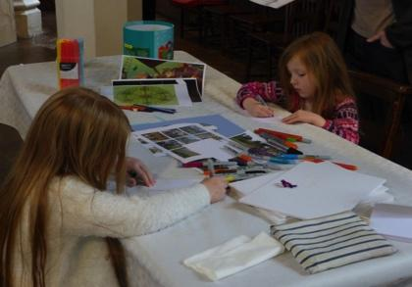
STORY 2: Experimenting
Strategy: At first instance experiment by testing ideas about the activities that attract people to cross the threshold (collecting evidence of interest to use the church)
Open the door
Signpost that the church is open
Arts and crafts materials
Materials for children
Dreaming booth

Slide 22
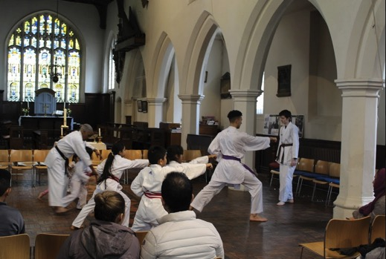
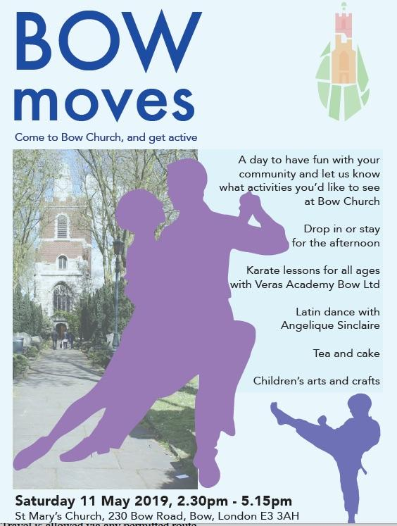
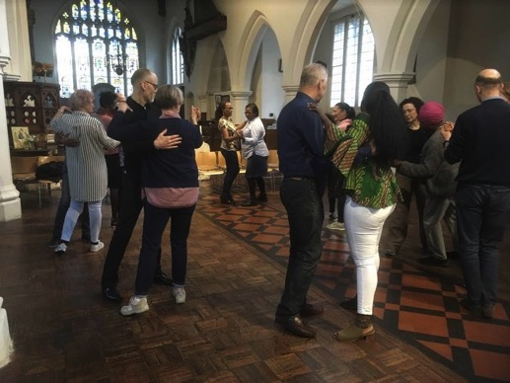
STORY 2: Experimenting
Strategy: At later stage evaluate ideas for regular activities run by local partners
Call for interested local people to propose ideas for running new activities in the space and provide opportunity for tester sessions to explore the mechanics and impact before making long term commitment.

Slide 23
STORY 2: Experimenting
Outcomes
A better understanding and evidence collection about the potential of the church space, the possibilities for building collaborations and the identification of ‘red lines’
‘ Encouraging people to think laterally and explore further what is possible and how things may happen … and that those things can contribute to the life of the parish in ways that might not be obvious on Sunday mornings.’

Slide 24
STORY 2: Experimenting
Resources:
Prototyping resource coming soon
http://empoweringdesign.net/

Slide 25
STORY 3: Demystifying design
Community Design Leadership that comes with
the development of awareness and confidence to engage in the process of design and explore design options

Slide 26
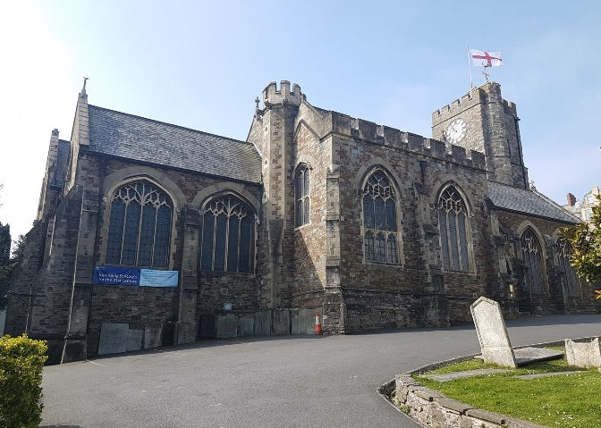
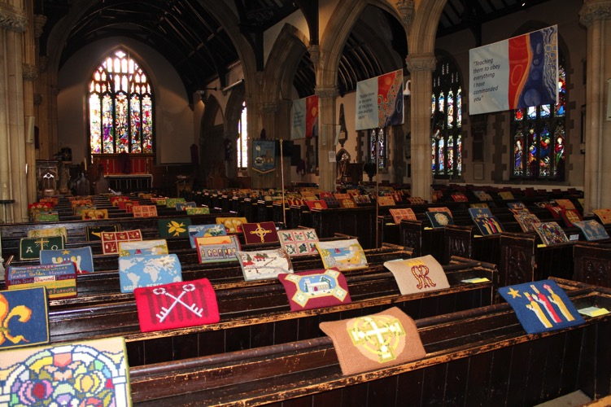
STORY 3: Demystifying design
Church of St Mary, Bideford, Devon

Slide 27
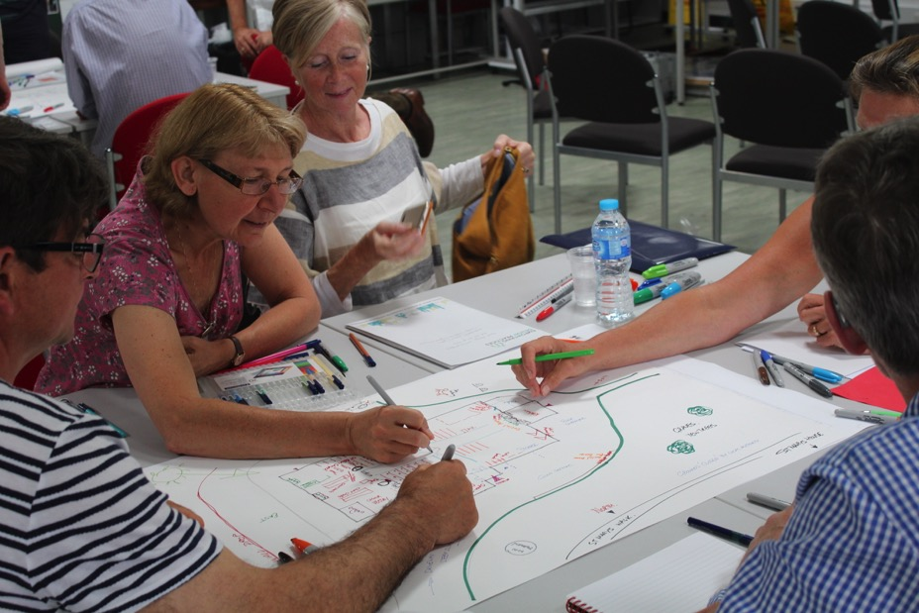
STORY 3: Demystifying design
Obstacle: Tendency to fixate on one idea (e.g. a new kitchen) and not consider options

Slide 28
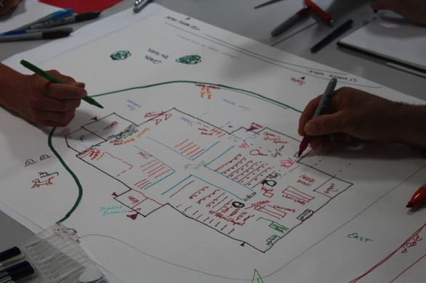
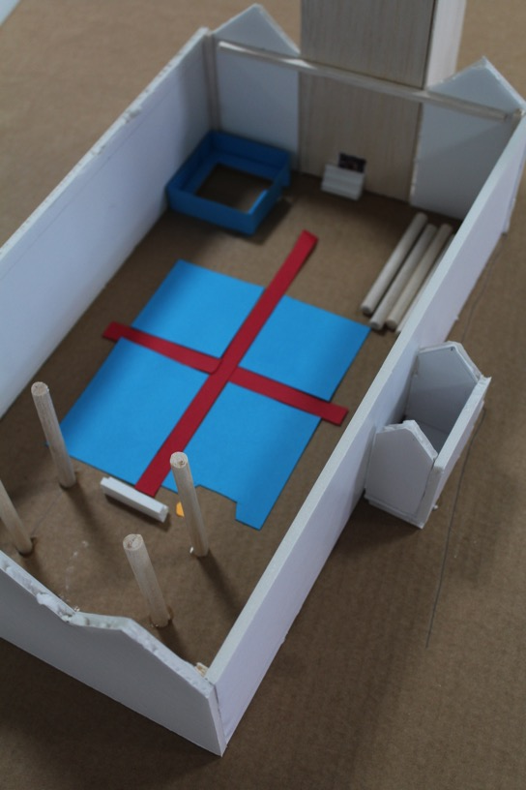
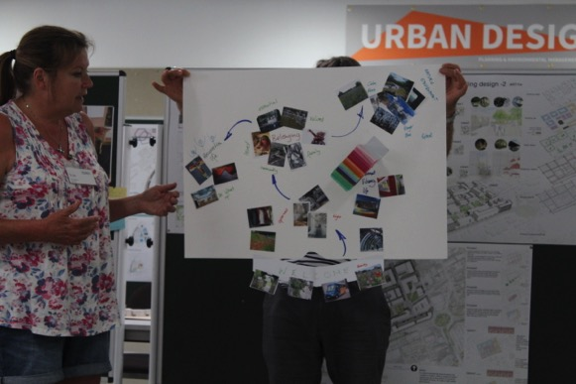
STORY 3: Demystifying design
Strategy: Involve the group into practical work of generating and evaluating options
Mapping issues and assets
Creating a visual and descriptive vision
Model ideas

Slide 29
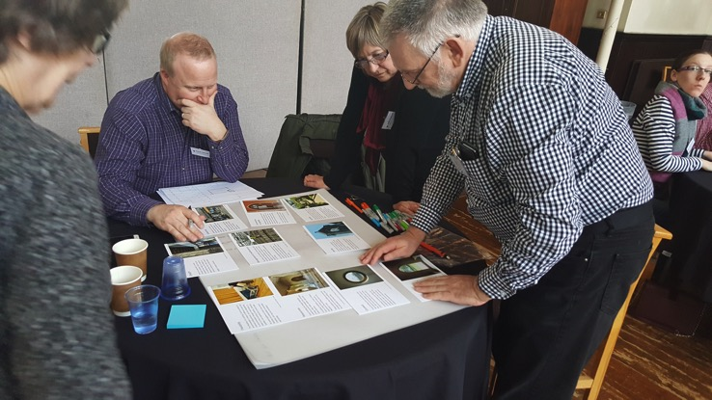
STORY 3: Demystifying design
Strategy: Explore large /small scale options using design cards (with themes and questions)

Slide 30
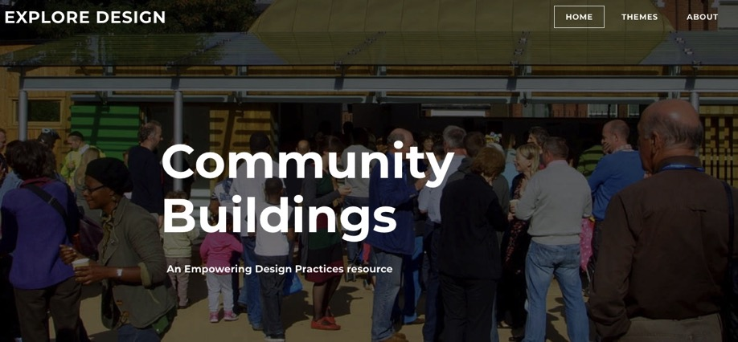
STORY 3: Demystifying design
Resources:
Explore Design website and prompt cards
http://explore-design.empoweringdesign.net/

Slide 31
STORY 3: Demystifying design
The outcome
Realisation that there are many different options
A deeper understanding of the impact of various design solutions on the everyday use and feel of the place

Slide 32
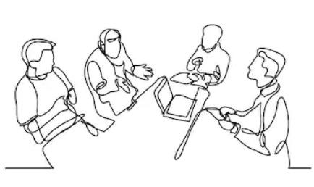
STORY 4: Creating opportunities for others to be part of design
Community Design Leadership that comes with
the creation of opportunities (events and materials) for inviting / engaging a community and professionals in shaping together design decisions

Slide 33
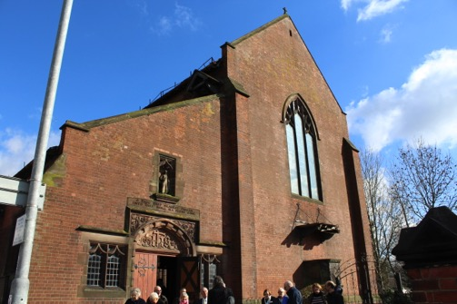
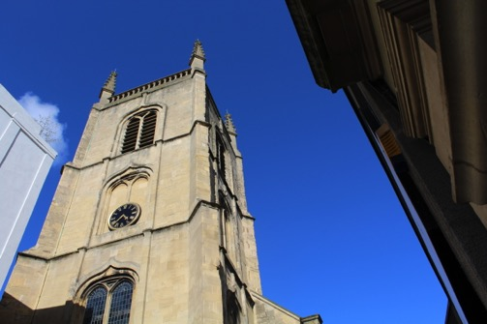
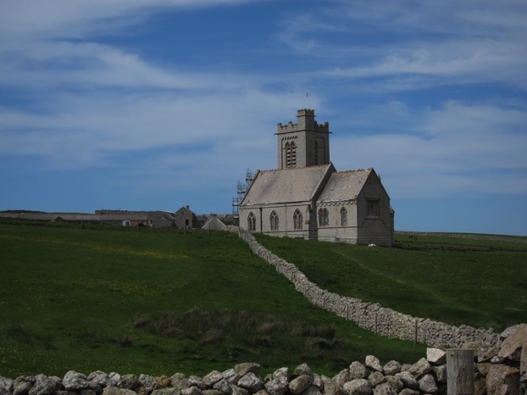
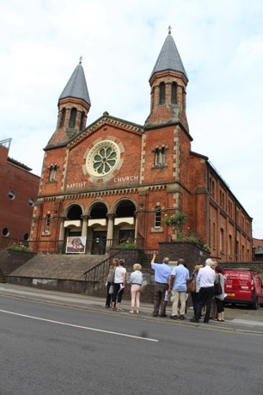
STORY 4: Creating opportunities for others to be part of design
Key story for most places of worship that we worked with…

Slide 34
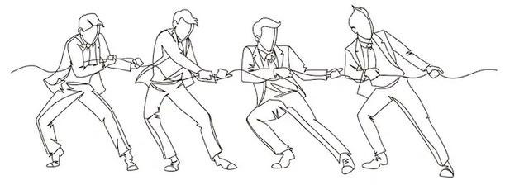
STORY 4: Creating opportunities for others to be part of design
Obstacle: Places of worship are facing complex challenges and tensions that cannot be (sustainably) addressed by a single person
Homeliness
(Confortable place for worshipers)
(the historic fabric of)
the building
Holiness
(Serving God)
Hospitality
(Open to the wider community)

Slide 35
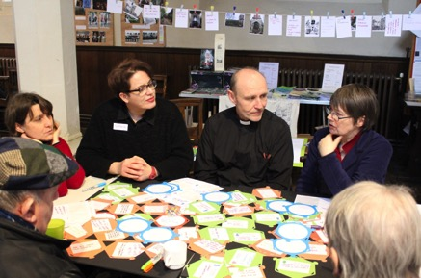
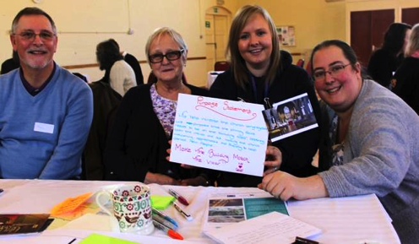
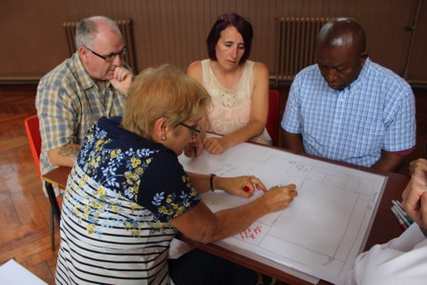
STORY 4: Creating opportunities for others to be part of design
Strategy
Create a team: a group of worshipers, building users, potential users or in some cases members of the wider community that can help connect to local need and resources
Set up processes: focus on setting up processes (activities) to bring people together to explore issues, develop a vision and define options
Explore
shared issues and opportunities
Develop
purposes for a project and vision
Define
design options and their impact

Slide 36
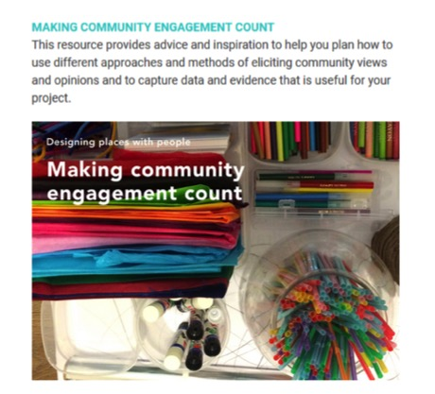
STORY 4: Creating opportunities for others to be part of design
Resources:
Designing places with people booklets
http://empoweringdesign.net/

Slide 37
As a conclusion….

Slide 38
Check our website / EDP resources
https://www.empoweringdesign.net

Slide 39
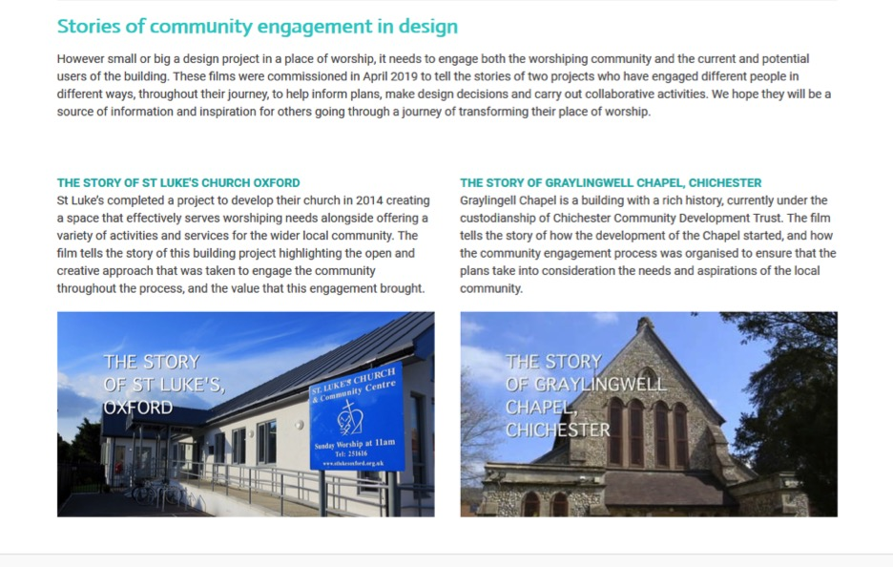
Resources page
Stories (video and PDFs)
of community leadership and engagement in design

Slide 40
Resources page
Guide (with printable tools)
How to think about changes in historic places of worship

Slide 41
Resources page
Guide (with tools)
key design themes to help you understand and explore design options in your buildings

Slide 42
Resources page
Guides (PDF booklets)
On developing community engagement strategies and activities in design

Slide 43
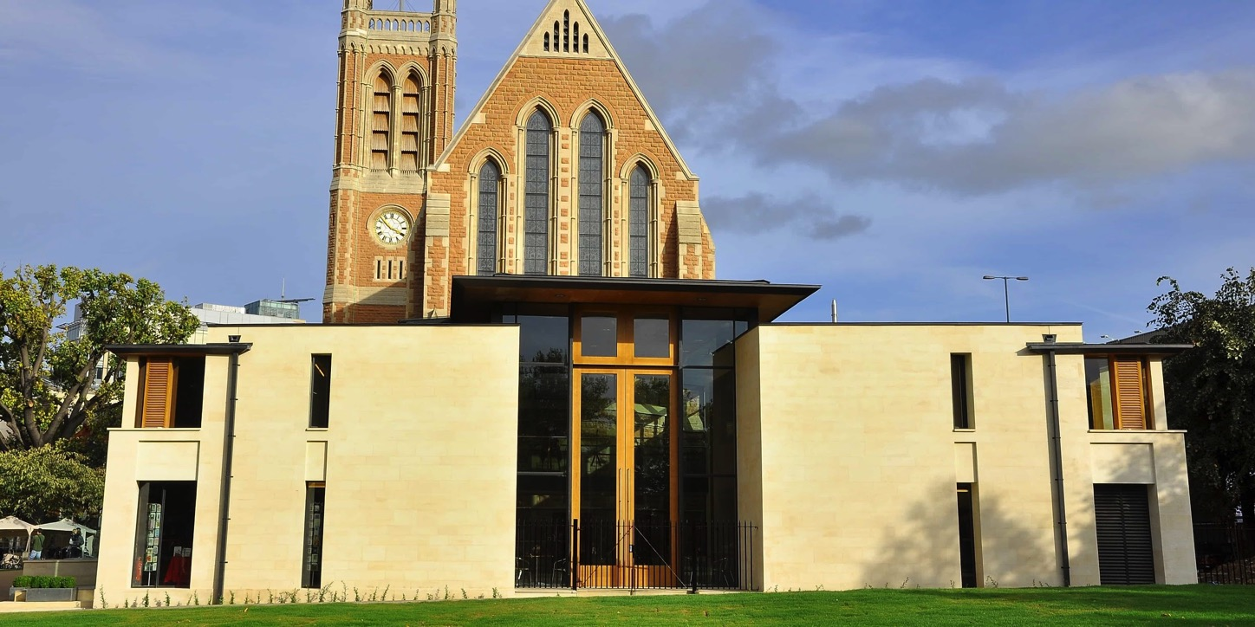
Please do join our conference
Empowering Design Practices: LIVE
Community design leadership in historic places of worship
12th of February 2020, 10:00-19:00
Venue: St Paul’s Hammersmith
Queen Caroline St. Hammersmith W6 9PJ

Slide 44
Thank you

