Slide 1
Rural Churches and Public Value
Notes:
All pictures copyright Historic England unless otherwise stated

Slide 2
Place – making
Well-being
Environment
Notes:
All pictures copyright Historic England unless otherwise stated

Slide 3
Place Making
Notes:
All pictures copyright Historic England unless otherwise stated

Slide 4
What is place-making?
Place making … shapes public spaces to improve a community’s cultural, economic, social and environmental situation.
https://historicengland.org.uk/services-skills/our-planning-services/support-for-place-making-and-design/

Slide 5
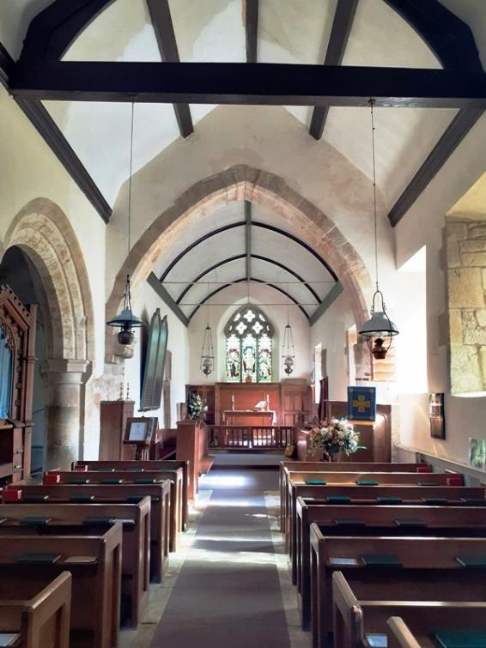
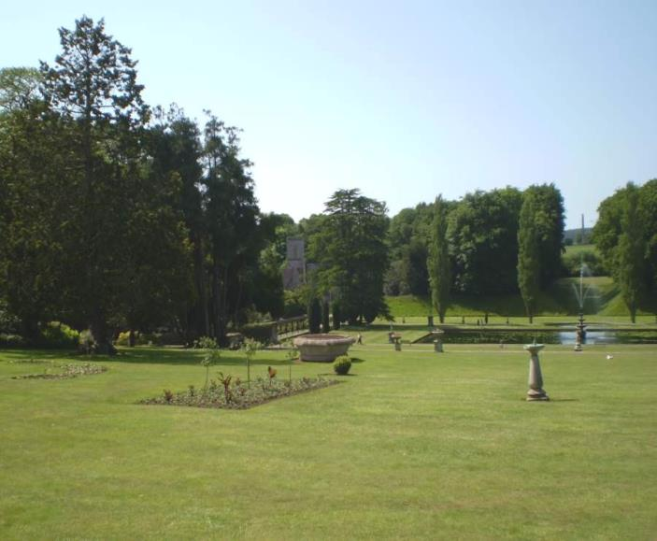
Notes:
All pictures copyright Historic England unless otherwise stated

Slide 6
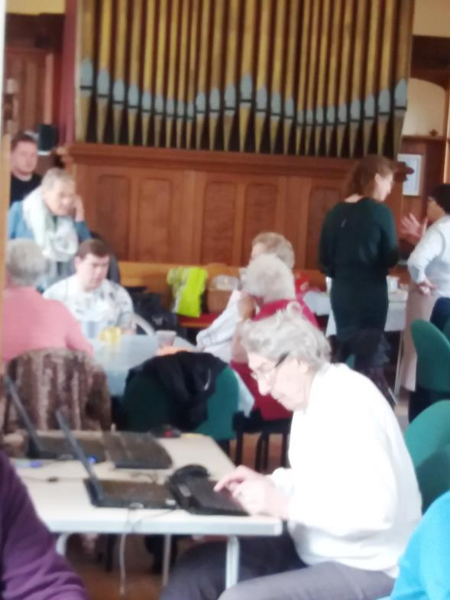
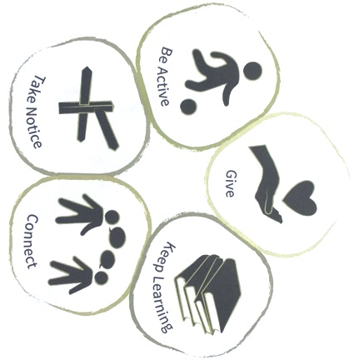
Well-being
Notes:
All pictures copyright Historic England unless otherwise stated

Slide 7
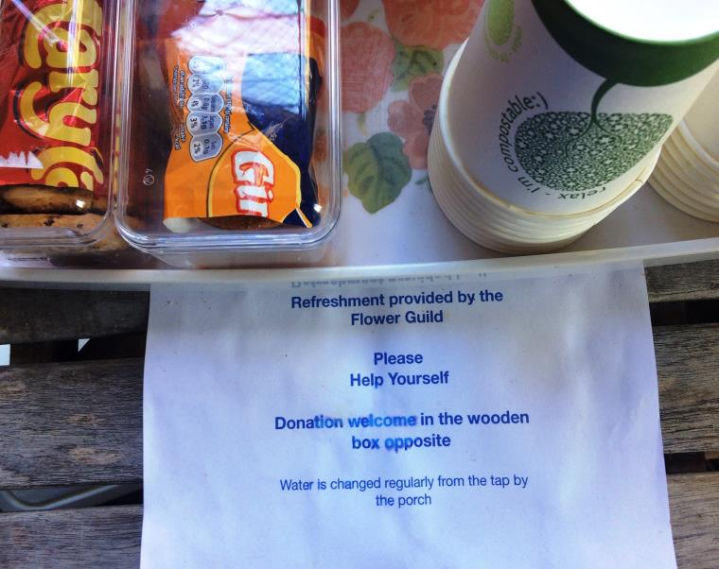
Notes:
All pictures copyright Historic England unless otherwise stated

Slide 8
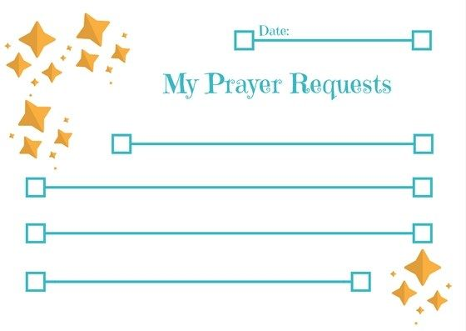
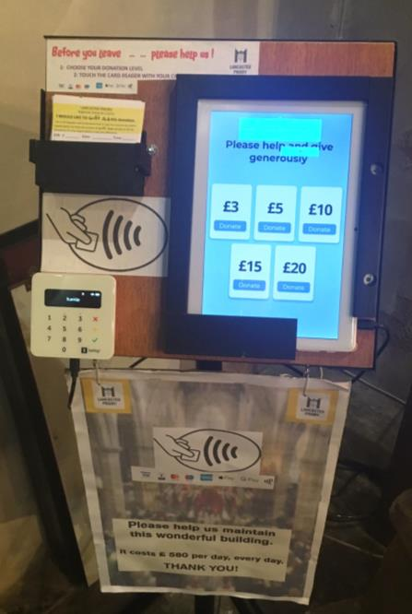
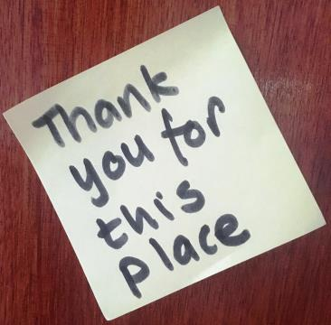
Notes:
All pictures copyright Historic England unless otherwise stated

Slide 9
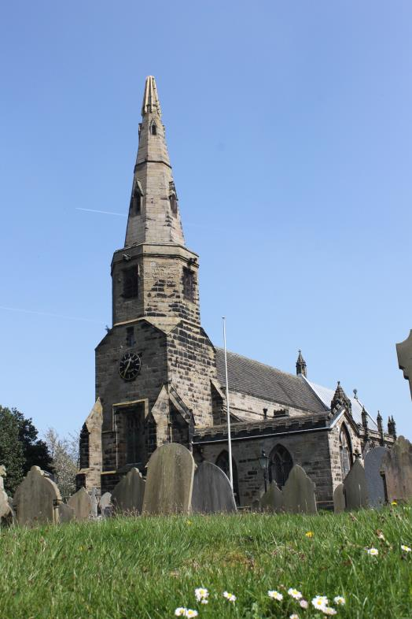
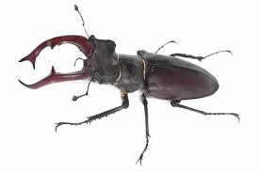
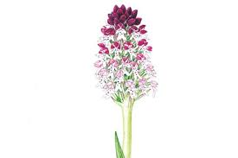
Environment
Notes:
Photograph copyright Ian Simpson

Slide 10
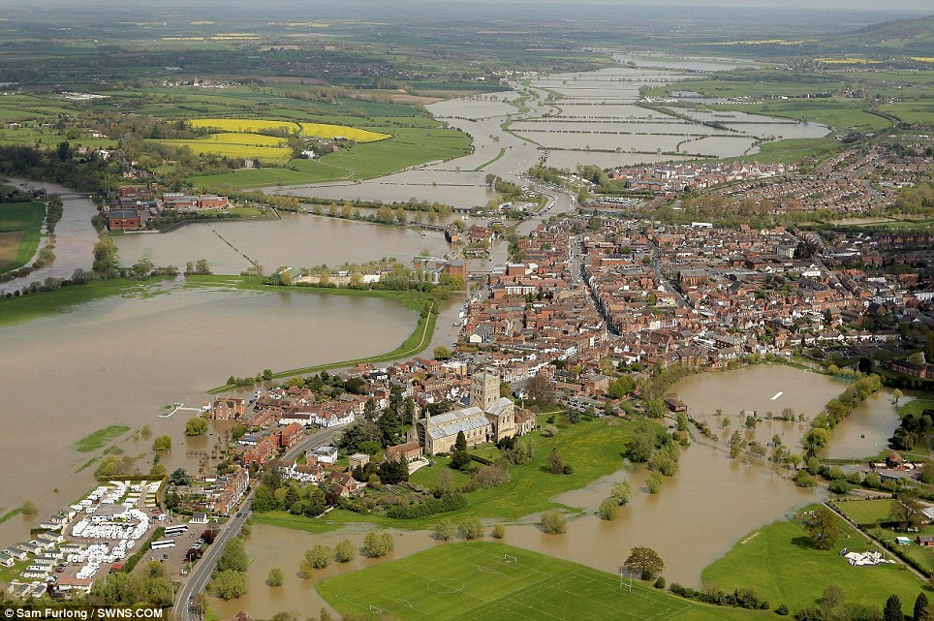
Notes:
Photograph copyright Sam Furlong

Slide 11
Fishlake St Cuthbert, Peter Pridham,Churchwarden
Copyright Aaron Walawalkar/The Guardian

Slide 12
